Slide 1
Database and SQL
By
JanardhanA Bandi

Slide 2
Content
What is Data, DataBase?
What is SQL
Data Types
Types of SQL Statements
Operators
DDL and DML Commands
SELECT Statement
WHERE Clause
String Matching
Pre-defined Functions
Aggregate and Window functions
Subqueries
Case and Decode
Constraints
Null Handling
Joins
Set Operators
CTEs
Pivot and Unpivot
Indexes
Views
Access Controls
Performance Tuning
Advanced SQL Queries
What Next?

Slide 3
Database Basics

Slide 4
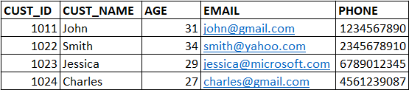
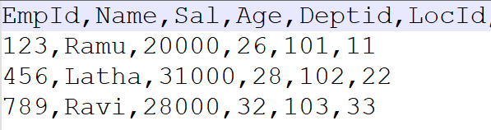
What is Data, Database?
Data is any thing that can be represented as text, numbers, or multimedia(image, sound, video etc.)
Examples: ‘Technology’, 243589, ‘2022-09-20’
Dataset is a structured collection of data that contains information of an entity
Examples:

Slide 5
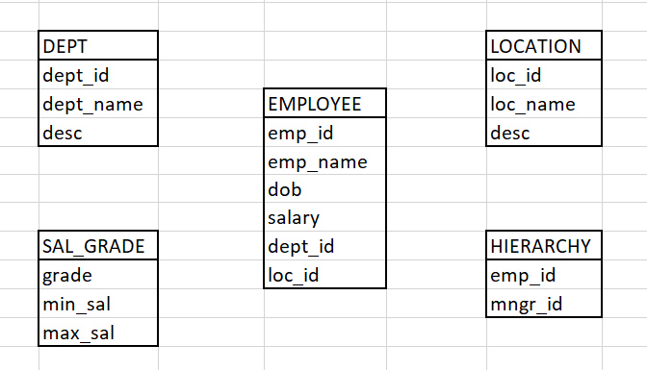
What is Data, Database?
Database is a system that allow users to store, organize and analyze data. It is an organized collection of data stored in multiple related datasets.
Example: Employee Database contains below datasets.

Slide 6
USES of Database?
Can handle huge amounts of data
Easy to combine different datasets
Analyze the data for decision making
Database is backend for many applications
Easy to share the data
Data security

Slide 7
What is RDBMS?
RDBMS – Relational Data Base Management Systems.
A relational Database is database that stores data in a table form, containing columns and rows.
RDBMS is a system used to store, manage, query, and retrieve data stored in a relational databases.
The RDBMS provides an interface between users and applications and the database.

Slide 8
List of RDBMS systems
Oracle
MySQL
Teradata
SQL Server
PsotgreSQL
Vertica
IBM DB2
Snowflake (Cloud Database)

Slide 9
What is Table?
Table is a database object that is a collection of related data entries, where data is organized in rows and columns.
Rows are also know as records
Columns are also known as fields
Example: Customer table
Metadata: Data about data, it gives the info that what data is stored in a table.

Slide 10
How to Load data into Database Tables?
Using manual insert statements
Importing data from files using SQL clients(Dbeaver, Squirrel, Oracle SQL dev, Teradata SQL Assistant, TOAD)
Load using ETL tools or scripts

Slide 11
How to Access the data from database?
SQL – Structured Query Language
We can access and manipulate the data from relational databases by using SQL.
SQL is a programming language used to communicate with these RDBMS systems like Oracle, Teradata, MySQL etc.
SQL is an ANSI/ISO standard, all databases support ANSI SQL so the syntaxes, keywords and functions or similar in all databases.
We can build SQL queries and procedures to operate with the data present in Database.
Queries can be written by using Operators, Keywords, Expressions, Functions..

Slide 12
DATA Types

Slide 13
Data types
Data types specify the type of data we storing or querying.
There are many data types to store
Characters or strings
Numeric values
Date and Time values
Boolean (True or False)
Images, audio, video data

Slide 14
Data types
CHAR(size) | A FIXED length string, it can contain letters, numbers, and special characters. The size parameter specifies the column length in characters.
VARCHAR(size) | A VARIABLE length string, it can contain letters, numbers, and special characters. The size parameter specifies the maximum string length in characters.
INT | It is used for the integer value. Its range is from -2147483648 to 2147483647.
INTEGER | Same as INT
BIGINT | A large integer. Its range is from -9223372036854775808 to 9223372036854775807.
FLOAT(size, d) | A floating point number. The total number of digits is specified in size. The number of digits after the decimal point is specified in the d parameter.
DOUBLE(size, d) | A normal-size floating point number. The total number of digits is specified in size. The number of digits after the decimal point is specified in the d parameter
NUMBER(size, d) | Number can be used instead of Integers and decimals
DECIMAL(size, d) | Same as Number

Slide 15
Data types
DATE | It is used to specify date format YYYY-MM-DD
TIME | It is used to specify the time format. Its format is hh:mm:ss
DATETIME | It is used to specify date and time combination. Its format is YYYY-MM-DD hh:mm:ss Supported range for DATETIME is '1000-01-01 00:00:00' to '9999-12-31 23:59:59'
TIMESTAMP | It is used to specify the timestamp. Supported range is from '1970-01-01 00:00:01' UTC to '2038-01-09 03:14:07' UTC.
BOOLEAN | Just to indicate True or False, 0 is False, any non-zero number is True

Slide 16
Operators in SQL

Slide 17
Operators in SQL
SQL Arithmetic Operators:
SQL Comparison Operators:
Operator | Description
+ | Addition
- | Subtraction
* | Multiplication
/ | Division
% | Modulo
Operator | Description
= | Equal to
> | Greater than
< | Less than
>= | Greater than or equal to
<= | Less than or equal to
<> or != | Not equal to

Slide 18
Operators in SQL
SQL Logical Operators:
Operator | Description
AND | TRUE if all the conditions separated by AND is TRUE
OR | TRUE if any of the conditions separated by OR is TRUE
NOT | Displays a record if the condition(s) is NOT TRUE
ALL | TRUE if all of the subquery values meet the condition
ANY | TRUE if any of the subquery values meet the condition
IN | TRUE if the operand is equal to one of a list of expressions
LIKE | TRUE if the operand matches a pattern
BETWEEN | TRUE if the operand is within the range of comparisons
EXISTS | TRUE if the subquery returns one or more records

Slide 19
Operators in SQL
SQL Bit-wise Operators:
SQL Set Operators:
Operator | Description
& | Bit-wsie AND
| | Bit-wsie OR
^ | Bit-wsie Exclusive OR
~ | Bit-wsie NOT
UNION
UNION ALL
INTERSECT
MINUS

Slide 20
How to Practice?

Slide 21
3 Ways
Using Online SQL Editors
By Installing Postgre SQL
From Snowflake – Easiest and Advanced

Slide 22
Employees Data for Practice
Set of 7 employee tables given for Practice.
Create and Insert data into those table for our practice
Given 3 versions of Tables(Online, Postgre, Snowflake)
I strongly suggest to practice in Snowflake as it is very advanced and cloud database

Slide 23
Types of SQL Statements

Slide 24
Types of SQL Statements
There are 5 types of SQL statements.
DDL – Data Definition Language
DML – Data Manipulation Language
DCL – Data Control Language
TCL – Transaction Control Language
DQL – Data Query Language

Slide 25
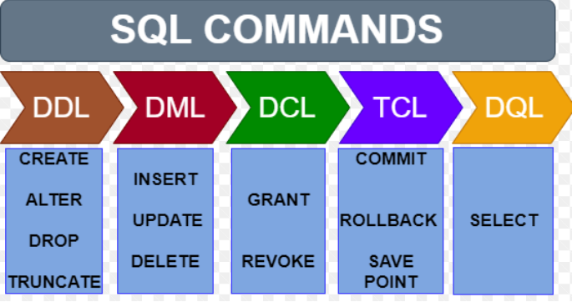
Types of SQL Statements

Slide 26
DDL (Data definition language)
DDL: Deals with the definition of database objects, these commands used to create, modify and remove the structure of the database objects like tables, views, functions etc.
Below are the DDL commands
Create
Alter
Drop
Truncate

Slide 27
Create
CREATE: To creates objects in the database like tables, indexes, functions, views, procedures and triggers etc.
Syntax: CREATE TABLE TAB_NAME
( Column1 DataType,
Column 2 DataTpe,
…….
);
CREATE VIEW VIEW_NAME as SELECT … FROM TAB_NAME;

Slide 28
ALTER
ALTER: Used to alter the structure of table like adding new columns, dropping existing column, changing the length or datatype of a column and to rename the table.
Syntax:
ALTER TABLE TABLE_A RENAME TO TABLE_B;
ALTER TABLE TABLE_NAME ADD new_column datatype;
ALTER TABLE TABLE_NAME MODIFY COLUMN column_name;
ALTER TABLE TABLE_NAME DROP COLUMN column_name;

Slide 29
DROP
DROP: Used to drop database objects like tables, views, functions, procedures, indexes etc.
Syntax:
DROP TABLE TABLE_NAME; or DROP TABLE_NAME;
DROP VIEW VIEW_NAME;
DROP FUNCTION FUN_NAME;
DOPR INDEX INDEX_NAME;

Slide 30
TRUNCATE
TRUNCATE: It deletes all rows from the table and we can’t rollback the deleted records.
Syntax:
TRUNCATE TABLE TABLE_NAME;

Slide 31
Now, Lets Practice DDL Statements..

Slide 32
DML (Data Manipulation language)
DML: DML statements are used to add the data, modify data and to delete the data from tables.
Below are the DML commands
Insert
Update
Delete

Slide 33
INSERT
INSERT: To insert data into a table, by using INSERT we can
Insert single record manually
Insert multiple records manually
Insert bulk data from other processes
Insert data from one table to another table
Syntax: INSERT INTO table_name(columns)
VALUES(……);
INSERT INTO table_a(columns) SELECT columns FROM table_b;

Slide 34
UPDATE
UPDATE: To modify data from the table. We use SET keyword for updating data.
By using UPDATE we can
Update one or more columns data
Update one or more records based on condition
Update entire table
Syntax: UPDATE TABLE table_name SET column1=… , column2=…;
UPDATE TABLE table_name SET column1=…
WHERE condition;

Slide 35
DELETE
DELETE: To remove records from table, by using DELETE we can
Delete one or more records based on condition
Delete all records
Syntax: DELETE FROM table_name;
DELETE FROM table_name WHERE condition;

Slide 36
INTERVIEW Question
Important interview question:
What is the difference between Delete and Truncate?
Ans:

Slide 37
TCL (TRANSACTION CONTROL language)
TCL: A transaction is set of SQL statements executed on the data stored in Database.
TCL commands are used to manage those transactions in the database and mainly to control the transactions made by DML commands like INSERT, UPDATE and DELETE.
COMMIT
ROLLBACK
SAVEPOINT

Slide 38
TCL (TRANSACTION CONTROL language)
COMMIT: It is used to permanently save any transaction into the database.
Syntax: COMMIT;
ROLLBACK: It is used to rollback the transactions made after last commit.
Syntax: ROLLBACK;
SAVEPOINT: It is used to save transactions up to a point and we can rollback the transactions made after that point.
SAVE TRANSACTION SP1;
transactions….
ROLLBACK TRANSACTION SP1;

Slide 39
DCL (Data CONTROL language)
DCL: DCL commands are used to handle access privileges for users and roles on database objects to. Only database administrator’s & owner’s of the database object can provide and remove the privileges.
GRANT: It is used to provide permissions on database objects to users and roles. Syntax: GRANT privilege_name ON db_object TO user|role
REVOKE: It is used to remove permissions on database objects to users and roles.
Syntax: REVOKE privilege_name ON db_object FROM user|role
Privileges: Privileges let the user know what are all operations that user can perform on that object.
Table/View level privileges: SELECT, INSERT, UPDATE, DELETE and ALL
Schema/Database level privileges: CREATE, ALTER and DROP

Slide 40
DQL (Data Query language)
DQL:
Select is the only DQL command we use to retrieve data from Database.
Select is the very important command that we use to fetch data from Tables and Views.
Select command plays key role in Data analysis.
Syntax: SELECT */column_list FROM table/view_name;
Let’s see what are the things we can do with SELECT..

Slide 41
SELECT Statement
Select:
Select command is used to retrieve data from Tables and Views in Database.
Syntax: SELECT */column_list FROM table/view_name;
With Select Statement we can
Fetch all columns(*) or only required columns from a table
Fetch all records or subset of records using where filter condition
Write expression
Call pre-defined functions and user defined functions
Calculate aggregations
Order data in ascending or descending order

Slide 42
EMPLOYEES Database
Lets Create Employees data related tables and insert sample data for our practice.

Slide 43
Where and Order by

Slide 44
Where Clause
Where:
We use WHERE clause to filter data from tables/views.
We can mention one or more conditions in WHERE clause based on our requirements.
The SELECT statement displays all the records satisfying the conditions mentioned in WHERE.
Syntax: SELECT */column_list FROM table/view_name WHERE condition;
Note: SQL keywords are case in-sensitive, we can use select or SELECT, WHERE or where.
But the data we are operating is case sensitive, so ‘a’ is different from ‘A’ in data.

Slide 45
Order by Clause
Order by:
To order the data in ascending order or descending order.
Default is ascending order, have to specify ‘desc’ for descending order.
Can be applied on any data type(Numeric, Strings, Date)
Can be applied on multiple columns
Syntax:
SELECT */column_list FROM table/view_name ORDER BY Col2;
SELECT */column_list FROM table/view_name ORDER BY Col3 desc;
SELECT */column_list FROM table/view_name ORDER BY Col1 desc, col2;

Slide 46
Lets Practice Where and Order By

Slide 47
String matching
Like - To match strings
Not like - Opposite match of strings
Wildcard operators: _ and %
'_’ - To match exactly single character
'%’ - To match Zero or more characters
Lets Practice String Matching..

Slide 48
Pre-defined functions

Slide 49
Predefined functions
SQL has so many predefined functions..
Numeric Functions
String Functions
Date and Time Functions
Conversion Functions
Null handling Functions
Aggregate Functions
Window Functions

Slide 50
Numeric Functions
ABS - Returns the absolute(positive) value of a numeric expression.
MOD - Equivalent to the % which returns remainder.
SQRT - Returns the square-root of a non-negative number or expression
SQUARE - Returns the square of a numeric expression.
POWER(x,y) – Returns x to the power of y value
CEIL – Returns the nearest equal or larger integer
FLOOR - Returns the nearest equal or smaller integer
ROUND – Returns the nearest integer based on the decimal part
SIGN – Returns sign of its argument(-1 for negative, 1 for positive, 0 for 0)
LOG - Returns the logarithm of a number or expression
LN - Returns the natural logarithm of a number or expression
EXP(x) – Returns Euler number (e – 2. 718282) to the power of x
FACTORIAL – Returns factorial of a number or expression

Slide 51
STRING Functions
LENGTH – To calculate length of given string
CONCAT – To combine two or more strings
TRIM – To remove spaces on both left and right sides of the given string
LTRIM – To remove spaces on the left side of the given string
RTRIM – To remove spaces on the right side of the given string
LPAD – To add spaces or characters on the left side of the given string
RPAD – To add spaces or characters on the right side of the given string
SUBSTR(SUBSTRING) – To get a part of the string
REVERSE – Returns reverse of given string
LOWER – Converts given string to lower case
UPPER – Converts given string to UPPER case
INITCAP – Converts first letter of each word in the given string to UPPER case
REPLACE – To replace one or more characters/words with other words

Slide 52
Date and time Functions
CURRENT_DATE() – Returns today’s date in server time zone
CURRENT_TIME() – Returns current time in server time zone
CURRENT_TIMESTAMP() - Returns current timestamp in server time zone
YEAR(date or ts) – Returns Year from given date or timestamp
MONTH(date or ts) - Returns Month from given date or timestamp
DAY(date or ts) – Returns Day of the month from given date or timestamp
WEEK(date or ts) – Returns Week number(1 to 53) of the year from given date or ts
TO_DATE(expr,format) – Converts given expr of certain format to Date
TO_TIMESTAMP(expr,format) – Converts given expr of certain format to Timestamp
DATEDIFF – To calculate difference between 2 dates in years, months, days, hours etc..
TIMESTAMPDIFF – To calculate difference between 2 timestamps in years, months, days, hours..
DATEADD – To add years, months, days, hours etc. to a Date
TIMESTAMPADD – To add years, months, days, hours etc. to a Timestamp
MONTHS_BETWEEN – To calculate the months between two dates or timestamps.
Other Dates:
SYSDATE()
DATETIME
LONG_DATE
NOW()

Slide 53
Conversion Functions
TO_CHAR – To convert a Decimal or Date expression to Char type
TO_DECIMAL or TO_NUMBER – To Convert a string with only numeric characters to Decimal, If string has non-numeric characters, conversion will fail.
TO_DATE(expr, format) – Converts given expr of certain format to Date
TO_TIMESTAMP(expr, format) – Converts given expr of certain format to Timestamp
CAST – To convert any datatype to other datatype.

Slide 54
Aggregate Functions
Aggregate functions are used to calculate summaries after grouping the data.
Summaries like Count, Minimum, Maximum, Sum, Average, Mode, Median.
Aggregate function performs calculation on multiple values of a column and returns a single value.
If we want to use Aggregate functions over some groups of data, we have to group the data first based on some column(s) or expression(s).
We use GROUP BY clause to group the data.
Syntax: SELECT column/expr, aggr_fun FROM table_name GROUP BY column/expr;
Having: Having clause is used to filter out the data from groups based on conditions, it is used after GROUP BY clause.
Syntax: SELECT column/expr, aggr_fun FROM table_name GROUP BY column/expr HAVING conditions;

Slide 55
Aggregate Functions
COUNT – To get the number of records from a table or view
SUM – To get the sum of all values of a column
AVG – To get average of all values of a column
MAX – To get the biggest values of a column
MIN – To get smallest value of a column
MODE – To get the most frequent value of values of a column
MEDIAN – To get middle value of column
Note: Except COUNT(*) none of the other aggregate functions consider nulls.

Slide 56
INTERVIEW QUESTIONS
Important Interview Questions:
1. What is the difference between WHERE and HAVING?
Ans: Where is used to filter out the data from a table or view based on conditions, but Having is used to filter out the data from groups of records based on specified conditions, Having is used along with GROUP BY clause.
2. Can you use both WHERE and HAVING in same SQL statement?
Ans: Yes, we can use
3. What is the order of execution of WHERE and HAVING in the query?
Ans: SELECT … FROM WHERE …. GROUP BY …. HAVING ….

Slide 57
NULL Handling Functions
What is a Null?
A column with NULL value means that column has no value.
A Null value is neither Zero(0) nor a blank space.
Length of a null value is null where length of a blank value is 0.
We can define nullability of a column in the table definition, called NOT NULL constraint.
If we define any column as NOT NULLABLE then it will not accept nulls, if you try to load nulls into that, the query will fail.
Null never matches with another null.
We should be very careful with nulls.

Slide 58
NULL Handling Functions
IFNULL(col1/expr1, col2/expr2) – If col1 is null then returns col2 otherwise returns col1
NVL (col1/expr1, col2/expr2) – If col1 is null then returns col2 otherwise returns col1
NVL2 (col1/expr1, col2/expr2, col2/expr2) – If col1 is not null then returns col2 otherwise returns col3
COALESCE( <expr1> , <expr2> [ , ... , <exprN> ] ) – Returns first not-null expression

Slide 59
All about nulls

Slide 60
Window functions

Slide 61
WINDOW Functions
A window is a group of related rows. A window can consist of one, or multiple rows.
A window function is any function that operates over a window of rows.
RANK – Returns rank over a group of values, skips the series in case of duplicates
DENSE_RANK – Returns rank over a group of values, doesn’t skips the series in case of duplicates
ROW_NUMBER – Returns a unique row number for each row within a group of values
LEAD – To get the next row information
LAG – To get the next row information
FIRST_VALUE – Returns the first value within an ordered group of values.
LAST_VALUE – Returns the last value within an ordered group of values.
NTH_VALUE – Returns the nth value within an ordered group of values.

Slide 62
Rank
Rank:
Returns the rank of a value within an ordered group of values.
The rank value starts at 1 and continues up sequentially.
If two values are the same, they have the same rank but skips the next sequence number.
Used to assign rank numbers, find the top values etc.
Syntax:
RANK() OVER ([partition by col/expr] order by col/expr [asc/desc])

Slide 63


Derive the Rank based on Salary
EMPID | FIRST_NAME | LAST_NAME | AGE | SALARY
1 | Anitha | Rao | 28 | 60000
2 | Vinay | Kumar | 31 | 70000
3 | Divya | Reddy | 25 | 50000
4 | Rama | Devi | 28 | 60000
5 | Naresh | Raju | 30 | 55000
6 | Uma | Shankar | 26 | 55000
7 | Tilak | Varma | 29 | 60000
EMPID | FIRST_NAME | LAST_NAME | AGE | SALARY | Rank
2 | Vinay | Kumar | 31 | 70000 | 1
1 | Anitha | Rao | 28 | 60000 | 2
4 | Rama | Devi | 28 | 60000 | 2
7 | Tilak | Varma | 29 | 60000 | 2
5 | Naresh | Raju | 30 | 55000 | 5
6 | Uma | Shankar | 26 | 55000 | 5
3 | Divya | Reddy | 25 | 50000 | 7
SELECT EMPID, FIRST_NAME, LAST_NAME, AGE, SALARY,
RANK() OVER(ORDER BY SALARY DESC) as Rank
FROM EMPLOYEES;

Slide 64
Dense_Rank
Desne_Rank:
Returns the rank of a value within a group of values, without gaps in the ranks.
The rank value starts at 1 and continues up sequentially.
If two values are the same, they have the same rank, but doesn’t skips the next sequence number.
Used to assign rank numbers, find the top values etc.
Syntax:
DENSE_RANK() OVER ([partition by col/expr] order by col/expr [asc/desc])

Slide 65


Derive Dense Rank based on Salary
EMPID | FIRST_NAME | LAST_NAME | AGE | SALARY
1 | Anitha | Rao | 28 | 60000
2 | Vinay | Kumar | 31 | 70000
3 | Divya | Reddy | 25 | 50000
4 | Rama | Devi | 28 | 60000
5 | Naresh | Raju | 30 | 55000
6 | Uma | Shankar | 26 | 55000
7 | Tilak | Varma | 29 | 60000
EMPID | FIRST_NAME | LAST_NAME | AGE | SALARY | DRank
2 | Vinay | Kumar | 31 | 70000 | 1
1 | Anitha | Rao | 28 | 60000 | 2
4 | Rama | Devi | 28 | 60000 | 2
7 | Tilak | Varma | 29 | 60000 | 2
5 | Naresh | Raju | 30 | 55000 | 3
6 | Uma | Shankar | 26 | 55000 | 3
3 | Divya | Reddy | 25 | 50000 | 4
SELECT EMPID, FIRST_NAME, LAST_NAME, AGE, SALARY,
DENSE_RANK() OVER(ORDER BY SALARY DESC) as Rank
FROM EMPLOYEES;

Slide 66
Row_Number
Row_Number:
Returns a unique row number for each row within a window partition.
The row number starts at 1 and continues up sequentially.
If two values are the same, assigns row number randomly.
Used to assign a sequence number irrespective of duplicates.
Syntax:
ROW_NUMBER() OVER ([partition by col/expr] order by col/expr [asc/desc])

Slide 67
Derive Row Number based on Salary
EMPID | FIRST_NAME | LAST_NAME | AGE | SALARY
1 | Anitha | Rao | 28 | 60000
2 | Vinay | Kumar | 31 | 70000
3 | Divya | Reddy | 25 | 50000
4 | Rama | Devi | 28 | 60000
5 | Naresh | Raju | 30 | 55000
6 | Uma | Shankar | 26 | 55000
7 | Tilak | Varma | 29 | 60000
EMPID | FIRST_NAME | LAST_NAME | AGE | SALARY | Rank
2 | Vinay | Kumar | 31 | 70000 | 1
7 | Tilak | Varma | 29 | 60000 | 2
4 | Rama | Devi | 28 | 60000 | 3
1 | Anitha | Rao | 28 | 60000 | 4
5 | Naresh | Raju | 30 | 55000 | 5
6 | Uma | Shankar | 26 | 55000 | 6
3 | Divya | Reddy | 25 | 50000 | 7
SELECT EMPID, FIRST_NAME, LAST_NAME, AGE, SALARY,
ROW_NUMBER() OVER(ORDER BY SALARY DESC) as Rank
FROM EMPLOYEES;

Slide 68
Which one to choose?
It’s completely depends on our requirements.
Suppose if I want to find winners/toppers based on their score/marks then I have to choose Dense_Rank for sure.
If I want to choose particular number of winners, I will go with Rank.
If I want to just generate a sequence number to rows based on some column/s, I will go with Row Number.
If we are sure there are no duplicate values, we can choose any one but use Row Number to avoid confusions.

Slide 69
LAG and LEAD
LAG: Can fetch the value for a particular column from previous row in the same table/group after sorting in some order, without using a self join.
Syntax: LAG ( col/expr, [ , <offset> , <default> ] )
OVER ( [ PARTITION BY <col/expr> ] ORDER BY <col/expr> [ { ASC | DESC } ] )
LEAD: Can fetch the value for a particular column from subsequent(next) row in the same table/group after sorting in some order, without using a self join.
Syntax: LEAD ( col/expr, [ , <offset> , <default> ] )
OVER ( [ PARTITION BY <col/expr> ] ORDER BY <col/expr> [ { ASC | DESC } ] )

Slide 70
FIRST_VALUE, LAST_VALUE and NTH_VALUE
FIRST_VALUE: Returns the first value within an ordered group of values.
Syntax: FIRST_VALUE( <col/expr> )
OVER ( [ PARTITION BY <col/expr> ] ORDER BY <col/expr> [ { ASC | DESC } ]
LAST_VALUE: Returns the last value within an ordered group of values.
Syntax: LAST_VALUE( <col/expr> )
OVER ( [ PARTITION BY <col/expr> ] ORDER BY <col/expr> [ { ASC | DESC } ]
NTH_VALUE: Returns the nth value within an ordered group of values.
Syntax: NTH_VALUE( <col/expr> , n)
OVER ( [ PARTITION BY <col/expr> ] ORDER BY <col/expr> [ { ASC | DESC } ]

Slide 71
Subqueries

Slide 72
Subquery
A Subquery is a query within another SQL query, also called as nested query or inner query.
Can be used with the SELECT, INSERT, UPDATE, and DELETE statements.
Can be used in Where clause, From clause and in Joins.
Subquery must be enclosed in parentheses.
The subquery generally executes first if it has no co-relation with the main query, so the result of a outer query is dependent on subquery or inner query.
Co-related subquery:
The Subquery that uses the values from outer query or dependent on the outer query is called Co-related subquery.
In co-related subquery, the result of the outer query is dependent on inner query and result of the inner query is dependent on outer query, hence called co-related.

Slide 73
In, exists
IN: To match a column or expression against a list of values, the values can be direct or from result of a subquery.
Syntax:
SELECT */column_list FROM table WHERE col1 IN (values..);
SELECT */column_list FROM table WHERE col1 IN (subquery);
EXISTS: Returns True or False based on the subquery result that has condition to evaluate.
Syntax:
SELECT */column_list FROM table WHERE EXISTS (SELECT * FROM table WHERE condition);
Note: NOT IN is just opposite to IN AND NOT EXISTS is just opposite to EXISTS.

Slide 74
Case and decode

Slide 75
Case statement
The CASE statement go through the conditions specified and returns the value where the condition is true and stops going through the next conditions, if none of the conditions are true then returns the value specified in ELSE clause.
CASE statement works like IF-ELSE (We can’t use IF-ELSE in SQL but we can use in Pl-SQL).
Syntax:
SELECT
CASE WHEN condition1 THEN result1 WHEN condition2 THEN result2
WHEN conditionN THEN resultN ELSE result END as col_name
FROM table_name;

Slide 76
DECODE statement
Decode compares the column/expression with search value and returns the result value where it matches and if none of the search values are matching with expression it returns the default value specified in the statement.
It works similar to IF-ELSE and CASE but the difference in CASE and IF-ELSE we can write any conditions, but in DECODE the conditions are based on the column/expression specified.
This is useful when we need to compare same col/expr with multiple values.
Syntax:
SELECT
DECODE (col/expr, search_1, result_1 [, search_2, result_2].....[,search_n,result_n] [, default])
FROM table_name;

Slide 77
Diff between CASE and DECODE
Important interview question:
What is the difference between CASE and DECODE?
CASE | DECODE
Case is a statement | Decode is system function
CASE works with other relational operators like (>, <,>=, <=) along with equal to (=) | Decode only works with equality(=) checks
Case can be used as parameter in Procedure calls | Decode doesn’t work in procedure calls
Case statement can be used in PL SQL blocks | Decode works in PL SQL programs but only in select statements
Case expects data type consistency of returning values | Decode does not expects

Slide 78
constraints

Slide 79
Constraints in sql
Constraints: Constraints are used to specify conditions or rules or restrictions for data in a table. In case of any violation to these constraints, the SQL statements will fail.
Below are the constraints in SQL.
UNIQUE
NOT NULL
DEFAULT
CHECK
PRIMARY KEY
FOREIGN KEY

Slide 80
Constraints in sql
UNIQUE: Unique constraint can be applied at column level, this constraint ensures that all values in that column are different and it won’t allow duplicates. It allows null values.
NOT NULL: Not Null can be applied at column level, this constraint won’t allow nulls into the column, if you try to load null value then SQL statement gives error.
DEFAULT: Default can be applied at column level, where we have to specify a default value for that column, for any record if we do not insert/load a value to that column then the default value will be stored in that column.
CHECK: Check constraint can be applied at column level, where we have to specify a condition. This allows only the values that are satisfying the condition. If the condition is false then the SQL statement gives error.
Note: We can specify all above constraints at the time of table creation or can add constraints later by using ALTER TABLE statement.

Slide 81
Constraints in sql
PRIMARY KEY:
Primary Key helps us to identify each row uniquely in a table.
It is combination of UNIQUE and NOT NULL constraints.
Primary Key can be applied on a single column or combination of multiple columns.
This is a table level constraint and can be added at the time of table creation or later by using ALTER TABLE statement.
FOREIGN KEY:
Foreign Key is used to specify referential integrity between tables.
That means same column present in two tables, in the first table that column is a Primary Key and in the other table it can be used as foreign key to refer the record from that other table.
Foreign Key is basically used to provide the links between database tables.
We use REFERENCES key word to specify foreign key relationships.

Slide 82

Constraints in sql
CREATE TABLE employee (
emp_id INT UNIQUE,
first_name VARCHAR(30) NOT NULL,
last_name VARCHAR(30),
salary FLOAT DEFAULT 0,
age INT CHECK (age > 18 and age < 60),
location VARCHAR(20),
dept_id INT REFERENCES dept(dept_id),
PRIMARY KEY (emp_id)
);
CREATE TABLE dept (
dept_id INT UNIQUE,
dept_name VARCHAR(30) NOT NULL,
manager_id INT,
loc_id INT REFERENCES location(loc_id),
PRIMARY KEY (dept_id)
);

Slide 83
Constraints in sql
Important Interview Question:
How many unique constraints and primary key constraints a table can have ?
Ans: A table can have any number of unique keys but only one primary key. That means we can define multiple unique keys on different columns, but can define single primary key at table level.

Slide 84
JOINS

Slide 85
JOINs in sql
JOIN: Join clause is used to combine rows from two or more tables by joining them based on a common filed(s) between the tables. We call them as Join Keys. Join Key can be a single column or set of columns.
empid | empname | salary | deptid
1 | John | 48000 | 101
2 | Charles | 55000 | 102
3 | Tina | 62000 | 101
deptid | deptname | loc_cd
101 | Sales | BNG
102 | Marketing | HYD
103 | Finance | CHN
loc_cd | location
BNG | Bangalore
HYD | Hyderabad
CHN | Chennai
MUM | Mumbai
empid | empname | salary | deptname | location
1 | John | 48000 | Sales | Bangalore
2 | Charles | 55000 | Marketing | Hyderabad
3 | Tina | 62000 | Sales | Bangalore

Slide 86
JOINs in sql
Below are the four types of joins in SQL
INNER JOIN
LEFT OUTER JOIN
RIGHT OUTER JOIN
FULL OUTER JOIN
Other than these 4 we have
SELF JOIN
CARTESIAN JOIN (or) CROSS JOIN

Slide 87
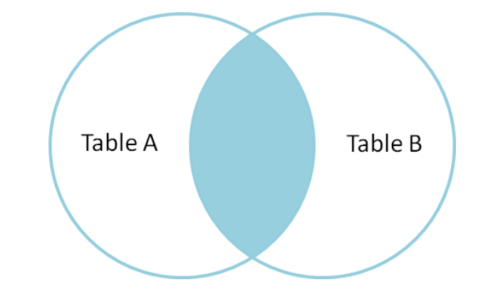
INNER JOIN
INNER JOIN: Returns all matching rows between both the tables based on the Join Key.
Syntax:
SELECT A.*, B.*
FROM TABLE_A A INNER JOIN TABLE_B B
ON A.Key = B.Key;
Employee Table
empid | empname | salary | deptid
1 | John | 48000 | 101
2 | Charles | 55000 | 102
3 | Tina | 62000 | 103
Dept Table
deptid | deptname
101 | Sales
102 | Marketing
104 | Finance
Employee INNER JOIN Dept On deptid
empid | empname | salary | E.deptid | D.deptid | deptname
1 | John | 48000 | 101 | 101 | Sales
2 | Charles | 55000 | 102 | 102 | Marketing

Slide 88
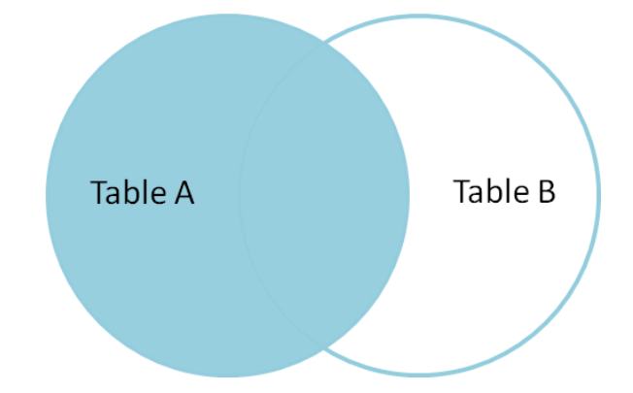
LEFT OUTER JOIN
LEFT OUTER JOIN: Returns all rows from Left table and matching rows from Right table. For all non-matching rows from Right table, it will return nulls.
Syntax:
SELECT A.*, B.*
FROM TABLE_A A LEFT OUTER JOIN TABLE_B B
ON A.Key = B.Key;
Employee Table
empid | empname | salary | deptid
1 | John | 48000 | 101
2 | Charles | 55000 | 102
3 | Tina | 62000 | 103
Dept Table
deptid | deptname
101 | Sales
102 | Marketing
104 | Finance
Employee LEFT OUTER JOIN Dept On deptid
empid | empname | salary | E.deptid | D.deptid | deptname
1 | John | 48000 | 101 | 101 | Sales
2 | Charles | 55000 | 102 | 102 | Marketing
3 | Tina | 62000 | 103

Slide 89
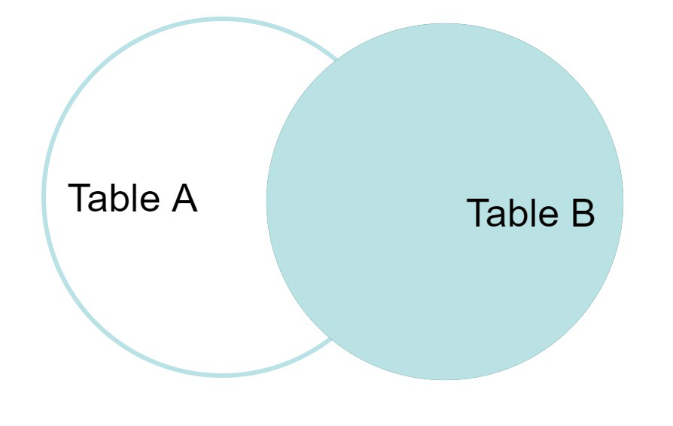
RIGHT OUTER JOIN
RIGHT OUTER JOIN: Returns all rows from Right table and matching rows from Left table. For all non-matching rows from Left table, it will return nulls.
Syntax:
SELECT A.*, B.*
FROM TABLE_A A RIGHT OUTER JOIN TABLE_B B
ON A.Key = B.Key;
Employee Table
empid | empname | salary | deptid
1 | John | 48000 | 101
2 | Charles | 55000 | 102
3 | Tina | 62000 | 103
Dept Table
deptid | deptname
101 | Sales
102 | Marketing
104 | Finance
Employee RIGHT OUTER JOIN Dept On deptid
empid | empname | salary | E.deptid | D.deptid | deptname
1 | John | 48000 | 101 | 101 | Sales
2 | Charles | 55000 | 102 | 102 | Marketing
 |  |  |  | 104 | Finance

Slide 90
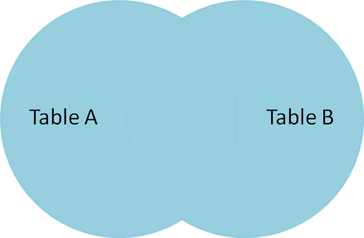
FULL OUTER JOIN
LEFT OUTER JOIN: Returns all rows from both Left and Right tables. For all non-matching rows from both tables, it will return nulls.
Syntax:
SELECT A.*, B.*
FROM TABLE_A A FULL OUTER JOIN TABLE_B B
ON A.Key = B.Key;
Employee Table
empid | empname | salary | deptid
1 | John | 48000 | 101
2 | Charles | 55000 | 102
3 | Tina | 62000 | 103
Dept Table
deptid | deptname
101 | Sales
102 | Marketing
104 | Finance
Employee FULL OUTER JOIN Dept On deptid
empid | empname | salary | E.deptid | D.deptid | deptname
1 | John | 48000 | 101 | 101 | Sales
2 | Charles | 55000 | 102 | 102 | Marketing
3 | Tina | 62000 | 103
 |  |  |  | 104 | Finance

Slide 91
SELF JOIN
SELF JOIN: Sometimes we may need to join a table with same table, we call that join as self join
Syntax:
SELECT A.*, B.*
FROM TABLE_A A INNER JOIN TABLE_A B
ON A.Key = B.Key; ( ON A.managerid = B.empid )
Employee Table
empid | empname | salary | managerid
1 | John | 78000
2 | Charles | 65000 | 1
3 | Tina | 61000 | 1
4 | Bobby | 40000 | 2
empid | empname | salary | B.empname as managername
1 | John | 78000
2 | Charles | 65000 | John
3 | Tina | 61000 | John
4 | Bobby | 40000 | Charles

Slide 92
CARTESIAN JOIN
CARTESIAN JOIN: Every row of a table will be joined with every row of other table.
There will be no join keys between two tables or no need to specify them.
We get the output row count as multiplication of both tables row count.
Syntax:
SELECT A.*, B.*
FROM TABLE_A A CROSS JOIN TABLE_B B;
(or simply)
SELECT A.*, B.*
FROM TABLE_A , TABLE_B B;
Employee Table
empid | empname | salary | deptid
1 | John | 48000 | 101
2 | Charles | 55000 | 102
Dept Table
deptid | deptname
101 | Sales
102 | Marketing
Employee CROSS JOIN Dept
empid | empname | salary | E.deptid | D.deptid | deptname
1 | John | 48000 | 101 | 101 | Sales
1 | John | 48000 | 102 | 102 | Marketing
2 | Charles | 55000 | 101 | 101 | Sales
2 | Charles | 55000 | 102 | 102 | Marketing

Slide 93
JOINs in sql – POINTS TO REMEMBER
We can achieve INNER JOIN with WHERE clause, but INNER JOIN is preferred.
SELECT A.*, B.* from TABLE_A A, TABLE_B B WHERE A.Key=B.Key
Be careful where there are nulls in Join keys, null never matches with another null.
In real time we mostly use INNER, LEFT OUTER and SELF joins.
TABLE_A LEFT OUTER JOIN TABLE_B is same as TABLE_B RIGHT OUTER JOIN TABLE_A.
Avoid using Cartesian joins as they are costly that means performance will be very slow.
If there are multiple matches in the joining table, we will get multiple records in the output.
While writing joins we should consider some important points.
What we need in the output exactly
The performance of the query should be good
Query should be in readable format that any one can understand it in future.

Slide 94
JOINs in sql
Important Interview question:
Below are two tables with one column in each, what is the output number of records after each type of join?
Table B
1
2
2
4
null
null
INNER JOIN –
LEFT JOIN –
RIGHT JOIN –
FULL OUTER JOIN –
CARTESIAN JOIN –
Table A
1
2
1
3
null

Slide 95
JOINs in sql
Important Interview question:
Below are two tables with one column in each, what is the output number of records after each type of join?
Table B
1
2
2
4
null
null
INNER JOIN – 1+2+1 = 4
LEFT JOIN – 4+1+1 = 6
RIGHT JOIN – 4+1+1+1 = 7
FULL OUTER JOIN – 4+1+1+1+1+1 = 9
CARTESIAN JOIN – 5*6 = 30
Table A
1
2
1
3
null

Slide 96
SET operators

Slide 97
SET OPERATORS in SQL
Set Operators in SQL are same as Set Operators in Mathematics.
Used to combine or compare result sets of two or more Select queries.
Below are the rules to perform Set operations
Number of columns must be same in all Select queries
Order of columns must be same in all Select queries
Datatypes must be compatible
Below are the 4 set operators is SQL:
UNION
UNION ALL
INTERSECT
MINUS

Slide 98
UNION
UNION: Union is used to combine result sets of two or more Select queries. After combining the result sets it eliminate duplicates if any, that means if same record exists in both result sets it shows only one record in the output.
Syntax:
SELECT col1, col2, …col_n FROM TABLE_A
UNION
SELECT col1, col2, …col_n FROM TABLE_B
UNION
SELECT col1, col2, …col_n FROM TABLE_C
…..
TABLE_A
empid | name
21 | Raja
22 | Gopal
TABLE_B
empid | name
22 | Gopal
25 | Seetha
28 | Kamal
TABLE_A UNION TABLE_B
empid | name
21 | Raja
22 | Gopal
25 | Seetha
28 | Kamal

Slide 99
UNION ALL
UNION ALL: Same as Union but Union all but it doesn’t eliminate duplicates.
Syntax:
SELECT col1, col2, …col_n FROM TABLE_A
UNION ALL
SELECT col1, col2, …col_n FROM TABLE_B
UNION ALL
SELECT col1, col2, …col_n FROM TABLE_C
…..
TABLE_A
empid | name
21 | Raja
22 | Gopal
TABLE_B
empid | name
22 | Gopal
25 | Seetha
28 | Kamal
TABLE_A UNION ALL TABLE_B
empid | name
21 | Raja
22 | Gopal
22 | Gopal
25 | Seetha
28 | Kamal

Slide 100
INTERSECT
INTERSECT: Used to combine result sets and returns only common rows between both the tables.
Syntax:
SELECT col1, col2, …col_n FROM TABLE_A
INTERSECT
SELECT col1, col2, …col_n FROM TABLE_B
INTERSECT
SELECT col1, col2, …col_n FROM TABLE_C
…..
TABLE_A
empid | name
21 | Raja
22 | Gopal
TABLE_B
empid | name
22 | Gopal
25 | Seetha
28 | Kamal
TABLE_A INTERSECT TABLE_B
empid | name
22 | Gopal

Slide 101
MINUS
MINUS: Minus operator returns the records that exists in first result set and do not exists in the next result set. Very useful to data validation between two tables.
Syntax:
SELECT col1, col2, …col_n FROM TABLE_A
MINUS
SELECT col1, col2, …col_n FROM TABLE_B
TABLE_A
empid | name
21 | Raja
22 | Gopal
TABLE_B
empid | name
22 | Gopal
25 | Seetha
28 | Kamal
TABLE_A MINUS TABLE_B
empid | name
21 | Raja
TABLE_B MINUS TABLE_A
empid | name
25 | Seetha
28 | Kamal

Slide 102
SET OPERATORS in SQL
Important Interview question:
What is the difference between UNION and UNION ALL, which gives better performance and which one you choose?
Ans: Union combines two or more result sets and eliminate the duplicate records, but Union All doesn’t eliminate duplicates.
Performance wise UNION ALL is better as the task of duplicate elimination is not required here.
So if you are concerned with duplicates better choose UNION and if you are sure that there are no duplicates then choose UNION ALL which gives better performance.

Slide 103
Common Table expressions (CTEs)

Slide 104
CTEs
A CTE (common table expression) is a named subquery defined in WITH clause.
We can think of the CTE as a temporary table. The result of the query expression is effectively a table.
We can define CTE once in the query and can be used at multiple places if needed.
CTEs can be used in Joins as well.
We can use CTEs in all DML statements along with Select statement.
Syntax:
With
cte1 as ( … ),
cte2 as (…) …. cteN(…)
SELECT * FROM cte;

Slide 105
Pivot and unpivot

Slide 106
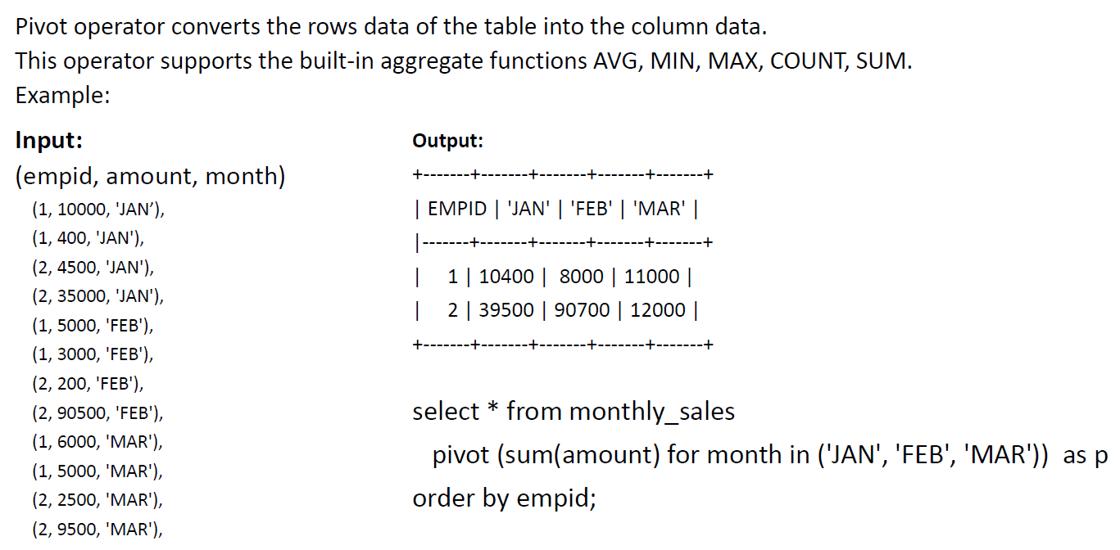
Pivot

Slide 107
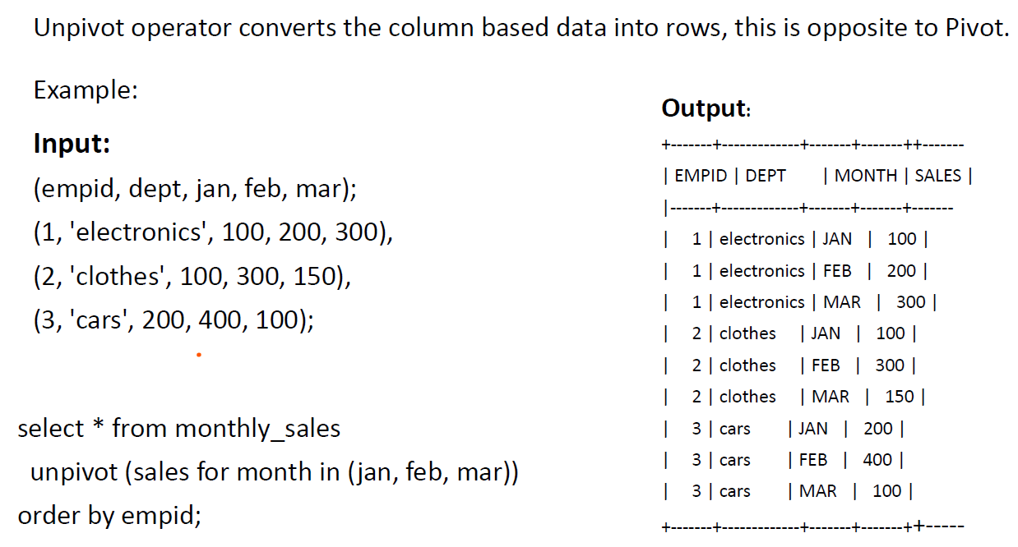
Unpivot

Slide 108
Indexes

Slide 109
INDEXES in SQL
INDEXES:
Index is a special look up table used to speedup the data retrieval from Database tables.
Indexes are just pointers to original data, they are similar to Index page in the book, to search particular topic in the book (column in the database).
Indexes improves the performance of SQL queries a lot when we are dealing with millions of rows.
Index can be created on a single column or combination of multiple columns in a table.
Syntax:
CREATE INDEX index_name ON TABLE_NAME(col_name);
Note: Indexes improves the performance of Select queries but degrades the performance of Insert and Update queries. Sometimes we drop and recreate indexes once the data load is completed.

Slide 110
INDEXES in SQL
UNIQUE INDEXES: Unique index on a column doesn’t allow duplicate values into that column.
It works both as Index and Unique constraint.
Syntax:
CREATE UNIQUE INDEX index_name ON TABLE_NAME(col_name);
COMPOSITE INDEXES: An index created on two or more columns of a table is called Composite Index.
Syntax:
CREATE INDEX index_name ON TABLE_NAME(col_1, col_2, ….);
Dropping an Index:
DROP INDEX index_name;

Slide 111
INDEXES in SQL
Important Interview Questions:
What are indexes and unique indexes?
What are the advantages of Indexes?
When do you create indexes (or) on which columns you create indexes?
Ans: We create indexes in below scenarios..
On large tables (avoid indexes on small tables)
On a column that contains wide range of distinct values
On column or set of columns those are frequently used in Where clause
On column or set of columns used frequently as Join keys
On columns where we don’t perform frequent Update operations

Slide 112
VIEWS

Slide 113
VIEWS in SQL
VIEWS:
A view is a virtual table that contains rows and columns. It is a schema object that stores SQL statement pointing to original tables and fetches data from these original tables when we query the view.
A view can be created on multiple tables by joining them.
A view can be created over another view.
In some databases we can perform DML operations on a view that has no transformations or joins, but in most of the databases views or read-only and we can’t perform DML operations on them.

Slide 114
VIEWS in SQL
Creating a view:
CREATE VIEW view_name as SELECT col1, col2, ..col_n FROM table_name;
Dropping a view:
DROP VIEW view_name;
Altering or Updating a view:
CREATE OR REPLACE VIEW view_name as SELECT col1, col2, ..col_n FROM table_name;

Slide 115
VIEWS in SQL
Advantages or Uses of Views:
1. Restricting the access to original database tables.
2. Simplifying the SQL queries to end users.
3. We can create multiple views on same table based on the requirement.
4. If we want to hide the original column names, we can rename them in the view definition.
5. We can summarize the data from multiple tables.
6. Views take very little space to store the queries.

Slide 116
VIEWS in SQL
Materialized Views:
A normal view just stores the SQL query not the data or results set.
A Materialized view is a view that stores the results of the query in that view.
So when we query the materialized view it returns the data from results stored in that view directly and it will not fetch the data from underlying tables.
Performance wise materialized views are better than views.
Syntax:
CREATE MATERIALIZED VIEW view_name AS SELECT col1, col2, .. col_n FROM table_name;

Slide 117
VIEWS in SQL
Data Refresh in Materialized views:
So, how the data(stored results) get refreshed when underlying tables gets updated?
There is no standard way of refreshing data but it is database specific.
In some databases there is Auto refresh(SQL Server, Snowflake)
In some databases we have to refresh manually at regular intervals(PostgreSQL, MongoDB)
Some databases supports both(Oracle, Redshift)
Advantages:
When we are frequently running same query, better create a materialized view over it.
When we query large dataset which returns few rows, better use materialized views.

Slide 118
VIEWS in SQL
Important Interview Question:
What are the differences between views and materialized views?
Views | Materialized Views
It is a virtual tables, just stores the SQL query | It stores the result set of the query
Doesn't occupy storage | Storage space needed to store result set
Query fetches data from underlying tables, so performance may be slow | Performs better than Views as it fetches data from pre computed result sets
No data refresh headache | Data refresh is cost oriented

Slide 119
ACCESS CONTROLS

Slide 120
DCL (Data CONTROL language)
Access controlling can be done by DCL commands in SQL
DCL: DCL commands are used to handle access privileges for users and roles on database objects to. Only database administrator’s & owner’s of the database object can provide and remove the privileges.
GRANT: It is used to provide permissions on database objects to users and roles. Syntax: GRANT privilege_name ON db_object TO user|role
REVOKE: It is used to remove permissions on database objects to users and roles.
Syntax: REVOKE privilege_name ON db_object FROM user|role

Slide 121
DCL (Data CONTROL language)
USERS: User can be a person or batch id who is operating or running SQL queries on database tables.
PRIVILEGES: Privileges let the user know what are all operations that user can perform on that object.
ROLES: A Role is a database object that group together a set of privileges that can be assigned to users.
Ex: Developer, Tester, Analyst, Administrator, EndUser etc.
Table/View level privileges: SELECT, INSERT, UPDATE, DELETE and ALL
Schema/Database level privileges: CREATE, ALTER and DROP

Slide 122
Performance Tuning

Slide 123
Performance tuning
Performance Tuning:
Tuning is the process of improving your SQL queries to run faster.
Also called as Query Optimization.
To reduce the consumption of resources and to reduce waiting time of data retrieval.
Reasons for slow performance:
Huge tables
More number of Joins
More aggregations
Inefficient query writing

Slide 124
Performance tuning
Tuning Process:
First analyze the query why it is taking long time to run.
Find which step or which part of the code is taking long time.
(Check Execution plan or Query plan or Query profile to find out this)
Apply tuning on that part or rewrite the query in other way.
Follow some standard tuning techniques.

Slide 125
SQL Tuning Techniques (All On-premise Databases)
First and important step is, create proper indexes, make use of function based indexes as well.
Select only required fields, don’t use select * always.
Avoid using multiple OR condition in Where clause, instead you can use Union or IN based on the conditions.
Avoid using not equal to operator (<> or !=), Instead use Not In.
Avoid using Distinct, instead we can use Group By on All columns.
Use Union All instead of Union if you are sure there are no duplicates.
Avoid joining tables using Where clause it will perform cross join first and then filters the records, Use Inner Join.
If you want to see sample data then restrict the data using Top 10 or Limit 10.
If possible avoid writing co-related subqueries.
Use CTEs instead of subqueries if you want to use same subquery at multiple places in the query.
Collecting the missing stats on table will help in Teradata.
Remove unnecessary ORDER BY clauses.

Slide 126
Performance in snowflake
There are lot of in-built features in snowflake to improve the performance, so first read and understand the concepts.
1. Data Storage:
The data is stored in micro-partitions after compression, if we have large tables then define cluster keys on the frequently used columns of the table, they will help to scan only required micro-partitions to fetch the data instead of scanning all partitions. Cluster keys behave like indexes in on-premise databases.
2. Metadata:
Snowflake manages meta data like number of rows, distinct values of each column, minimum and maximum of values stored in each column. So when you try to fetch the table count or minimum or maximum values, the query will use metadata instead of scanning entire table.

Slide 127
Performance in snowflake
3. Caching:
Snowflake has 2 types results cache and disk cache. The result of a query will be stored in the results cache until 24 hours, so if we run the same query again with-in 24 hours, the query will fetch the data from results cache instead of scanning entire table again unless until the data is not updated. In case of disk cache the results will be stored in the memory and this memory will be effective until we close that session.
4. Vertical scaling and Horizontal scaling:
In Snowflake we have flexibility to increase the size of warehouse(Actual processing unit). We have sizes from X-Small to 6XL and the cost will get doubled when we upgrade to next level. But if you are dealing with very large tables and have multiple joins then increasing the size of warehouse to next level will help the query to run faster. This is called Vertical scaling. Suppose if we have so many concurrent queries running and the queries are going into waiting queues then we can go for multi clustering where we increase the number of clusters which is called as Horizontal scaling.

Slide 128
Performance in snowflake
5. Dedicated virtual warehouses:
If we have multiple teams working or accessing same database then better use dedicated virtual warehouse for each team like one for Development team, one for Analyst team, One for End users etc. And always use dedicated warehouse for batch processing.
After following all above things, if your query is still running slow then use the SQL performance tuning techniques discussed in previous slide.

Slide 129
Best practices

Slide 130
Best Practices in writing SQL queries
Select only required fields.
Write appropriate comments.
Use proper alias names.
Follow standard naming conventions for your table names, view names and field names.
Format your queries, it should be easily understandable to others.

Slide 131
Advanced SQL Queries

Slide 132
Advanced queries
How to Calculate Cumulative Sum?
Ho to Eliminate Duplicate pair of records
Ho to Eliminate Duplicate pair of records using SPLIT_PART
How to add up values into single row using LISTAGG?
Working with Regular Expressions
How to generate Sequence Number for existing records?

Slide 133
What Next? - PL/SQL
Introduction to Programming languages
What is PL/SQL?
Variables and Constants
Conditional Statements(if-else)
Looping Statements(for, while)
Cursors
User Defined Functions
Stored Procedures
Exception handling
Packages
Triggers

Slide 134
Thank You &
Wish you all the very best
Janardhana Bandi

