Slide 1

A Case Study on Risk-Based Loan Approval: Predicting Defaults in FinTech Lending
Sai Santhosh Venkatesh Charumathi
Computer Science Graduate Student at Rice University

Slide 2
Model Features
Features | Description
term | The number of payments on the loan. Values are in months and can be either 36 or 60.
int_rate | Interest Rate on the loan
grade | Assigned loan grade
emp_length | Employment length in years. Possible values are between 0 and 10 where 0 means less than one year and 10 means ten or more years.
home_ownership | The home ownership status provided by the borrower during registration or obtained from the credit report. Our values are: RENT, OWN, MORTGAGE, OTHER
annual_inc | The self-reported annual income provided by the borrower during registration.
verification_status | Indicates if income was verified, not verified, or if the income source was verified
purpose | A category provided by the borrower for the loan request.

Slide 3
Model Features
Features | Description
dti | A ratio calculated using the borrower’s total monthly debt payments on the total debt obligations, excluding mortgage and the requested loan, divided by the borrower’s self-reported monthly income.
pub_rec | Number of derogatory public records
revol_util | Revolving line utilization rate, or the amount of credit the borrower is using relative to all available revolving credit.
initial_list_status | The initial listing status of the loan. Possible values are — W, F
mort_acc | The self-reported annual income provided by the borrower during registration.
pub_rec_bankruptcies | Number of public record bankruptcies
loan_to_income | The ratio of the loan amount to the borrower's annual income.
total_interest_owed | The total interest due on the loan, calculated as the product of the loan amount and the interest rate (expressed as a fraction).

Slide 4
Model Features
Features | Description
installment_to_income_ratio | The ratio of the monthly installment to the borrower's monthly income.
active_credit_pct | The proportion of the borrower's credit accounts that are active (open) relative to their total credit accounts.
credit_age | The number of years since the borrower’s earliest credit line was opened.

Slide 5
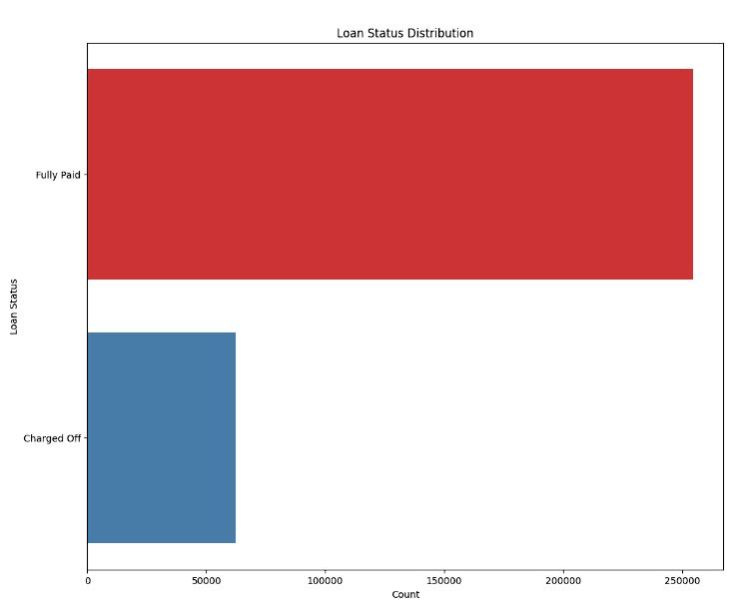
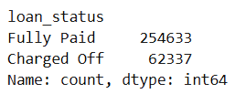
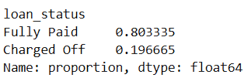
Target Feature
Features | Description
loan_status | Current status of the loan
Heavily Imbalanced

Slide 6
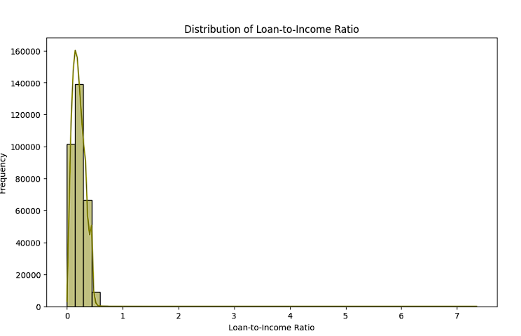
Loan_to_income

Slide 7
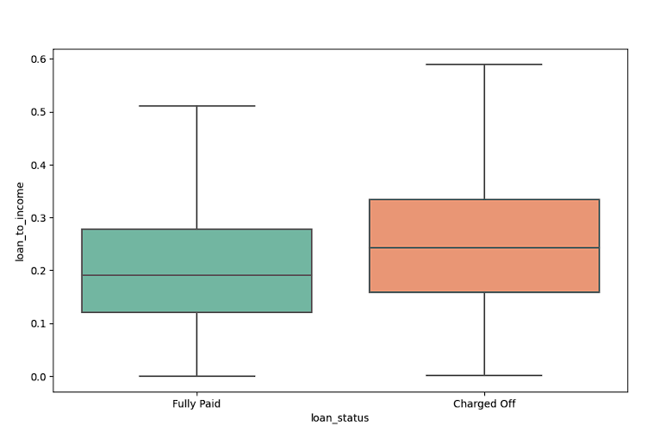
Loan_to_income
The median Loan-to-Income Ratio appears slightly higher for Charged Off loans than for Fully Paid loans. This suggests that borrowers with a higher debt burden relative to income might be more likely to default.

Slide 8
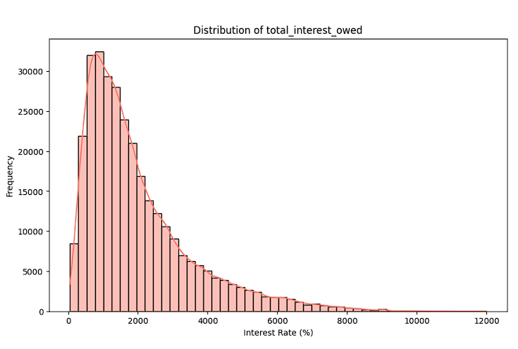
Total_interest_owed

Slide 9
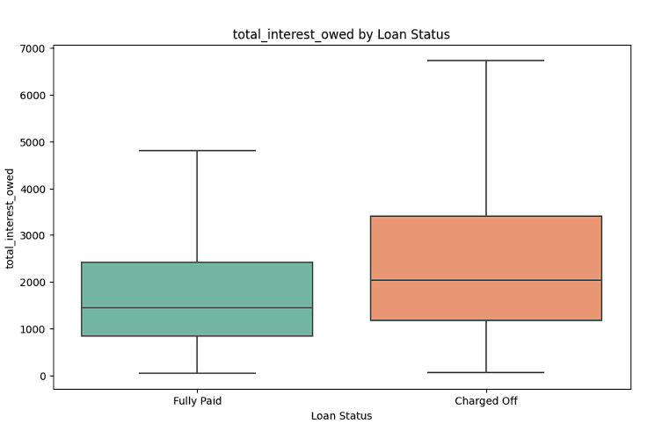
Total_interest_owed
The median interest owed is noticeably higher for Charged Off loans than for Fully Paid loans. This suggests that borrowers who default tend to owe more in interest, possibly due to higher loan amounts, longer loan terms, or higher interest rates.

Slide 10
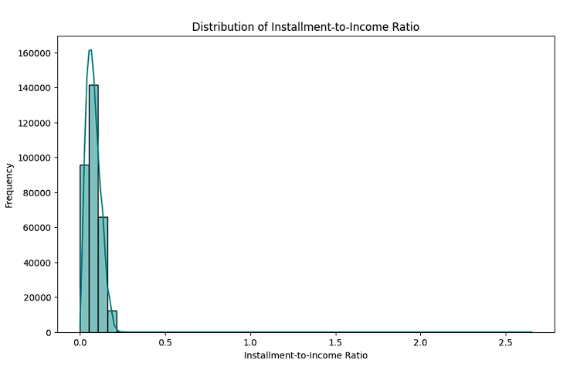
Installment_to_income_ratio

Slide 11
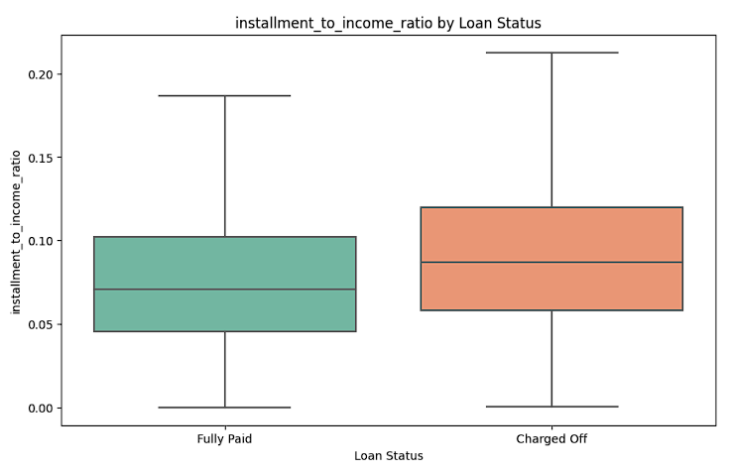
Installment_to_income_ratio
The median installment-to-income ratio is higher for Charged Off loans than for Fully Paid loans. This suggests that borrowers who allocate a higher percentage of their income toward loan installments are more likely to default.

Slide 12
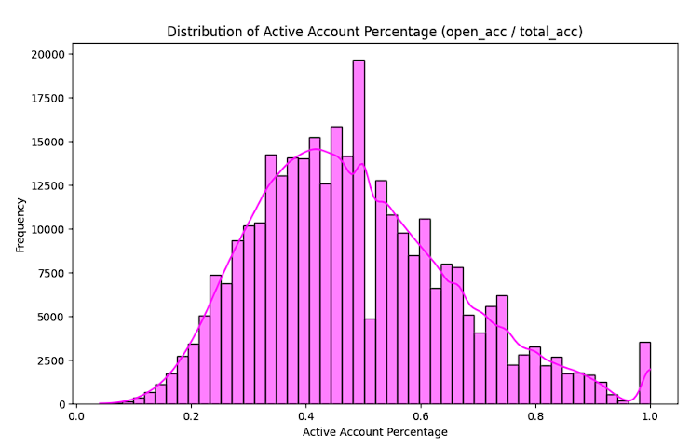
Active_credit_pct

Slide 13
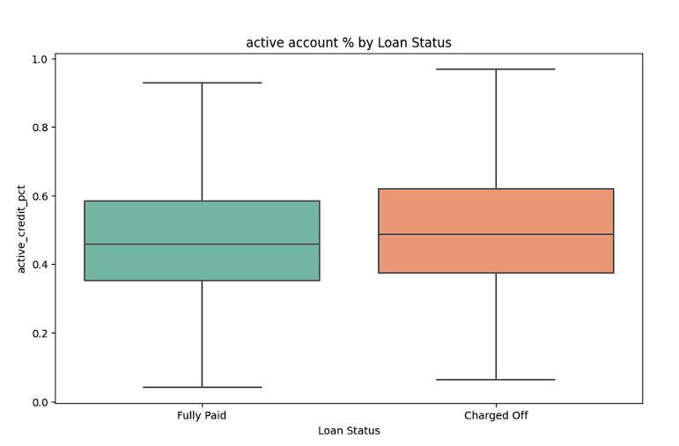
Active_credit_pct
The median active account percentage is slightly higher for Charged Off loans than Fully Paid loans. This suggests that borrowers with a higher proportion of open accounts relative to their total accounts may have a slightly higher risk of default.

Slide 14
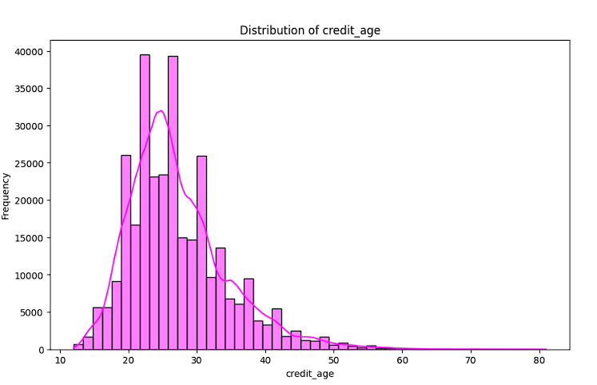
Credit_age (Credit History)

Slide 15
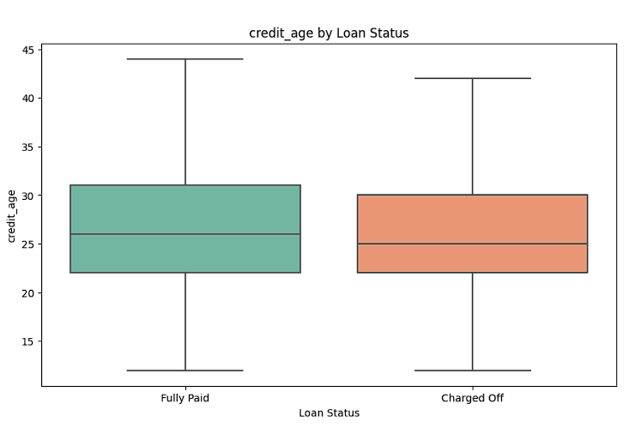
Credit_age (Credit History)
The median credit age is slightly higher for Fully Paid loans compared to Charged Off loans. This aligns with industry expectations—borrowers with longer credit histories tend to be more financially stable and less likely to default.

Slide 16

LightGBM Model Training Metrics
Metric | Train | Test
Accuracy | 77.8% | 69.4%
AUC-ROC Score | 87.9% | 71.8%
Class 0 (Charged)
Precision | 46% | 34%
Recall | 82% | 60%
F1-Score | 59% | 43%
Class 1 (Fully Paid)
Precision | 95% | 88%
Recall | 77% | 72%
F1-Score | 85% | 79%

Slide 17
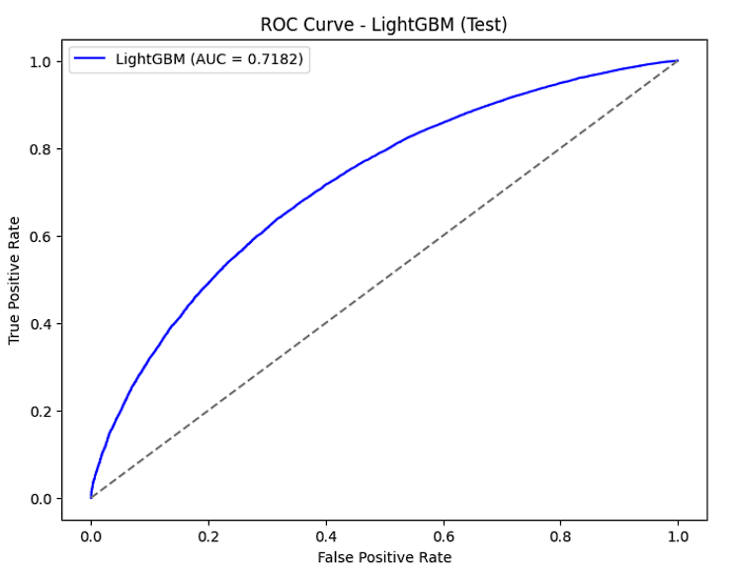
LightGBM Model Training Metrics

Slide 18
XGBoost Model Training Metrics
Metric | Train | Test
Accuracy | 67.9% | 66.6%
AUC-ROC Score | 75.3% | 72.3%
Class 0 (Charged)
Precision | 35% | 32%
Recall | 90% | 66%
F1-Score | 46% | 43%
Class 1 (Fully Paid)
Precision | 90% | 89%
Recall | 68% | 67%
F1-Score | 77% | 76%

Slide 19
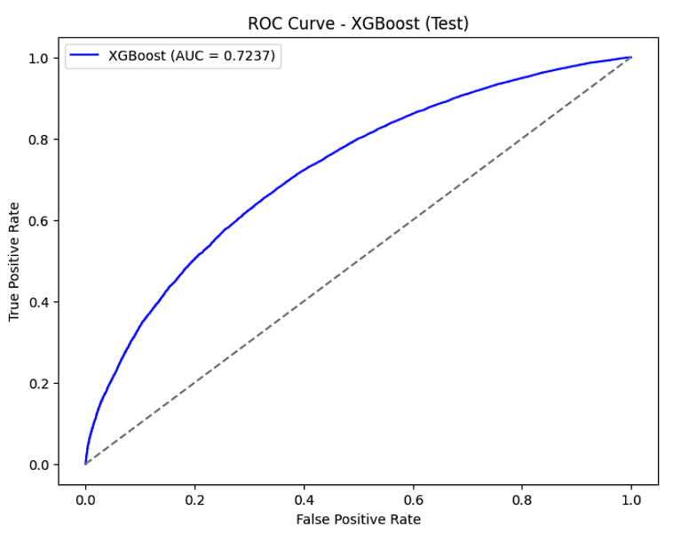
XGBoost Model Training Metrics

Slide 20
Prediction Data Distribution
LightGBM Prediction | XGBoost Prediction
Class 1 (Fully Paid) 65.8% | Class 1 (Fully Paid) 59.76%
Class 0 (Charged Off) 34.16% | Class 0 (Charged Off) 40.23%
In loan risk prediction, missing a default (false negative) is more costly than overpredicting defaults (false positives).
A model with lower precision but high recall for defaults ensures that nearly all high‑risk loans are flagged, reducing potential credit losses.
This trade-off is justified in credit risk management, where it's safer to overestimate risk than to miss truly risky cases.

Slide 21
Thank You!

