Slide 1
Efficient deep unrolling networks for image reconstruction of X-ray CT scans
Under the supervision of Professor Subhadip Mukherjee
Kadagala Sai Siva Sankar
20EC39017

Slide 2
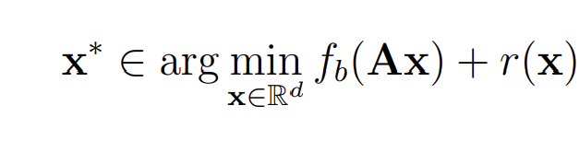
Problem Statement
The image reconstruction task in CT entails recovering x† from noisy measurement given by
y = Ax† + w
A classical way to obtain a good estimate of x† is to solve the optimization problem :

Slide 3
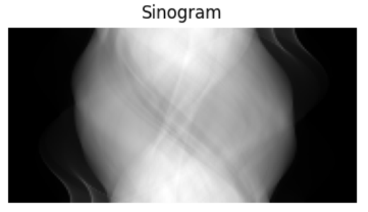
Forward projection and Back projection
Forward Projection is the process of adding up all of the pixel values along the measured direction.
Source: https://howradiologyworks.com/filtered-backprojection-fbp-illustrated-guide-for-radiologic-technologists/

Slide 4
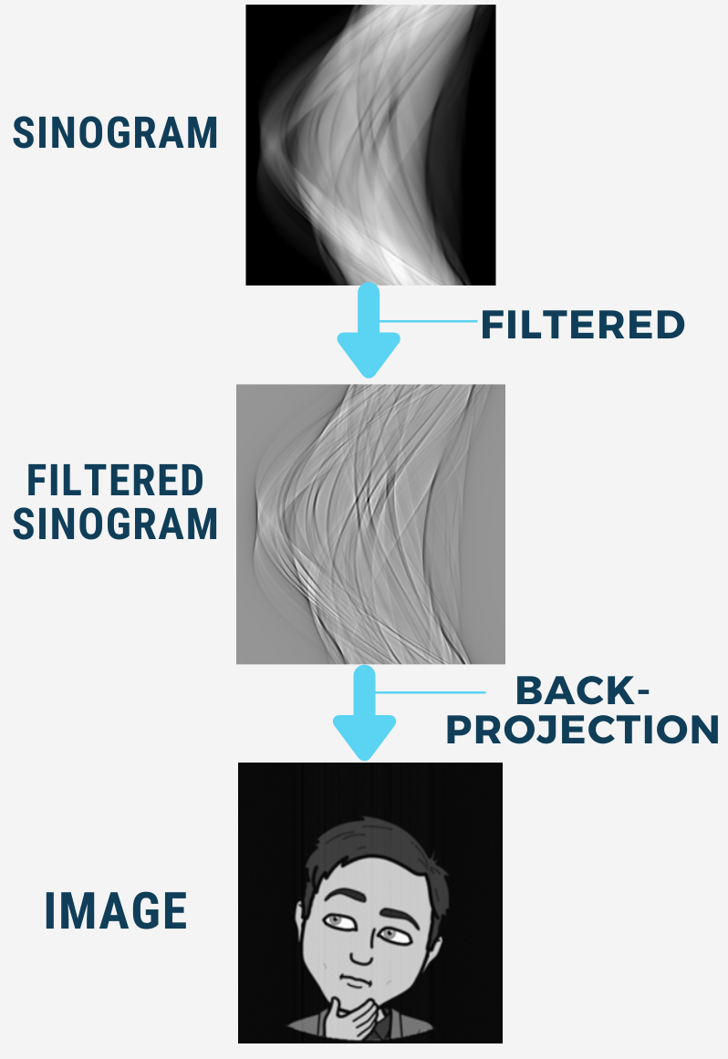
Filtered Back projection
If we simply use back projection then the images will be too blurred as extra information is present.
→Apply a fast 1D sharpening filter in the projection space, and then perform a back projection operation to map the data back along the rays which over which it was acquired
Source: https://howradiologyworks.com/filtered-backprojection-fbp-illustrated-guide-for-radiologic-technologists/

Slide 5
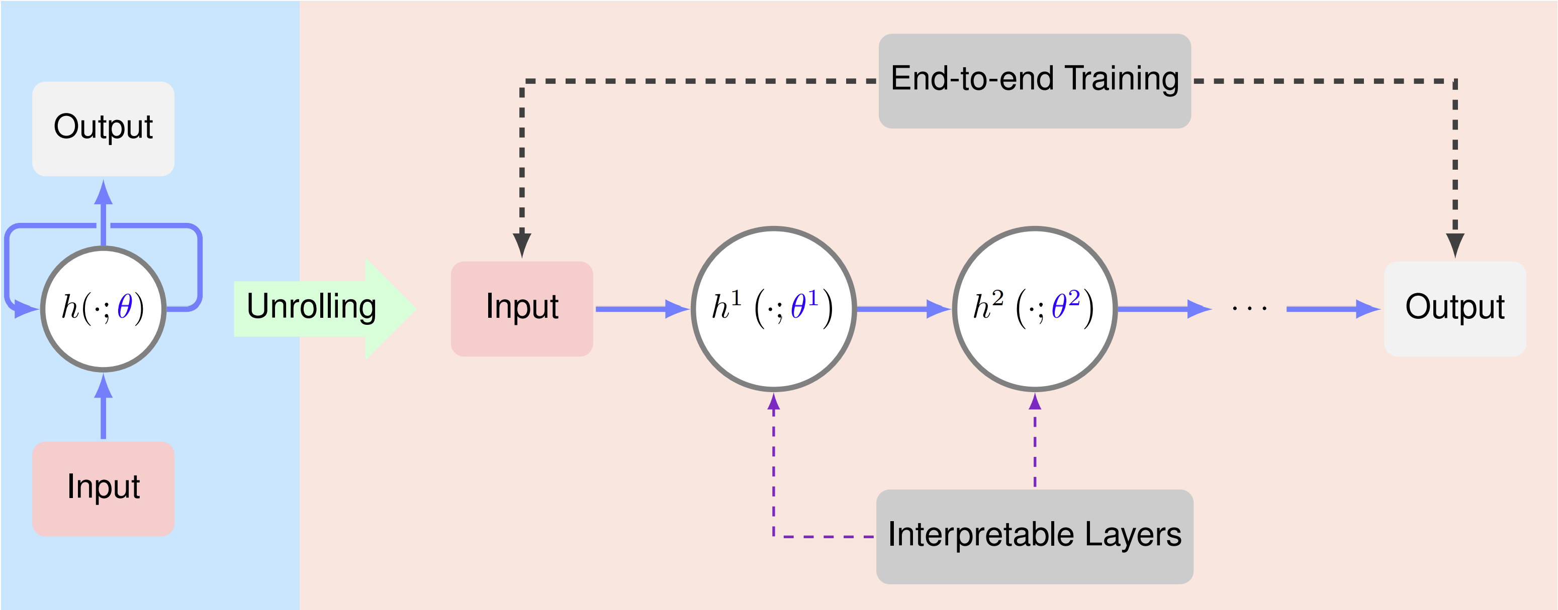
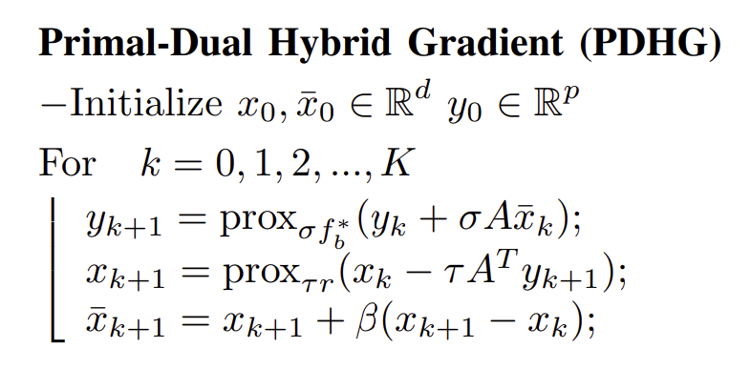
Deep Unrolling networks
Deep networks are hindered by their Blackbox nature, i.e., lack of interpretability.
Unrolling networks use prior domain knowledge from the iterative reconstructive approach. Unlike the convectional MLP, it doesn’t learn everything from scratch.
Source: Algorithm Unrolling: Interpretable, Efficient Deep Learning for Signal and Image Processing Monga et al. ,2020

Slide 6
Objectives
The current state-of-the-art deep learning based method: Learned Primal Dual network.
But, in real-world clinical CT applications:
→Reconstruction of a 3D volume is essential
→Computationally expensive
How can we enhance the efficiency of deep unrolling networks for image reconstruction, especially in high-dimensional imaging tasks like X-ray CT in 3D setting?

Slide 7
Learned stochastic Primal-Dual
Replace the forward and adjoint operators in the full-batch LPD network with only subsets of it.
Simple example:
(2,4,6,8,10,12,14,16,18)
(2,8,14) (4,10,16) (6,12,18)
In each layer, we use only one of the subsets

Slide 8
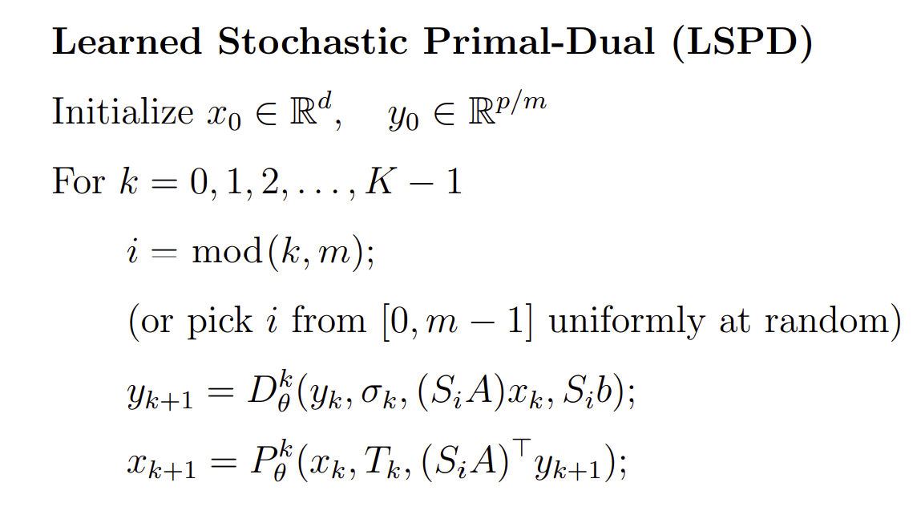
For the same number of layers, the LSPD network is approximately m-time more efficient than the full-batch LPD network in terms of computational complexity

Slide 9
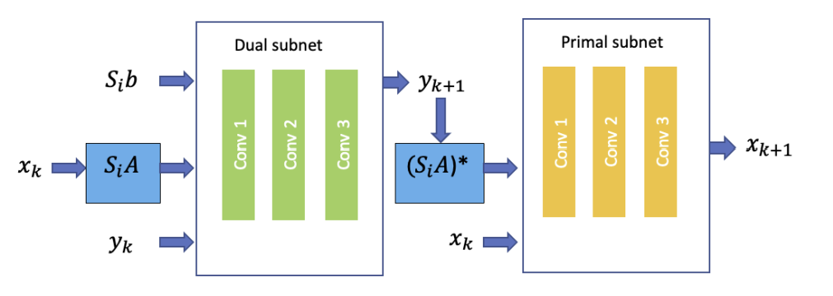
one layer of LSPD network
12 DualNet and PrimalNet blocks.
The kernel size is set to 5, and the step sizes tau and sigma are initialized to 0.01.
The batch size is set to 1.
We use MSE loss with the Adam optimizer, with an initial learning rate of 5e-5 and betas set to (0.5, 0.99).
The network is trained for 15 epochs.

Slide 10
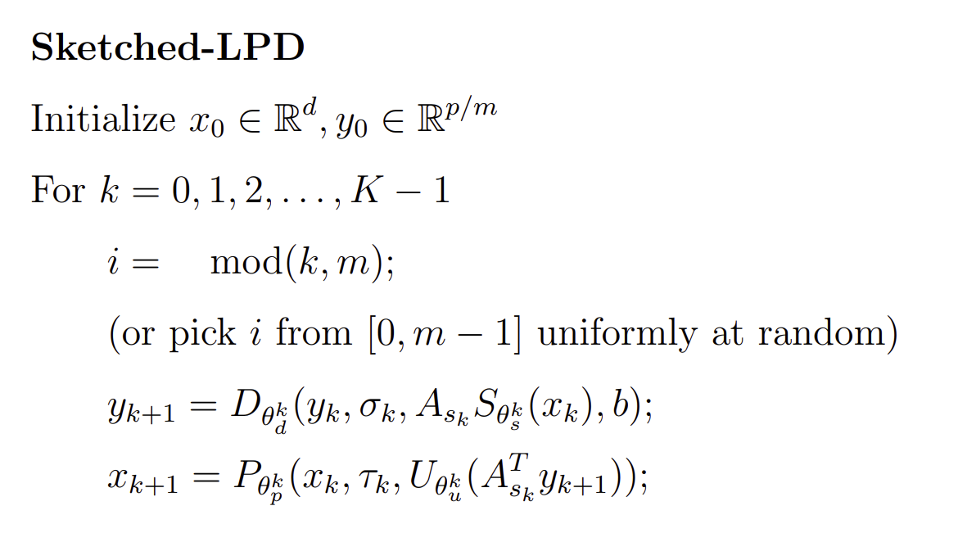
Sketched- LPD
Downsample x
Upsample

Slide 11
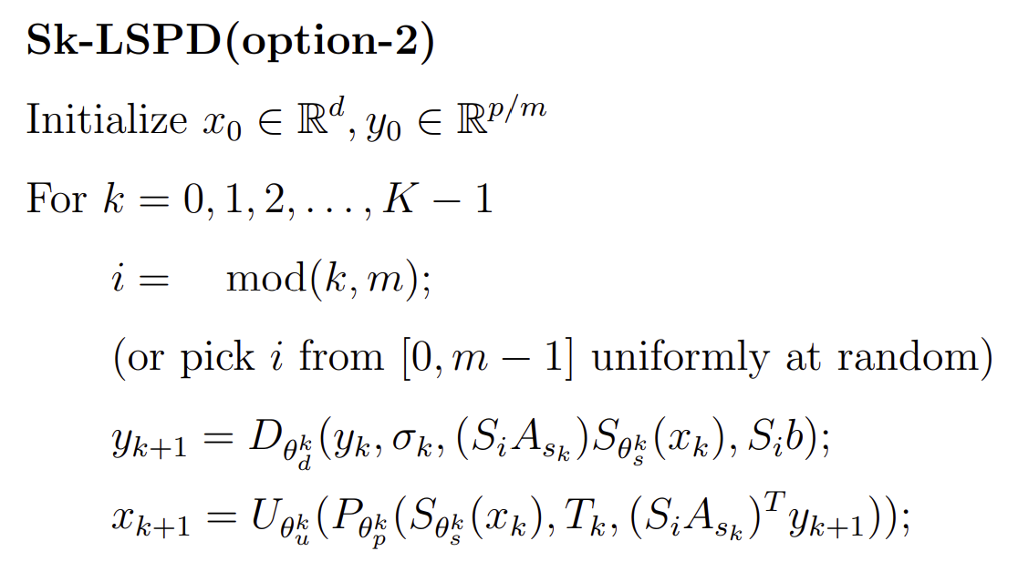
Sketched- LSPD

Slide 12
Results

Slide 13
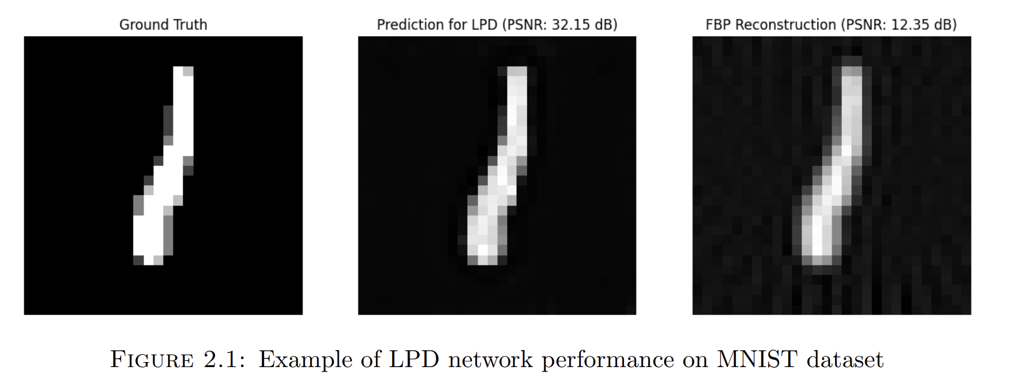
Experiment 1:Learned Primal Dual (LPD) on MNIST dataset
PSNR: Peak signal to noise ratio
SSIM: Structural Similarity Index

Slide 14
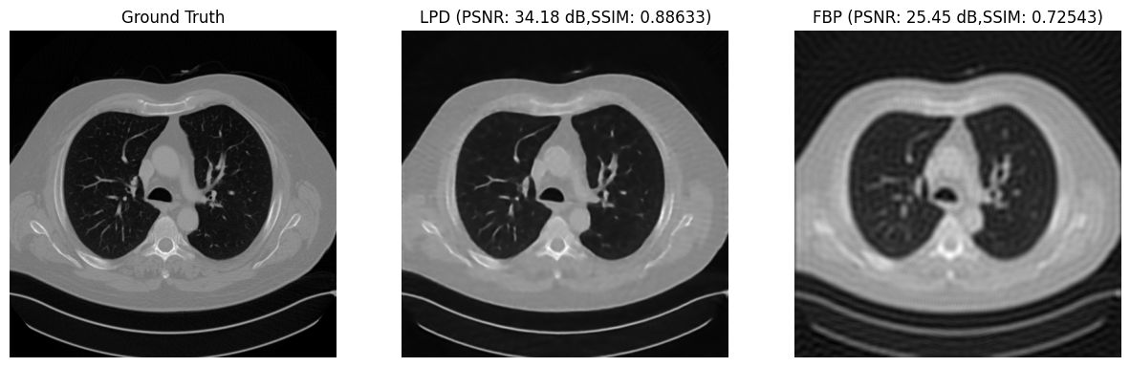
Experiment 2:LPD on Mayo-Clinic dataset

Slide 15
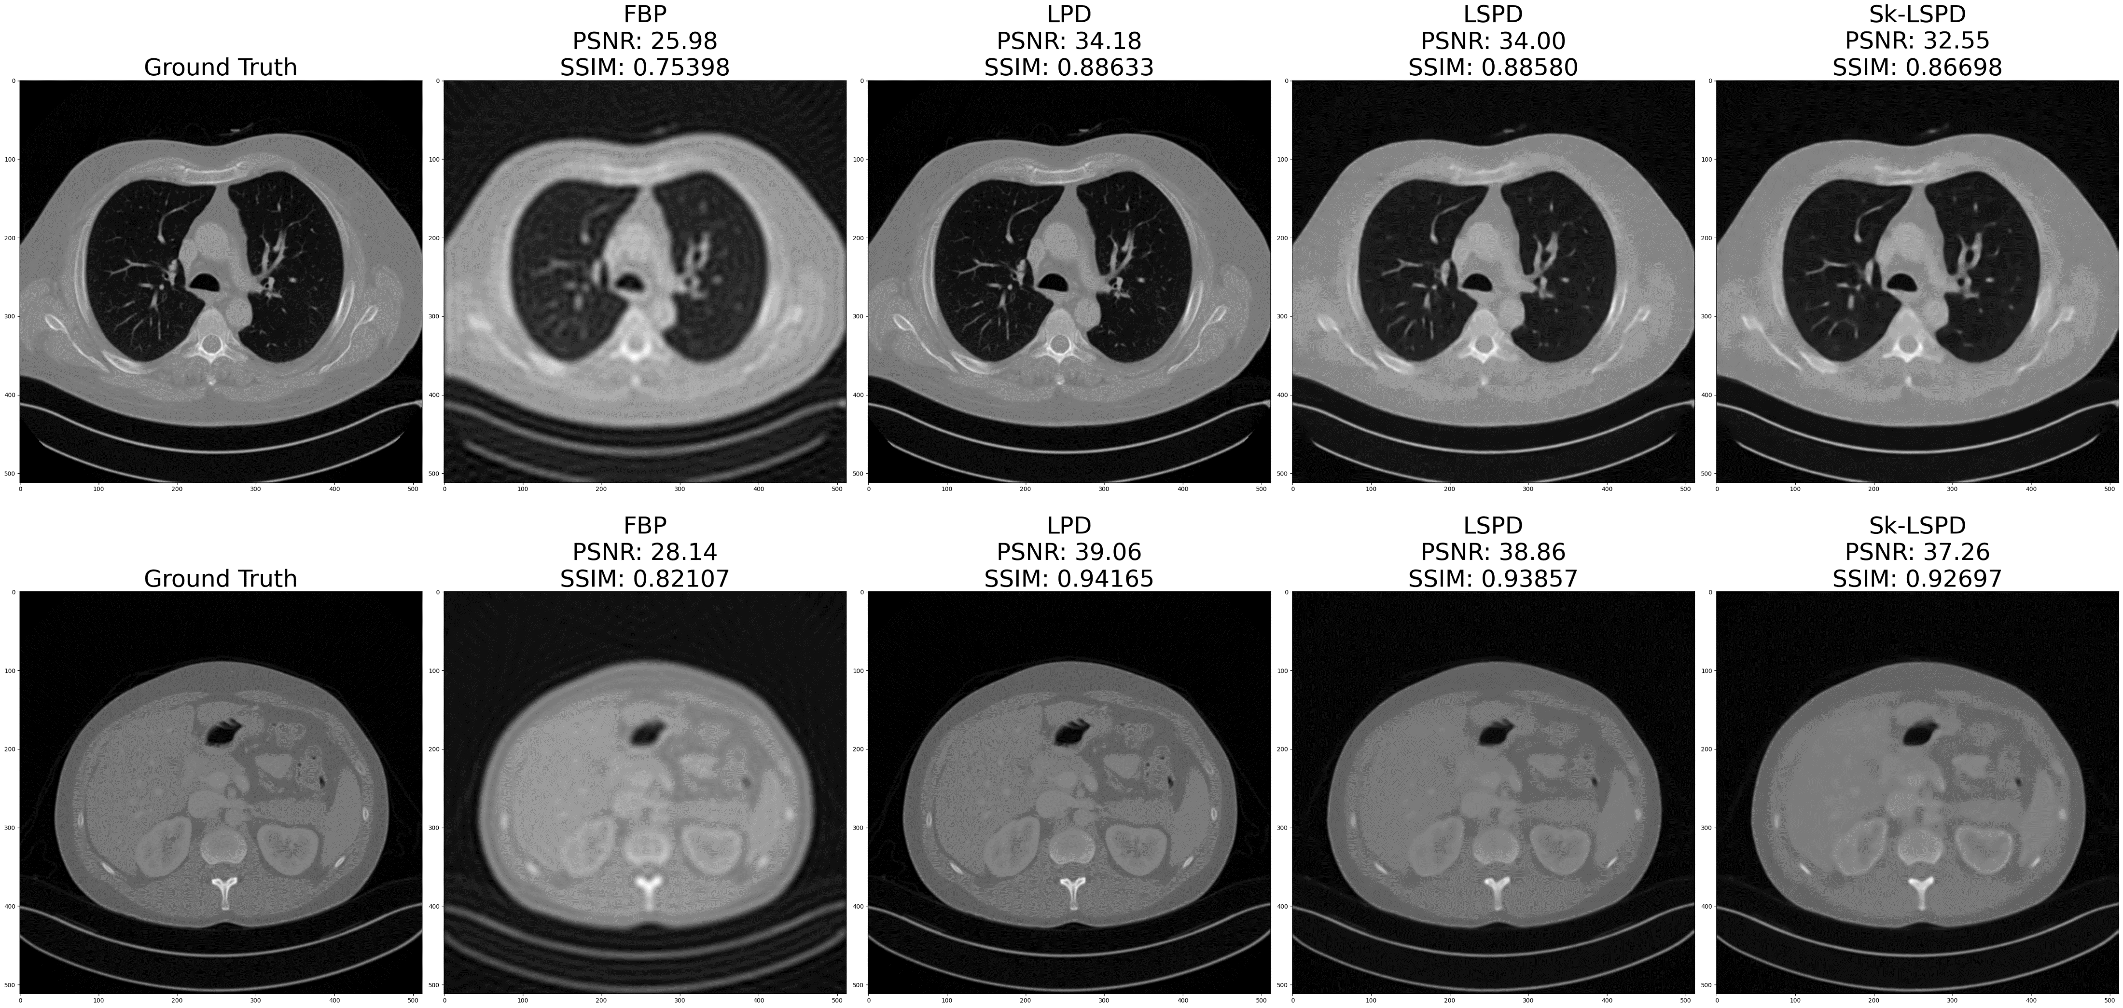
Experiment 3: Learned Stochastic Primal Dual (LSPD) and Sketched-LSPD on Mayo-Clinic dataset

Slide 16
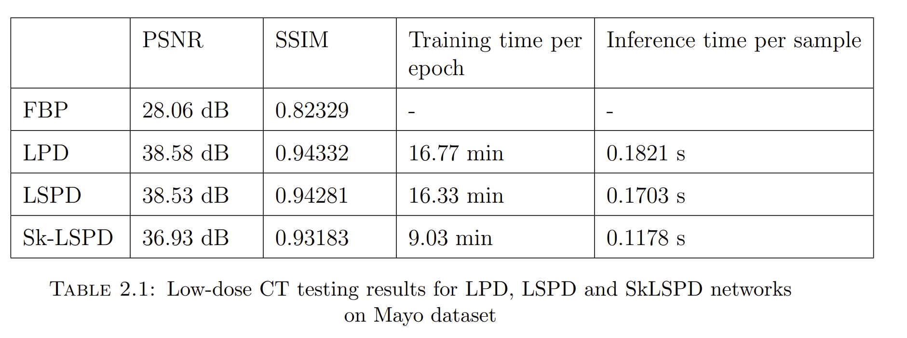

Slide 17
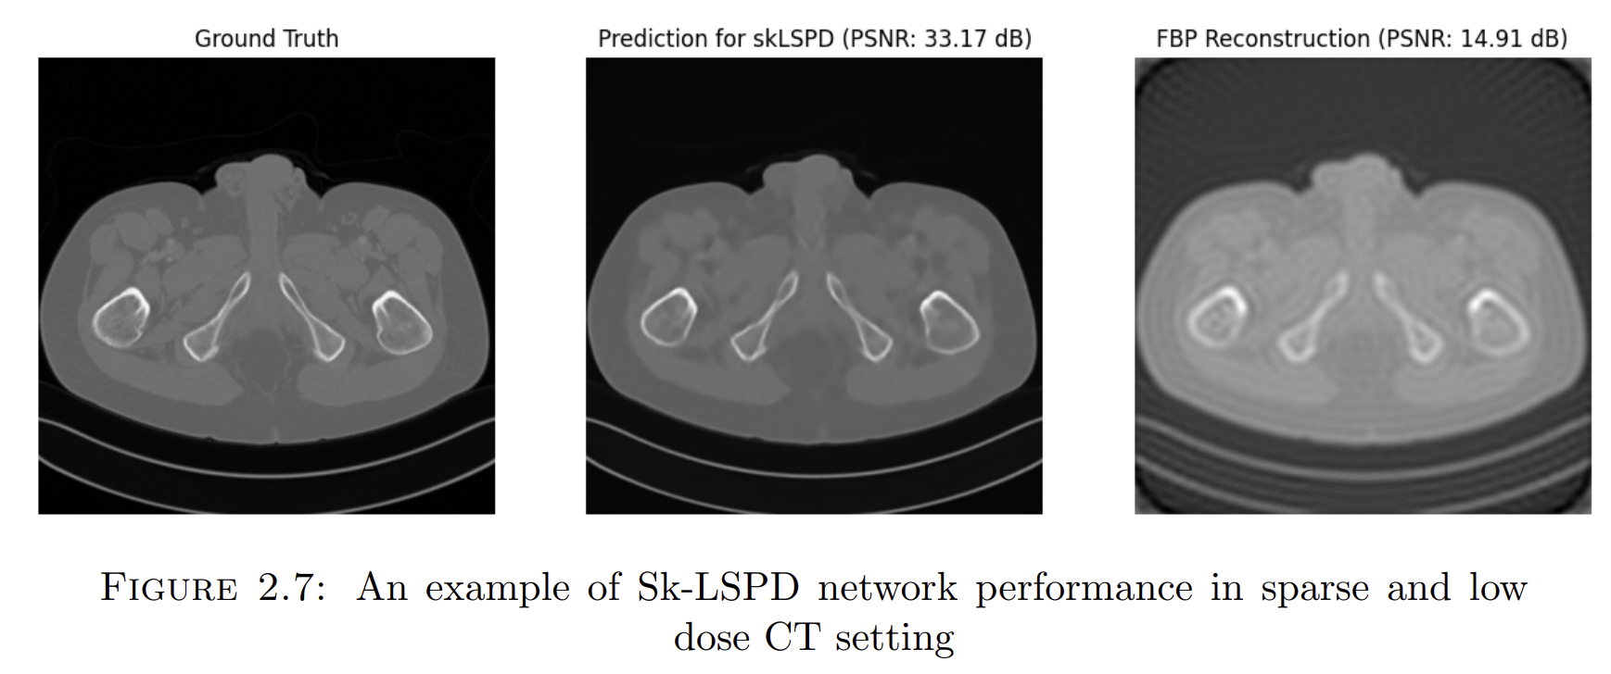
Experiment 4:Sk-LSPD on Mayo Clinic CT dataset corrupted with Poisson noise

Slide 18
Conclusions
We have demonstrated the competitiveness of the sketched and stochastic variants of LPD.
In the 2D setting, the convolutional networks dominate the overall computation, yet we anticipate that these variants will significantly decrease forward pass time in the computationally intensive 3D setting.
Our future objectives will center on building a 3D proof of concept for stochastic unrolling and sketching.

Slide 19
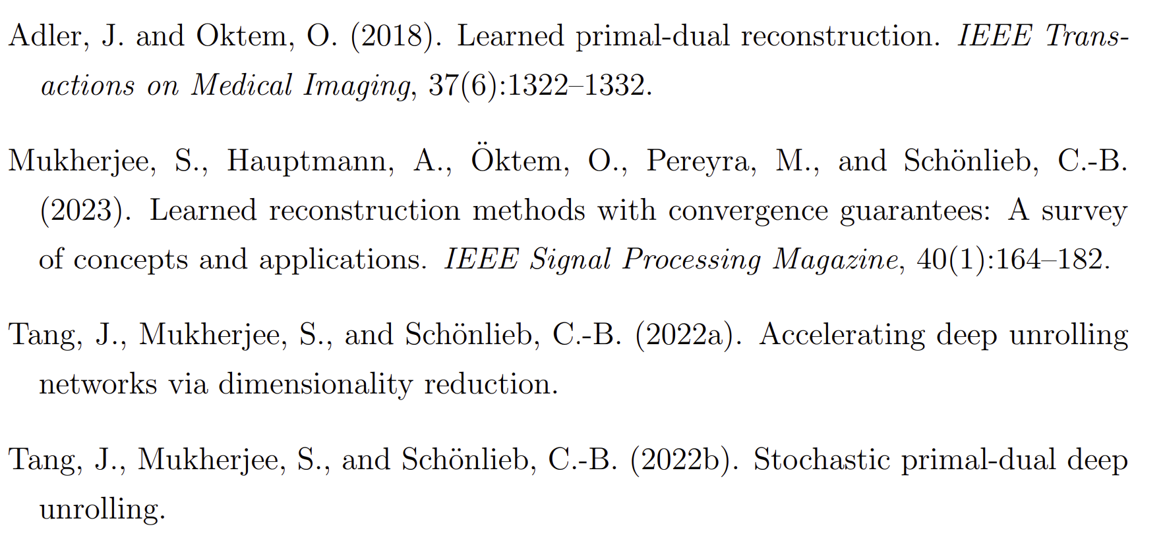
Bibliography

