Slide 1
Team d30

Slide 2
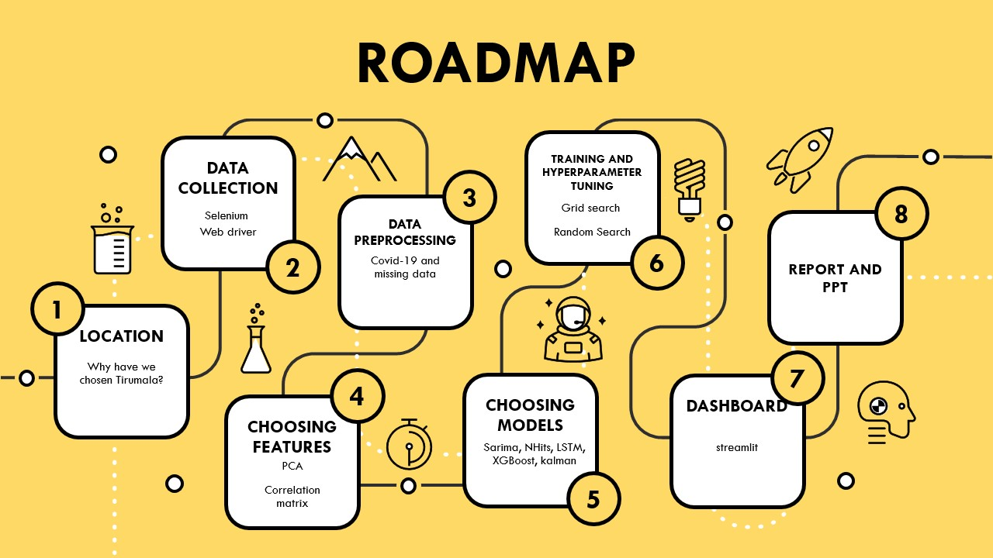
AGENDA
Introduction
Primary goals
Areas of growth
Timeline
Summary

Slide 3
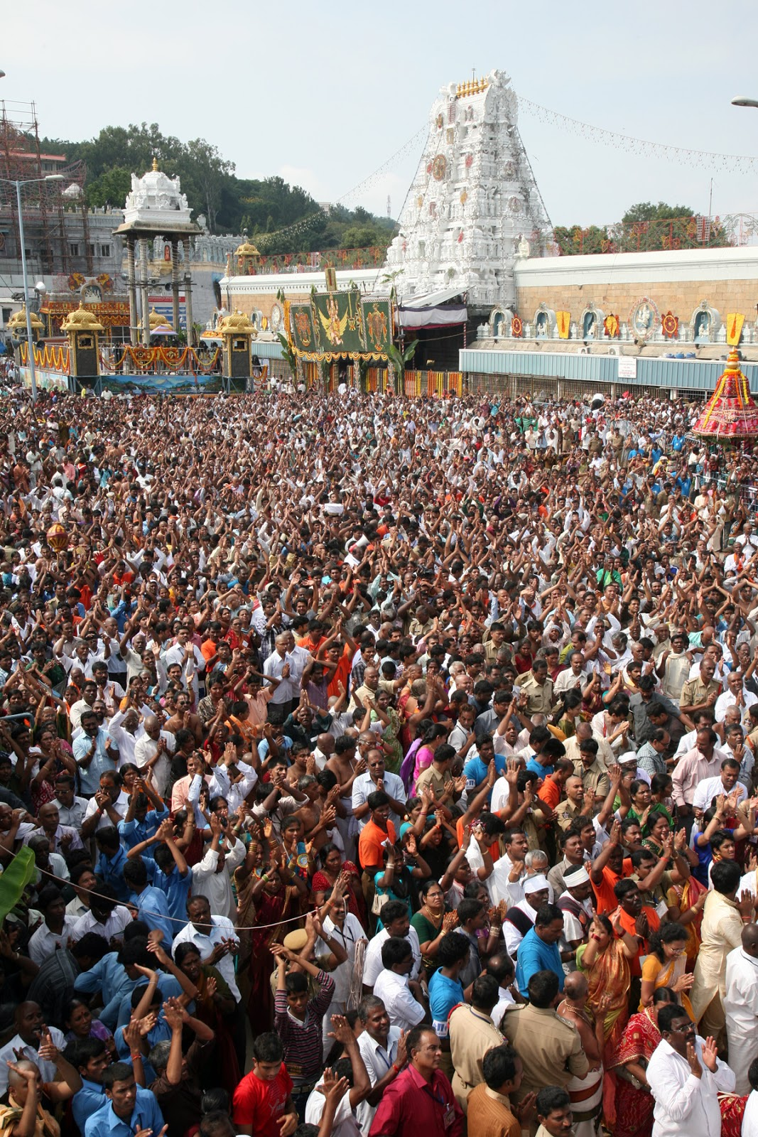
WHY Tirumala?
The temple receives a massive number of visitors daily, with an average of 50,000 to 100,000 devotees visiting the Tirumala temple at Tirupati.
Predicting tourist arrivals to Tirupati using internet search indices can be beneficial for planning and managing resources. It helps authorities prepare for the influx of visitors, improving infrastructure, and ensuring the safety and comfort of pilgrims.
Managing the free food service called "Anna-Prasadam" efficiently is crucial. With such a high number of devotees visiting daily, there is a need to prevent wastage of food while ensuring that everyone in need is served. Predictive models can help in resource allocation, reducing waste, and making the food service more effective.
This Photo by Unknown author is licensed under CC BY-NC-ND.

Slide 4


Data scraping and feature extraction
From the archives of http://news.tirumala.org/ we have used web scraping to extract the data of number of pilgrims visiting Tirumala temple.
The code is tailored to fetch pilgrim data from the "Darshan News" articles on tirumala.org. It captures data specific to the date of each article, providing a snapshot of daily pilgrim statistics
We conducted a comprehensive analysis of Google Trends data spanning a period of 10 years.
The objective was to gain insights into the popularity of 13 relevant search indexes over time.
Due to limitations in data availability, we encountered the challenge of handling non-continuous weekly data.
To address this, we divided the dataset into 5-year segments and subsequently merged them after normalization, ensuring a consistent and comparable basis for analysis.

Slide 5
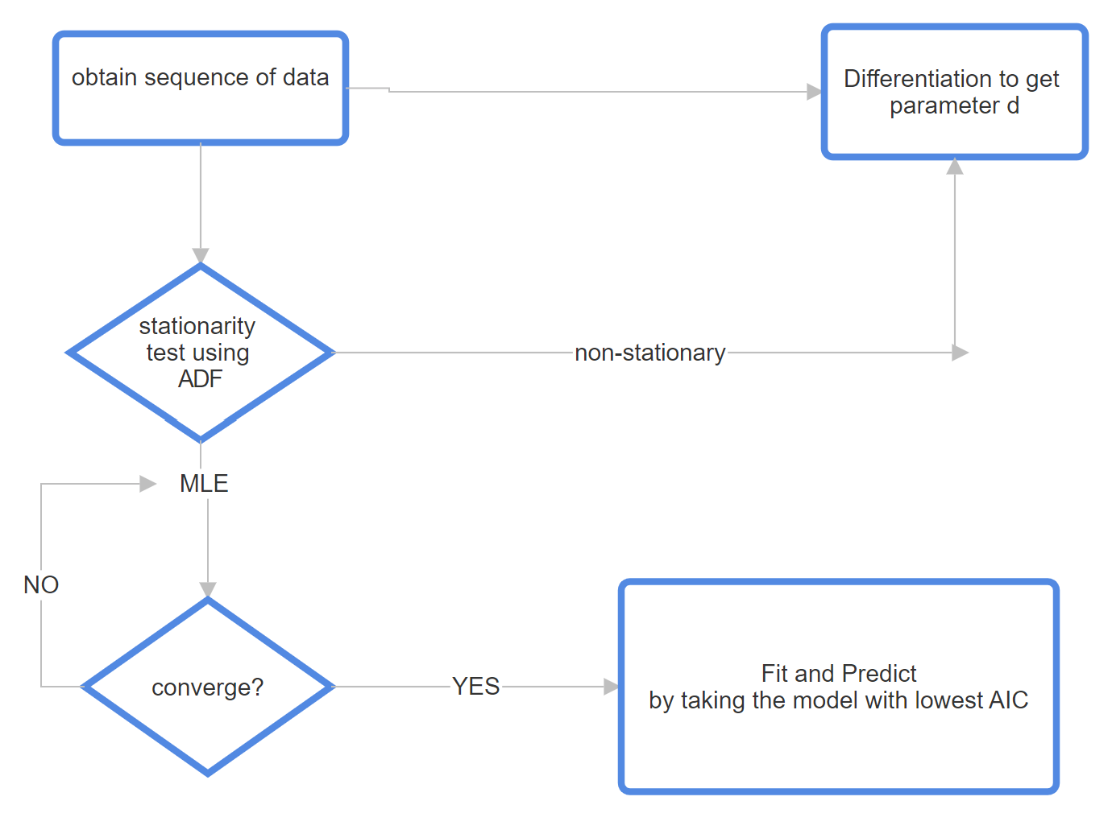
SARIMA model
The primary steps in our analysis involved ensuring data "stationarity" through differencing and validating stationarity using the "ADF test."
We employed Principal Component Analysis (PCA) as a powerful technique for dimensionality reduction. The objective was to streamline a dataset with 13 original features into a more concise representation containing only 5 key features.
ADF test is used to check stationary of data
The "AIC criterion" (Akaike Information Criterion) is a measure used to evaluate the goodness of fit of a statistical model

Slide 6
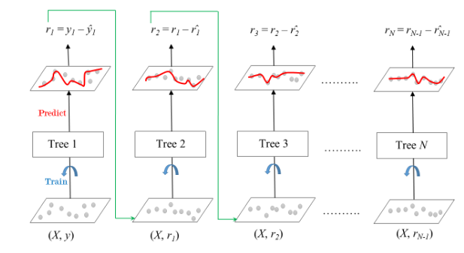
GRADIENT BOOSTING REGRESSOR
Gradient Boosting is an ensemble learning technique that works in an iterative manner, where each tree corrects the errors of the previous ones.
Trees are added sequentially, and the process continues until a predefined number of trees is reached or a performance threshold is met.
Gradient Boosting minimizes the loss function by iteratively optimizing the model's predictions.
Key parameters include: n_estimators, max_depth, learning_rate, min_samples_split and loss

Slide 7
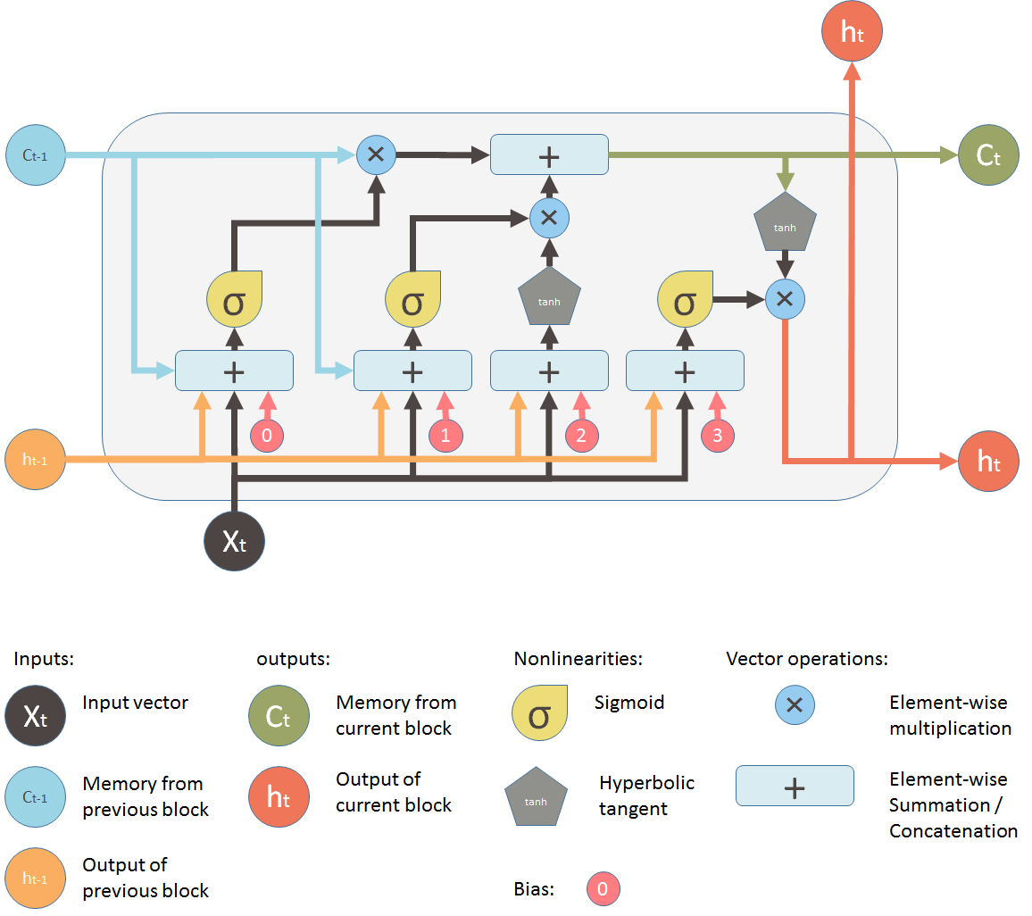
LSTM
LSTM Layer: The LSTM layer is the primary component for sequence modeling. It is responsible for capturing temporal dependencies in the input data.
Activation Function: Leaky Rectified Linear Unit (LeakyReLU) activation functions are applied after each layer. LeakyReLU is used to introduce non-linearity while preventing the vanishing gradient problem.
Dense Layers : Two dense layers follow the LSTM layer. The first dense layer contains 32 units, and the second has 16 units. These layers are meant to extract higher-level representations from the LSTM output.
Output Layer: The output layer is a single dense unit, which produces the predicted tourist count.
Optimizer: The Adam optimizer with a learning rate of 0.001 is employed for gradient descent. Adam is known for its efficiency and effectiveness in training deep neural networks.

Slide 8
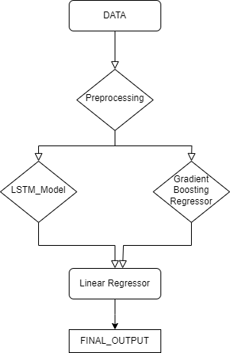
ENSEMBLE MODEL
We ensembled an LSTM Model and a Gradient Boosting regressor to achieve a more robust and generalized model.
The weights for the LSTM Model and Gradient Boosting Regressor in the final ensemble regression is 0.46 and 0.56 respectively.

Slide 9
N-HiTS: Neural Hierarchical Interpolation for Time Series Forecasting
Extension of N-BEATS: N-HiTS is an extension of the N-BEATS model, tailored for time series forecasting.
Authors: Developed by Challu and Olivares, it aims to enhance accuracy while lowering computational costs.
Key Techniques:
Hierarchical Interpolation: Introduces hierarchical interpolation to improve input treatment.
2) Multi-Rate Data Sampling: Incorporates multi-rate data sampling for more effective output construction.
KALMAN FILTER FORECASTER
Recursive Estimation: The Kalman filter is a recursive algorithm used for estimation tasks, such as forecasting and state estimation.
Prediction and Update: It predicts the system's next state based on its previous state estimate and incorporates new measurements. The Kalman gain is used to update the state estimate and its associated uncertainty.
Iterative Process: These prediction and update steps are repeated iteratively as new measurements become available.

Slide 10
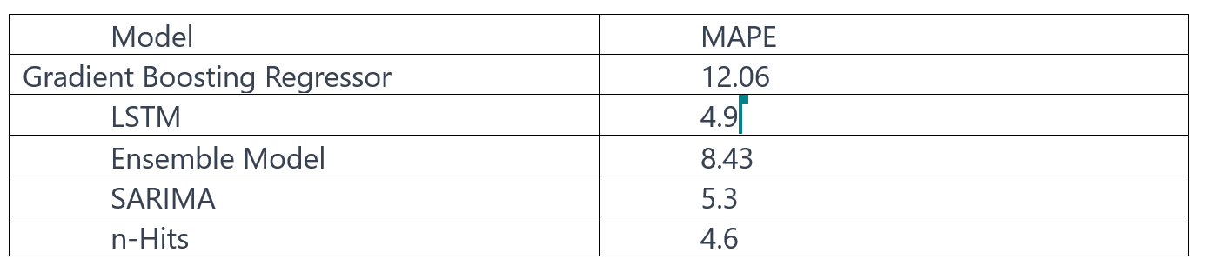
RESULTS

Slide 11
THANK YOU

