Slide 1
Summer Internship 2024
Under the Guidance of Prof. Indrajit Chakrabarti (IIT KGP)
Kadagala Sai Siva Sankar
20EC39017

Slide 2
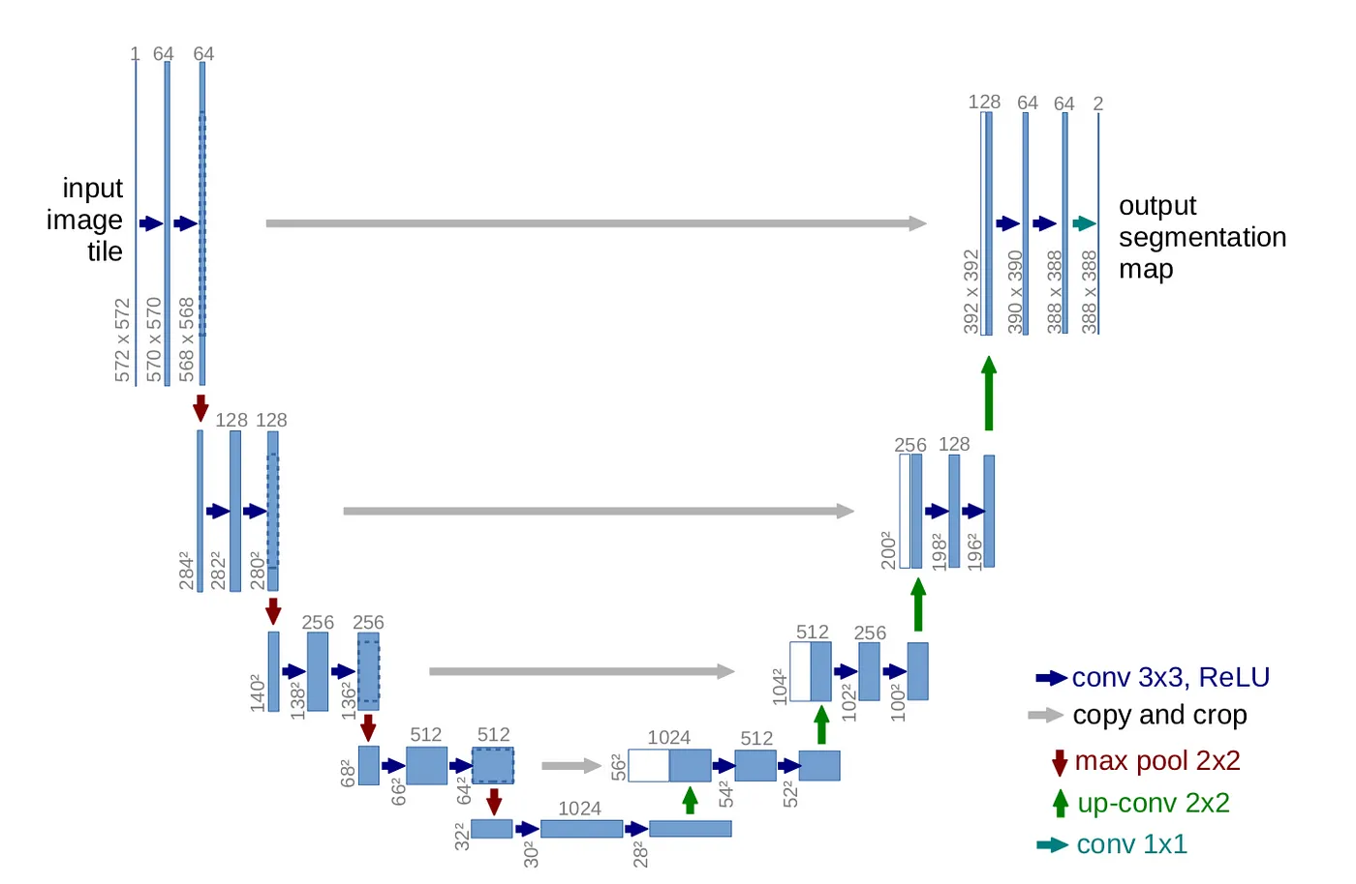
Task-1: UNet using NumPy library

Slide 3
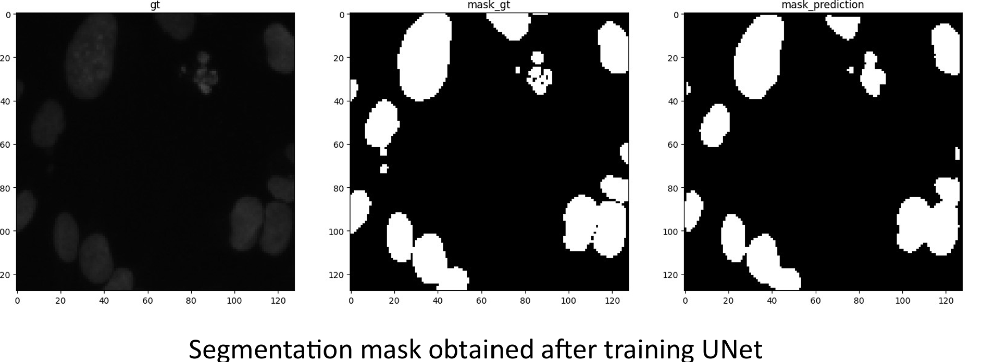

Slide 4
Motivation for Task-2
Models require extensive computational resources, making them challenging to run on low-power devices like the Raspberry Pi.
Reduction in model complexity can lead to faster inference times and lower memory usage.

Slide 5
Quantization
Quantization reduces the precision of the numbers (weights, activations) used in a neural network, typically from 32-bit floating-point (FP32) to a lower precision, like 16-bit floating-point (FP16), 8-bit integer (INT8), or even lower
This results in:
Reduced Memory Footprint: Lower precision requires less storage space, making the model smaller.
Faster Computations: Lower precision arithmetic can be executed faster on certain hardware, leading to faster inference times.

Slide 6
Pruning
Pruning involves reducing the number of parameters in a neural network by eliminating weights that are considered unnecessary or redundant.
The goal is to create a smaller, more efficient model that performs similarly to the original one.

Slide 7
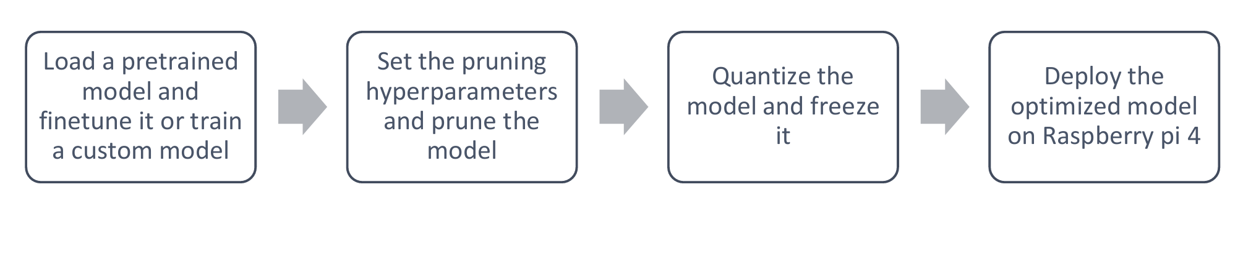
Task -2: Deployable end-to-end optimized DNN framework for image classification
Created a pipeline consisting of pruning and quantization of the models.
Tested this pipeline using pre-trained LeNet5, ResNet50, MobileNet_v2, and VGG16 models. The dataset used is MNIST.
Used multiple pruning libraries (torch-pruning, torch.utils.prune etc.)
Used torch.quantization and optimum-quanto for quantization.

Slide 8
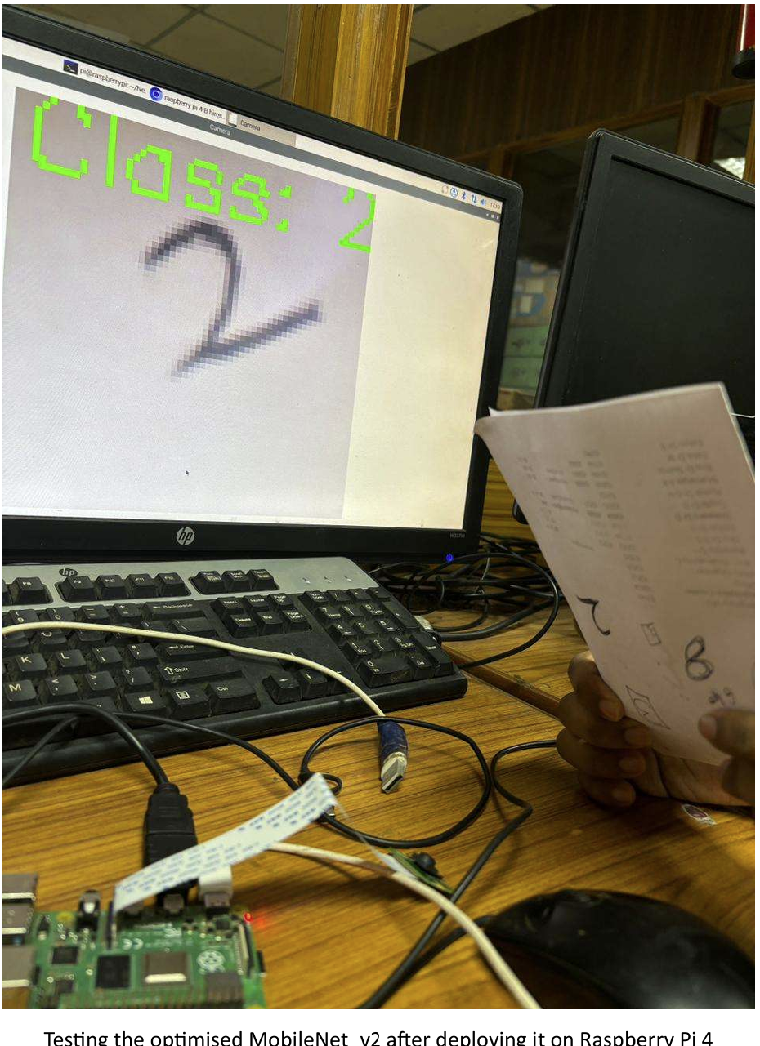
Deployed the optimized model on
Raspberry Pi 4 model B (and 12 MP
RPI camera) for testing.

Slide 9
Thank You!

