Slide 1
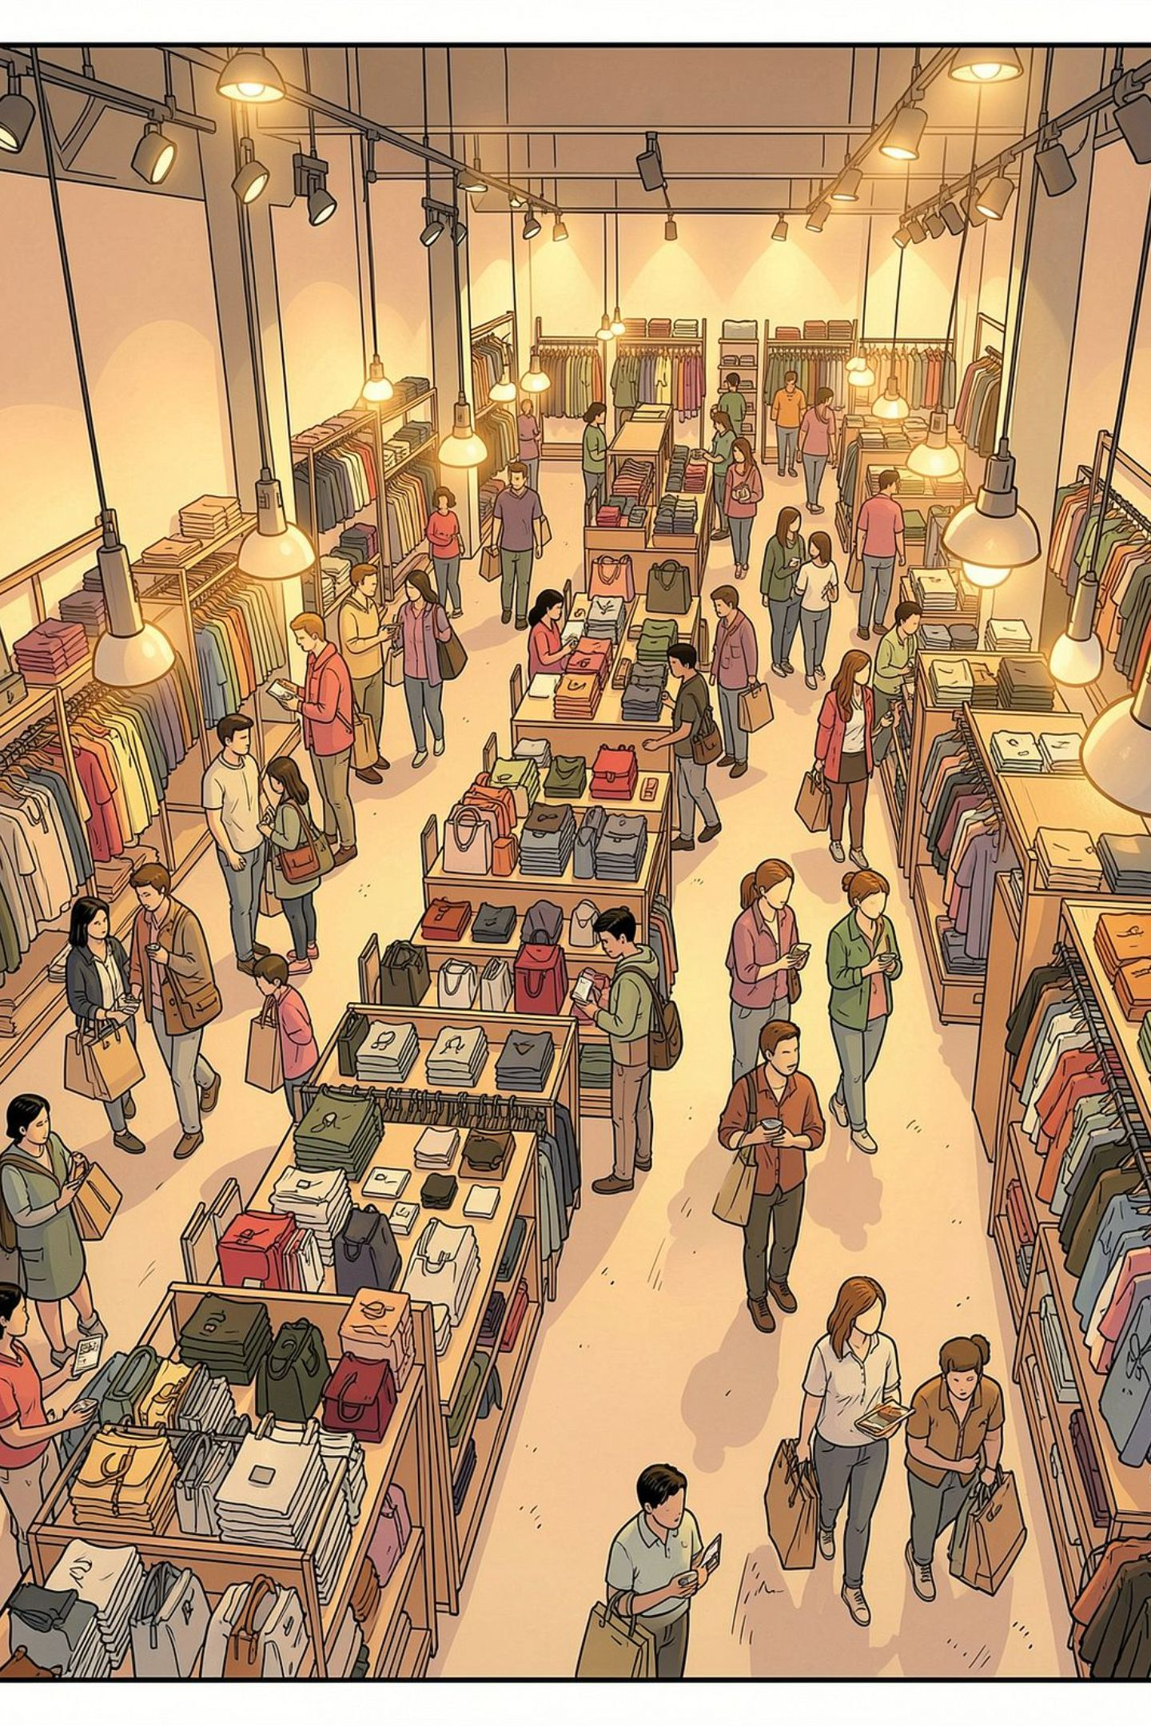
Customer Shopping Behavior Analysis
Transactional insights from 3,900 purchases across demographics, categories, and behavior patterns.

Slide 2

Dataset at a Glance
3,900
18
37
Transactions
Features
Missing Values
Review Rating only
Key Features
Demographics: Age, Gender, Location, Subscription
Purchases: Category, Amount, Season, Size, Color
Behavior: Discount, Frequency, Review Rating, Shipping

Slide 3

Python: Data Preparation
01
Load & Explore
pandas, df.info(), .describe()
02
Clean Missing Data
Imputed Review Rating by category median
03
Standardize & Engineer
Snake_case, age_group, purchase_frequency_days
04
Load to PostgreSQL
Cleaned DataFrame ready for SQL analysis

Slide 4
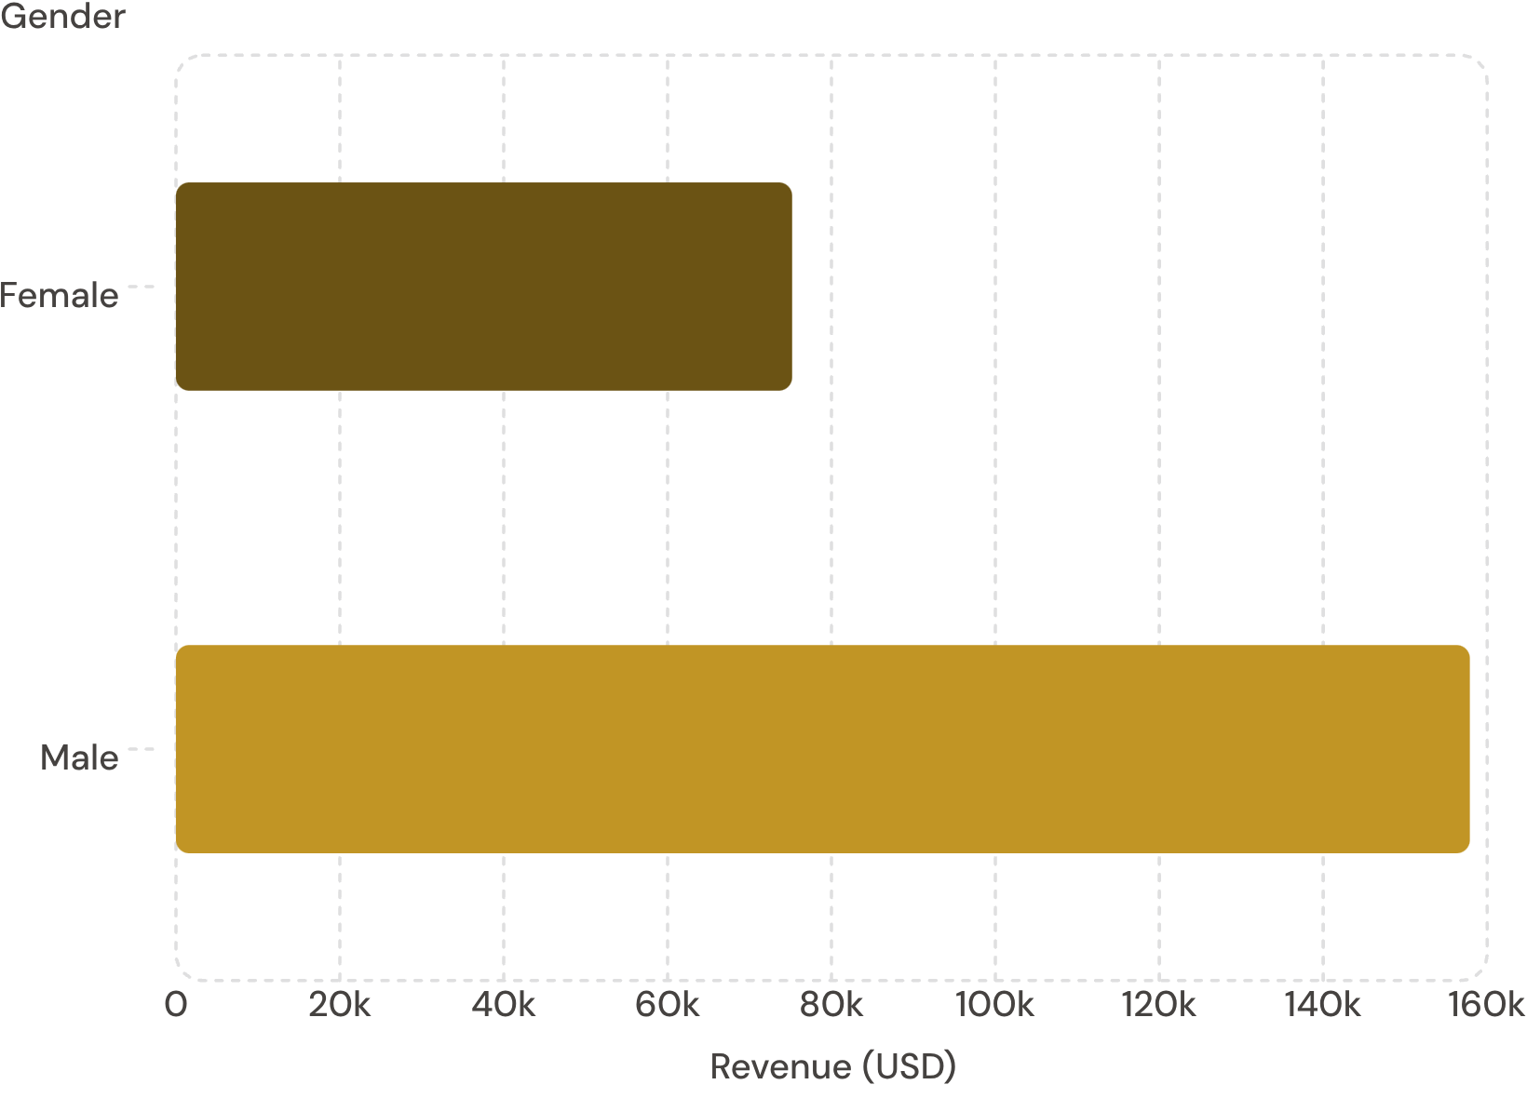

Revenue by Gender
Key Finding
Male customers generated 2.1× more revenue than female customers — a critical segment for targeted campaigns.
Male: $157,890 · Female: $75,191

Slide 5
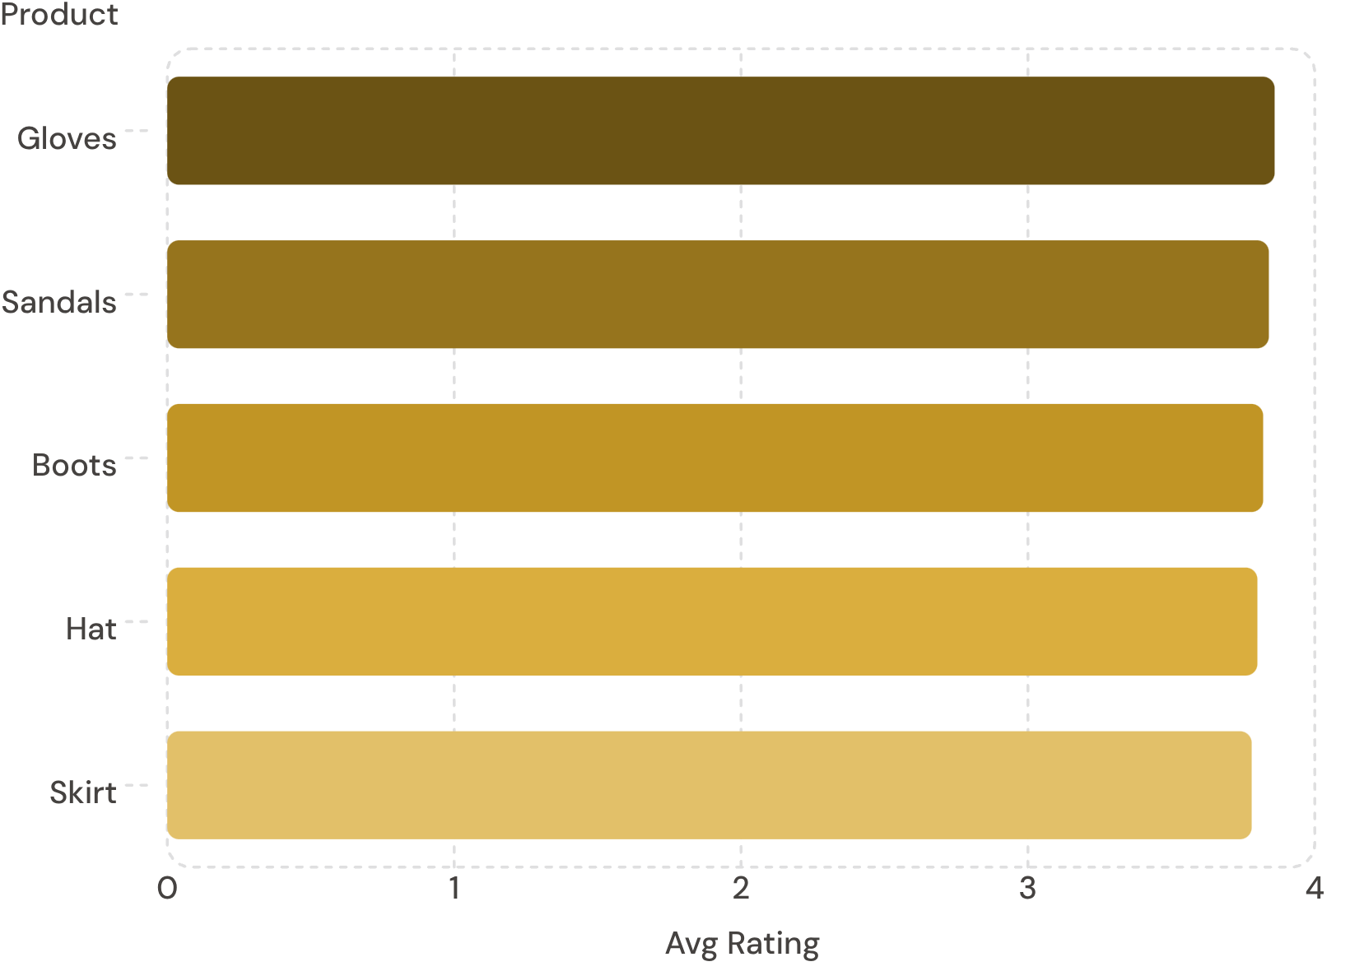
Product Ratings & Shipping Insights
Top 5 Products by Rating
Shipping Type Comparison
Standard
Express
Avg spend: $58.46
Avg spend: $60.48
Express shipping customers spend slightly more on average.

Slide 6
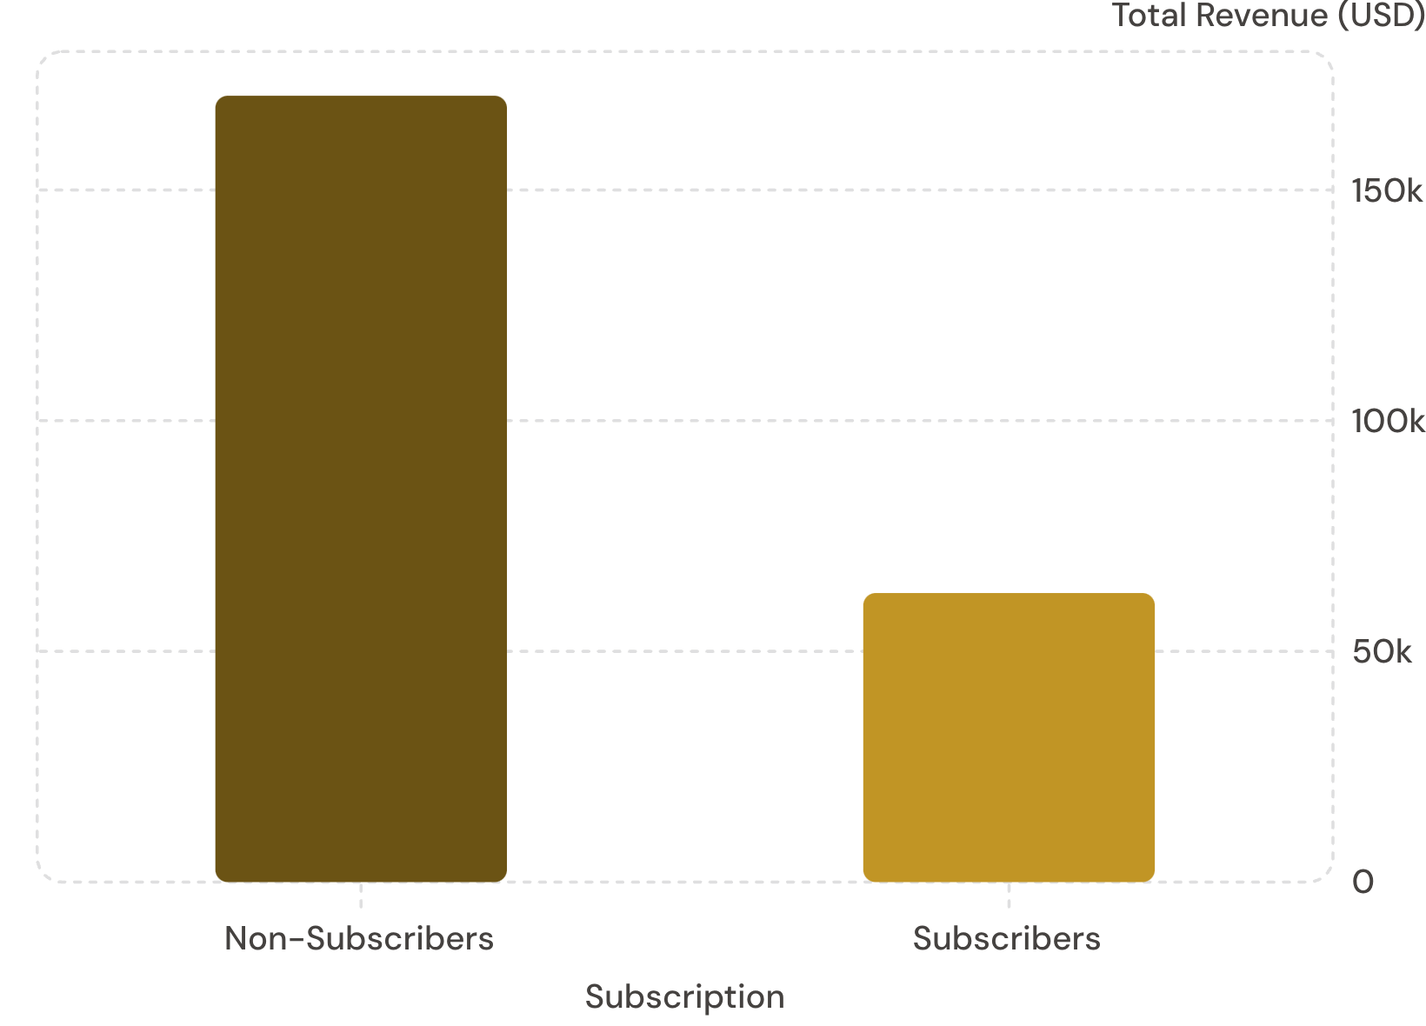

Subscribers vs. Non-Subscribers
Subscription Breakdown
Non-Subscribers
Subscribers
1,053 customers · Avg spend $59.49
2,847 customers · Avg spend $59.87
Similar spend per customer, but subscribers are only 27% of the base.

Slide 7
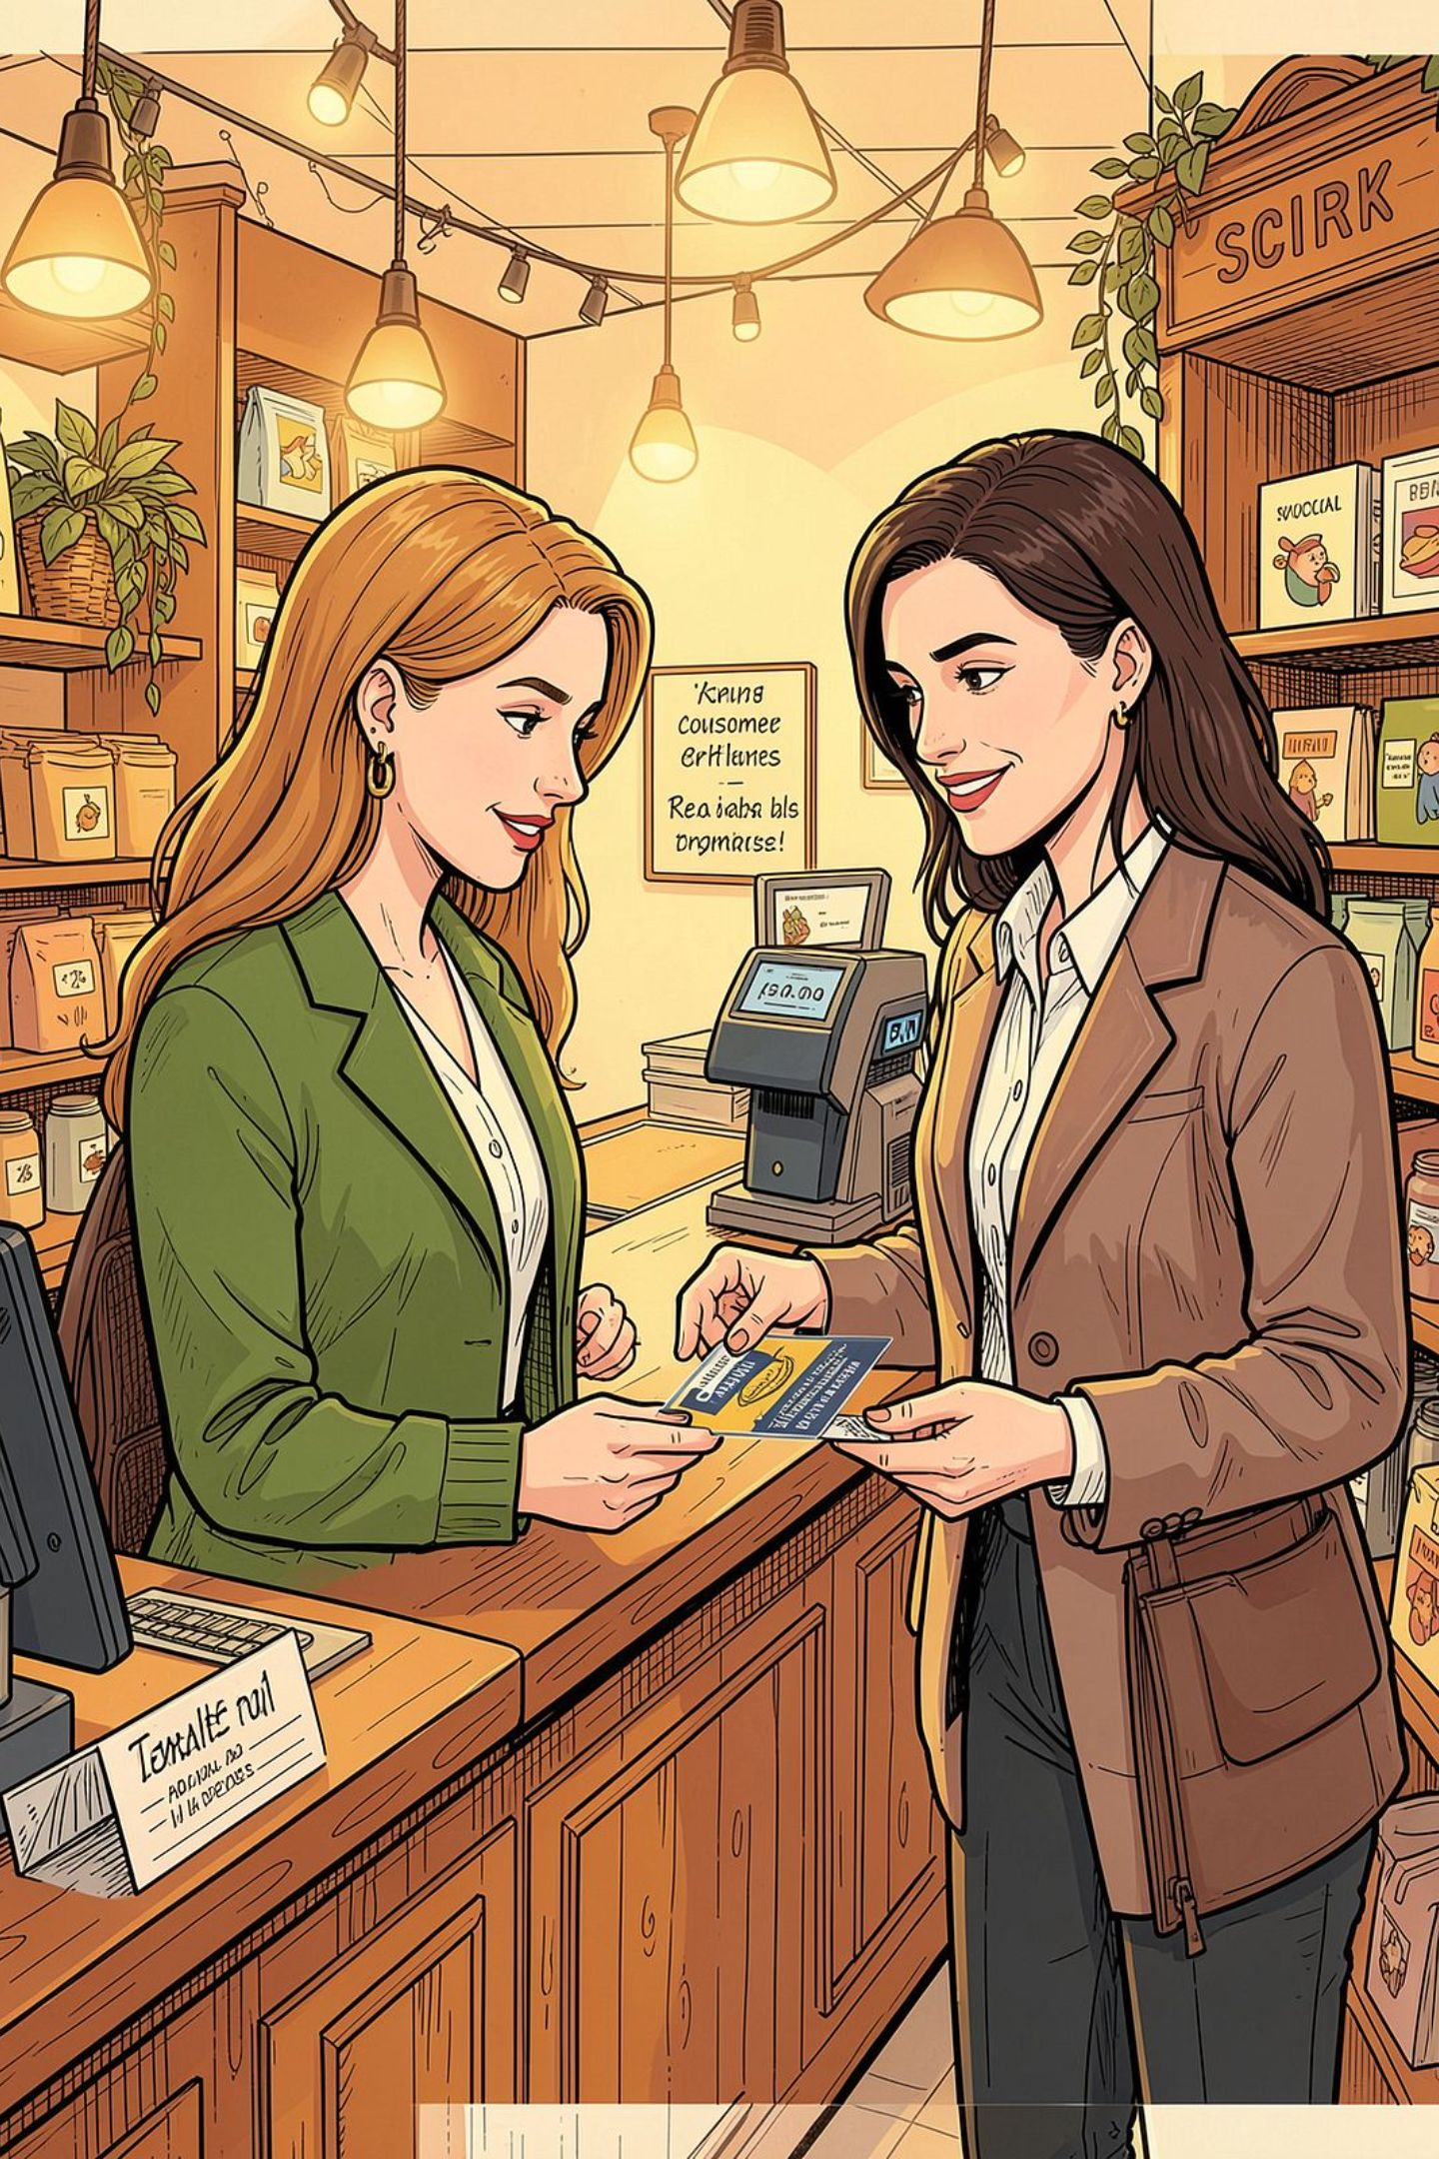
Customer Segmentation
Loyal
Returning
3,116 customers
701 customers
New
83 customers
839 customers used discounts yet spent above average. Of repeat buyers (5+ purchases), 958 subscribe vs. 2,518 who don't.

Slide 8
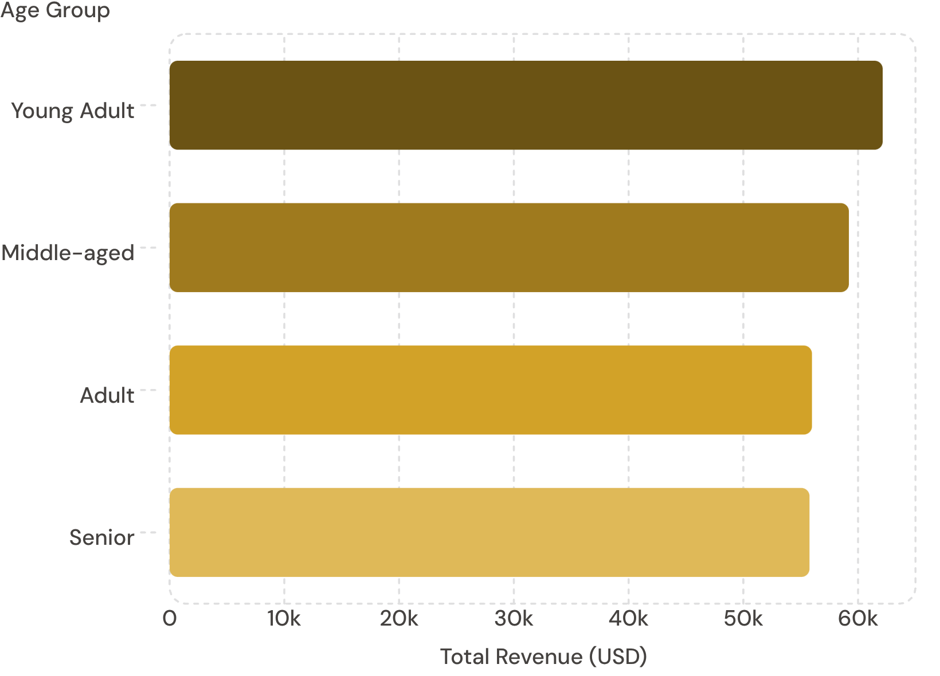
Revenue by Age Group
Top Products by Category
Clothing: Blouse, Pants, Shirt
Footwear: Sandals, Shoes, Sneakers
Outerwear: Jacket, Coat
Accessories: Jewelry, Sunglasses, Belt

Slide 9
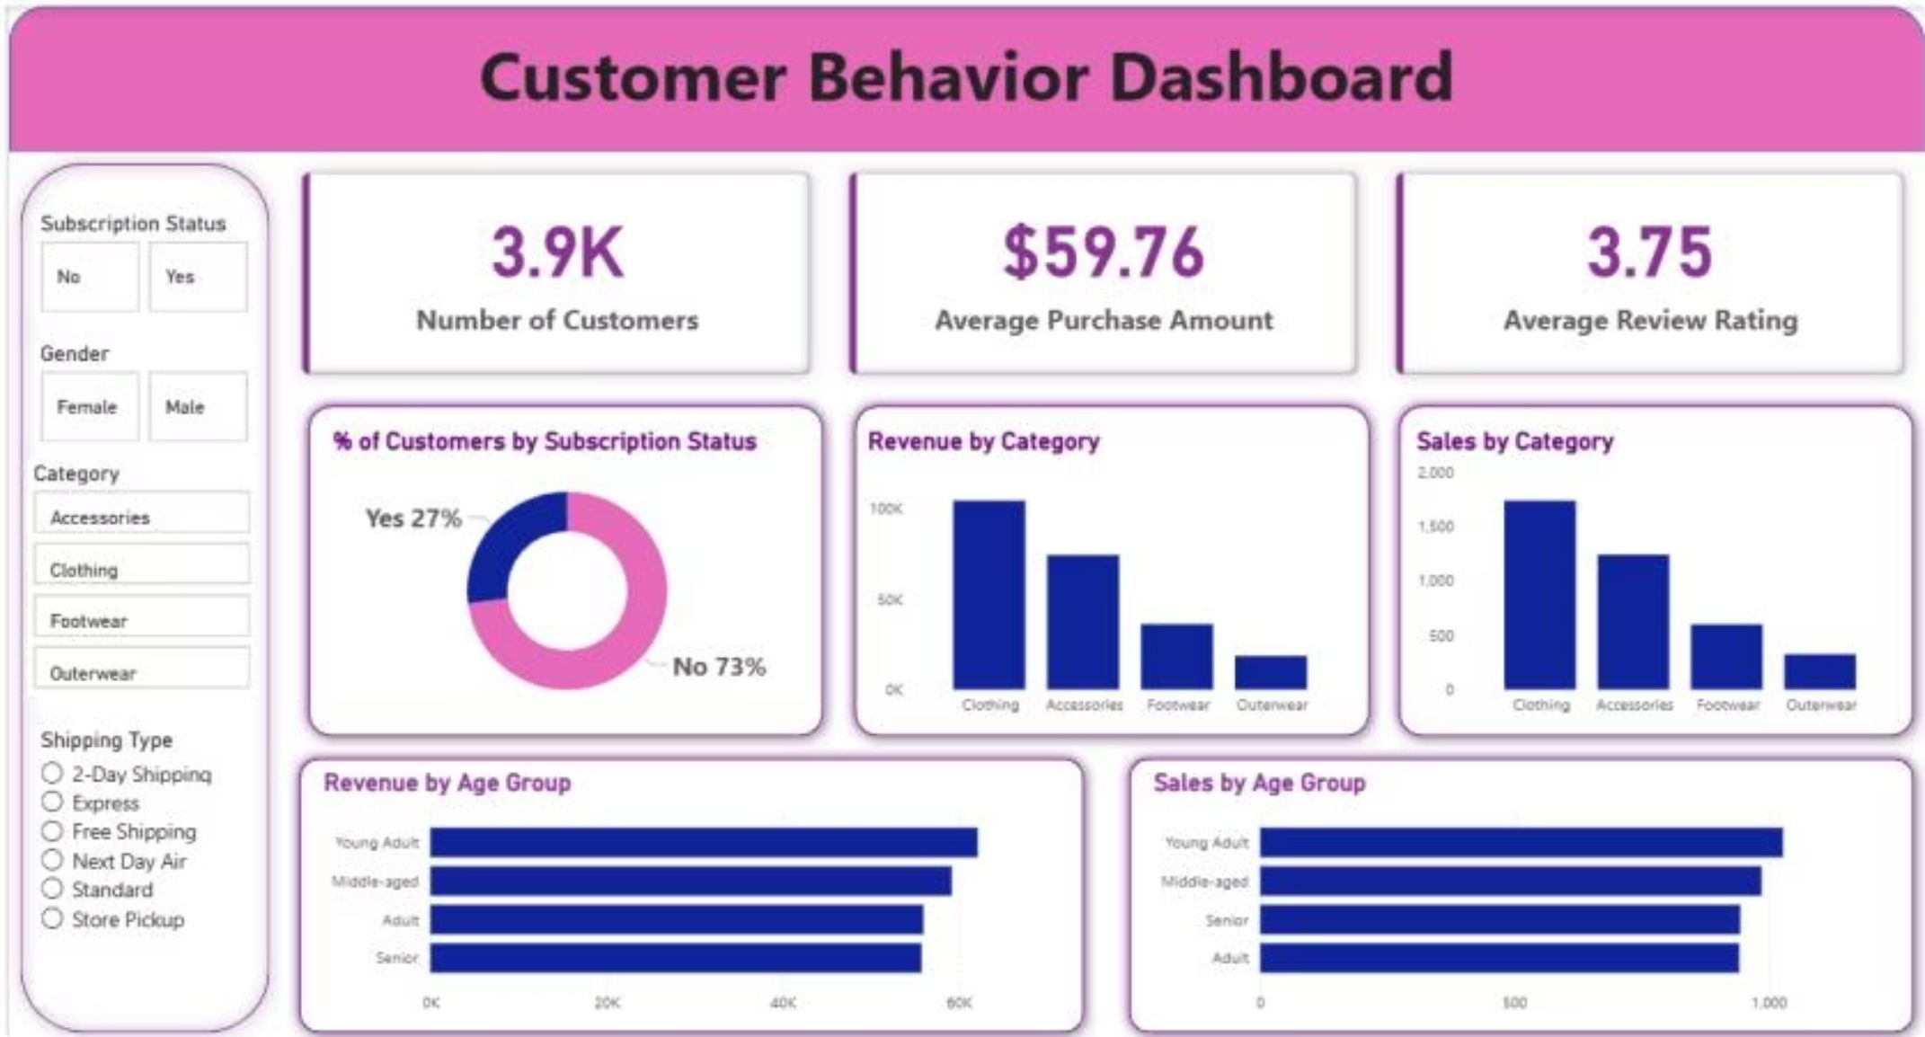
Power BI Dashboard
3.9K Customers
$59.76 Avg
Total transaction base
Purchase amount
3.75 Avg
Clothing Leads
Review rating
$100K revenue, top category

Slide 10





Business Recommendations
Boost Subscriptions
Promote exclusive subscriber benefits
Loyalty Programs
Reward repeat buyers to grow Loyal segment
Review Discount Policy
Balance sales lift with margin control
Targeted Marketing
Focus on high-revenue age groups & express shippers

