Slide 1
VAIDYA A SEMI-HUMANOID AUTOMATED TESTING ROBOT
Presented by
Kunchey Sunny
Deepika
Mallikarjuna

Slide 2
Overview
Vaidya is a semi humanoid automated testing robot. Which is being designed and developed to be able to enter the medical industry with AL and ML capabilities.
The main aim of the project is to deliver a friendly humanoid robot, which can interact with people and test them and send the results to the regarding person within no time.
Vaidya is a semi humanoid robot which is build to test, human being on medical bases.
The robot is designed to be friendly.
The can test a persons SOP level, Blood pressure and body temperature
The results are directly sent to the remote doctor as the robot is IoT enabled.
The robot can also move in all directions, talk and recognize people based on its AL capabilities.

Slide 3
Hardware components
The hardware components used for the project are Arduino uno, Node MCU, simple amplifiers and various sensors are used for the project
Various sensors are being tested and possibilities are being verified to be able to use them in the project.
Different controlling boards are also being tested and ESP 32 is being considered for the AL capabilities.

Slide 4
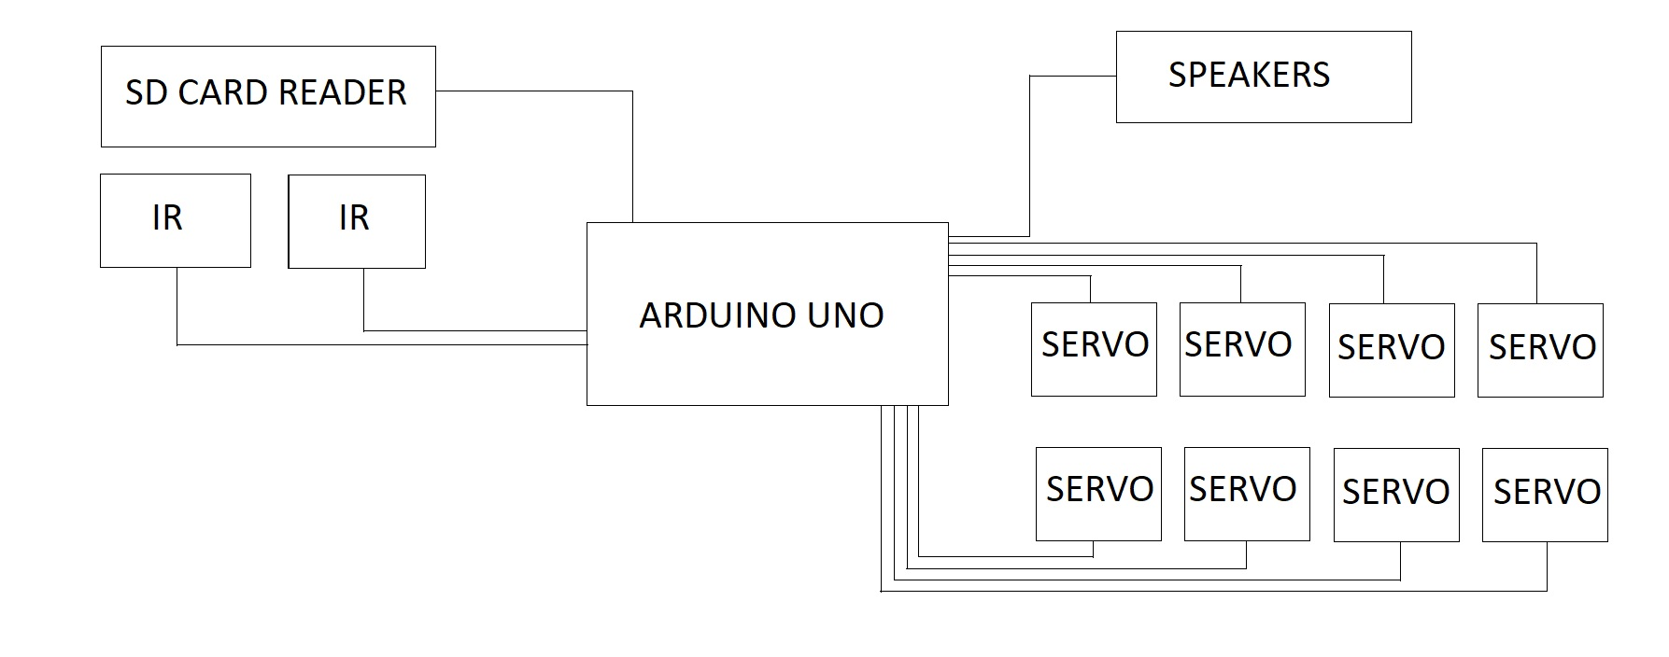
Block Diagram

Slide 5
SOFTWARE TOOLS
Arduino Integrated Development Environment
The Arduino Integrated Development Environment - or Arduino Software (IDE) - contains a text editor for writing code, a message area, a text console, a toolbar with buttons for common functions and a series of menus.
Proteus Design Suite
The Proteus Design Suite is a proprietary software tool suite used primarily for electronic design automation. The software is used mainly by electronic design engineers and technicians to create schematics and electronic prints for manufacturing printed circuit boards.

Slide 6
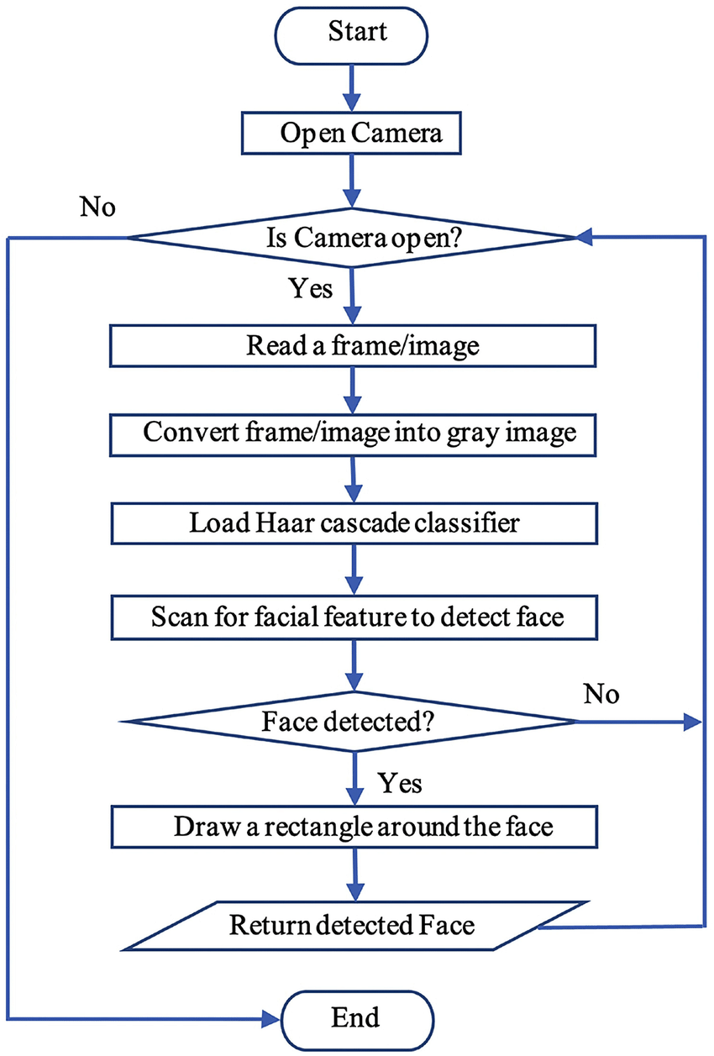
Implementation of AI and ML
Facial recognition defined
Facial recognition is a way of recognizing a human face through technology. A facial recognition system uses biometrics to map facial features from a photograph or video. It compares the information with a database of known faces to find a match. Facial recognition can help verify a person’s identity.

Slide 7
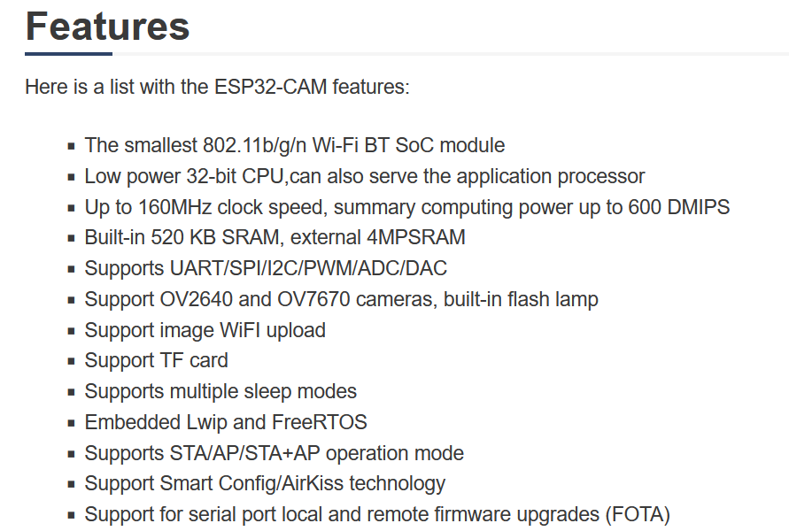
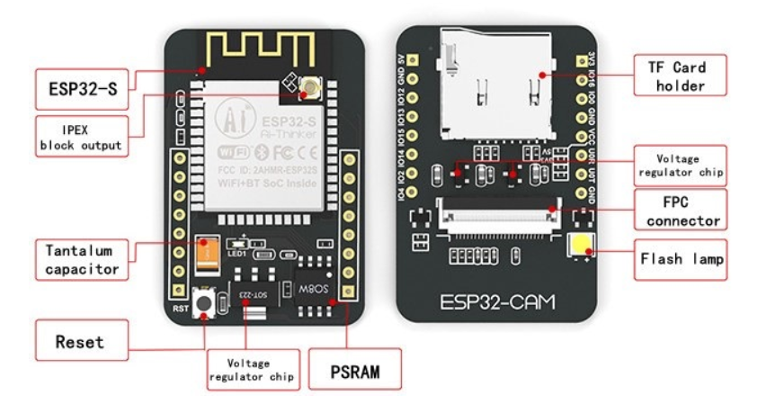
Implementation of AI and ML
ESP-32 CAM

Slide 8
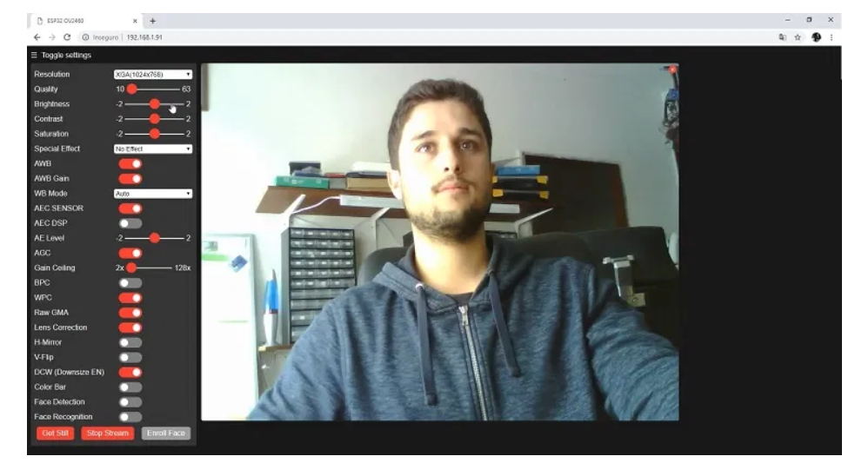
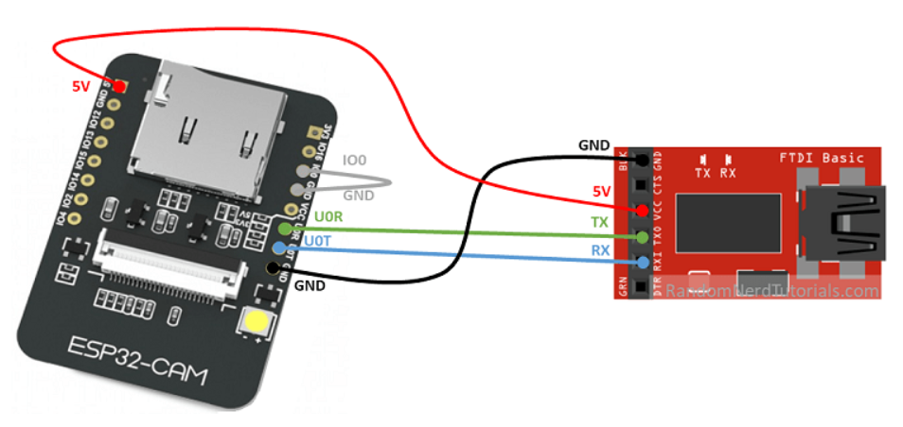
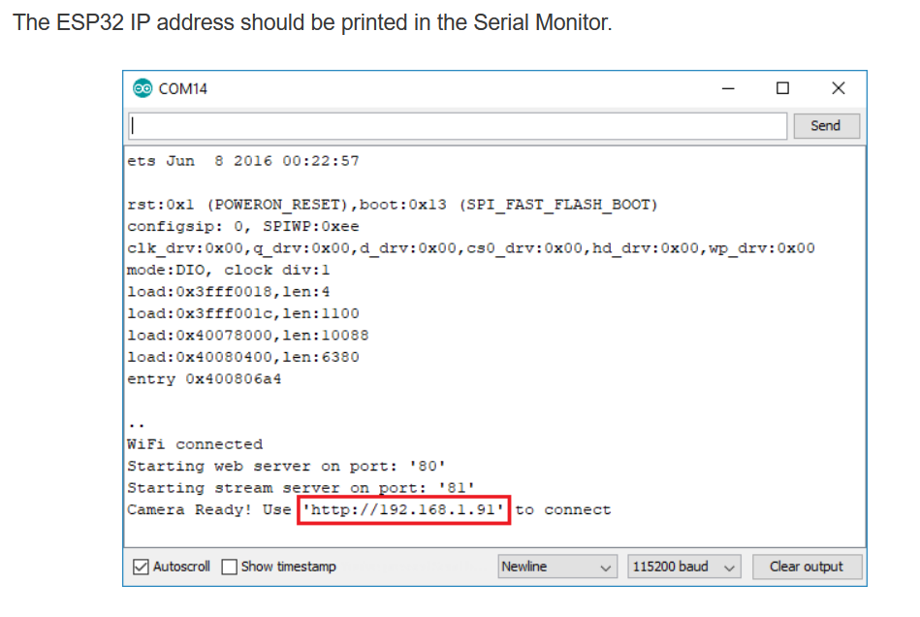
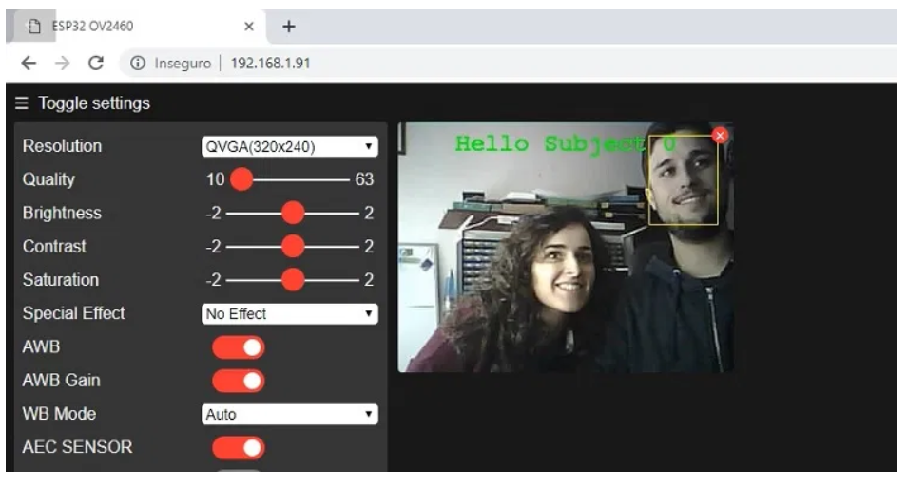
FACIAL RECOGNITION USING ESP-32

Slide 9
THANK YOU

