Slide 1
Skillith Agentic AI for Personalized Course Pathways. ”Your AI Coach for Smarter Learning Decisions”
CAPSTONE PROJECT
Presented By:
Sai Videsh – IIITDM Kurnool – BTech_CSE

Slide 2
OUTLINE
Problem Statement
Proposed Solution
System Development Approach (Technology Used)
Algorithm & Deployment
Result
Conclusion
Future Scope
References

Slide 3
Problem Statement
Students often struggle to identify the right learning path that aligns with their interests and long-term goals due to the overwhelming number of online courses and a lack of personalized guidance. LearnMate aims to solve this by acting as an Agentic AI coach that interacts with students, understands their interests (like Frontend Development, Cybersecurity, UI/UX Design, etc.), assesses their current skill level, and dynamically builds a personalized course roadmap that adapts over time based on progress and preferences.

Slide 4
Proposed Solution
The proposed system aims to solve the issue students face in choosing the right learning path among the vast number of online resources. Learners often feel overwhelmed when trying to align courses with their personal interests, skill levels, and long-term goals. This solution introduces an AI-powered agent that delivers personalized, structured learning roadmaps based on user input. The agent adjusts and evolves the learning path dynamically over time based on user progress and feedback.
User Data Collection
The system begins by collecting three core pieces of input from the student: their domain of interest (e.g., frontend development, cybersecurity), current skill level (beginner, intermediate, advanced), and a time-bound or career-specific goal (e.g., job-ready in 3 months).
These inputs are used to generate a unique learning roadmap tailored to the individual.
Optionally, the user can update their progress or resubmit information as their learning evolves, allowing the roadmap to adapt accordingly.
Data Processing and Personalization Logic
Structured prompts are designed within IBM Watsonx Prompt Lab to map inputs to a curated 10- to 12-week learning plan.
Each plan includes a week-by-week breakdown of topics, tools, hands-on tasks, and recommended certifications.
The tone of the roadmap is intentionally practical, aiming to make the learner feel guided rather than overwhelmed.

Slide 5
Proposed Solution
AI Model and Intelligent Behavior
The core engine of the system is powered by IBM Granite, accessed through Watsonx Prompt Lab.
The model functions as an agentic assistant, capable of not just responding to single prompts but tracking previous conversations to offer updated roadmaps based on new inputs.
The agent can also handle follow-ups such as “I’ve completed week 3, what’s next?” and adjust the path accordingly.
There is an option to integrate RAG (Retrieval-Augmented Generation) to pull real-time data or course listings for enhanced personalization.
Deployment and Platform Integration
The front-end chat interface is implemented using IBM Watsonx Assistant or directly through the Prompt Lab interface.
Backend logic and API routing (if required) are handled via IBM Cloud Functions or a lightweight Python/Flask application.
The system is hosted entirely on IBM Cloud Lite, meeting the platform and service requirements for project deployment.
Efforts have been made to ensure the system is scalable and accessible through a responsive and simple interface.
Evaluation and Feedback Loop
The effectiveness of the roadmap is evaluated based on direct user testing.
Feedback is collected through manual surveys or thumbs up/down functionality.
Further improvements to the prompts and flow are made based on real-world usage.
Success metrics include roadmap completion rate, session retention, and positive feedback ratio.
Result The final solution, named Skillith, delivers personalized and adaptive learning plans to students using IBM’s LLM infrastructure and Cloud Lite services. The system provides meaningful, goal-driven guidance to help learners progress effectively toward their desired outcomes, whether job readiness, freelancing capability, or domain mastery.

Slide 6
System Approach
1. System Requirements
List all the hardware, software, and platform-related requirements needed to build and test the solution. For example:
A system with a stable internet connection
Modern web browser (Chrome, Edge)
IBM Cloud account (Lite tier or above)
IBM Watsonx Studio and Runtime access
Optional: IBM Cloud Functions (for backend hosting)
2. Libraries and Tools Used
This subsection lists all the necessary libraries, platforms, and tools:
IBM Watsonx Studio
IBM Watsonx Agent Builder (Agentic Lab)
IBM Granite (LLM model)
Mistral (for comparison testing)
RAG file upload capability
Optional: Python (Flask backend), IBM Cloud CLI, VS Code

Slide 7
System Approach
3. Methodology and Development Steps
Logged into IBM Cloud and deleted all existing resources for a clean environment
Accessed Watsonx Studio and created new runtime and studio environments
Opened Watsonx Agent Lab and followed the documentation to create a new agent
Associated required services and generated an API key for access
Provided a system prompt to guide the agent’s behavior for generating learning roadmaps
Uploaded a RAG document to act as a reference database for the agent
Tested agent output across different LLMs including IBM Granite and Mistral
Analyzed model responses and performance for accuracy and quality
Deployed the final version once consistent results were obtained
Due to time constraints, the UI and backend hosting were not implemented
The project remains ready for future upgrades with a frontend and backend layer on IBM Cloud

Slide 8
Algorithm & Deployment
This document provides an in-depth description of the system architecture, implementation steps, model configuration, and deployment process for the Agentic AI project, an AI-powered personalized learning coach. This system was designed to assist students in identifying the best course pathway based on their interests, skill levels, and goals. Built using IBM Watsonx and IBM Granite models, the solution fulfills both the practical need for personalization and the technical requirement of utilizing IBM Cloud Lite services.
1. Introduction to the Project Goal
The Agentic AI system was conceptualized as a solution to address the overwhelming landscape of online learning platforms and courses, where students struggle to find direction aligned with their unique aspirations. The objective was to create an intelligent assistant capable of dynamically constructing and adapting personalized course roadmaps. This assistant, named Skillith, was designed to:
Interact with users via natural language
Collect three key inputs: interest area, current skill level, and time/career goal
Generate clear, actionable, and motivational learning roadmaps (10–12 weeks)
Use Retrieval-Augmented Generation (RAG) to enhance factual accuracy
Provide guidance with real-world tools, mini projects, and optional certifications
This solution was implemented using IBM Watsonx Studio, integrated with IBM Granite 7B models and deployed within IBM Cloud Lite infrastructure.
2. IBM Cloud Setup and Service Provisioning
The implementation began by logging into the IBM Cloud portal. To avoid conflicts or resource limitations, all existing or unnecessary resources were deleted to free up space under the Lite plan, ensuring a clean slate.
Using the IBM Cloud console, Watsonx Studio was searched and opened. A new Watsonx Studio project was created, named Skillith_Project. During creation, it was linked to a newly created instance of Watsonx Runtime, which is required for executing and managing AI models. This project serves as the central workspace for building and training models, integrating data, and managing AI agents.
The Watsonx documentation for Agentic AI Labs was consulted to understand the structure and behavior of agent-based AI systems. Important details included how agents process user instructions, integrate retrieval-based knowledge using RAG, and utilize system prompts to define consistent personality and behavior.

Slide 9
Algorithm & Deployment
3. Agent Construction Process
Within Watsonx Studio, the "Build AI Agents" section was opened. A new agent named Skillith was created, linked to the active project and runtime instance. The agent was configured to allow external data retrieval and a new API key was generated to enable future integration or API access.
A system prompt was added to the agent to define its behavior. This prompt explained that Skillith was a learning coach that gathers three inputs from the user (interest area, skill level, and time/career goal), and then generates a week-by-week roadmap in a simple, actionable format. The tone was set to be encouraging and beginner-friendly.
To improve the factual accuracy of answers, a RAG knowledge file (plain text) was uploaded. This file contained curated information about learning paths, tools, mini projects, certifications, and more. The agent was configured to reference this RAG file when generating responses, allowing it to behave more like a domain-specific tutor.
4. Model Selection and Configuration
Several models were available for powering the agent, including Mistral, LLaMA, and IBM Granite. After trying different models, IBM Granite 7B was selected due to its ability to understand intent well, structure responses consistently, and refer correctly to the RAG file.
The final configuration settings used were:
Model: Granite-7B
Max Tokens: 2000
Temperature: default
Frequency Penalty: default
This configuration was sufficient to allow multi-turn conversations, progress tracking, and switch in learning tracks (e.g. from Frontend to Cybersecurity) without breaking the conversation flow.

Slide 10
Algorithm & Deployment
5. Testing and Iteration
The agent was tested with several user queries, such as:
“I'm a beginner in Frontend Development. Want to be job-ready in 3 months.”
“I’ve completed till Week 3. What’s next?”
“I want to start freelancing in UI/UX Design within 6 weeks.”
Each time, the agent returned:
A clear roadmap split by week
Key tools to learn such as VS Code, Figma, GitHub, etc.
Mini projects like designing landing pages, writing Python scripts, or training ML models
Platform suggestions for learning (Coursera, freeCodeCamp, etc.)
Optional certifications and follow-up guidance
Multiple rounds of testing were done to polish language, remove grammar mistakes, and refine the prompt further to make it more generalizable.
6. Deployment
Once the agent behavior was fine-tuned, it was deployed from Watsonx Studio itself. The deployment used the Agentic AI Deployment space named Agentic_AI_01.
The deployed version retained access to the same RAG database, model configuration, and system prompt. After deployment, the agent was again tested to ensure behavior matched the build version.
This deployed agent is now available for use via API or direct integration into a front-end.

Slide 11
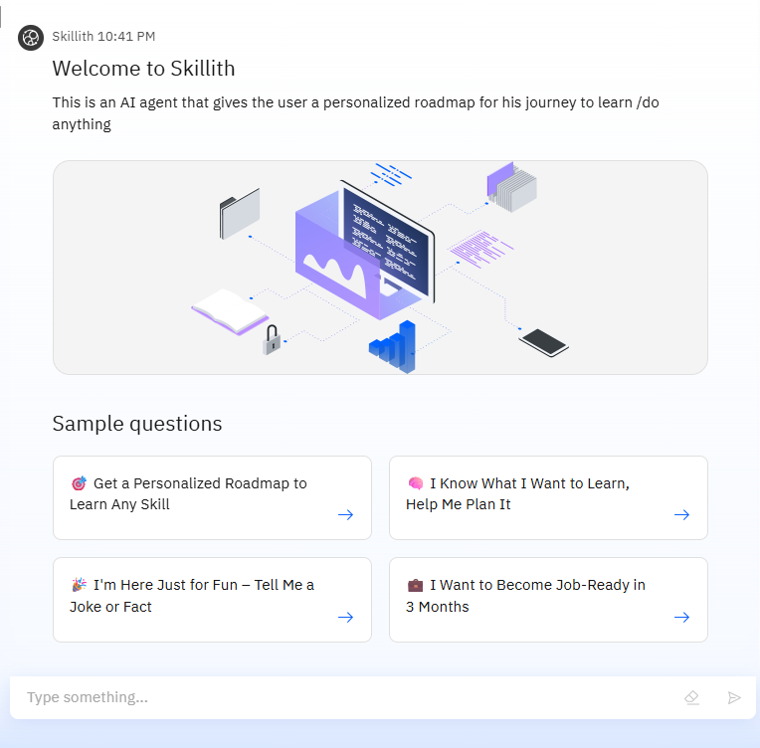
Result

Slide 12
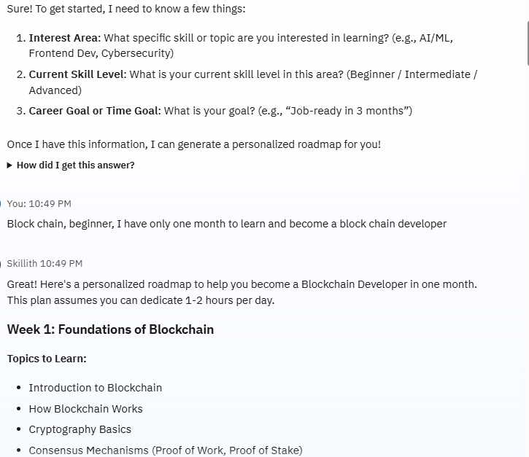
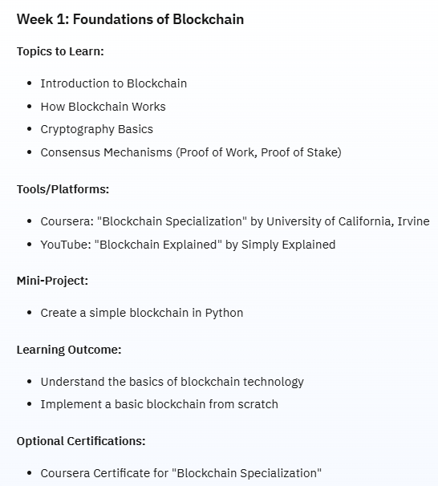
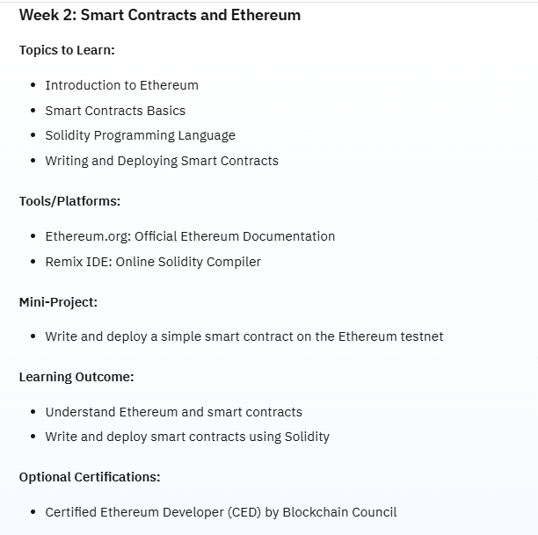
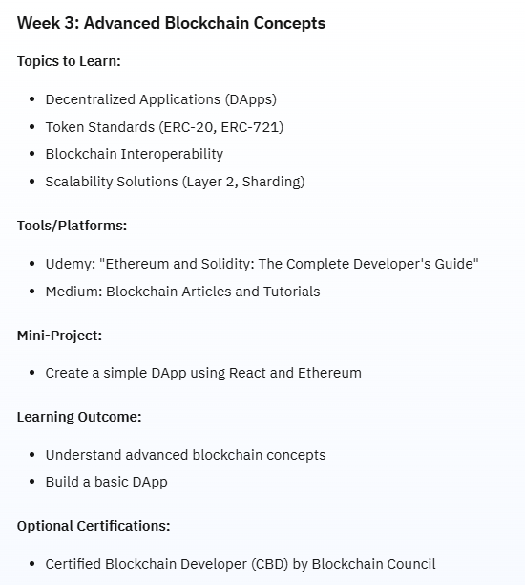


Result

Slide 13
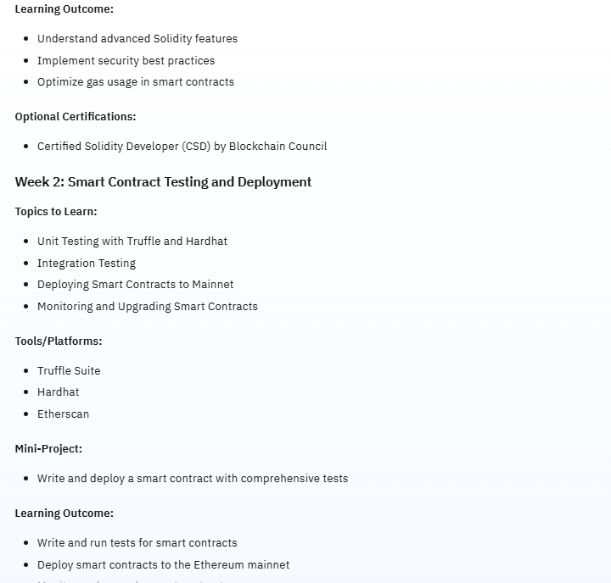
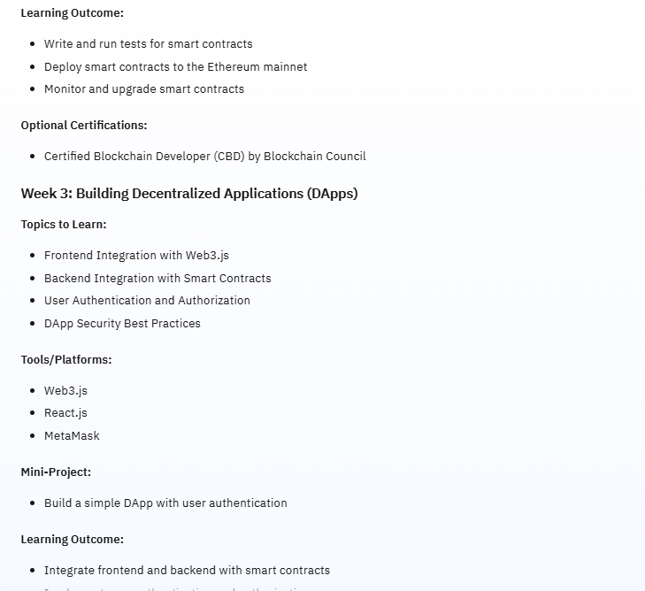
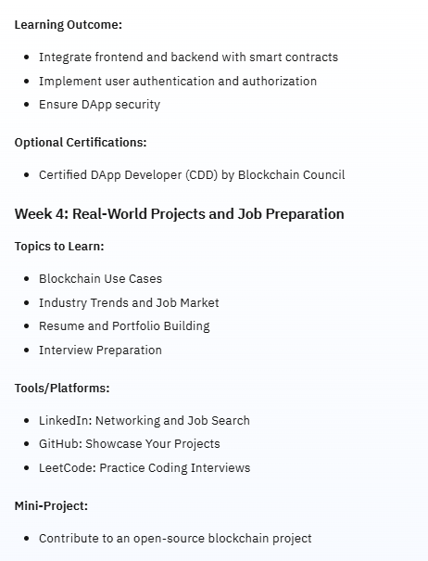
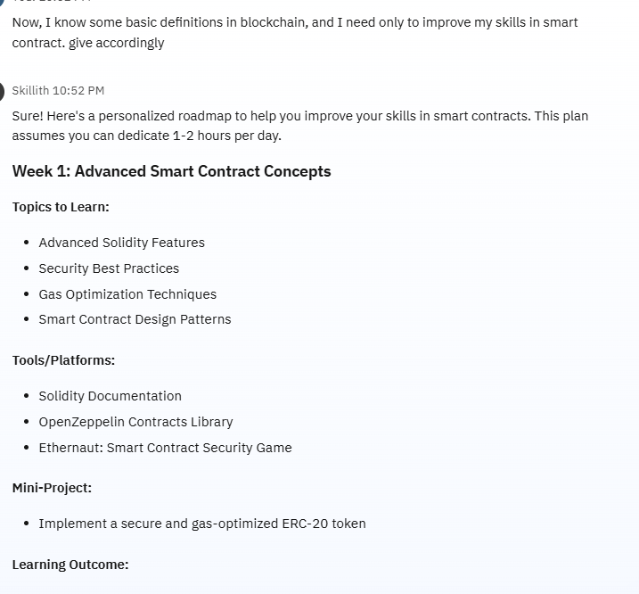
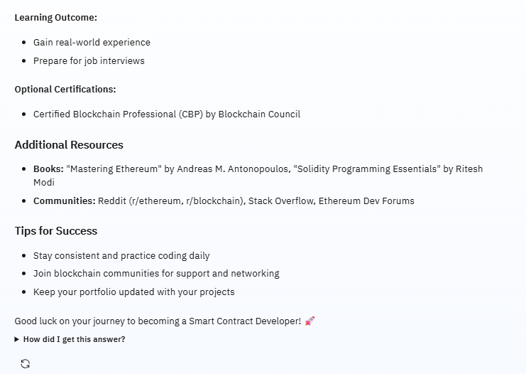
Result

Slide 14
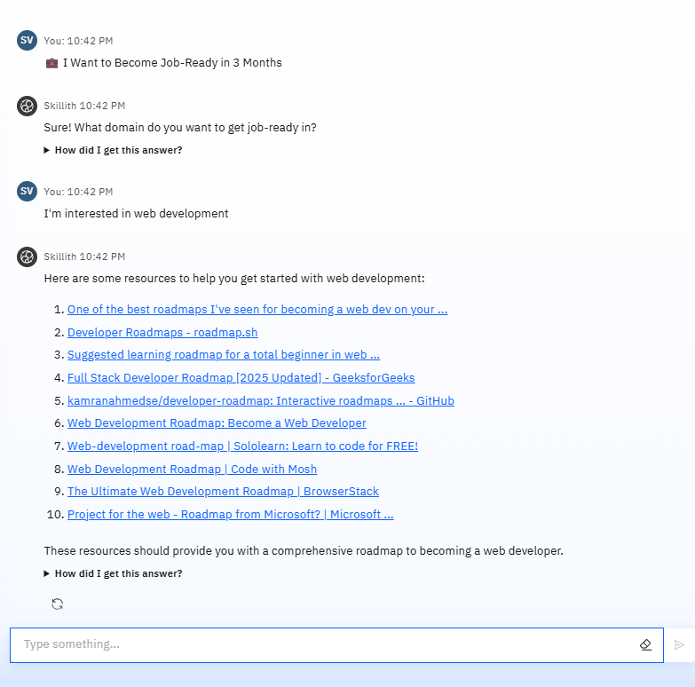
Result

Slide 15
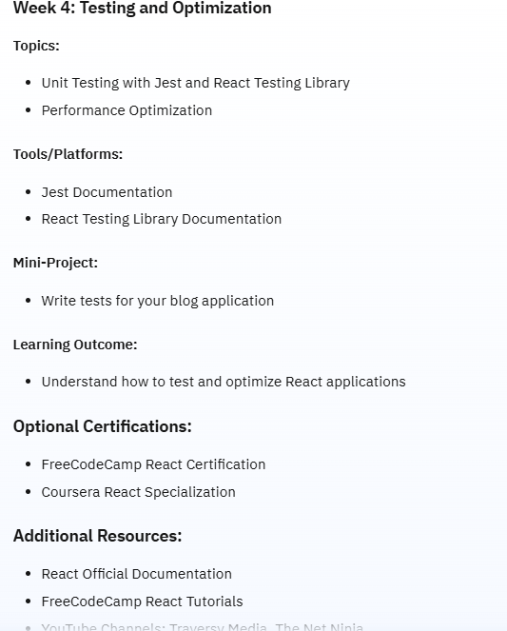
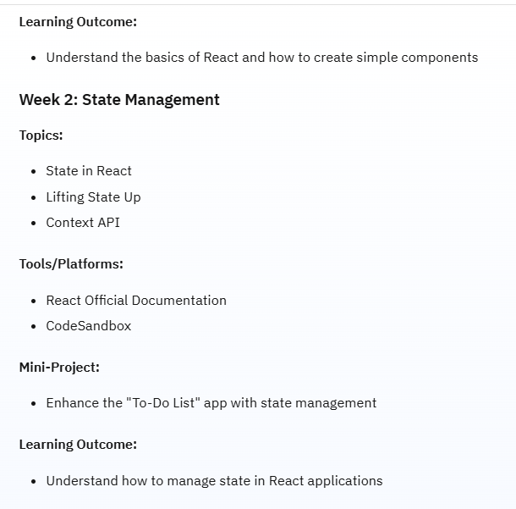
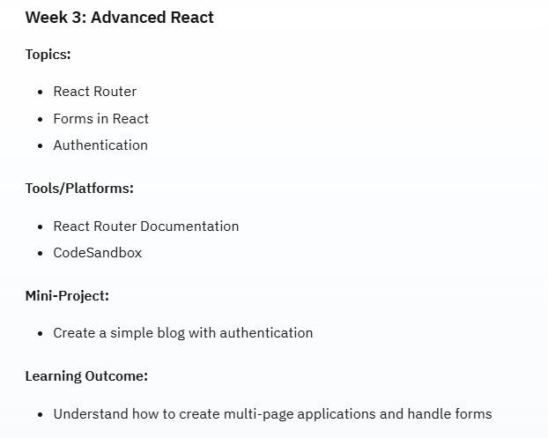
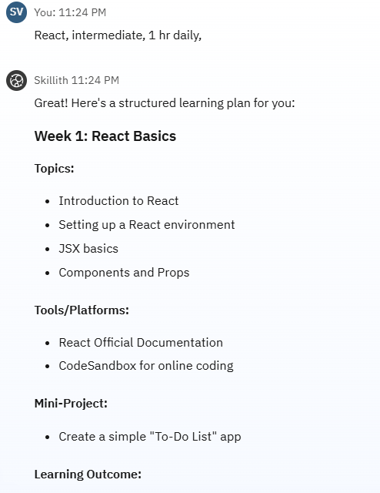
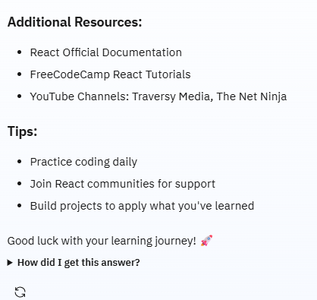
Result

Slide 16
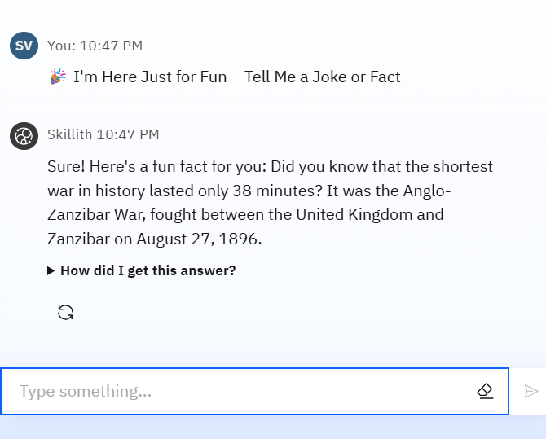
Result

Slide 17
Conclusion
The Agentic AI Learning Coach project successfully demonstrates the use of Agentic AI capabilities using IBM Watsonx Studio, Granite models, and RAG knowledge bases. It solves a real problem faced by students: “What should I learn next based on who I am and what I want?”
The agent was built, tested, and deployed with modular steps, allowing for future updates. The current deployment works well for single-turn and follow-up interactions. The project meets the IBM Cloud Lite and IBM Granite usage requirements. With minimal enhancements like UI integration and progress tracking, this system can easily evolve into a complete SaaS product to help students and learners worldwide.

Slide 18
Future scope
Due to time limitations, the frontend UI and backend hosting were not completed. However, plans are in place for the following:
A clean web-based chat UI where users can provide their inputs
Backend (Flask or Node.js) to connect the frontend with the Watsonx API
MongoDB or Cloudant for storing user inputs and tracking progress
Option to resume conversations
Authenticated user dashboard to manage roadmaps
All of these can be deployed using IBM Cloud services.

Slide 19
References
IBM Watsonx Documentation The official IBM documentation was the core reference for setting up Watsonx Studio, creating AI agents, integrating RAG (Retrieval-Augmented Generation), and deploying models like IBM Granite. It provided all necessary steps and configuration guidelines.
https://www.ibm.com/docs/en/watsonx.
Zoom Session Recordings (Internal) Live classes and recorded Zoom sessions played a crucial role in understanding practical implementation details, especially around deploying AI agents, configuring runtimes, and testing use cases in real-time using Watsonx Studio.
YouTube – IBM Technology Channel Video tutorials from IBM’s official YouTube channel helped visualize the agent creation process, explore model behavior (Granite, Mistral), and understand how to deploy working agents using the Watsonx interface.
https://www.youtube.com/@IBMTechnology

Slide 20
IBM Certifications

Slide 21
IBM Certifications

Slide 22
IBM Certifications

Slide 23
THANK YOU

