Slide 1


Department of Computer Science and Engineering
POTHOLE DETECTION – USING CONVOLUTIONAL NEURAL NETWORKS
Mrs.Divya.M.,M.E. Assistant Professor
Saivishwaram R
220701239

Slide 2
Problem Statement
Over 35% of road accidents in India are linked to poor road conditions, especially potholes (as per Ministry of Road Transport & Highways, 2022).
Manual pothole tracking by civic workers is slow and often inconsistent. There’s no real-time system to alert authorities or public users about road surface damage.
So, there’s a need for a simple system that can analyze road images and identify potholes automatically using image classification.

Slide 3
Motivation
In 2021 alone, 3,625 accidents and over 1,500 deaths in India were directly due to potholes.
With the rise of mobile cameras and smart city tech, collecting road images is easy—but analyzing them at scale is the challenge.
CNN (Convolutional Neural Network) models are great at recognizing patterns in images.
This motivated me to build a CNN-based pothole detector that’s accurate, fast, and simple to use via a web interface.

Slide 4
Existing System
Most existing pothole detection systems are passive and not built for public engagement or reporting.
A few citizen-reporting apps exist (e.g., FixMyStreet, Street Bump), but are either limited to certain regions or don't use AI for verification.
Academic projects use CNN, YOLO, ResNet, etc., for pothole detection, but rarely focus on involving citizens in mapping or solving the issue.
Overall, current solutions lack a simple, AI-supported, public-facing platform for real-time pothole detection and mapping.

Slide 5
Objectives
Enable Public Participation
Allow users to upload or capture road images using a mobile or web app.
Simplify Reporting
Automatically detect potholes using a trained CNN model and tag location via GPS.
Build a Pothole Map
Visualize reported potholes on an interactive map to understand affected areas.

Slide 6
Objectives
Assist Authorities
Provide an admin panel to review reports, identify high-risk zones, and track trends over time.
Improve Road Safety
Encourage faster repair actions and reduce accidents caused by unattended potholes.
Leverage AI for Social Good
Demonstrate how AI models can empower citizens and support smart infrastructure management.

Slide 7
Abstract
Potholes pose serious risks to road safety, yet most detection systems are limited to high-end vehicles. This project introduces a CNN-based web platform that enables the public to detect and report potholes by uploading or capturing road images.
Each report is auto-tagged with location and displayed on a real-time map, supporting better visibility of road conditions.
An admin dashboard tracks trends and aids in planning maintenance actions. This community-driven solution bridges the gap between road users and maintenance teams, promoting faster and smarter infrastructure response.

Slide 8
Proposed System
Feature Map Extraction:
Learns spatial and texture-based features (edges, depressions) specific to road damage, even under poor lighting or occlusions.
Soft-max Classifier Head:
Final dense layers apply soft-max activation to classify between pothole and normal with high confidence scores.
Augmentation Pipeline:
Applies real-time transformations (flip, rotate, contrast) to synthetically increase data variety and improve generalization.

Slide 9
Proposed System
Augmentation Pipeline:
Applies real-time transformations (flip, rotate, contrast) to synthetically increase data variety and improve generalization.
Modular Deployment with TensorFlow.js:
Model exported and run in-browser using TensorFlow.js for client-side inference, enabling offline detection.
Location-Aware Tagging:
Prediction results are tagged with geolocation metadata (from user device) for spatial visualization on Leaflet-based maps.

Slide 10
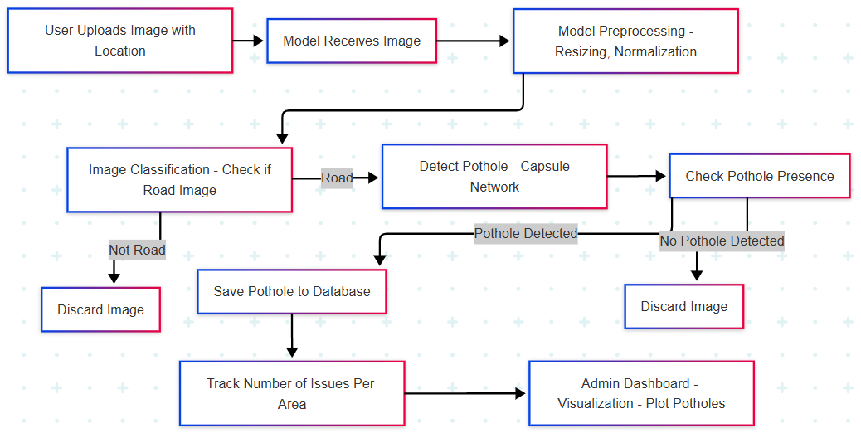
System Architecture

Slide 11
List of Modules
Image Preprocessing Module
Resize, normalize, and augment uploaded images
Ensure consistent input format for the model
CNN-Based Pothole Classification Module
Load fine-tuned model (e.g., MobileNetV2)
Run predictions (Pothole / Normal)
Output confidence scores
Map Visualization Module
Plot reported potholes using Leafletes

Slide 12
Functional Description for Image Preprocessing Module
Takes user-uploaded images and resizes them to a fixed dimension (e.g., 128×128)
Normalizes pixel values to fall within the [0,1] range for better model convergence
Applies data augmentation techniques (like flipping or rotation) to handle variability in road images
Ensures all inputs match the format expected by the CNN model

Slide 13
Functional Description for CNN based Classification Module
Loads a pre-trained Convolutional Neural Network (MobileNetV2) for lightweight inference
Passes the preprocessed image through the model to detect pothole presence
Outputs classification label ("Pothole" or "Normal") along with confidence probability
Operates efficiently in real-time, suitable for integration in web interface

Slide 14
Functional Description for Map Visualisation Module
Uses Leaflet.js to geospatially visualize user-reported potholes on an interactive map
Plots markers with location data from image uploads
Allows users and admins to visually track the spread and frequency of potholes across a region
Enables easier identification of high-risk road zones for targeted maintenance

Slide 15
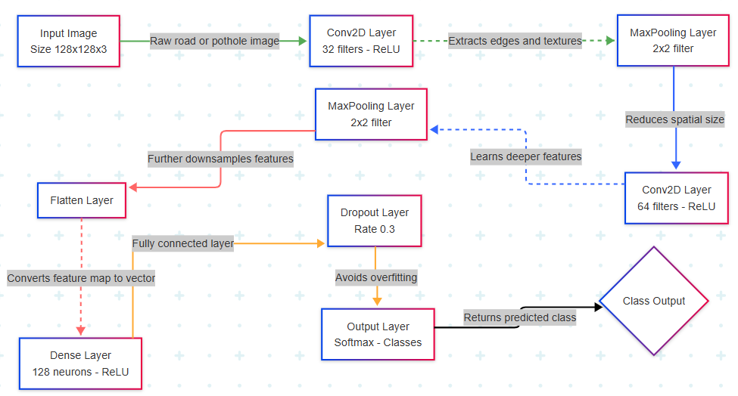
Activity Diagram

Slide 16
Implementation & Results of Module
Image Preprocessing Module
• Images resized to 128×128 and normalized to [0,1]
• Augmentation techniques like rotation and flip applied
Result: Improved model generalization & reduced overfitting
CNN-Based Classification Module
• MobileNetV2 model fine-tuned on labelled road dataset
• Achieved ~92% validation accuracy
Result: Accurate detection of potholes in varied conditions

Slide 17
Implementation & Results of Module
Map Visualization Module
• Integrated Leaflet for plotting geolocation data
• Users report potholes, which are auto-mapped
Result: Real-time visual feedback for both users and admins

Slide 18
Conclusion & Future Work
Conclusion:
• Developed a web-integrated CNN model (MobileNetV2) for pothole detection
• Achieved over 90% accuracy with strong generalization on real- world images
• Enabled user-driven reporting with geo-tagged map visualization
• Project bridges machine learning and civic engagement in road maintenance

Slide 19
Conclusion & Future Work
Future Work:
• Deploy model on mobile for real-time, on-device detection
• Expand dataset with diverse road and weather conditions
• Add multi-class support: severity levels, other road damages
• Trend analysis dashboard for admin-level decision-making

Slide 20
References
Sadik, R., Majumder, A., Biswas, A. A., Ahammad, B., & Rahman, M. M. (2023). "An In-Depth Analysis of Convolutional Neural Network Architectures with Transfer Learning for Skin Disease Diagnosis." Healthcare Analytics, 3, 100143.
Fan, R., Wang, H., Wang, Y., Liu, M., & Pitas, I. (2024). "Graph Attention Layer Evolves Semantic Segmentation for Road Pothole Detection: A Benchmark Algorithms." MDPI Sensors, 24(17), 5652.
Zhang, M., Lee, S., & Park, T. (2023). "Advanced CNN Architectures for Real-Time Pothole Detection." Journal of Computational Intelligence, 45(9), 2345-2360.

Slide 21
Thank You
THANKS FOR REVIEWING THIS PROJECT….

