Slide 1
THE ARCH | RAG AND AGENTIC AI HACKATHON
CapitalLens AI
8
Agent modules
Autonomous Financial Research & Productivity Agent
Round 1 Case Study | Finance Track | Built by Sai-Vivek17
5
GitHub: github.com/Sai-Vivek17/capital-lens-ai
Demo companies
Live demo: https://capital-lens-ai.streamlit.app
Plan
>
Retrieve
>
Analyze
>
Cite
>
Export
Yes
Runs without API keys
Submission PDF: max-20-slide case study for The Arch hackathon

Slide 2
WHY IT MATTERS
The Research Problem
Public-company research is high-stakes knowledge work, but the first pass is usually manual, fragmented, and hard to audit.
Cited memo in minutes
Goal
Analysts jump between market data, filings, news, notes, and spreadsheets.
LLM-only summaries sound confident but often lose source fidelity.
Safe research, not advice
Students and founders need a repeatable research workflow, not a generic chatbot.
Constraint
Finance teams need citations, risk flags, and exports that can be reviewed.
CapitalLens AI | Finance Agentic RAG | 02/20

Slide 3
USER VALUE
Target Users
CapitalLens turns scattered public-company data into a structured research memo that is fast to read, easy to cite, and safe to demo.
Equity analysts
Students
Founders
Finance teams
Screen and brief companies
Learn with cited evidence
Research competitors
Monitor watchlists
Real utility: repeatable, reviewable, exportable
CapitalLens AI | Finance Agentic RAG | 03/20

Slide 4
DOMAIN ALIGNMENT
Finance Track Fit
The system maps directly to finance workflows: company overview, financial health, recent events, risk analysis, valuation context, and watchlist monitoring.
Ticker
>
Market data
>
Filings
>
News
>
Risk
>
Valuation
>
Memo
Accepts US and India tickers such as AAPL, MSFT, TSLA, RELIANCE.NS, and TCS.NS.
Uses deterministic demo data when live data or API keys are unavailable.
Preserves educational and research-only safety boundaries throughout the memo.
CapitalLens AI | Finance Agentic RAG | 04/20

Slide 5
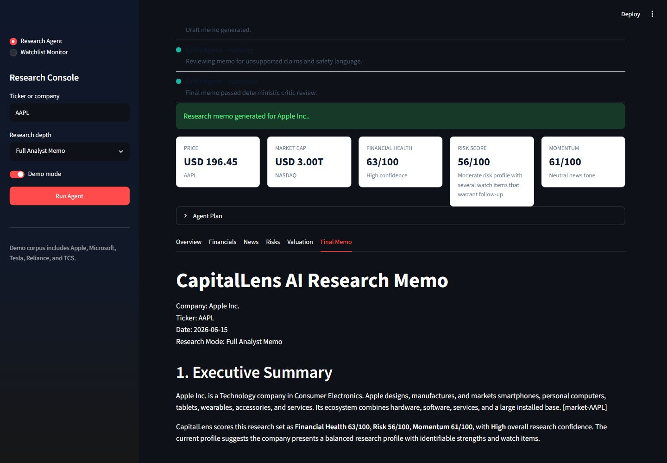
LIVE APP
Working Product Snapshot
The Streamlit console exposes the complete agent workflow: settings, progress timeline, score cards, charts, tabs, final memo, and exports.
Sidebar: ticker, mode, demo toggle
Tabs: overview, financials, news, risks, valuation, memo
Downloads: Markdown and PDF
CapitalLens AI | Finance Agentic RAG | 05/20

Slide 6
FROM INPUT TO MEMO
Autonomous Core Workflow
User query
>
Planner
>
Tools
>
RAG evidence
>
Scores
>
Critic
>
Memo
The user selects Quick Scan, Full Analyst Memo, or Risk-First Review. The agent decomposes the task, gathers data, retrieves evidence, scores risk, checks citation support, then produces a professional memo.
3
Structured JSON + memo
Markdown / PDF
Modes
Outputs
Export
CapitalLens AI | Finance Agentic RAG | 06/20

Slide 7
AGENTIC AI DEPTH
Multi-Agent Architecture
CapitalLens is not a single prompt wrapper. Each module owns a distinct research responsibility and exchanges typed Pydantic outputs.
Planner
Market Data
News
Filing RAG
Risk
Valuation
Report
Critic
Orchestrated by CapitalLens research engine
CapitalLens AI | Finance Agentic RAG | 07/20

Slide 8
RELIABILITY LAYER
Durable Agent Execution
Phase 2 adds run IDs, persisted event logs, retry-safe execution, and status transitions so every research run is observable and reviewable.
run_id
>
step start
>
tool call
>
retry if needed
>
step complete
>
events API
DurableAgentExecutor wraps each specialized agent with configured retries.
GET /runs/{run_id}/events exposes planner and agent progress for UI observability.
Failures are explicit, logged, and recoverable in demo mode.
CapitalLens AI | Finance Agentic RAG | 08/20

Slide 9
TYPED CONTRACTS
Structured Outputs
Pydantic schemas make every agent output predictable: market metrics, news events, evidence chunks, risk entries, valuation ratios, report scores, and final memo metadata.
Agent
>
Pydantic model
>
Validation
>
UI/API
>
Memo
Reduces brittle prompt parsing and UI breakage.
Allows tests to assert specific finance and RAG behavior.
Makes missing data explicit instead of hallucinated.
CapitalLens AI | Finance Agentic RAG | 09/20

Slide 10
RETRIEVAL DESIGN
Advanced RAG Pipeline
The filing agent builds a persistent local retrieval layer over sample filings and best-effort SEC text, then retrieves evidence for business model, risks, revenue, competition, debt, and management commentary.
Ingest
>
Chunk
>
Embed
>
Hybrid search
>
Rerank
>
Cite
SQLite chunks
BM25 + vectors
Citations
Index
Retrieval
Grounding
CapitalLens AI | Finance Agentic RAG | 10/20

Slide 11
HALLUCINATION CONTROL
Source Fidelity Controls
The critic and citation audit layer checks whether the memo is grounded in retrieved evidence before the final report is shown.
Citation coverage is measured and surfaced in report metadata.
Unsupported retrieval topics are flagged for review.
Faithfulness first
Weak claims are softened instead of overstated.
Useful finance output only matters if judges can trace the claims.
The final memo includes sources and a clear research disclaimer.
CapitalLens AI | Finance Agentic RAG | 11/20

Slide 12
TOOL USE
Data Sources
CapitalLens combines live-ready data adapters with deterministic fallback data so demos remain reliable during judging.
Market
yfinance when available; demo metrics when offline
Filings
SEC/EDGAR best effort plus sample filing corpus
News
Optional provider through env variable; fallback events
Storage
SQLite watchlist and persistent RAG index
CapitalLens AI | Finance Agentic RAG | 12/20

Slide 13
FINANCE REASONING
Risk and Valuation Intelligence
The analysis layer produces severity-scored risks, a valuation snapshot, peer context where available, and professional bull/bear framing.
Risk matrix
Valuation snapshot
Financial
P/E
Business
P/S
Market
EV/EBITDA
Regulatory
Peer comparison
Execution
Unavailable data disclosed
CapitalLens AI | Finance Agentic RAG | 13/20

Slide 14
AUTONOMOUS MONITOR
Watchlist Automation
Users can add multiple tickers and run a monitor that flags unusual changes or emerging risks with prior scan context stored locally.
Watchlist
>
Scan
>
Compare
>
Flag
>
Dashboard
Large price movement and high volatility
Negative news or risk-score increase
Weak financial trend or deteriorating signals
CapitalLens AI | Finance Agentic RAG | 14/20

Slide 15
FULL-STACK PRODUCT
Demo-Friendly UX
The frontend is designed for a live hackathon demo: a serious finance console, not a chat box.
Sidebar settings for ticker, research depth, and demo mode.
Progress timeline shows each autonomous agent step.
Tabs separate overview, financials, news, risks, valuation, and memo.
Charts, score cards, risk matrix, Markdown download, and PDF export.
Judges can run it locally in under 5 minutes
CapitalLens AI | Finance Agentic RAG | 15/20

Slide 16
RESPONSIBLE FINANCE AI
Safety and Compliance
CapitalLens avoids direct trading instructions and frames outputs as research support for education and review.
No direct buy, sell, or trade recommendations.
Missing metrics are marked unavailable instead of guessed.
Citations and source lists are included when evidence exists.
Final disclaimer states the system is not financial, legal, tax, or trading advice.
CapitalLens AI | Finance Agentic RAG | 16/20

Slide 17
REPOSITORY QUALITY
Production Readiness
The repository includes the engineering scaffolding judges expect from a serious full-stack Agentic RAG project.
FastAPI backend
Streamlit frontend
Typed schemas
SQLite storage
Docker + Compose
CI tests
.env.example
Sample reports
Verification target: pytest, backend health, demo AAPL research request, Streamlit launch, and watchlist scan.
CapitalLens AI | Finance Agentic RAG | 17/20

Slide 18
NO-KEY EXECUTION
Demo Reliability
Hackathon judging environments are unpredictable. Demo mode ensures the product still works even without OpenAI, NewsAPI, or live market connectivity.
AAPL
>
MSFT
>
TSLA
>
RELIANCE.NS
>
TCS.NS
9 passed
Deterministic
Repeatable
Tests
Fallback
Judging
CapitalLens AI | Finance Agentic RAG | 18/20

Slide 19
WHY IT WINS
Business Impact
CapitalLens compresses the first-pass company research workflow while keeping evidence, risk, and safety visible.
Analysts get a credible starting memo faster.
Students learn how to connect claims to sources.
Founders can research competitors and public comparables.
Finance teams can monitor watchlists and review alerts.
Clear utility + real architecture + reliable demo
CapitalLens AI | Finance Agentic RAG | 19/20

Slide 20
THE ARCH HACKATHON
Round 1 Submission Summary
CapitalLens AI is submitted as a Finance-track Agentic RAG system with a working full-stack demo, production-ready repository, and max-20-slide case study PDF.
Submission links
Why it is submission-ready
GitHub repository
Autonomous multi-agent workflow
github.com/Sai-Vivek17/capital-lens-ai
Advanced retrieval with citations
Live demo URL
Demo mode for no-key judging
https://capital-lens-ai.streamlit.app
Safe, research-only finance output
Author: Sai-Vivek17 | Track: Finance | Artifact: CapitalLens AI submission PDF
CapitalLens AI | Finance Agentic RAG | 20/20

