Slide 1
MONGO DB PRESENTATION
by
SAI GURU PRIGEESH M

Slide 2

NoSQL, document-oriented database
• Stores data in JSON-like BSON format
• Designed for scalability and flexibility
• Used for building modern applications with dynamic schema

Slide 3
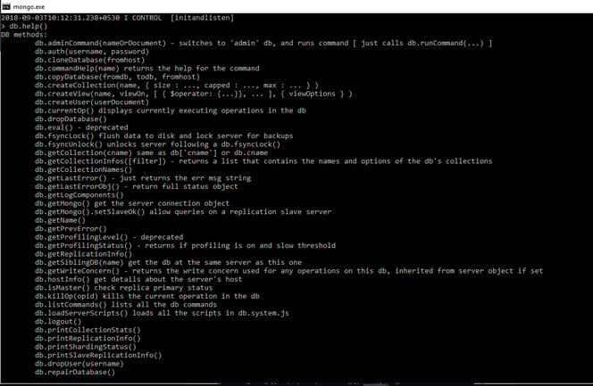
To get a list of commands, type db.help() in MongoDB client

Slide 4
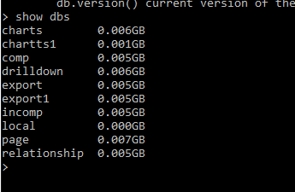


Slide 5


To know your current working/selected database execute the following command
db
To drop the database execute following command, this will drop the selected database
db.dropDatabase()

Slide 6
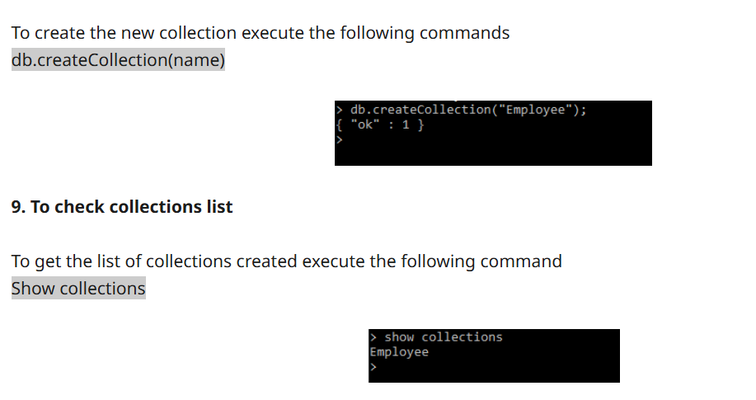

Slide 7
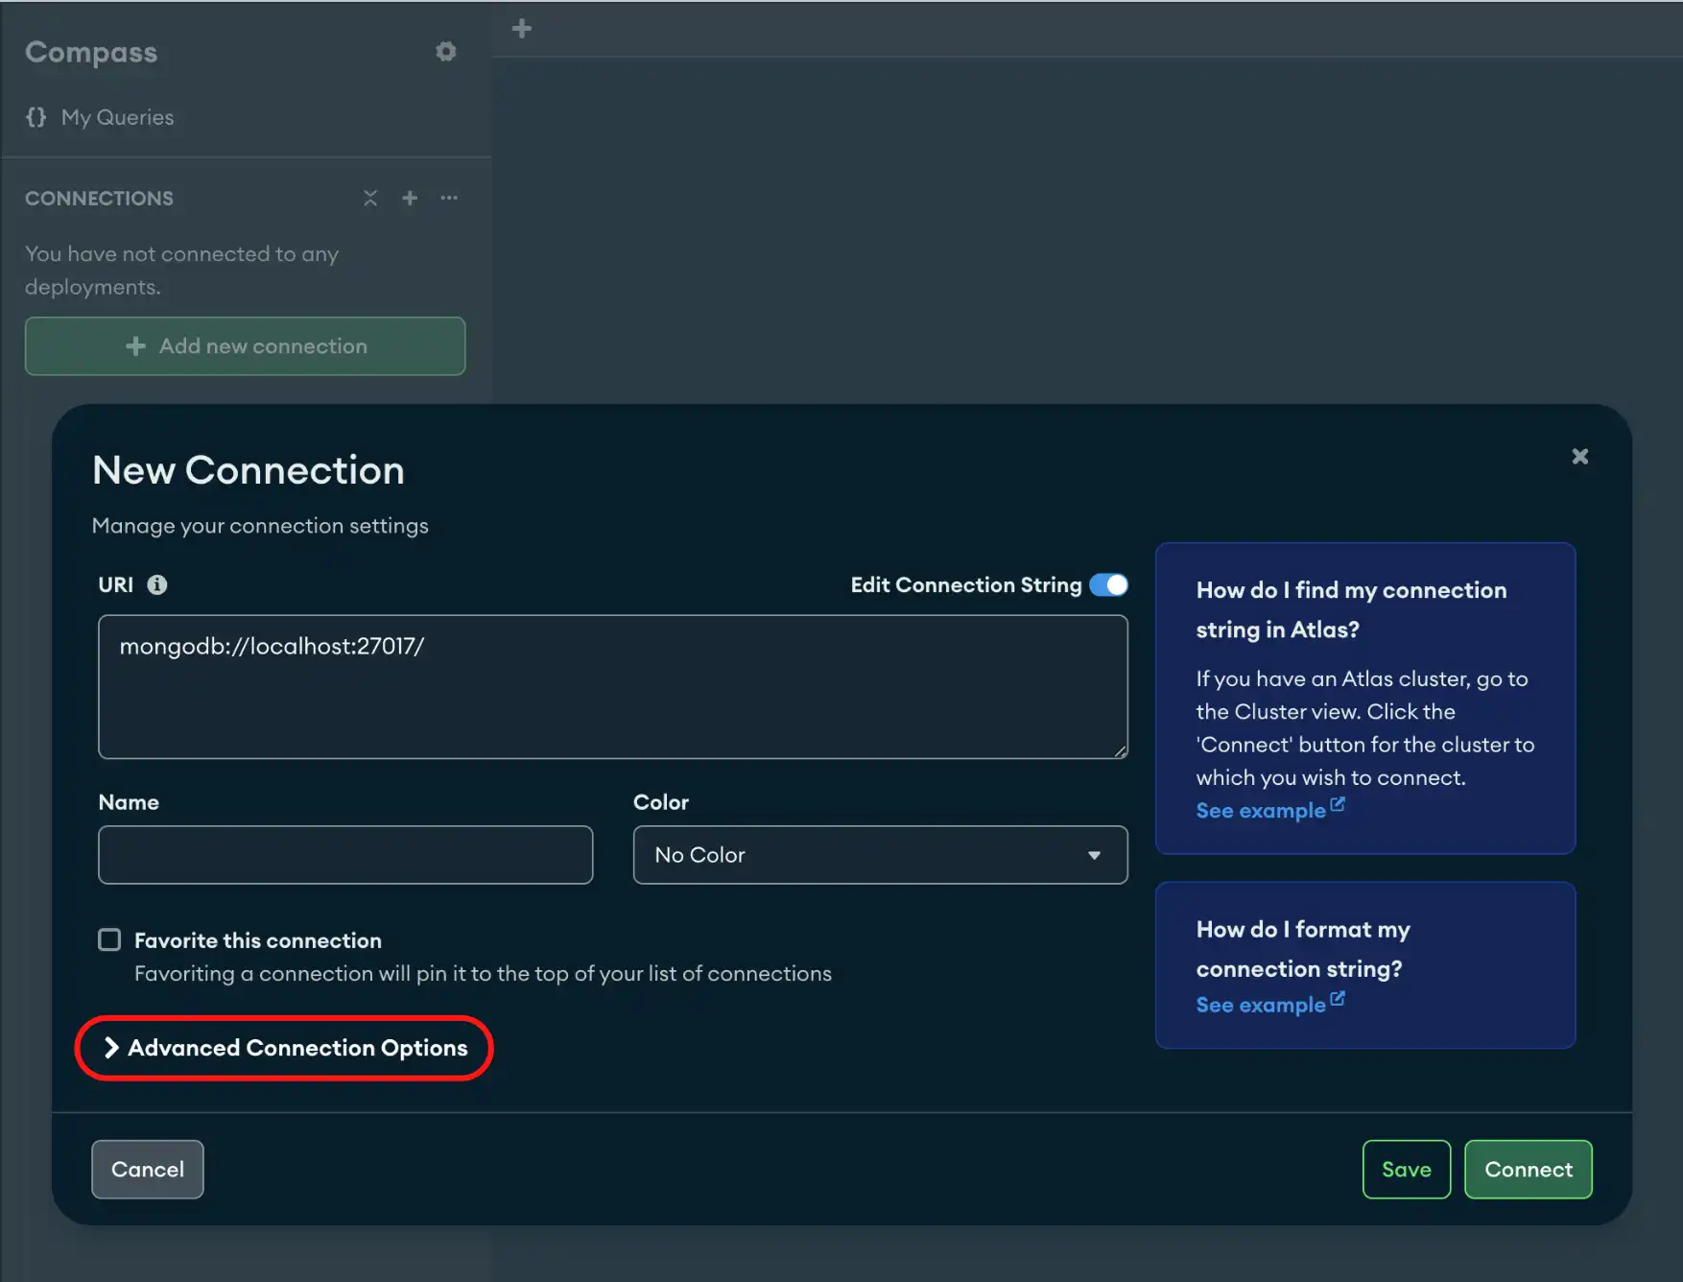

Slide 8
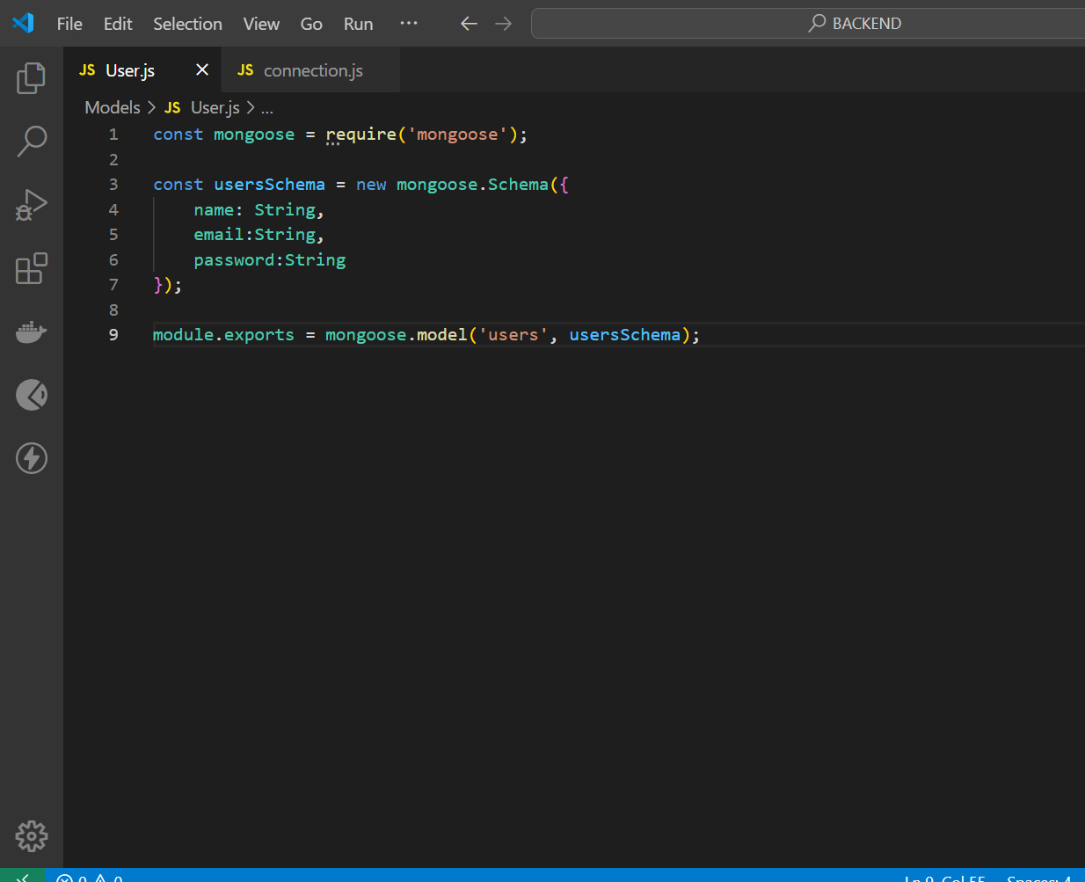

Slide 9
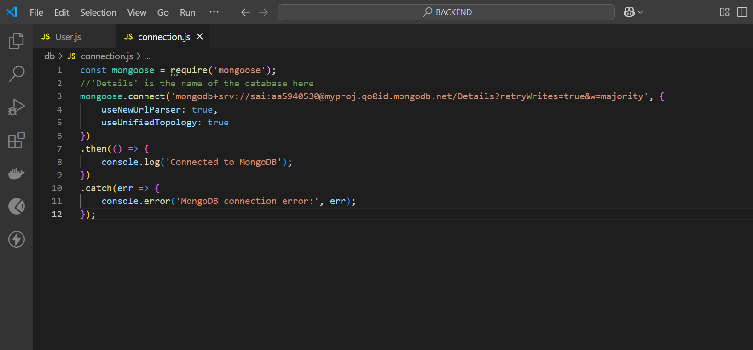

Slide 10
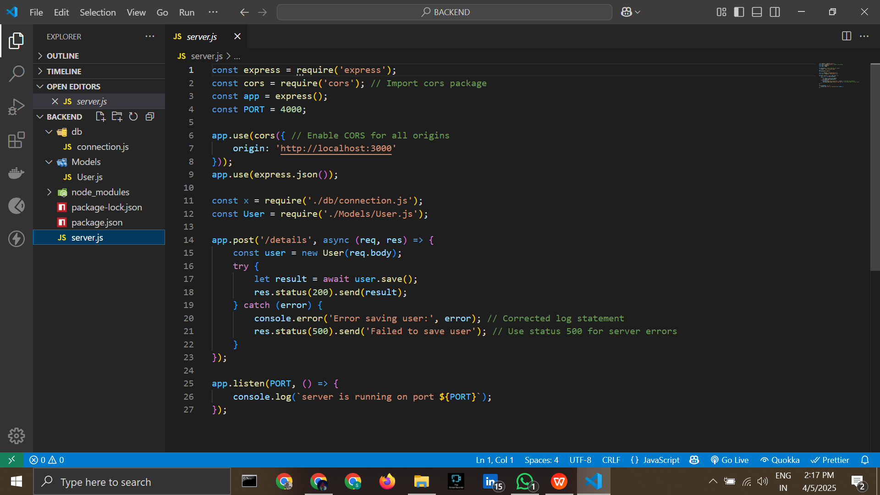

Slide 12
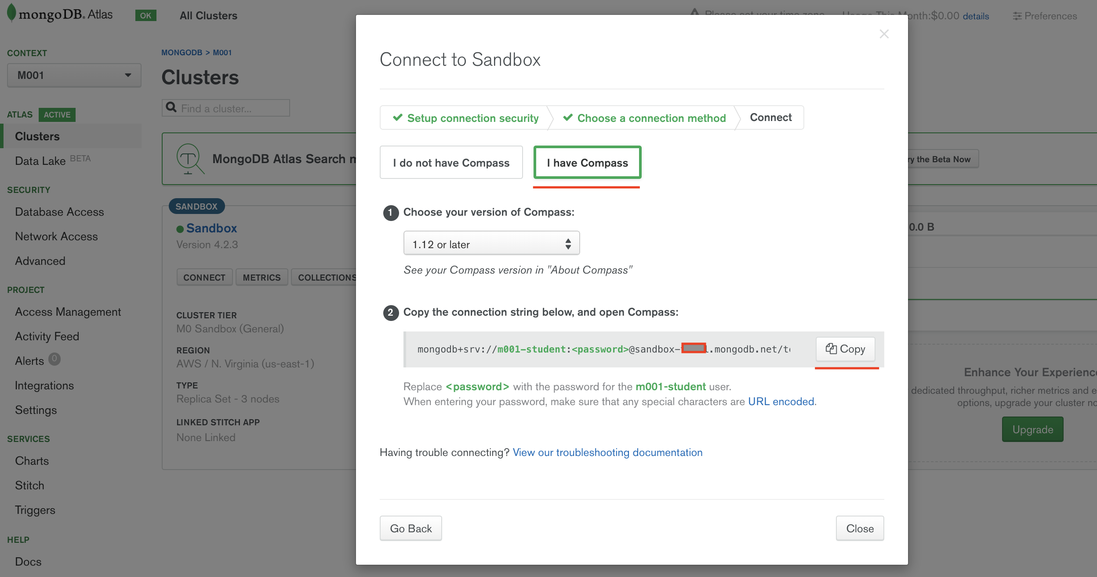

Slide 13


