Slide 1

Keylogger
and
Security
Presented by:
LANKA SAI KRISHNA
06/06/2024 Annual Review
1

Slide 2


PROJECT TITLE
Keylogger and security
3/21/2024 Annual Review
2

Slide 3



AGENDA
Introduction to the project
Problem statement
Project overview
Identification of end users
Solution and its value proposition
The ‘wow’ factor in the solution
Modelling
Results and conclusion
3/21/2024 Annual Review
3

Slide 4


Introduction
Keylogger and security
Keyloggers, or keystroke loggers, are devices or
software programs designed to capture and record
every keystroke made on a computer's keyboard.
They can capture everything from simple text inputs to sensitive information like passwords, credit card numbers, and personal messages. Given
their potential for misuse, understanding keyloggers
and implementing security measures against them is
crucial.
3/21/2024 Annual Review
4

Slide 5

PROBLEM STATEMENT
The increasing reliance on digital devices and the internet for daily activities, cybersecurity threats such as keyloggers have become a significant concern. Keyloggers, which record keystrokes to capture sensitive information like passwords and credit card details, pose a severe risk to individuals and organizations alike. The challenge is to develop a robust security solution that can effectively detect and mitigate keylogger threats while ensuring minimal impact on system performance.
3/21/2024 Annual Review
4

Slide 6

PROJECT OVERVIEW
The project aims to create an advanced security solution focused on detecting and preventing keyloggers. This solution will integrate multiple detection techniques, including behavior analysis, signature-based detection, and heuristic methods, to identify and neutralize keyloggers in real time. The project will involve designing user-friendly interfaces, ensuring compatibility across various operating systems, and conducting extensive testing to validate the effectiveness of the solution.
3/21/2024 Annual Review
5

Slide 7


WHO ARE THE END USERS?
INDIVIDUALS:
Everyday computer users who need protection from keyloggers to safeguard their personal information.
BUSINESSES:
Organizations looking to protect their employees' and customers' data from keylogging threats.
FINANCIAL INSTITUTIONS:
Banks and other financial entities that require high-security measures to protect sensitive financial transactions.
GOVERNMENT AGENCIES:
Entities that handle confidential and sensitive information requiring robust cybersecurity measures.
3/21/2024 Annual Review
6

Slide 8

YOUR SOLUTION AND ITS VALUE PROPOSITION
Security Software: Our software detects and blocks keylogging attempts in real-time.
Encryption: We use advanced encryption techniques to safeguard your data.
Firewalls: Our firewalls prevent unauthorized access and block malicious software.
User Education: We educate users to recognize and avoid keylogger threats.
Detection Tools: Our software regularly scans for keyloggers and alerts users to potential threats.
Incident Response Plan: We have a plan in place to address keylogger attacks swiftly and effectively.
Forensic Analysis: We conduct forensic analysis to identify the source of attacks and prevent future incidents.
3/21/2024 Annual Review
7

Slide 9
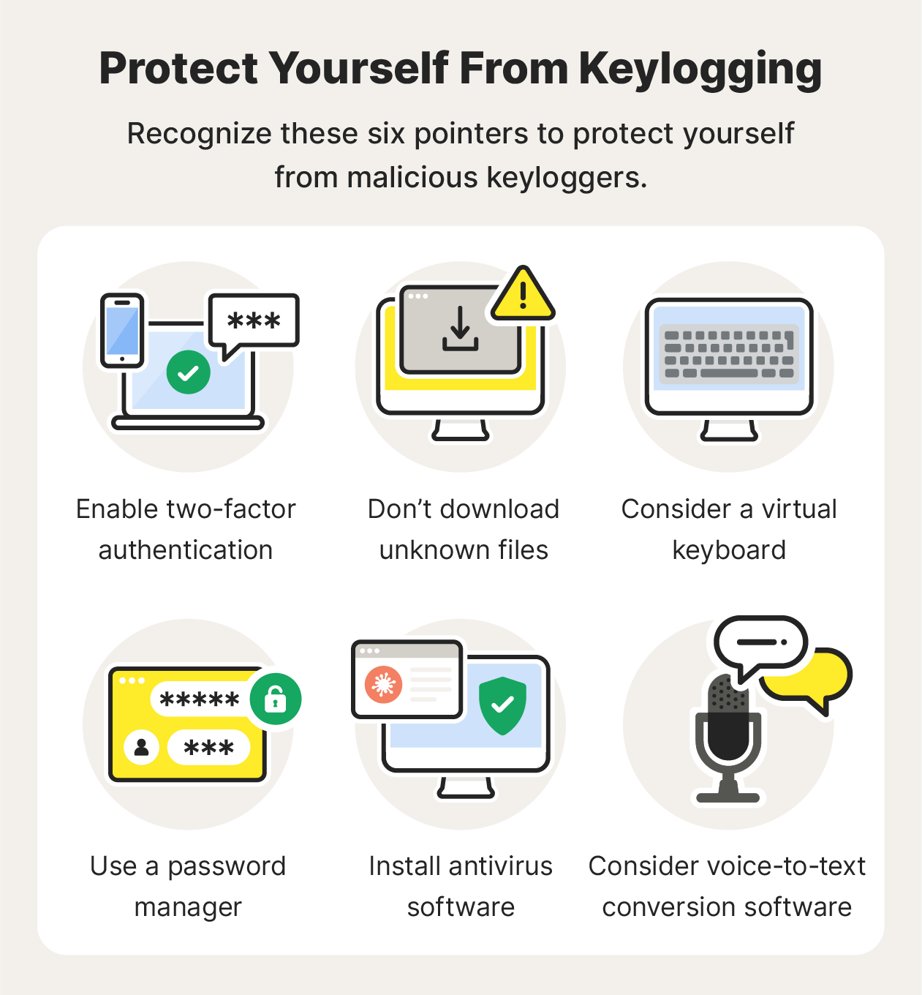

3/21/2024 Annual Review
7

Slide 10

THE WOW IN YOUR SOLUTION
AI-Powered Detection: Utilizes artificial intelligence and machine learning to continuously improve detection accuracy and adapt to new threats.
Cloud Integration: Offers cloud-based threat analysis and updates, ensuring users are protected against the latest threats without manual intervention.
Comprehensive Reports: Generates detailed security reports and analytics, providing users with insights into attempted attacks and overall system health.
Customizable Alerts: Allows users to set custom alert thresholds and notifications, tailoring the security experience to their specific needs.
3/21/2024 Annual Review
8

Slide 11
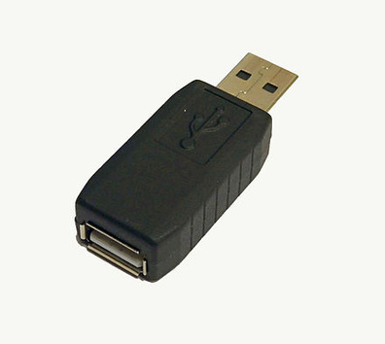
MODELLING
Keylogger, a tool intended to record every keystroke made on the machine and offers the attacker the ability to steal large amounts of sensitive information without the permission of the owner of the message. The primary objective of this project is to detect keylogger applications and prevent data loss and sensitive information leakage. This project aims to identify the set of permissions and storage levels owned by each of the applications and hence differentiate applications with proper permissions and keylogger applications that can abuse permissions. The keyloggers are detected using Black-box technique. Black-box approach is based on behavioral characteristics which can be applied to all keyloggers and it does not rely on the structural characteristics of the keylogger. This project aims to develop detection system on mobile phones based on machine learning algorithm to detect keylogger applications.
Hardware keylogger
3/21/2024 Annual Review
9

Slide 12
RESULTS
The presence of keyloggers poses a significant threat to security, as they can clandestinely capture sensitive information such as passwords, credit card numbers, and personal data. This information can be exploited for identity theft, financial fraud, and unauthorized access to systems and networks. To safeguard against this threat, it's imperative to implement robust security measures such as antivirus software, regular software updates, intrusion detection systems, and stringent access controls. Additionally, user awareness and education about the risks associated with keyloggers are crucial for fostering a security-conscious culture. By adopting proactive strategies and staying vigilant, individuals and organizations can better protect themselves against the insidious nature of keyloggers and minimize the potential impact on their security and privacy. Keyloggers can silently capture sensitive information like passwords and financial data. This can lead to identity theft, financial loss, and unauthorized access to systems. Keylogger Detection and Security
3/21/2024 Annual Review
10

Slide 13
Project link
https://github.com/Sai-krrish/sai-krishna.git
3/21/2024 Annual Review
10

