Slide 1



indiajob
market

Slide 2

CONTENTS
Abstract
Introduction
System Requirements
Architecture
Uses of data analysis library
Advantages
Conclusion

Slide 3
abstract
The Indian job market is a dynamic and multifaceted landscape undergoing significant transformation driven by technological advancements, demographic shifts, government policies, and global economic trends.
This project, "India Job Market," aims to provide a comprehensive analysis of its current state, key drivers, emerging challenges, and future trajectory. The abstract will delve into various facets, including:
Current Scenario:
An overview of the present employment landscape, highlighting growth sectors, stagnant industries, and the formal versus informal economy divide.

Slide 4
Key Drivers of Change:
Examination of factors such as digitalization, automation, the rise of the gig economy, government initiatives (e.g., Skill India, Make in India), and foreign investments influencing job creation and destruction.
Challenges and Opportunities:
Discussion of pertinent issues like skill gaps, underemployment, regional disparities, and the impact of global disruptions, alongside the immense opportunities presented by India's young workforce, growing domestic consumption, and focus on innovation.
Sectoral Analysis:
A closer look at specific sectors demonstrating high growth potential (e.g., IT, healthcare, renewable energy, manufacturing) and those facing headwinds.

Slide 5
Introduction
India's job market is a dynamic and evolving landscape, characterized by its vast scale, youthful demographic, and a strong push towards technological advancement and formalization. As of mid-2025, it presents a mixed picture of immense opportunities alongside significant challenges.
Sectoral Hotspots: Several sectors are driving significant job growth.
Information Technology (IT) and IT-Enabled Services (ITeS): Continues to dominate, with a strong focus on digital transformation, cloud, AI, and cybersecurity.
Healthcare and Pharmaceuticals: Booming due to increased spending, advancements in biotechnology, and telemedicine.
Financial Services and FinTech: Expanding rapidly with digital banking, mobile payments, and blockchain technology.

Slide 6
E-commerce and Retail: Driven by the growth of online shopping, creating demand in logistics, supply chain, digital marketing, and customer service.
Manufacturing and Engineering: Benefiting from government initiatives like "Make in India," leading to increased demand for engineers and skilled labor.
Renewable Energy: Poised for significant growth as India pursues ambitious sustainability goals.
Rise of the Gig Economy and Flexible Work: The gig economy is expanding, with more individuals choosing freelance and contract work due to online platforms offering greater autonomy and work-life balance. Remote and hybrid work models, accelerated by the pandemic, are also becoming integral to the job market.
High Job Mobility: Indian professionals are exhibiting high job mobility, actively seeking new roles and negotiating for better pay and benefits. They are increasingly prioritizing purpose, ethics, and flexibility in their careers.

Slide 7
system requirements
OPERATING SYSTEM:
The analysis can be performed on Windows .
Python:
Python 3.x is required for running the analysis.
Libraries:
Pandas: Install the Pandas library using pip, a package manager for Python. Pip install pandas

Slide 8
2. Matplotlib: Install the Matplotlib library using pip as well
pip install matplotlib
3.Seaborn: Install the seaborn library using pip command
Pip install seaborn
HARDWARE REQUIREMNTS :
IDE – Jupyter Notebook
Storage Space – free storage space enough for running on machine

Slide 9
ARCHITECTURE
The architecture of the hotel booking analysis using Python, Matplotlib, and Pandas involves several key steps that form a cohesive workflow.
The process typically includes data acquisition, data preprocessing, data visualization.
Let's explore the architecture in more detail:
IMPORTING DATASET
DATA FILTERING
DATA CLEANING
DATA GROUPING
DATA VISUALISATION

Slide 10


IMPORTING DATASET
The project begins with data collection, where the Hotel Booking Dataset is sourced from reliable repositories or research databases. The dataset is then loaded into the Python environment using the Pandas library, creating a structured DataFrame for efficient data handling

Slide 11
data filtering
1 fulltime_h = ijm[(ijm['Job Type'] == 'Full-time') & (ijm['Number of Applicants'] > 100)]
fulltime_h.head()
2 recent = ijm[ijm['Posted Date'] > '2025-01-01']
recent.head()

Slide 12
DATA CLEANING
1 ijm.drop_duplicates(inplace=True)
uni_rows=ijm.shape[0]
uni_rows
2 ijm['Salary Range'] = ijm['Salary Range'].str.replace(' LPA', '')
ijm['Salary Range']

Slide 13
DATA GROUPING
1ijm.groupby('Job Type')['Number of Applicants'].mean()
2ijm.groupby('Company Name').size().rename('Job Listing')

Slide 14
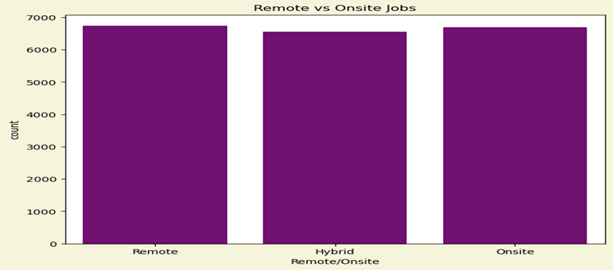
data vizulatization
1 plt.figure(figsize=(8,6),facecolor='beige')
sns.countplot(x='Remote/Onsite', data=ijm,color='purple')
plt.title('Remote vs Onsite Jobs')
plt.show()

Slide 15
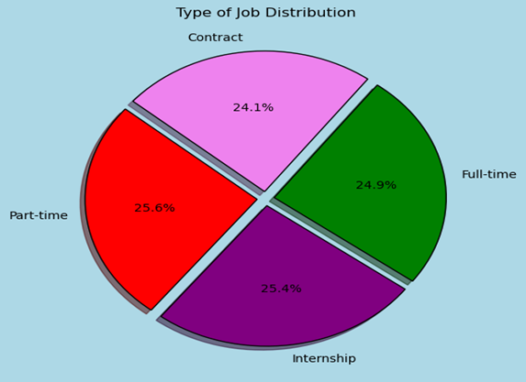
data vizulatization
2.plt.figure(figsize=(6,6),facecolor='lightblue')
colors = sns.color_palette('Set3')
ijm['Job Type'].value_counts().plot.pie(autopct='%1.1f%%',shadow=True,explode=(0.05,0.05,0.05,0.05), startangle=140, colors={'purple','violet','red','green'},wedgeprops={'edgecolor': 'black', 'linewidth': 1})
plt.title('Type of Job Distribution')
plt.ylabel('') # Removes extra ylabel
plt.show()

Slide 16
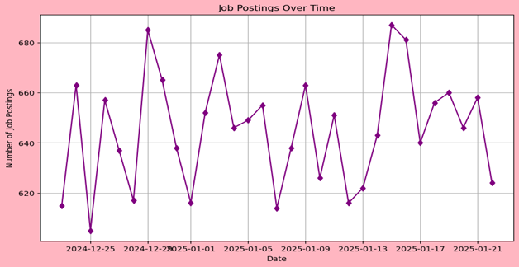
data vizulatization
3.ijm['Posted Date'] = pd.to_datetime(ijm['Posted Date'], dayfirst=True)
jobs_over_time = ijm.groupby('Posted Date').size()
plt.figure(figsize=(10,6),facecolor='lightpink')
plt.plot(jobs_over_time.index, jobs_over_time.values, marker='d', color='purple')
plt.title('Job Postings Over Time')
plt.xlabel('Date')
plt.ylabel('Number of Job Postings')
plt.grid(True)
plt.show()

Slide 17
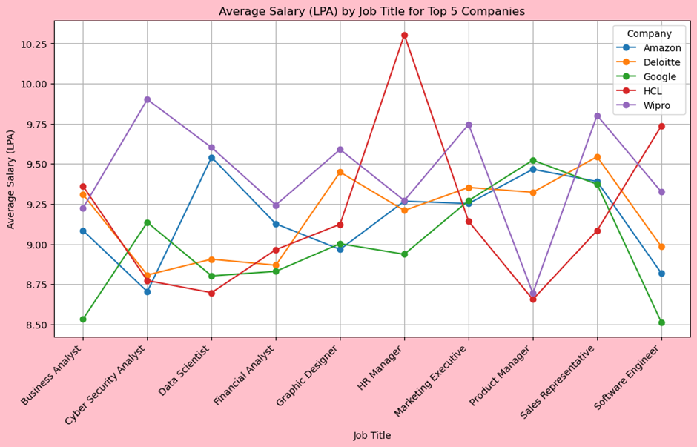
data vizulatization
4.plt.figure(figsize=(12,6),facecolor='pink')
for company in grouped['Company Name'].unique():
company_data = grouped[grouped['Company Name'] == company]
plt.plot(company_data['Job Title'], company_data['Average Salary (LPA)'], marker='o', label=company)
plt.title('Average Salary (LPA) by Job Title for Top 5 Companies')
plt.xlabel('Job Title')
plt.ylabel('Average Salary (LPA)')
plt.xticks(rotation=45, ha='right')
plt.legend(title='Company')
plt.grid(True)
plt.show()

Slide 18
data vizulatization
5.top_companies = ijm['Company Name'].value_counts().nlargest(5).index
filtered_df = ijm[ijm['Company Name'].isin(top_companies)]
plt.figure(figsize=(12,6),facecolor='lightgrey')
sns.countplot(y='Company Name', hue='Salary Range', data=filtered_df, palette='coolwarm')
plt.title('Salary Range Distribution for Top 5 Companies')
plt.xlabel('Number of Job Listings')
plt.ylabel('Company Name')
plt.legend(title='Salary Range', bbox_to_anchor=(1.05, 1), loc='upper left')
plt.show()

Slide 19
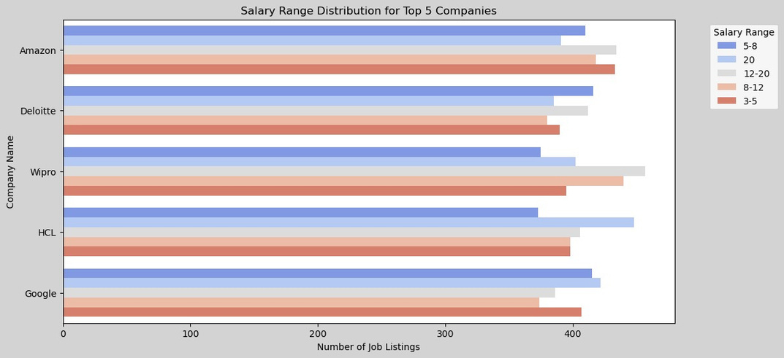
data vizulatization
5.top_companies = ijm['Company Name'].value_counts().nlargest(5).index
filtered_df = ijm[ijm['Company Name'].isin(top_companies)]
plt.figure(figsize=(12,6),facecolor='lightgrey')
sns.countplot(y='Company Name', hue='Salary Range', data=filtered_df, palette='coolwarm')
plt.title('Salary Range Distribution for Top 5 Companies')
plt.xlabel('Number of Job Listings')
plt.ylabel('Company Name')
plt.legend(title='Salary Range', bbox_to_anchor=(1.05, 1), loc='upper left')
plt.show()

Slide 20
USES OF DATA ANALYSIS LIBRARY
PANDAS
MATPLOTLiB
SEABORN
Data Manipulation:. It allows filtering, grouping, and aggregating data to derive meaningful insights.
Handling Missing Data: Pandas' functions handle missing data points effectively, ensuring data quality and preventing biases in the analysis.
Joining and Merging: Pandas is used to combine datasets when additional information, such as customer reviews or hotel amenities, is available separately.
Data Visualization: Matplotlib allows the creation of various visualizations like line plots, bar charts, and scatter plots to depict booking trends, revenue fluctuations, and customer distribution.
Time Series Analysis: With Matplotlib, time series plots can illustrate booking patterns over specific time intervals, highlighting seasonal variations and trends.
Enhanced Data Visualization: Seaborn is built on top of Matplotlib and offers more aesthetically pleasing and informative visualizations. It simplifies the creation of complex plots like heatmaps, pair plots, and violin plots.
Categorical Data Visualization: It excels at visualizing categorical data, such as room types or customer nationalities, using bar plots or box plots, which aids in understanding preferences and trends.

Slide 21
advantages
1.Massive and Growing Consumer Market:
Population Size: With over 1.4 billion people, India is the world's most populous country, offering an enormous potential customer base for a wide range of goods and services.
Growing Middle Class: A rapidly expanding middle class with increasing disposable income is driving consumer spending across various sectors.
Youthful Demographic: India has a significant "demographic dividend" with a large young, working-age population, contributing to both a robust workforce and a dynamic consumer base.

Slide 22
2.Strong Economic Growth:
Fastest-Growing Major Economy: India has consistently been one of the fastest-growing major economies globally, with robust GDP growth rates. This signals a dynamic economic environment and potential for high returns.
Macroeconomic Stability: The country has achieved a high macroeconomic stability ranking due to a robust democracy, structural reforms, and increasing government and private investment.

Slide 23
conclusion
The Indian job market is dynamic and holds immense promise. To fully capitalize on its demographic dividend and sustain its economic growth trajectory, a multi-faceted approach is critical. This includes:
Bridging the Skill Gap: Continuous investment in industry-aligned vocational training, higher education reforms, and reskilling programs is paramount to ensure the workforce is equipped with future-ready skills, particularly in areas like AI, data science, and green technologies. Public-private partnerships in education and skill development will be crucial.

Slide 24
Formalization and Social Security: Efforts to formalize the economy, provide social security nets, and improve working conditions in the informal sector are essential for inclusive growth and better quality jobs.
Promoting Entrepreneurship and Innovation: Fostering a vibrant startup ecosystem, coupled with support for MSMEs, can generate a significant number of jobs and encourage self-employment.

Slide 25
Thank You

