Slide 1
U.S. Airline Performance & Delay Analysis
By Sai Nandini Dodla
Date: July 29, 2025

Slide 2
Project Objectives
- Understand patterns of flight delays and cancellations
- Analyze airline and airport performance using real data
- Deliver insights via interactive dashboards
- Recommend actions to improve operations and reduce delays

Slide 3
Methodology
Data Source: U.S. domestic flight data (Jan 2015)
Tools Used:
- SQLite (Visual Studio Code) for SQL analysis
- Tableau for visualization & dashboards
Steps:
- Data cleaning, enrichment, and EDA
- SQL-based KPI extraction
- Dashboard design and stakeholder-ready visualization

Slide 4
Key Metrics
- Total Flights Analyzed: 201
- Average Arrival Delay: 58.49 minutes
- On-Time Performance (≤15 mins delay): 29.85%
- Cancellation Rate: 16%
- Top Delay Reasons: Airline/Carrier (8), Weather (7)

Slide 5
Airline & Airport Insights
Airlines:
- American Eagle: Highest cancellation & delay
- Skywest: Most flights, low OTP
- Atlantic Southeast: Zero cancellations
Airports:
- Wilmington: Worst avg delay (114.5 mins)
- Saturday: Highest delays; Thursday: Best day for OTP

Slide 6
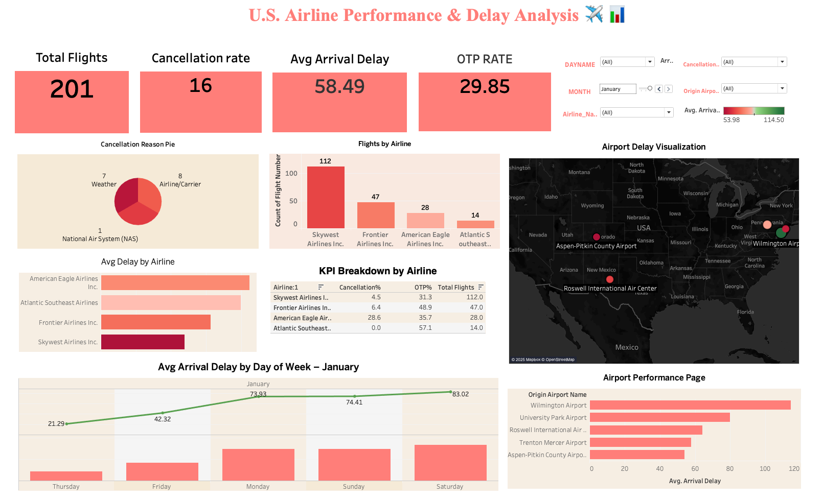
Dashboard Highlights
- KPIs: Flights, Delays, Cancellations, OTP
- Bar Charts: Delays by airline/airport
- Pie Chart: Cancellation reasons
- Map: Delay visualization by location
- Filters: Airline, Airport, Date, Reason
- Color logic: Green = good OTP, Red = high delay

Slide 7
Key Recommendations
1. Improve staffing and turnaround ops (esp. American Eagle)
2. Prioritize delay reduction at Wilmington & Roswell
3. Allocate more resources on weekends to cut peak delays

Slide 8
Conclusion
- SQL + Tableau enabled deep insights from flight data
- Visual dashboards support actionable decisions
- Potential to improve satisfaction & efficiency
Limitations:
- Based only on January data
- Further monthly/seasonal analysis recommended

