Slide 1
AI Fitness Trainer using OpenCV and Mediapipe
Guided By:
Mr.Amanullah Mohammad,M.Tech,Ph.D
Computer Science and Engineeing Department
Aditya College of Engineering and Technology
Team Members :
1) B. Veera Mahalakshmi -19P31A0507
2) D. Nirosha -19P31A0512
3) R. Sai Praneeth Chandra -19P31A0543
4) S. Naga Satya -20P35A0504
AI Fitness Trainer Using OpenCV and Mediapipe

Slide 2
List of Contents
Abstract
Objective
Introduction
Existing Model
Proposing model
Formulae Used
Advantages
Hardware/Software Requirements
UML Diagrams
User Interface
Conclusion
AI Fitness Trainer Using OpenCV and Mediapipe

Slide 3
Abstract
Recently lot of people facing many health issues due to the lack of physical activity. Not getting enough physical activity can lead to heart disease, even for people who have no other risk factors. It can also increase the likelihood of developing other heart disease risk factors, including obesity, high blood pressure, high blood cholesterol. Many people refrain from physical activities like workouts or yoga for various reasons like driving out to gym, trainer fees, social anxiety and hectic schedule. Our objective is develop a solution which can guide the user on how to properly perform a particular exercise or a yoga asana. With the help of OpenCV library and Mediapipe framework, we can develop an application that detects the user’s exercise pose and provides personalized, detailed recommendations on how the user can improve their form
AI Fitness Trainer Using OpenCV and Mediapipe

Slide 4
Objective
These days virtual assistant plays a crucial role in our day-to-day life activities and has become an inseparable part of our lives.
AI is one such emerging field that we aim to explore through this project of AI-based workout trainer.
In our project, we introduce AI Fitness Trainer that detects the users exercise pose, counts the specified exercise repetitions and provides recommendations on how the user can improve their form.
AI Fitness Trainer Using OpenCV and Mediapipe

Slide 5
Introduction
Recently lot of people facing many health issues due to the lack of physical activity. Not getting enough physical activity can lead to heart disease, even for people who have no other risk factors. It can also increase the likelihood of developing other heart disease risk factors, including obesity, high blood pressure, high blood cholesterol. Many people refrain from physical activities like workouts or yoga reasons:
1)driving out to gym
2)trainer fees
3)social anxiety
4)hectic schedule.
AI Fitness Trainer Using OpenCV and Mediapipe

Slide 6
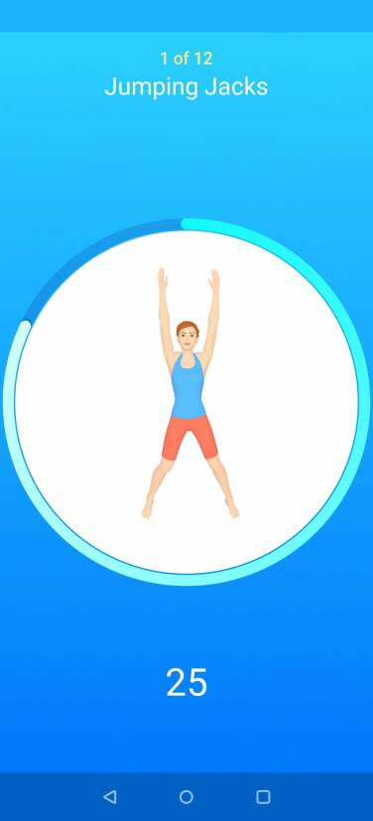
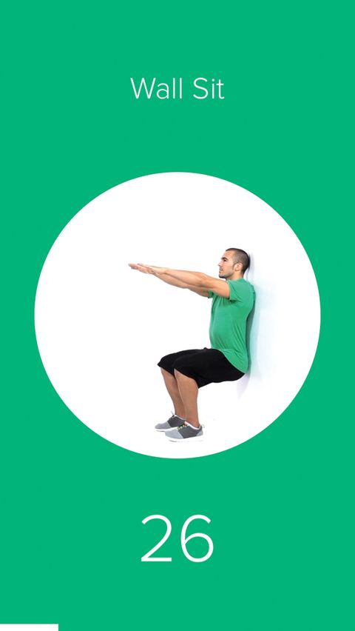
Existing Model
The scope of the existing system is very limited. All of these application are too focused on telling users about what to do rather than how to do.
Their services do not reflect upon the performance of the users and it doesn’t let the user know of their shortcomings in the posture they maintain while performing their exercises
AI Fitness Trainer Using OpenCV and Mediapipe

Slide 7
Proposing Model
The process is as follows:
1) Real time video feed is captured through camera
2) Mediapipe establishes pose landmarks onto the person
3) User’s pose landmarks co-ordinates are extracted from
real time video
4) The co-ordinates are passed on the associated validation
function.
5) After each successful completion of exercise, count is
incremented.
6) If user commits any mistakes, they will notified to the user through voice commands.
7) This can be used by the user to improve their performance
AI Fitness Trainer Using OpenCV and Mediapipe

Slide 8
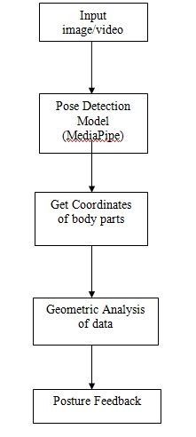
System Model
AI Fitness Trainer Using OpenCV and Mediapipe

Slide 9
Formulae Used:
Mediapipe provides us with locations of different body parts in the 2D space of the image. By picking any three points that correspond to a body part (e.g. left ankle, left knee, left hip), we can estimate the angle that's formed between these three points using simple trigonometry.
Formula for calculating angle formed by 3 points: Angle = math.degrees(math.atan2(y3-y2,x3-x2)- math.atan2(y1-y2,x1-x2))
Then, at each video frame, we calculate the mean squared error (MSE) between the current joint angles and the initial joint angles. This will give us a single value estimate of how far we are from the starting position. This can be used to keep count of repetitions
AI Fitness Trainer Using OpenCV and Mediapipe

Slide 10
Advantages
Our project is to overcome the following issues
1) To overcome the Shortage of gym trainers
2) To provide a economically viable option
3) Easy to use for people with busy schedule
4) For micro managing members of a gym center
5) For people with social anxiety
6) For beginners looking for guidance
AI Fitness Trainer Using OpenCV and Mediapipe

Slide 11
Hardware/Software Requirements
Software Requirements
Python
Libraries : CV2
Framework : Mediapipe
Hardware Requirements
OS: Windows 10 Operating System
RAM: 8GB
Intel Core i5
Webcam
AI Fitness Trainer Using OpenCV and Mediapipe

Slide 12
OpenCV Information
Open CV is one of the most widely used applications of computer vision. It is used for Human Face detection, Human Body detection, Landmark detection & much more.
Open CV Library is used for user image processing modules of detecting bodies. Image processing is a set-in which input is Users image & Output is image related set of characteristics & In Video Processing Real-time Analysis will be done in the human body will be detected.
AI Fitness Trainer Using OpenCV and Mediapipe

Slide 13
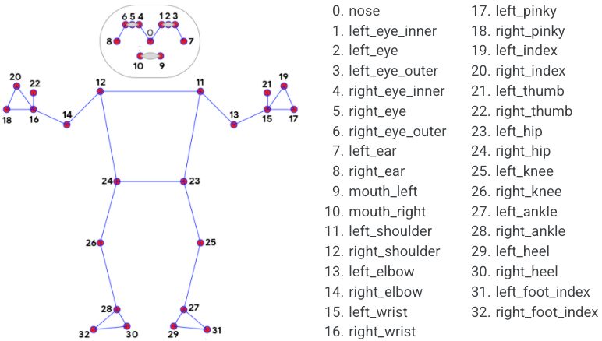
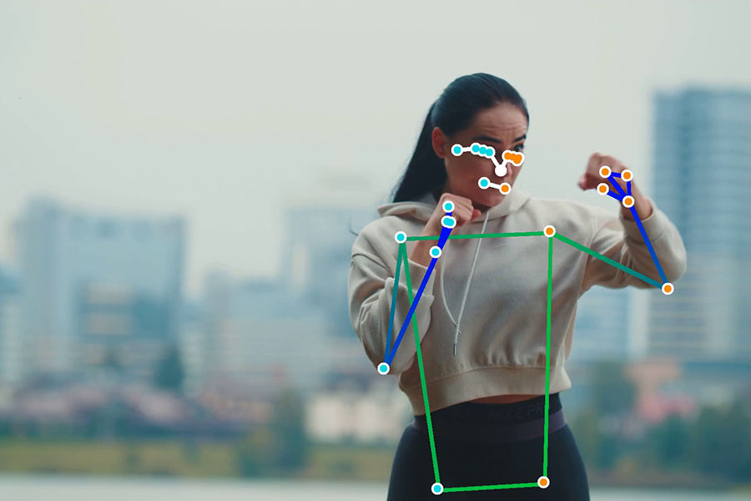
Mediapipe Information
MediaPipe Pose is a ML solution for high-fidelity body pose tracking, inferring 33 3D landmarks and background segmentation mask on the whole body from RGB video frames.
The landmark model in MediaPipe Pose predicts the location of 33 pose landmarks
AI Fitness Trainer Using OpenCV and Mediapipe

Slide 14
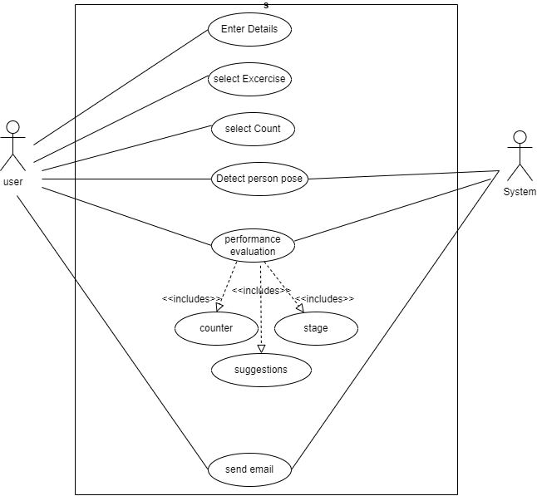
Use Case Diagram
AI Fitness Trainer Using OpenCV and Mediapipe

Slide 15
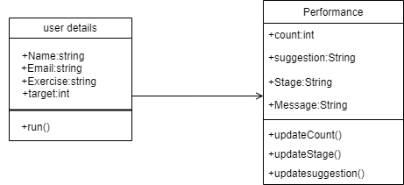
Class Diagram
AI Fitness Trainer Using OpenCV and Mediapipe

Slide 16
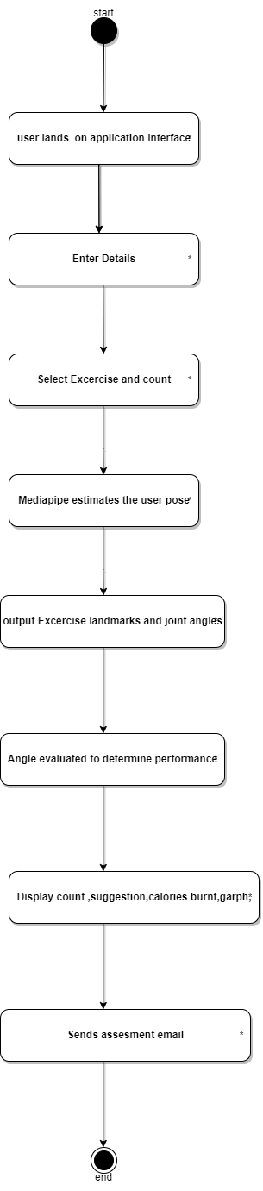
Activity Diagram
AI Fitness Trainer Using OpenCV and Mediapipe

Slide 17
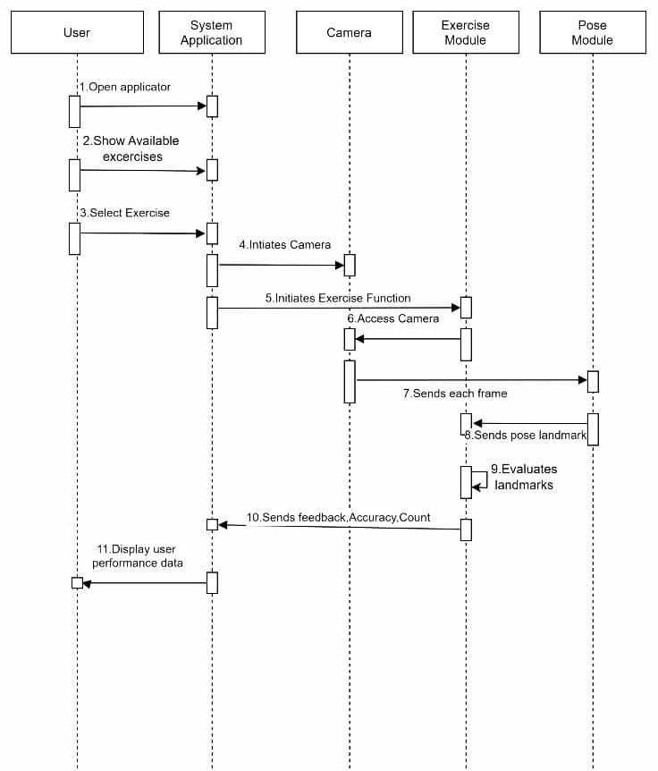
Sequence Diagram
AI Fitness Trainer Using OpenCV and Mediapipe

Slide 18
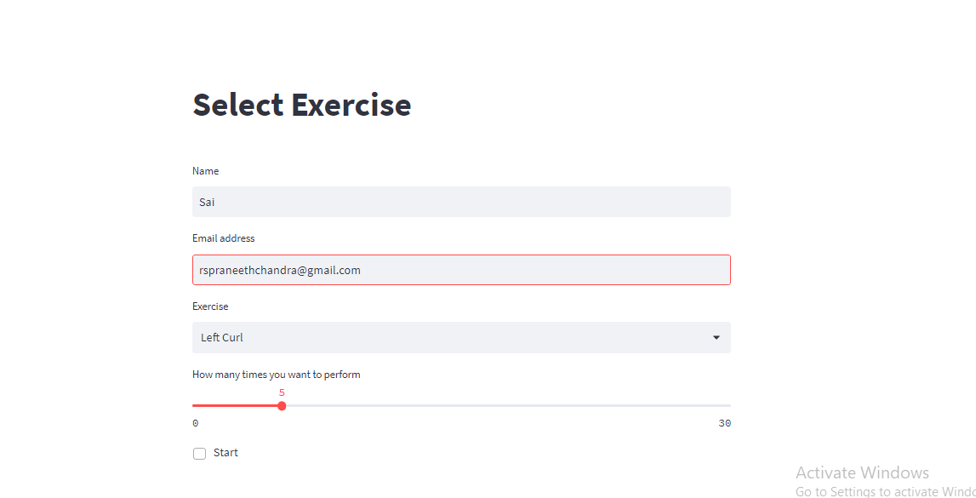
Project Execution Demo
Enter the details
AI Fitness Trainer Using OpenCV and Mediapipe

Slide 19
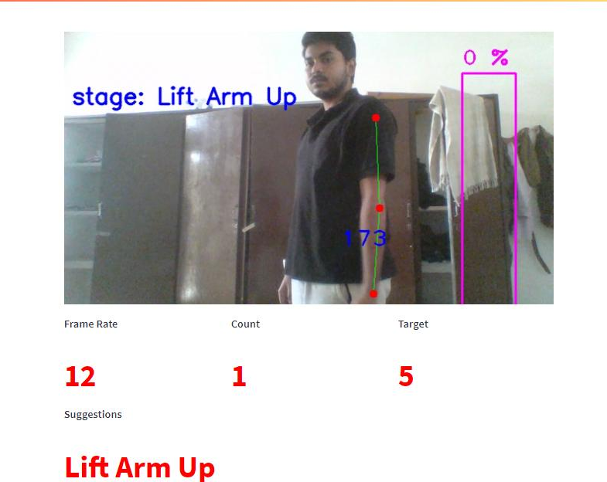
Start Performing the exercise
AI Fitness Trainer Using OpenCV and Mediapipe

Slide 20
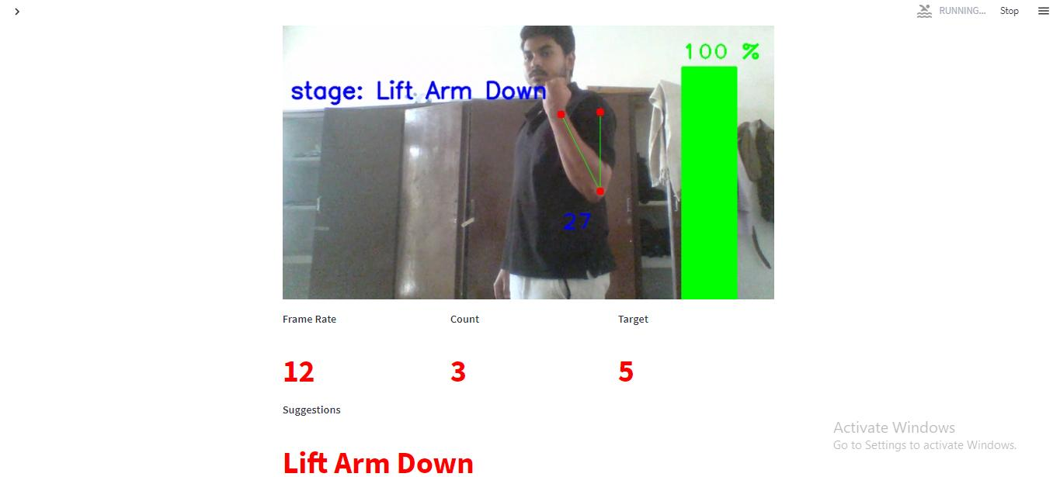
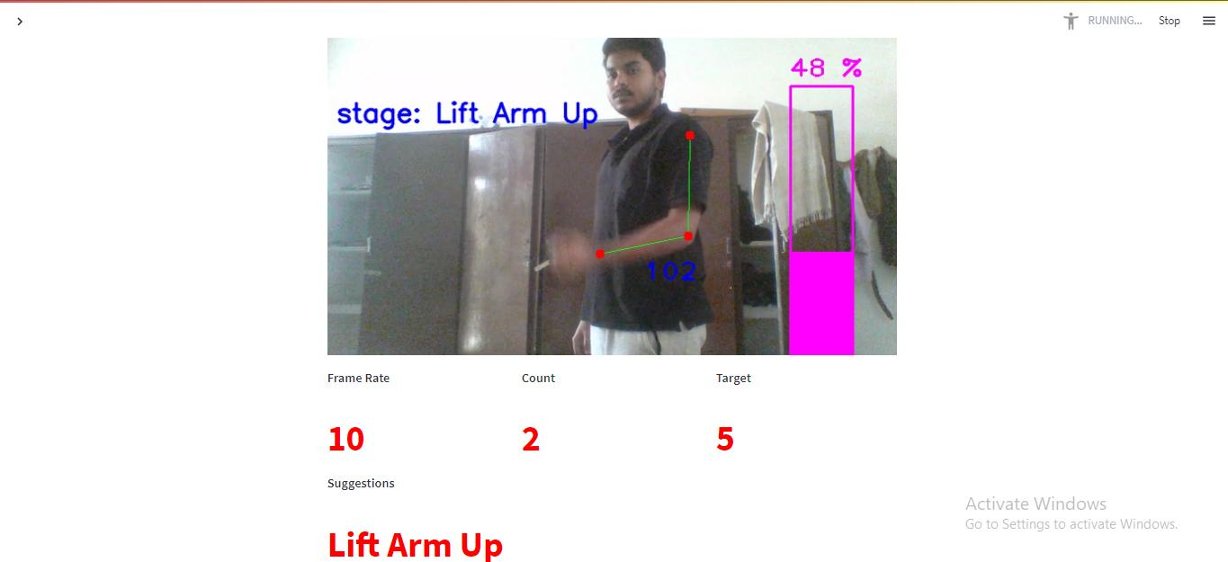
Watch the count and progress bar increasing
AI Fitness Trainer Using OpenCV and Mediapipe

Slide 21
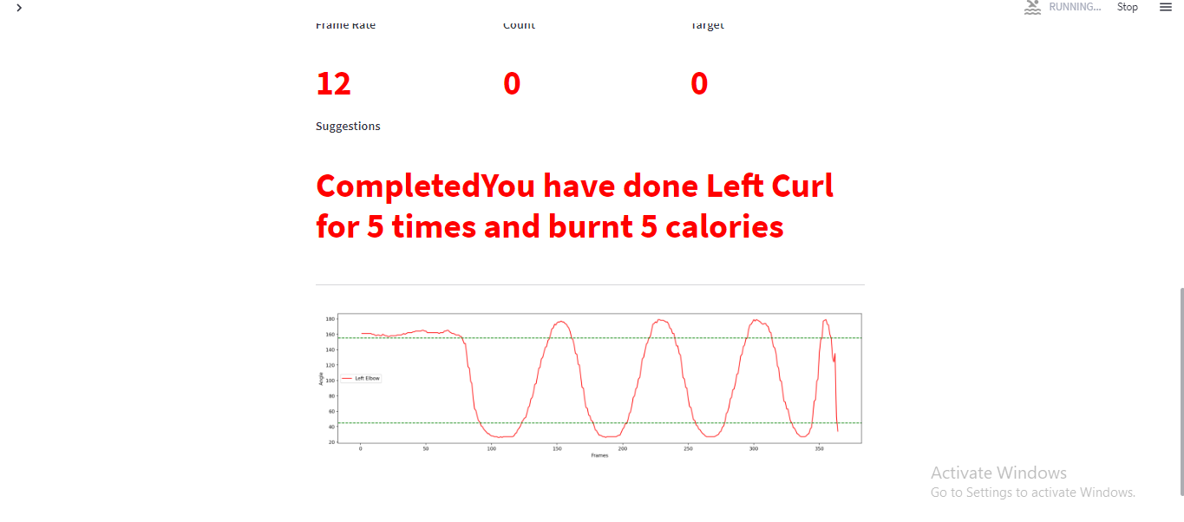
Get performance graph and message after target reached
AI Fitness Trainer Using OpenCV and Mediapipe

Slide 22
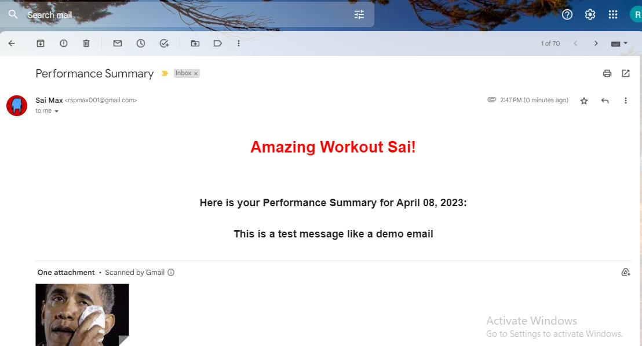
Get Email on your performance
AI Fitness Trainer Using OpenCV and Mediapipe

Slide 23
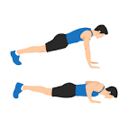
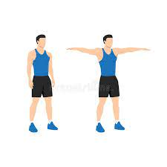
Pushups Lateral Curls

Slide 24
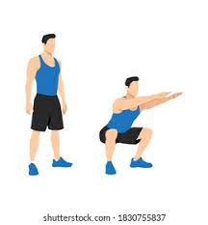
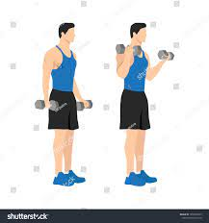
Curls
Squats

Slide 25
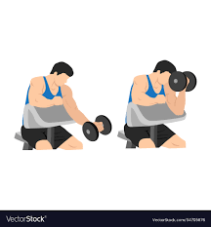
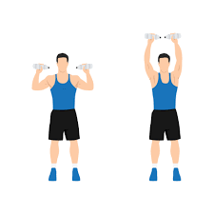
Left Curl
Shoulder Press

Slide 26
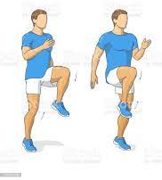
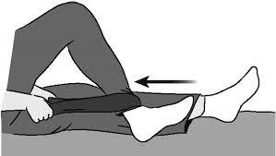
High Knees
Knee Bend

Slide 27
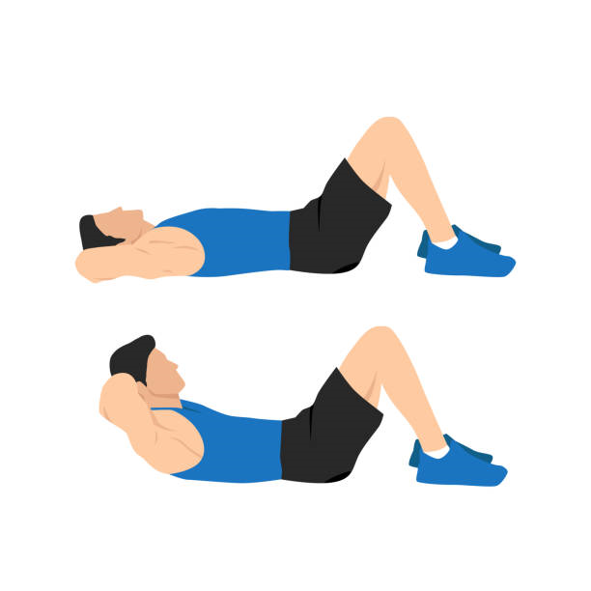
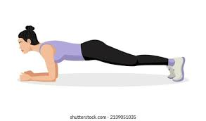
Sit Up
Plank

Slide 28
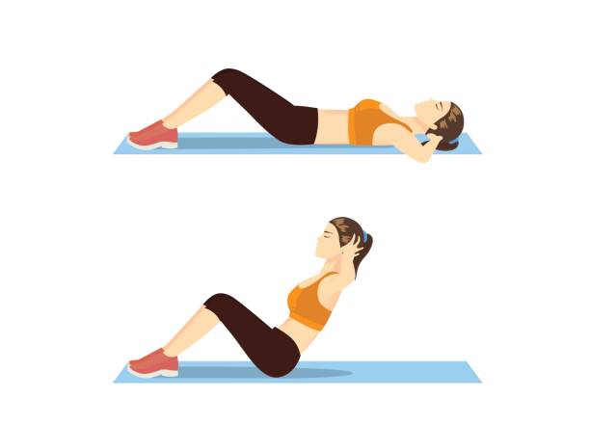
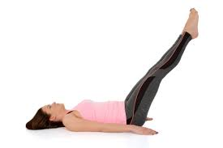
Crunches
Half Plough Pose

Slide 29
Conclusion
Nowadays our life is becoming busier and we hardly find time in our schedules to be healthy and fit and exercise daily. This has caused many diseases and health issues. Implementation of Artificial Intelligence in the field of fitness can solve many problems. The health-related applications and devices are making our lives easier and eases our fitness journey. Individuals can use this application in their own workouts, hence making them more efficient are less error-prone. There is a lot of scope of development in this project like it can be upgraded to support more exercises. The data collected by the AI Fitness Trainer can be saved and processed for the next sessions. The trainer will suggest you work out plan and its intensity according to your body type and weight.
AI Fitness Trainer Using OpenCV and Mediapipe

Slide 30
This application can be developed into more robust by adding more features for ease of use. The application can not only be used at homes but by increasing the scope can be used in gyms as smart trainers thus reducing the human intervention. This application will offer different styles of yoga to give user an overall fitness regime.
AI Fitness Trainer Using OpenCV and Mediapipe

Slide 31
THE END
AI Fitness Trainer Using OpenCV and Mediapipe

