Slide 1
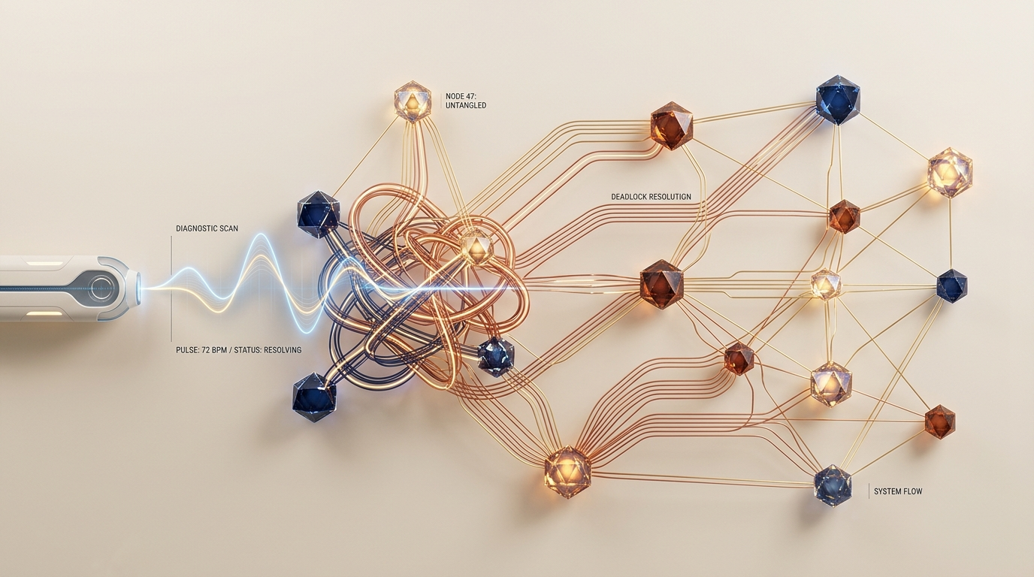
OPERATING SYSTEMS CAPSTONE • REVIEW - 1 (CO-1 TO CO-5)
DeadlockDoctor
High-Performance Resource Allocation & Deadlock Management System
Use Case #11: Banker's Avoidance, 3-Color DFS Detection, Starvation-Aware Cost Recovery & POSIX Concurrency Harness
Team Members (3 Students):
• [Student 1 Name] ([Student 1 Roll No])
• [Student 2 Name] ([Student 2 Roll No])
• [Student 3 Name] ([Student 3 Roll No])
Deliverables: C11 Core Engine • Interactive CLI Shell • HTML5 SVG Dashboard • Scenario Parser

Slide 2
SECTION 1: PROJECT IDENTIFICATION & FORMULATION (5 MARKS)
Problem Statement & Core Project Objectives
The Concurrency Deadlock Crisis
Core Objectives & Technical Scope
Multi-threaded OS runtimes frequently freeze due to resource contention satisfying all 4 Coffman conditions simultaneously:
• 1. Mutual Exclusion: Resources (mutexes, GPU, disks) are non-shareable and held exclusively.
• 2. Hold and Wait: Processes hold allocated resources while actively waiting for others.
• 3. No Preemption: OS cannot forcibly reclaim mutexes without corrupting application state.
• 4. Circular Wait: Cyclic dependency chains leave threads trapped indefinitely.
Traditional Fallback Failures: Static timeouts and blind SIGKILL restarts cause severe data loss, wasted CPU compute, and cascading pipeline starvation.
1. Complete Avoidance Engine: Implement Dijkstra's Banker's Algorithm with safe sequence verification in O(P²×R).
2. Sub-Millisecond Detection: Build 3-Color DFS cycle search on Wait-For Graphs (WFG) in O(V+E) + multi-instance reduction.
3. Starvation-Aware Recovery: Formulate multi-attribute cost metric C(Pi) to abort optimal victims and release blocked threads.
4. Havender's Prevention: Enforce linear hierarchical ordering and hold-and-wait validation.
5. Real POSIX Watchdog: Intercept live multithreaded mutex deadlocks in <100ms with thread-safe telemetry.
6. Dual Diagnostic UI: Provide an interactive CLI shell with native OS passthrough + modern SVG web dashboard.

Slide 3
SECTION 2: REQUIREMENTS ANALYSIS (10 MARKS)
Functional & Non-Functional Engineering Specifications
Functional Requirements (FR-01 to FR-06)
Non-Functional Requirements (NFR-01 to NFR-05)
• FR-01 Dynamic State Matrices: Tracks Allocation, Need, Max Claim, and Available matrices up to 64 processes & 32 resources.
• FR-02 Banker's Safety Engine: Simulates grants and derives valid execution sequences <P_i1, ..., P_in> before state commits.
• FR-03 3-Color DFS Graph Traversal: Constructs bipartite RAG and reduced WFG to identify directed back-edges in O(V+E).
• FR-04 Vector Matrix Reduction: Identifies contention sets for multi-instance resource types.
• FR-05 Cost-Based Recovery: Evaluates 4 victim selection policies (cheapest, lowest priority, fewest resources, starvation-safe).
• FR-06 Prevention Guard: Enforces Havender's linear ordering and pre-allocation protocols.
• NFR-01 Sub-Millisecond Response: Cycle detection and Banker's safety verification executes in <50 microseconds.
• NFR-02 Zero Memory Leaks: 100% clean memory verification under AddressSanitizer (ASan) & UBSan.
• NFR-03 Thread-Safety & Concurrency: POSIX mutex synchronization protects all matrix state transitions.
• NFR-04 Strict ISO C11 Standards: Built with GCC flags -std=c11 -Wall -Wextra -Wpedantic with 0 warnings/errors.
• NFR-05 Extensible Scenario Parser: Deterministic replay of .dd benchmark scripts for regression testing.
• I/O Architecture: ANSI colored CLI REPL + REST API JSON exporter for SVG web visualization.

Slide 4
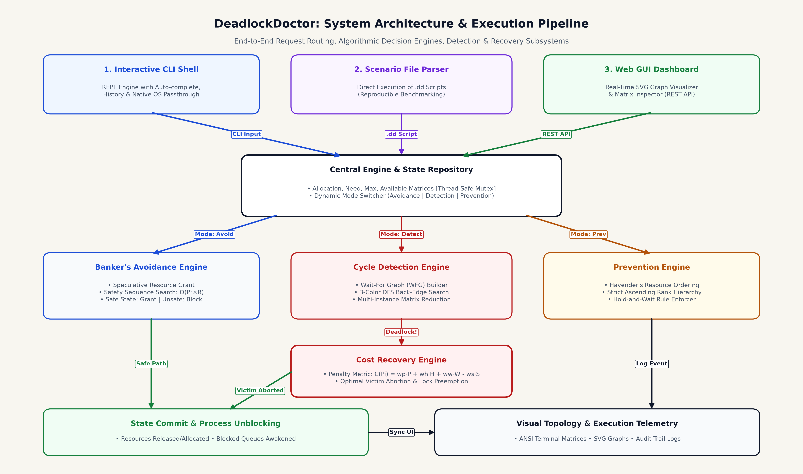
SECTION 3: DESIGN & ARCHITECTURE (10 MARKS)
System Architecture & End-to-End Execution Pipeline Flowchart

Slide 5
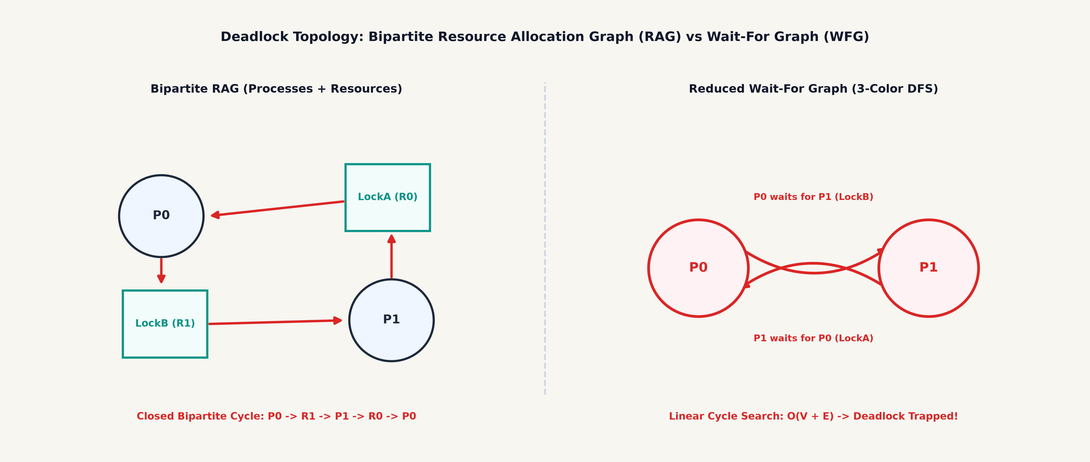
SECTION 3: ALGORITHMIC RIGOR & FORMULATIONS
Deadlock Graph Topologies & Mathematical Formulations
1. Banker's Algorithm & 3-Color DFS
2. Multi-Attribute Penalty Metric & Prevention
• Banker's Safety Condition: Need[i][j] = Max[i][j] - Allocation[i][j]
• Work Vector Simulation: If Finish[i] == false & Need[i] <= Work => Work += Alloc[i]
• 3-Color DFS Cycle Math: WHITE (unvisited) -> GRAY (active in stack) -> BLACK (visited). A directed edge to a GRAY node confirms a deadlock cycle in O(V + E).
• Victim Cost Formula: C(Pi) = wp·Priority(Pi) + wh·Held(Pi) + ww·Work(Pi) - ws·Starve(Pi)
• Optimized Selection: Victim = argmin_{P ∈ Deadlocked} C(P) (lowest penalty score is aborted).
• Havender's Linear Ordering: Strict ascending resource rank f(Ri) < f(Rj) mathematically guarantees cycle impossibility.

Slide 6
CURRICULUM ALIGNMENT & RUBRIC COVERAGE
Course Outcomes (CO-1 to CO-5) Implementation Evidence
Course Outcome | OS Domain & Syllabus Focus | DeadlockDoctor Implementation Evidence | Code Files & Evidence
CO-1 | OS Services, System Calls & Shell Interface | Custom interactive REPL shell with command dispatching, help system, ANSI table visualizer, and seamless native OS passthrough (pwd, ls, cd, cat). | src/main.c src/ui/visualizer.c
CO-2 | Process Management, States & Scheduling | Process lifecycle control (RUNNING, BLOCKED, TERMINATED), priority queues, state vector updates, and cost-based preemption/abort. | src/core/resource_mgr.c src/recovery/recovery.c
CO-3 | Concurrency, Synchronization & Mutexes | Thread-safe matrix access with POSIX mutex locks, multithreaded lock race simulation harness, and asynchronous watchdog timer. | src/demo/live_demo.c include/demo/live_demo.h
CO-4 | Memory Management & Runtime Safety | Dynamic 2D/1D matrix allocations, zero leaks verified with AddressSanitizer & UndefinedBehaviorSanitizer (-fsanitize=address,undefined). | src/core/resource_mgr.c Makefile (make memcheck)
CO-5 | File Subsystems & Scenario Scripting | Deterministic .dd scenario script parser with lexer/tokenizer for reproducible deadlock benchmarks, state dumps, and audit logs. | src/scenario/scenario.c scenarios/*.dd

Slide 7
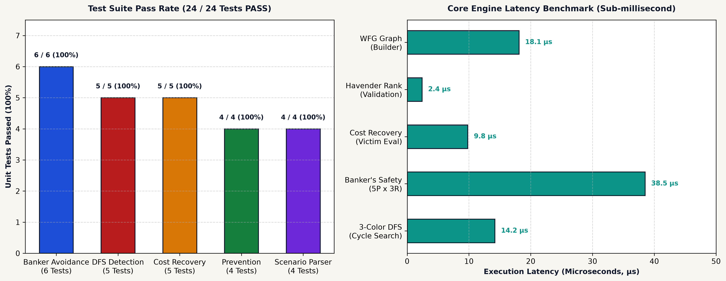
SECTION 4: VERIFICATION & BENCHMARKING
Unit Test Suite, Performance Latency & Memory Audit
Memory Audit & ASan Verification
• Leak Sanitizer: 0 bytes leaked in 0 allocations.
• AddressSanitizer: 0 heap buffer overruns / use-after-free.
• UndefinedBehavior: 0 integer overflows / null dereferences.
• Valgrind Target: All heap memory freed on shell exit.
Automated Scenario Matrix
• 01_bankers_safe.dd: Safe sequence derived [PASS]
• 02_bankers_unsafe.dd: Unsafe request blocked [PASS]
• 03_single_instance_cycle.dd: Cycle detected & resolved [PASS]
• 04_multi_instance_deadlock.dd: Vector reduction [PASS]
• 05_starvation_recovery.dd: Penalty protection [PASS]
• 06_complex_mesh.dd: Dense graph resolution [PASS]

Slide 8
SECTION 5: DEMONSTRATION & DELIVERABLES
Live Execution Suite, Interactive Shell & Review Deliverables
1. Interactive CLI REPL
2. HTML5 Web Dashboard
3. Real Pthread Deadlock Race
• show / matrices: Inspect Allocation, Need, Max & Available tables.
• req <p> <r> <k>: Request resource units with dynamic safety check.
• detect: Run 3-Color DFS on WFG and print cycle path.
• recover: Execute cost penalty victim selection & abort.
• banker: Calculate Banker's safe execution sequence.
• mode <avoid|detect|prev>: Switch engine operating mode.
• OS Passthrough: Execute pwd, ls, cd, cat seamlessly.
• Visual Graph Canvas: SVG rendering of Bipartite RAG and Wait-For Graph (WFG).
• Live Matrix Inspector: Real-time updates of Allocation & Available chips.
• Theme Switcher: Toggle between Dark Studio & Warm Cream palettes.
• REST API Backend: Python HTTP micro-server bridging C state to browser.
• Interactive Triggers: One-click safe/unsafe request dispatching.
• POSIX Concurrency: Spawns 2 real threads locking pthread_mutex_t in reverse order.
• Lock Race Creation: Worker1 holds MutexA -> wants MutexB; Worker2 holds MutexB -> wants MutexA.
• Asynchronous Watchdog: Detects blocked state within 100ms and breaks deadlock safely.
• Review-1 Outcome: 100% of Review-1 milestones met across CO-1 through CO-5.
DeadlockDoctor: Production-Grade Resource & Deadlock Management Engine • Fully Verified for Review - 1
Summary: 24/24 Unit Tests Passed • 0 Memory Leaks (ASan) • Sub-millisecond Execution • Complete C11 + Web GUI Suite

