Slide 1
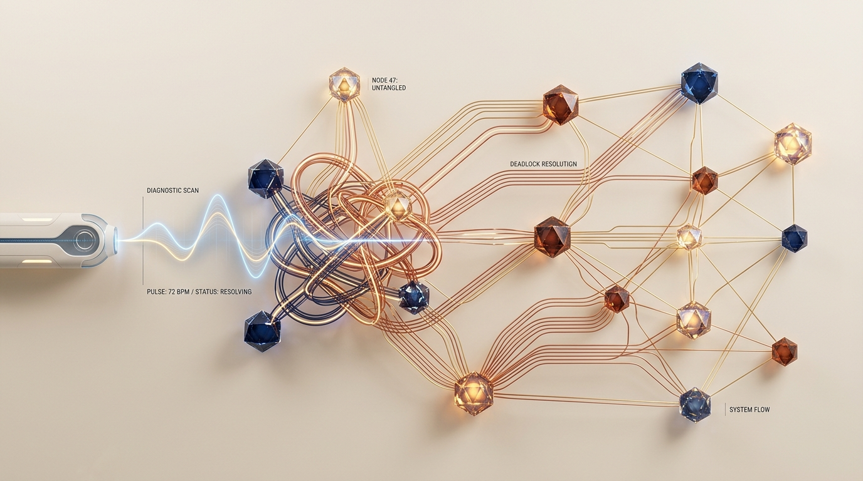
OPERATING SYSTEMS CAPSTONE • REVIEW 1 (CO-1 TO CO-5)
DeadlockDoctor
High-Performance Resource Allocation & Deadlock Management System
Use Case #11: Banker's Avoidance, 3-Color DFS Detection, Starvation-Aware Cost Recovery & POSIX Concurrency Harness
TEAM MEMBERS (3 STUDENTS)
DELIVERABLES
C11 Core Engine
Interactive CLI Shell
[Student 1 Name] ([Student 1 Roll No])
[Student 2 Name] ([Student 2 Roll No])
[Student 3 Name] ([Student 3 Roll No])
HTML5 SVG Dashboard
Scenario Parser

Slide 2
SECTION 1 • PROJECT IDENTIFICATION & FORMULATION • 5 MARKS
Problem Statement & Core Objectives
The Concurrency Deadlock Crisis
Core Objectives & Technical Scope
Multi-threaded runtimes freeze when contention satisfies all 4 Coffman conditions at once:
1
Complete Avoidance Engine
Dijkstra's Banker's Algorithm with safe-sequence check, O(P²×R).
1
Mutual Exclusion
2
Hold and Wait
2
Sub-Millisecond Detection
3-Color DFS on Wait-For Graphs in O(V+E) plus multi-instance reduction.
Mutexes, GPU and disks are held exclusively.
Processes keep resources while waiting for more.
3
Starvation-Aware Recovery
Multi-attribute cost metric C(Pi) picks the best victim to abort.
3
No Preemption
4
Circular Wait
4
Havender's Prevention
Linear resource ordering and hold-and-wait validation.
Forced reclaim would corrupt application state.
Cyclic chains trap threads indefinitely.
5
Real POSIX Watchdog
Catches live mutex deadlocks in <100 ms with thread-safe telemetry.
Why traditional fallbacks fail
Static timeouts and blind SIGKILL restarts cause data loss, wasted CPU and cascading pipeline starvation.
6
Dual Diagnostic UI
Interactive CLI shell with OS passthrough + modern SVG web dashboard.

Slide 3
SECTION 2 • REQUIREMENTS ANALYSIS • 10 MARKS
Functional & Non-Functional Specifications
Functional Requirements (FR-01 to FR-06)
Non-Functional Requirements (NFR-01 to NFR-05)
FR-01
Dynamic State Matrices
Tracks Allocation, Need, Max and Available for up to 64 processes & 32 resources.
NFR-01
Sub-Millisecond Response
Cycle detection and safety checks run in <50 µs.
FR-02
Banker's Safety Engine
Simulates grants and derives a safe sequence before any state commit.
NFR-02
Zero Memory Leaks
100% clean under AddressSanitizer and UBSan.
FR-03
3-Color DFS Traversal
Builds bipartite RAG and reduced WFG; finds back-edges in O(V+E).
NFR-03
Thread-Safety
POSIX mutexes protect every matrix state transition.
FR-04
Vector Matrix Reduction
Identifies contention sets for multi-instance resource types.
NFR-04
Strict ISO C11
-std=c11 -Wall -Wextra -Wpedantic with 0 warnings or errors.
FR-05
Cost-Based Recovery
4 victim policies: cheapest, lowest priority, fewest resources, starvation-safe.
NFR-05
Extensible Scenario Parser
Deterministic replay of .dd scripts for regression testing.
FR-06
Prevention Guard
Enforces Havender's linear ordering and pre-allocation protocols.
I/O
Architecture
ANSI-colored CLI REPL + REST/JSON exporter for the SVG web dashboard.

Slide 4
SECTION 3 • DESIGN & ARCHITECTURE • 10 MARKS
System Architecture & Execution Pipeline
1. Interactive CLI Shell
REPL with auto-complete, history & OS passthrough
2. Scenario File Parser
Runs .dd scripts (reproducible benchmarks)
3. Web GUI Dashboard
Real-time SVG graphs & matrix inspector
CLI
.dd script
REST API
Central Engine & State Repository
Allocation, Need, Max, Available matrices (thread-safe mutex) • Mode switcher: Avoidance | Detection | Prevention
Mode: Avoid
Mode: Detect
Mode: Prevent
Banker's Avoidance Engine
Speculative grant • safety search O(P²×R) • Safe: grant / Unsafe: block
Cycle Detection Engine
WFG builder • 3-Color DFS back-edge search • multi-instance reduction
Prevention Engine
Havender's resource ordering • hold-and-wait enforcer
Safe path
Deadlock!
Log event
State Commit & Unblocking
Resources released / allocated • blocked queues awakened
Cost Recovery Engine
C(Pi) = wp·P + wh·H + ww·W − ws·S • optimal victim abort
Visual Topology & Telemetry
ANSI matrices • SVG graphs • audit logs

Slide 5
SECTION 3 • ALGORITHMIC RIGOR
Deadlock Graph Topologies & Formulations
Bipartite RAG (processes + resources)
Reduced Wait-For Graph (3-Color DFS)
P0
LockA (R0)
P0 waits for P1 (LockB)
P0
P1
LockB (R1)
P1
P1 waits for P0 (LockA)
Closed cycle: P0 → R1 → P1 → R0 → P0
Linear cycle search O(V+E) → deadlock trapped
Banker's Algorithm & 3-Color DFS
Penalty Metric & Prevention
Need[i][j] = Max[i][j] − Allocation[i][j]
If Finish[i] == false and Need[i] ≤ Work, then Work += Alloc[i]
WHITE → GRAY → BLACK; an edge to a GRAY node confirms a cycle
C(Pi) = wp·Priority + wh·Held + ww·Work − ws·Starve
Victim = argmin C(P) over deadlocked P (lowest score is aborted)
Havender ordering: f(Ri) < f(Rj) makes cycles impossible

Slide 6
CURRICULUM ALIGNMENT & RUBRIC COVERAGE
Course Outcomes (CO-1 to CO-5): Implementation Evidence
CO | OS Domain & Syllabus Focus | Implementation Evidence | Code Files
CO-1 | OS Services, System Calls & Shell | Custom REPL shell with command dispatch, help, ANSI table visualizer and native OS passthrough (pwd, ls, cd, cat). | src/main.c src/ui/visualizer.c
CO-2 | Process Management & Scheduling | Lifecycle states (RUNNING, BLOCKED, TERMINATED), priority queues, state-vector updates, cost-based abort. | src/core/resource_mgr.c src/recovery/recovery.c
CO-3 | Concurrency & Synchronization | Thread-safe matrix access via POSIX mutexes, lock-race harness and asynchronous watchdog timer. | src/demo/live_demo.c include/demo/live_demo.h
CO-4 | Memory Management & Runtime Safety | Dynamic 1D/2D matrix allocation; zero leaks under ASan + UBSan (-fsanitize=address,undefined). | src/core/resource_mgr.c Makefile (make memcheck)
CO-5 | File Subsystems & Scripting | Deterministic .dd scenario parser (lexer/tokenizer) for reproducible benchmarks, state dumps and audit logs. | src/scenario/scenario.c scenarios/*.dd

Slide 7
SECTION 4 • VERIFICATION & BENCHMARKING
Unit Tests, Latency & Memory Audit
Memory Audit & ASan Verification
Automated Scenario Matrix (6 / 6 PASS)
Leak Sanitizer: 0 bytes leaked
AddressSanitizer: 0 overruns / use-after-free
UBSan: 0 overflows / null dereferences
Valgrind: all heap memory freed on exit
01_bankers_safe.dd
✓ Safe sequence derived
02_bankers_unsafe.dd
✓ Unsafe request blocked
03_single_cycle.dd
✓ Cycle detected & resolved
04_multi_deadlock.dd
✓ Vector reduction
05_starvation.dd
✓ Penalty protection
06_complex_mesh.dd
✓ Dense graph resolved

Slide 8
SECTION 5 • DEMONSTRATION & DELIVERABLES
Live Execution Suite & Review Deliverables
1 Interactive CLI REPL
2 HTML5 Web Dashboard
3 Real Pthread Race
show inspect Allocation, Need, Max, Available
req <p> <r> <k> request units with safety check
detect run 3-Color DFS, print cycle path
recover cost-based victim selection & abort
banker compute safe execution sequence
mode <avoid|detect|prev> switch engine mode
Graph canvas SVG of bipartite RAG and WFG
Matrix inspector live Allocation & Available chips
Themes Dark Studio / Warm Cream
REST backend Python micro-server bridges C state
Triggers one-click safe / unsafe requests
Two threads lock pthread_mutex_t in reverse order
Race Worker1: holds A, wants B
Worker2: holds B, wants A
Watchdog detects block within 100 ms, breaks it safely
Outcome 100% of Review-1 milestones met
24 / 24
0
<50 µs
C11 + Web
unit tests passed
memory leaks (ASan)
detection time
complete suite

