Slide 1
B I T T U X E R O X K I O S K
15,000+
students. 1 photocopy shop.
Closes at 5:30 PM.
Autonomous 24/7 Smart Self-Service Printing & Document Kiosk
Zero Queues · Zero Leakage · 24/7

Slide 2
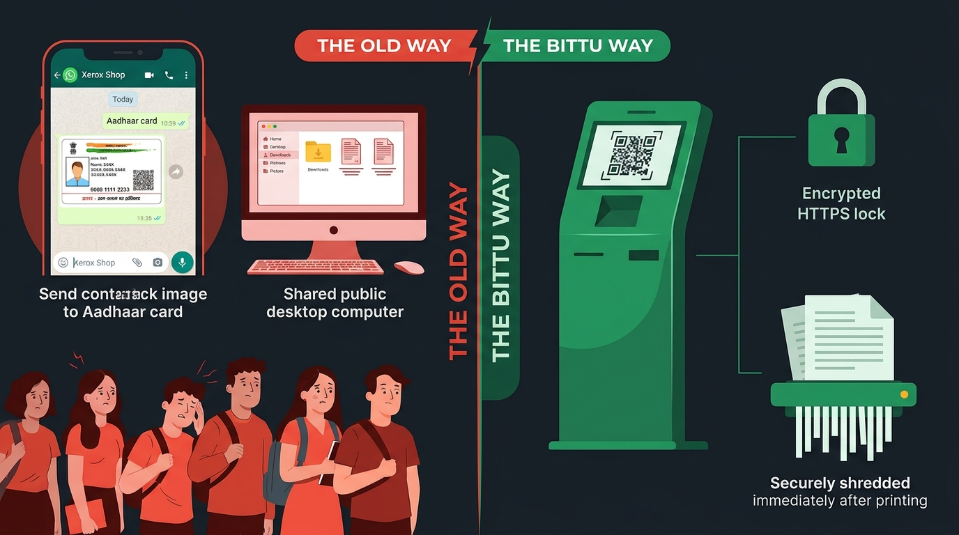
T H E C R I S I S
Your Aadhaar on a stranger's phone.
🕐 9:30 AM – 5:30 PM
⏱️ 20–45 Minutes
💸 ₹3 – ₹5 / Page
Restricted Hours
Peak Queue Time
Monopoly Pricing

Slide 3
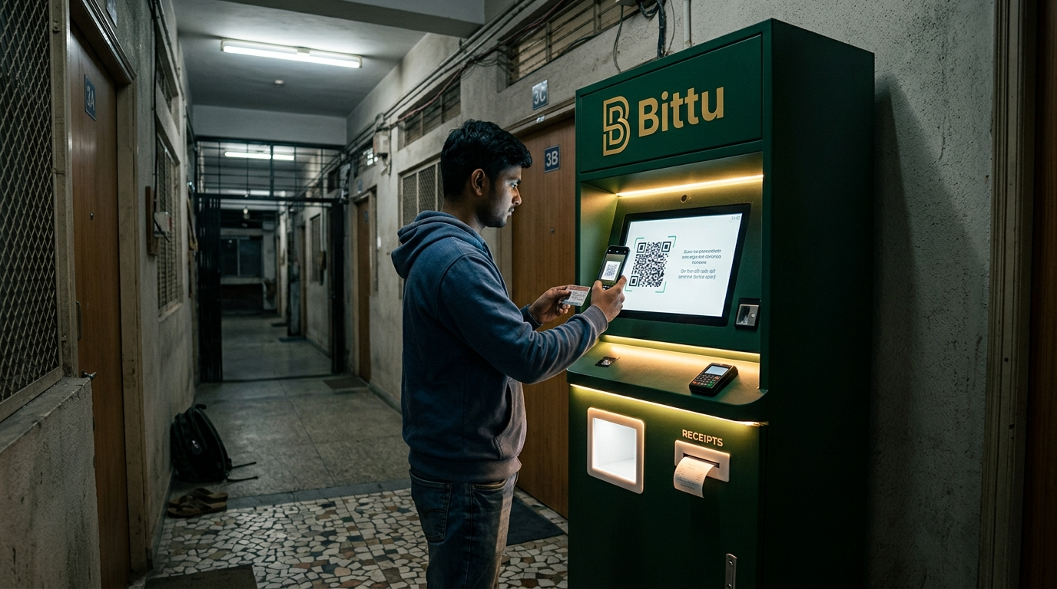
T H E S O L U T I O N
Meet Bittu.
24/7
₹2.50
0.36 m²
🔒 Secure
Always On
Per Page
Footprint
Zero Data Retention

Slide 4
U N D E R T H E H O O D
Engineering That No Competitor Has.
⚡ EXPRESS LANE SCHEDULER
Small jobs never wait.
• Bulk jobs split into 5-page micro-chunks.
• Between chunks, express jobs (< 5 pages) jump in.
100-page job running. 2-page job arrives:
[Chunk 1-5] → PAUSE → [2-pg Express] → RESUME [6-10]...
Student B waits 15 sec, not 8 minutes.
🔋 3-TIER SMART POWER
71% energy savings via PIR.
3 min idle
Display dims, printer standby
22W
15 min idle
Display OFF, deep sleep
4W
2–6 AM
Night mode, relay cuts power
1.5W
🔒 DPDP-COMPLIANT SECURITY
Volatile RAM Buffer (tmpfs)
Files live in RAM only — never touch disk.
Post-Print Auto-Delete
Removed the instant CUPS says done.
TLS 1.3 In-Transit
End-to-end encrypted file transfer.
OTP Rate-Limited
3 attempts/min. 2-hour auto-expiry.
🏫 CAMPUS ERP INTEGRATION
1-Tap Exam Hall Tickets
Print admit cards with security watermark.
Grade Cards & Certificates
Semester reports, fee receipts, attendance.
Secure Session Bridge
Student authenticates via Reg No + OTP.
Zero Credential Exposure
ERP tokens never reach kiosk frontend.
🛠️ TECH STACK
Frontend Chromium Kiosk PWA
Backend Python + FastAPI (async)
Print Engine CUPS on Linux
Bot python-telegram-bot
Database SQLite (jobs, logs)
Payments Razorpay / UPI QR
Hardware Raspberry Pi 5 / 4B
CAD OpenSCAD (parametric)

Slide 5
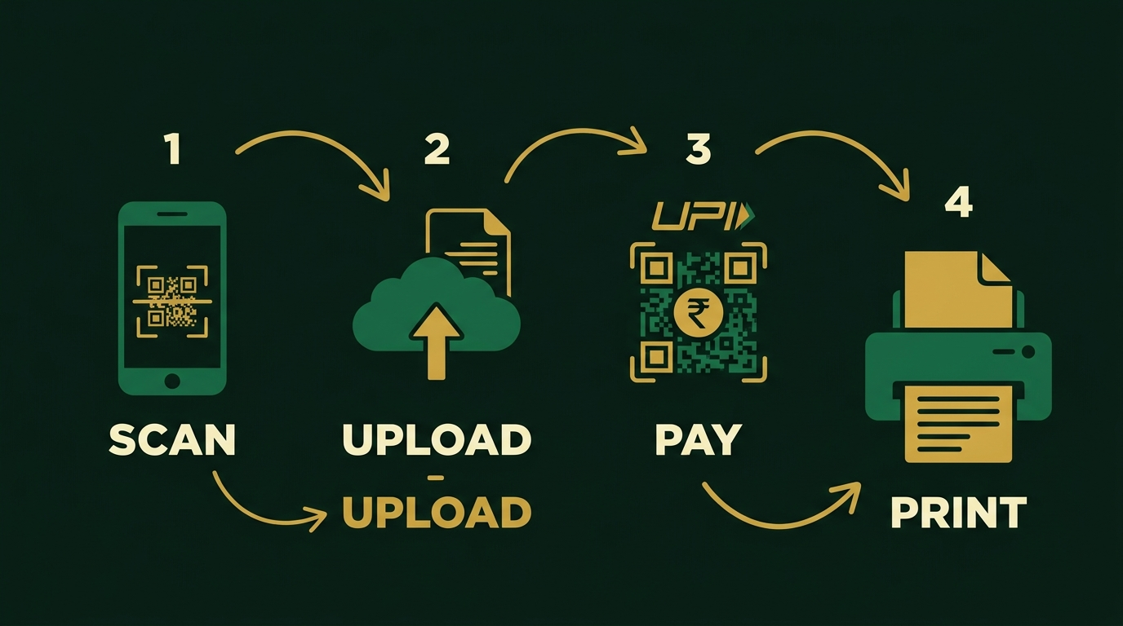
W O R K F L O W
Scan. Upload. Pay. Print.
Under 60 seconds. No app download. No clerk. No queue.
QR + Web Upload
Telegram / WhatsApp Bot
No app install needed
Send doc → get PIN → print

Slide 6
U N I T E C O N O M I C S
The Numbers Work.
COST BREAKDOWN PER PAGE
COST
SELL
PROFIT
🟢 Paper (75 GSM)
₹0.52
43%
₹1.20
→
₹2.50
=
₹1.30
🟡 Toner Cartridge
₹0.25
21%
🟠 Drum Amortization
₹0.10
8%
52% Gross Margin
CAPEX: ₹48,400
🔵 Electricity
₹0.03
3%
🟤 Jam/Misprint Buffer
₹0.05
4%
MONTHLY PROFIT & PAYBACK
🔴 Campus Floor Share
₹0.25
21%
Conservative · 150 pages/day
₹4,875/mo
Total Production Cost
₹1.20
Payback: ~10.5 months
Realistic · 350 pages/day
₹11,375/mo
Payback: ~4.2 months
Peak Season · 700 pages/day
₹22,750/mo
Payback: ~2.1 months ⚡

Slide 7
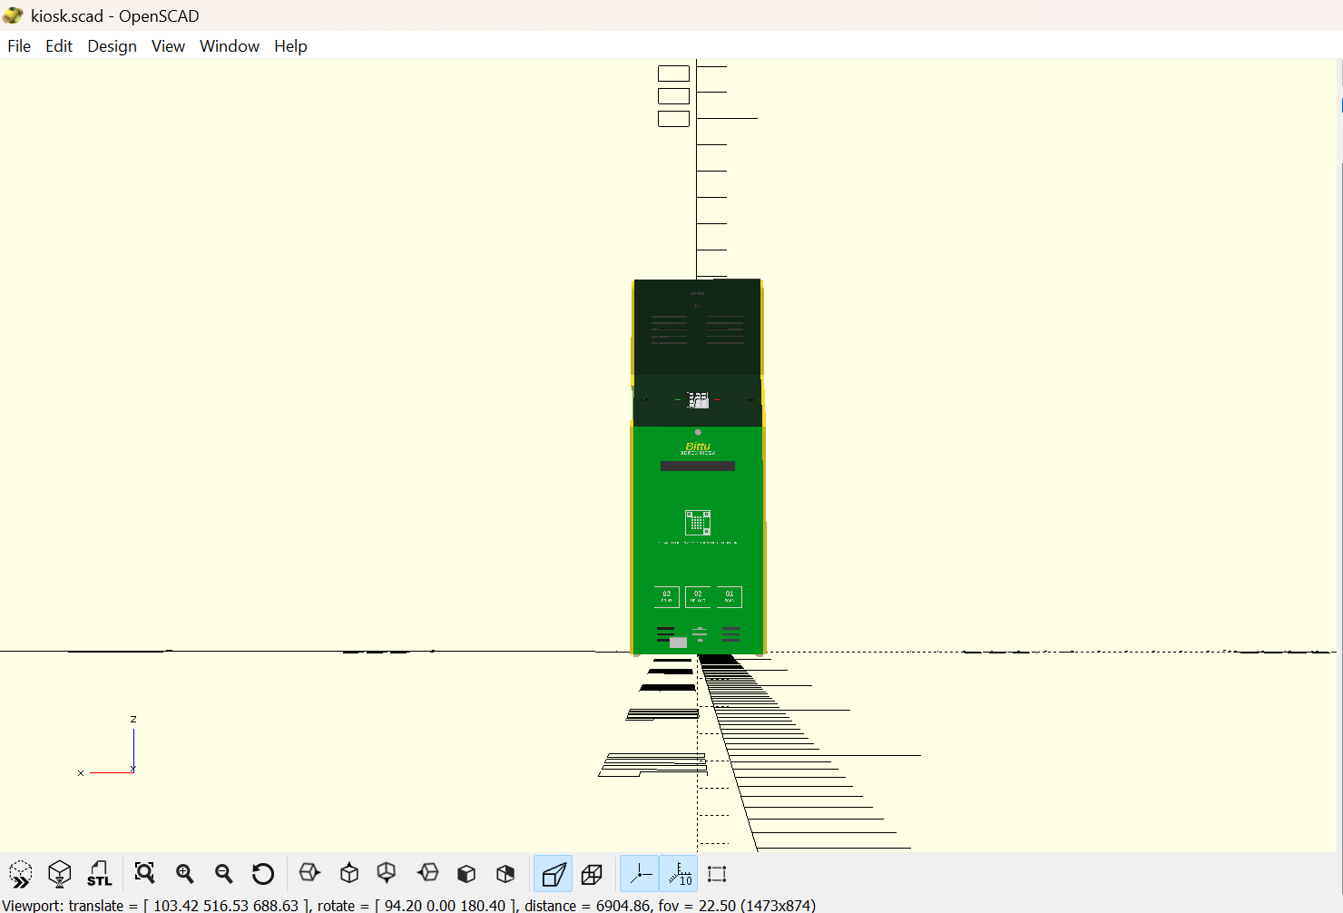
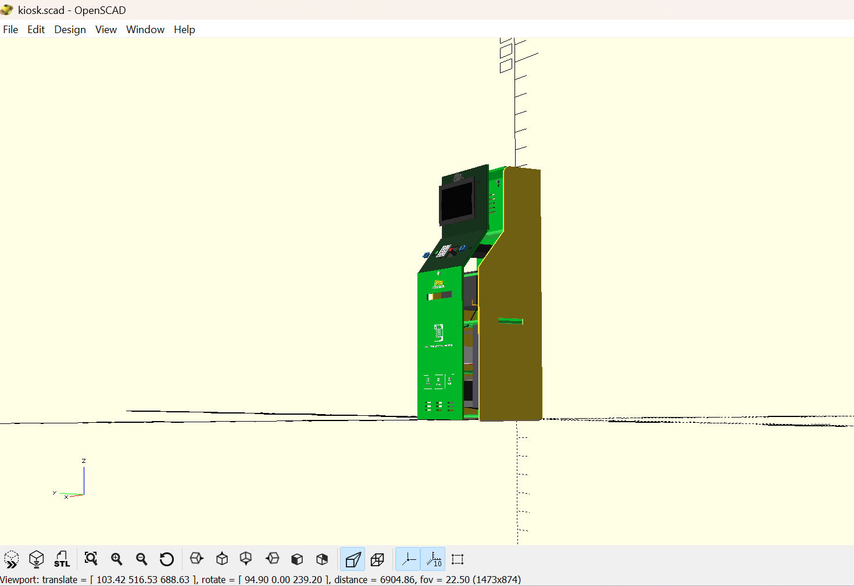
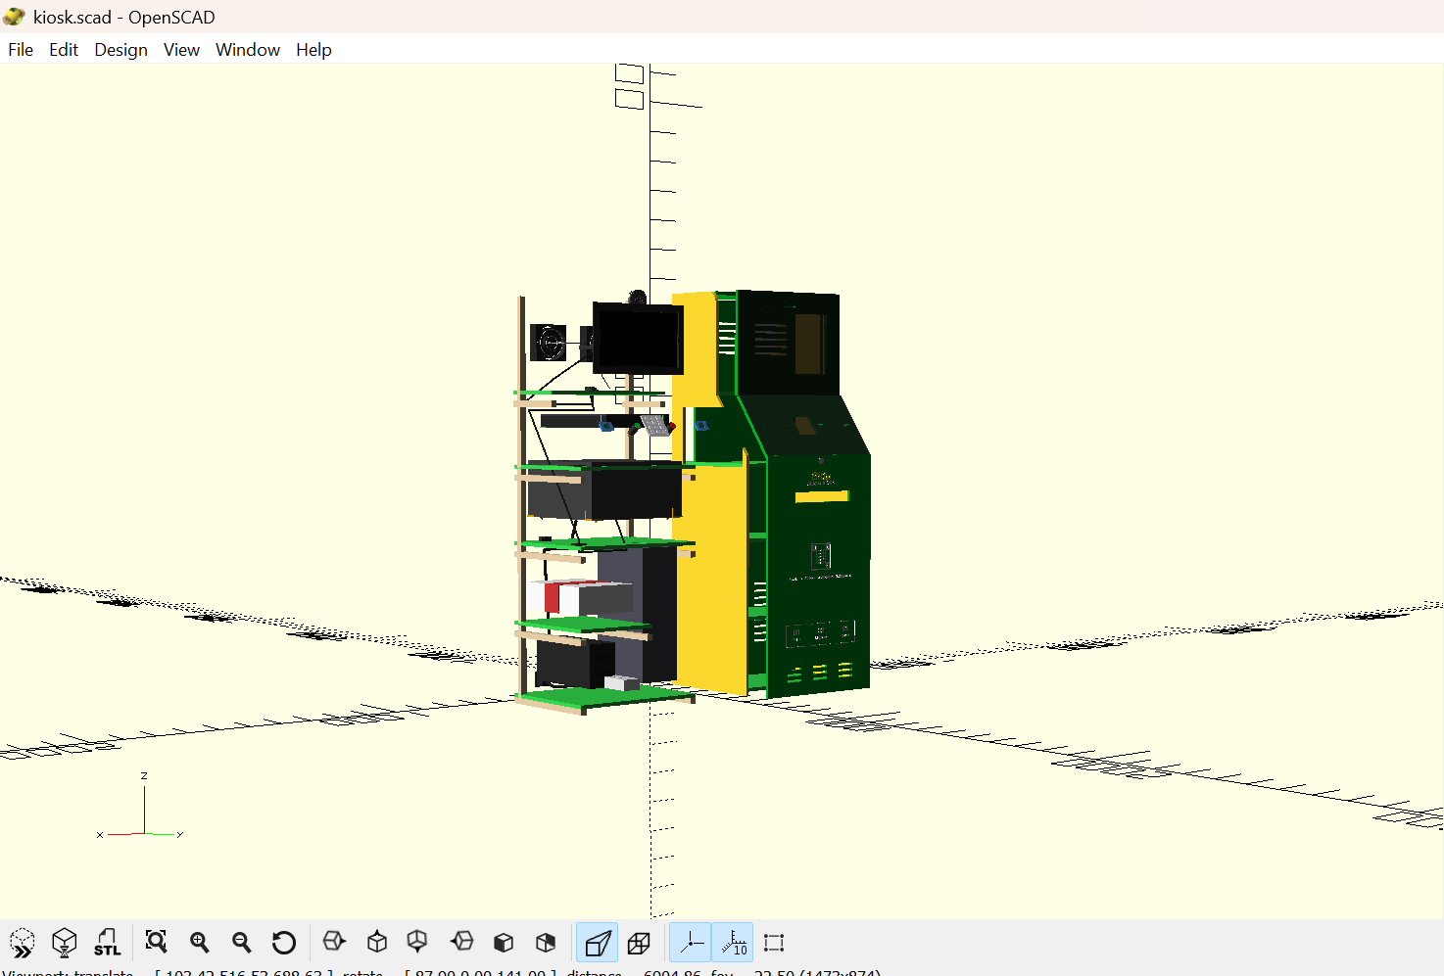
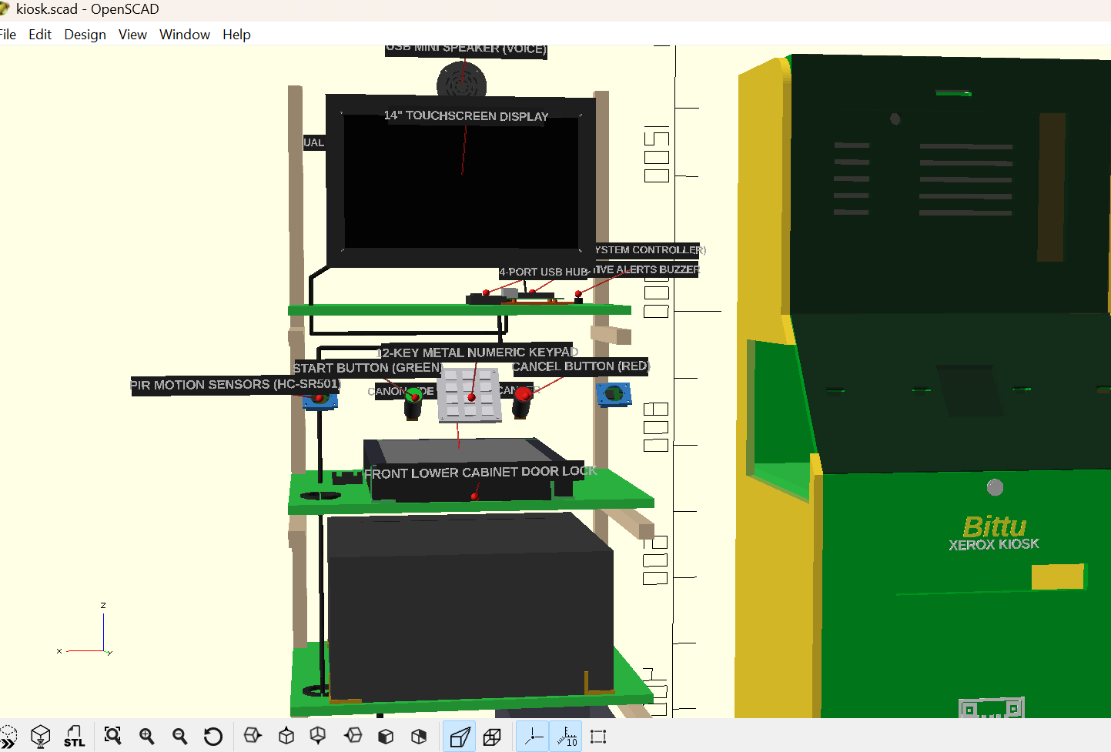
C O M P E T I T I V E E D G E
70% Lower. 100% Yours.
Qwikprint PRO
₹3.49 Lakh
Proprietary · Revenue Cut · No Campus API
Qwikprint MINI
₹1.65 Lakh
Limited features
★ Bittu Xerox Kiosk
₹50,000
💰 100% Profit
🔓 Open Source
🎓 Campus-Native
No royalty splits
Python + FastAPI
ERP + Telegram Bot
FULL 3D CAD · ENGINEERED & MODELED

Slide 8
T H E A S K
Let’s Build Together.
₹1 Lakh
0.36 m²
~30 Days
Seed Grant
for 2 Pilot Kiosks
Lobby Space
+ 1 Power Socket
To Deliver
Working Pilot
Start with 1 kiosk at KLU. Scale to ~50 campuses across AP & Telangana.
Every exam season without a kiosk = 2,00,000+ pages of unserved demand.
Bittu Xerox Kiosk
Zero Queues · Zero Leakage · 24/7

