Slide 1

FACE RECOGNITION BASED
ATTENDANCE SYSTEM
Automating Attendance with AI
Presented by: ENGINEERING DEPARTMENT OF ARTIFICIAL INTELLIGENCE
AND DATA SCIENCE

Slide 2
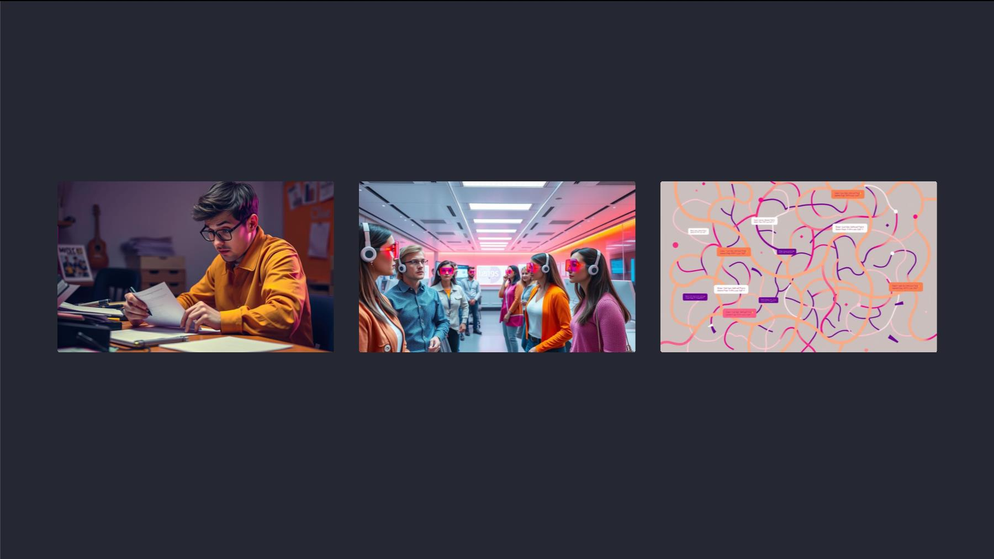
Problem Statement
Manual Attendance
Need for Automation
Challenges
Time-consuming and error-prone.
Contactless attendance for hygiene and
efficiency.
Accuracy, duplicate elimination, and
real-time processing are key.

Slide 3
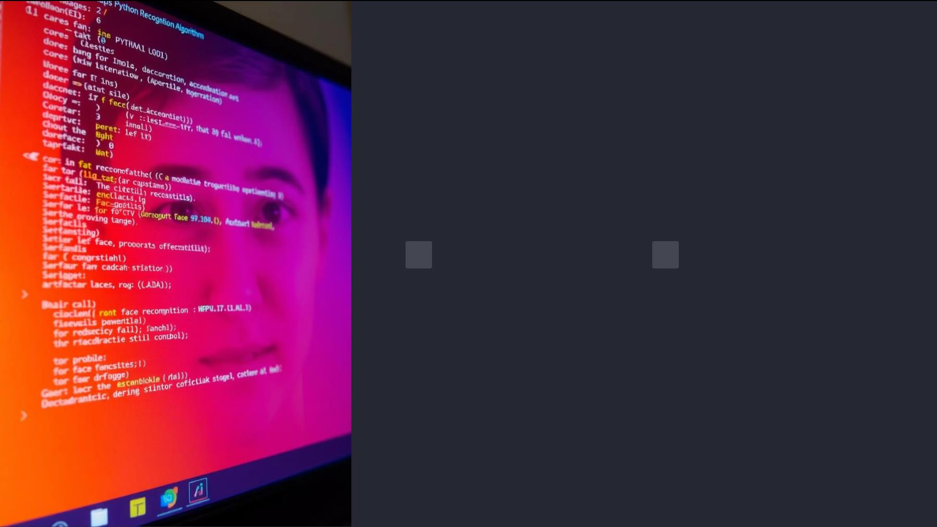
Introduction
AI-Powered Solution
Key Features
Python-based system using
facial recognition to
Real-time face detection,
automated logging with
timestamps, and CSV-based
record management.
automate attendance.

Slide 4

WORKFLOW DIAGR AM
Face Capture
1
Live camera feed captures the user's face.
2
3
4
5
Face Detection
OpenCV identifies the face in the captured image.
Encoding
Local Binary Patterns (LBP) is a texture descriptor
that encodes pixel intensity differences in a grid.
Matching
The encoded vector is compared to known faces in
the database.
Attendance Logging
Timestamp and details are recorded in a CSV file
using Pandas.

Slide 5

Technical Architecture
Face Detection
Encoding
Matching
Logging
OpenCV and the face
Local Binary Patterns (LBP)
encodes pixel intensity
differences.
The Euclidean distance
method compares the
encoded vector to stored face
data.
Attendance records are
stored in a CSV file using
Pandas.
recognition library perform
real-time face detection.

Slide 6
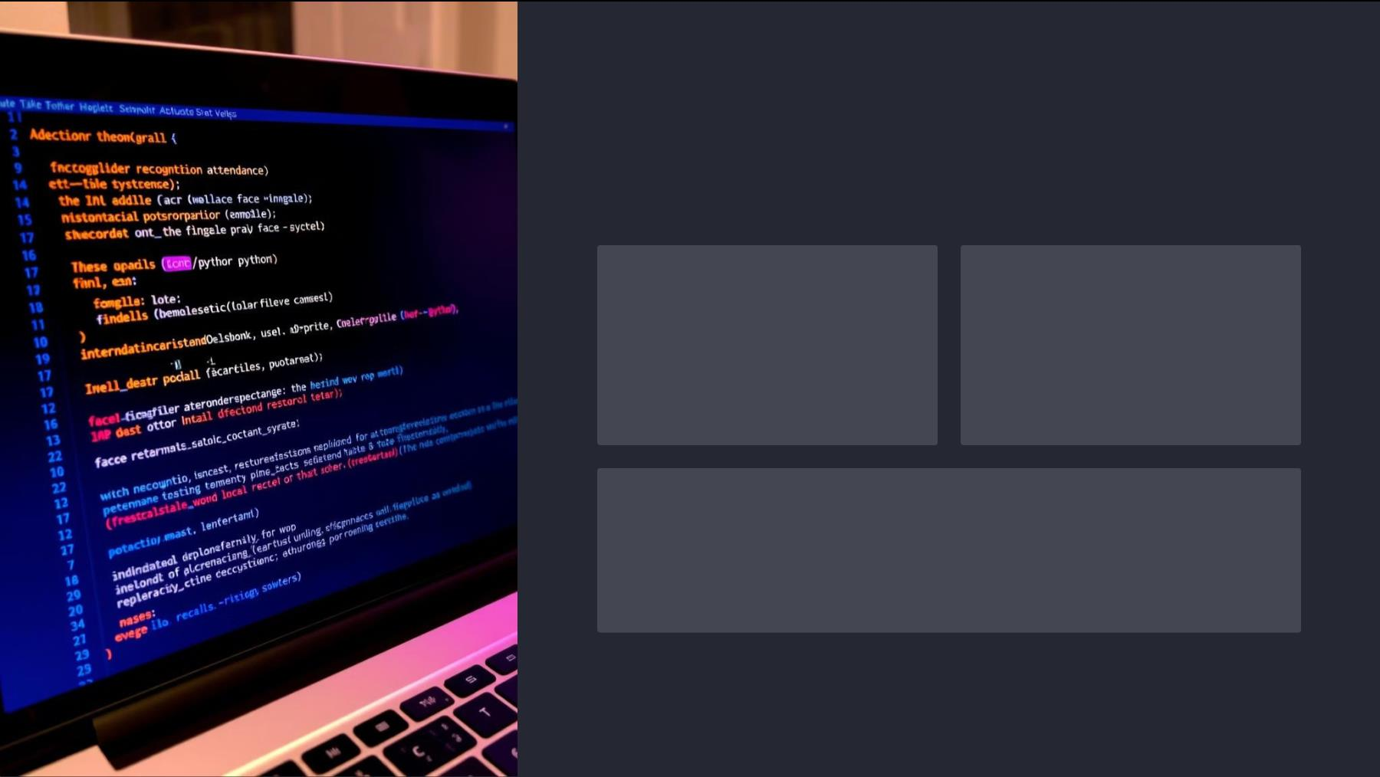
IMPLEMENTATION STEPS
Install Dependencies
Organize Known Faces
Run pip install opencv-python
face recognition, pandas to
install required packages.
Create a folder named Images
and place images of registered
individuals.
Run the Script
Execute the Python script to detect faces, match them, and log
attendance.

Slide 7
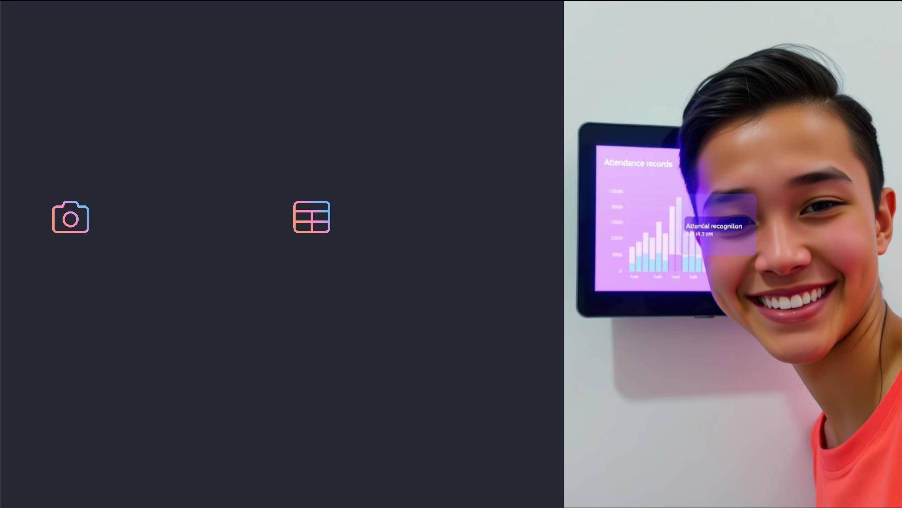
Live Demo & Sample Output
Live Demo
Sample CSV Output
A live demo captures facial data in
real-time, demonstrating accurate
face detection and matching.
A sample CSV file showcases the
structured format of logged
attendance records with
timestamps and names.

Slide 8

Advantages
1
Fast & Efficient
2
4
Accurate & Scalable
The system quickly
The system provides
processes attendance data,
saving time and effort.
accurate recognition, even
with diverse facial features
and large datasets.
3
Contactless &
Hygienic
Reduced Manual
Workload
The system eliminates
physical contact, promoting
a healthy and safe working
environment.
The system automates the
attendance process,
minimizing human
intervention.

Slide 9

Future Enhancements
GUI Development
1
A user-friendly graphical interface will enhance usability.
Cloud Integration
2
Secure cloud storage will provide scalability and accessibility.
Liveness Detection
3
4
Advanced features will prevent spoofing and ensure authenticity.
Mobile App Support
A mobile application will allow users to access attendance
records on their devices.

Slide 10
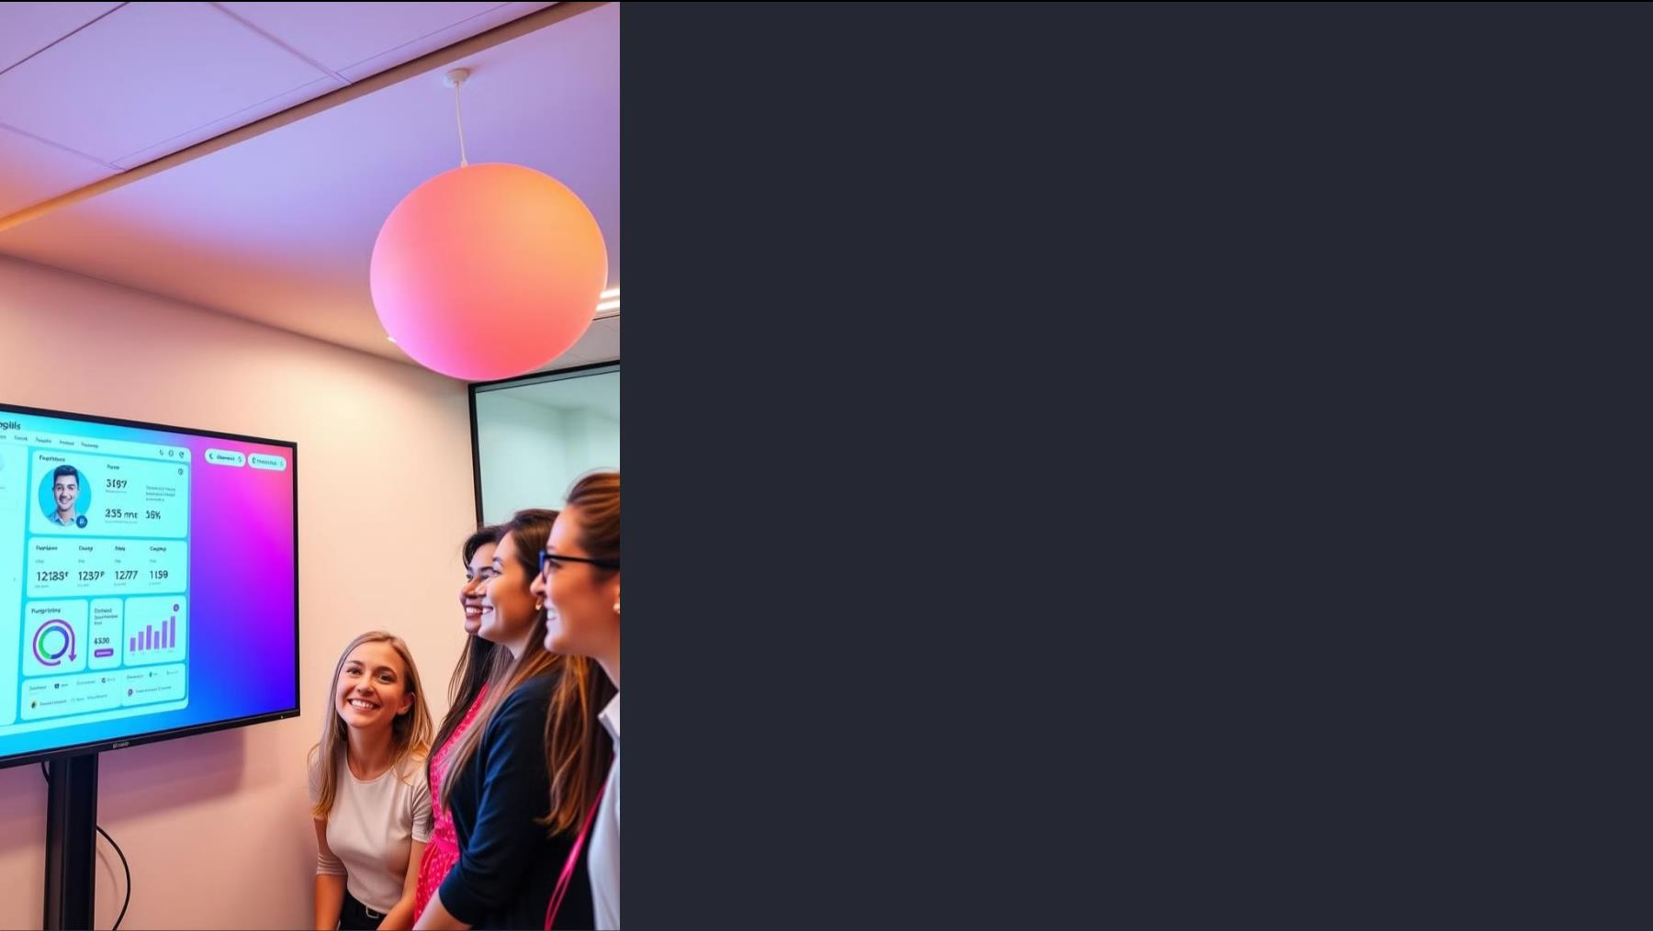
Conclusion
This system offers a robust and user-friendly attendance solution. It
leverages advanced AI technology to automate, streamline, and enhance
the traditional attendance process.

Slide 11

Thank You!
Thank you for exploring our Face Recognition Based Attendance System.
We hope this presentation has provided valuable insights into the
implementation, advantages, and future enhancements of our innovative
system.

