Slide 1
VERIFLOW
Preserving row-pipeline behavior across lossy schema migration
Sai Mohita.C
Registration No. 24BCE2057
https://github.com/Sai181006/VeriFlow
Research prototype · 30 October 2026
Notes:
Repository: https://github.com/Sai181006/VeriFlow

Slide 2
RESEARCH QUESTION
A schema can lose data without changing a pipeline
Record reconstruction and pipeline behavior are different questions.
Old field
Lossy migration
Pipeline observation
score = 5.7 (decimal)
→
score = 5 (integer)
→
Does this row pass the filter?
Potentially changed
Provably unchanged
score > 5: true before, false after.
score >= 5: true before and after.
VERIFLOW · RESEARCH & COMPILER DEMO
02

Slide 3
RELATED RESEARCH
Recent work frames the gap, but addresses different tasks
Study | What it studies | Question VeriFlow tests
Awiti et al. (2025) | ETL operator repair after source changes | Can a typed row observation be preserved?
Kramer et al. (2025) | Robust, adaptive cleaning pipelines | Can guards be executed per migrated row?
Auge & Heuer (2022) | Provenance-assisted inversion | Which old cells does this pipeline need?
Ortín et al. (2026)* | Broader query equivalence after migration | What does a smaller executable row contract buy?
Gap addressed here: a per-row executable preservation decision for a typed pipeline. * 2026 preprint.
VERIFLOW · RESEARCH & COMPILER DEMO
03
Notes:
Awiti et al. 2025 https://reference-global.com/article/10.2478/fcds-2025-0006
Kramer et al. 2025 https://www.vldb.org/2025/Workshops/VLDB-Workshops-2025/QDB/QDB25_4.pdf
Auge and Heuer 2022 https://arxiv.org/abs/2211.13810
Ortín et al. 2026 preprint https://arxiv.org/abs/2604.22415

Slide 4
SYSTEM MAP
From explicit mapping to an executable preservation decision
Old pipeline
Impact analysis
Evolved program
Migration + replay
Typed .vfl source; operations and select
→
Dependencies, exact rules, guards
→
New cells → old VM register bindings
→
Admit, retain or reject; compare observations
Preservation contract
Old execution = evolved execution from new row + certified guards + retained old cells
VERIFLOW · RESEARCH & COMPILER DEMO
04

Slide 5
COUNCIL DECISION
One bounded extension: terminal-aware projection retention
If a row stops before select, a field used only by select cannot affect its result.
1 · Execute operations
2 · Observe terminal result
3 · Retain if reached
let / require / keep; bind inputs conservatively
→
Filtered, rejected, error, or emitted
→
Bind old select-only cells for emitted rows
Real ICU recovered pipeline
4,025 emitted rows retain vent_sari; 3,290 filtered rows retain no old cell.
VERIFLOW · RESEARCH & COMPILER DEMO
05

Slide 6
COMPILER ARCHITECTURE
Three compiler phases, one replayable execution path
Phase 1 · Front end
Phase 2 · Middle end
Phase 3 · Back end
lexer.py → parser.py → ast.py
Tokens, syntax tree, source positions
ir.py → optimizer.py
Intermediate operations; safe rewrites
vm.py / runtime.py
Generated VM instructions and execution
→
→
Evolution path: impact.py + evolved.py compile new-schema bindings; migration.py writes and replays the persisted bundle.
VERIFLOW · RESEARCH & COMPILER DEMO
06

Slide 7
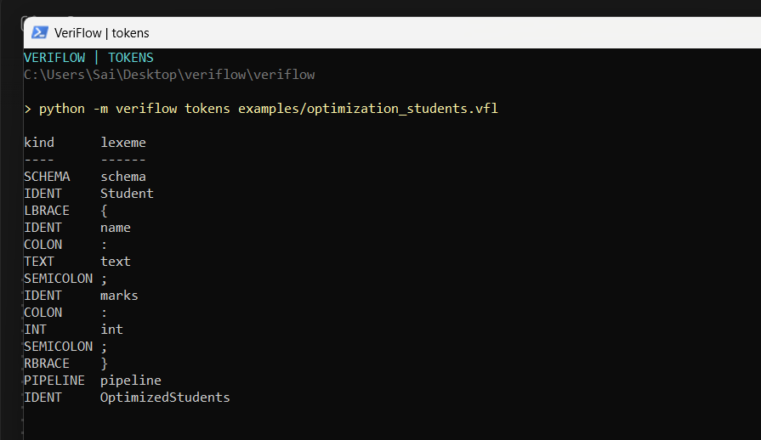
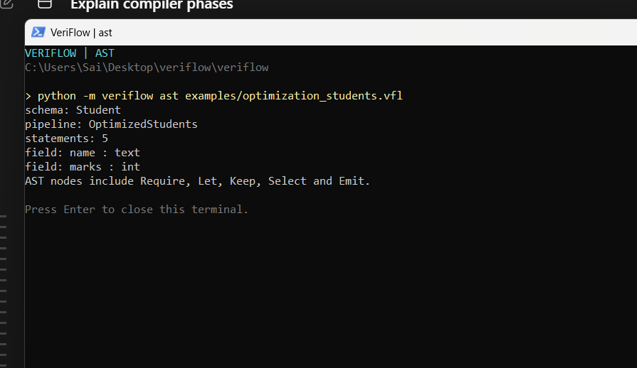
LIVE OUTPUT · FRONT END
Phase 1: source text becomes tokens and a syntax tree
Actual lexer output: token stream
Actual parser output: AST
Lexer recognizes keywords and literals; parser checks structure before semantic validation.
VERIFLOW · RESEARCH & COMPILER DEMO
07

Slide 8
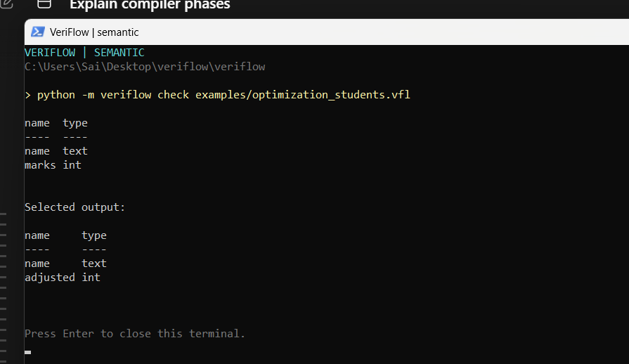
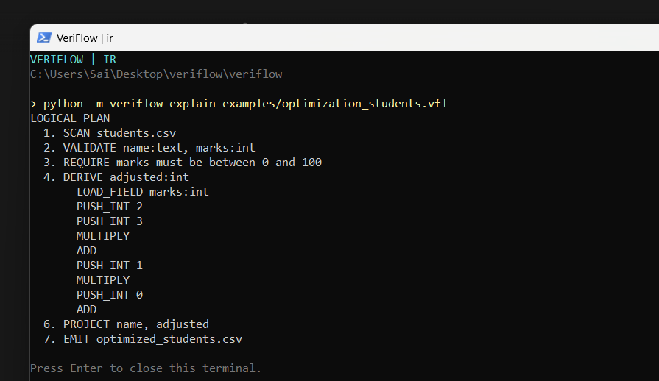
LIVE OUTPUT · MIDDLE END
Phase 2: checks and lowers the pipeline
Actual semantic analysis output
Actual intermediate representation
Type checking rejects invalid field use; lowering turns operations into explicit IR instructions.
VERIFLOW · RESEARCH & COMPILER DEMO
08

Slide 9
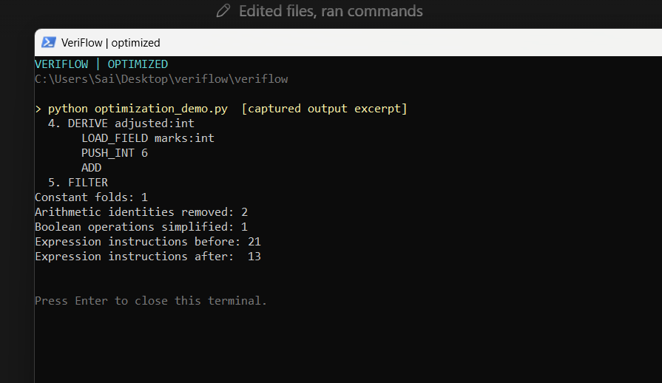
OPTIMIZATION PASS
The optimizer simplifies IR before code generation
Before: unoptimized IR
After: optimized IR
Demo: 21 instructions → 13 (8 removed, 38.1% fewer).
This is instruction-count evidence for the sample, not a general runtime speedup claim.
VERIFLOW · RESEARCH & COMPILER DEMO
09

Slide 10
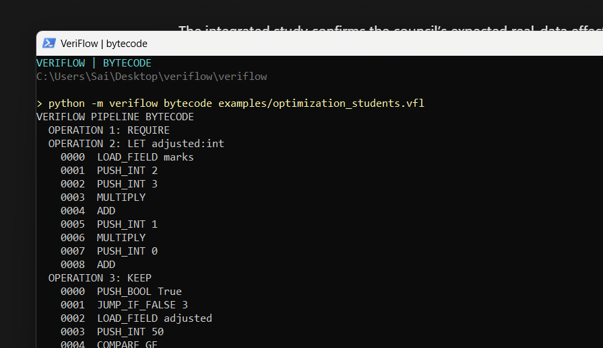
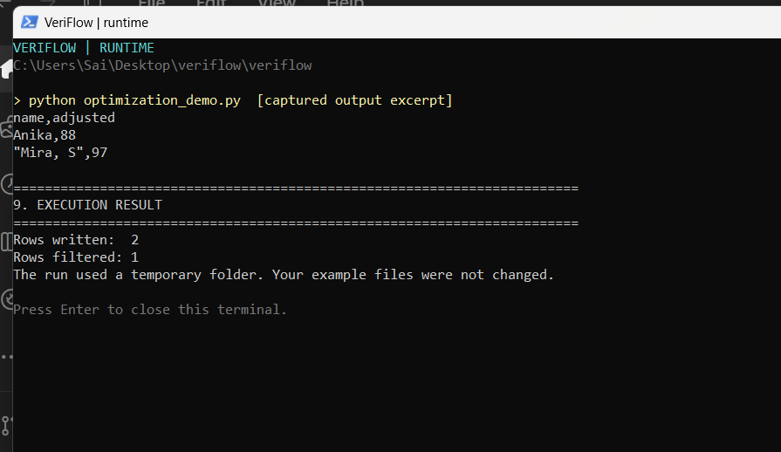
LIVE OUTPUT · BACK END
Phase 3: IR becomes VM instructions, then runs
Generated VM bytecode
Execution output from the generated program
The generated artifact is executable VM bytecode; the VM produces the row observations used in migration checks.
VERIFLOW · RESEARCH & COMPILER DEMO
10

Slide 11
EVALUATION DATA
One real paired history plus controlled synthetic stress
Data | Rows | Schema change | Evidence status
Malaysia ICU | 7,315 paired | Official drop + 4 renames | Actual before/after CSV
UCI Abalone | 4,177 | Injected numeric conversion | Controlled stress
UCI Iris | 150 | Injected numeric conversion | Controlled stress
UCI Red Wine | 1,599 | Injected numeric conversion | Controlled stress
The 10 injected cases reuse 5,926 distinct UCI rows; 17,928 case-rows are repeated workloads.
VERIFLOW · RESEARCH & COMPILER DEMO
11
Notes:
Official Malaysian ICU change: https://github.com/MoH-Malaysia/covid19-public/commit/4e80229047d796f14c7aac82910a3377277b699f
UCI Abalone: https://archive.ics.uci.edu/dataset/1/abalone
UCI Iris: https://archive.ics.uci.edu/dataset/53/iris
UCI Wine Quality: https://archive.ics.uci.edu/dataset/186/wine+quality

Slide 12
MEASURED RESULT
Real ICU history: sparse replay preserves all accepted rows
Recovered workload | Accepted | Old cells | Sidecar bytes | Typed mismatch
Sparse (terminal-aware) | 7,315 | 4,025 | 1,088,711 | 0
Full-row baseline | 7,315 | 36,575 | 1,728,544 | 0
Guard-only | 0 | 0 | 0 | N/A
Retained old cells
Sparse
4,025
Full-row
36,575
Sparse retains 89.0% fewer old cells than full-row on this workload.
VERIFLOW · RESEARCH & COMPILER DEMO
12
Notes:
Source data: official MoH Malaysia paired ICU CSV history. Study results: evaluation/migration-results.json, run 30 October 2026; three repetitions per strategy.

Slide 13
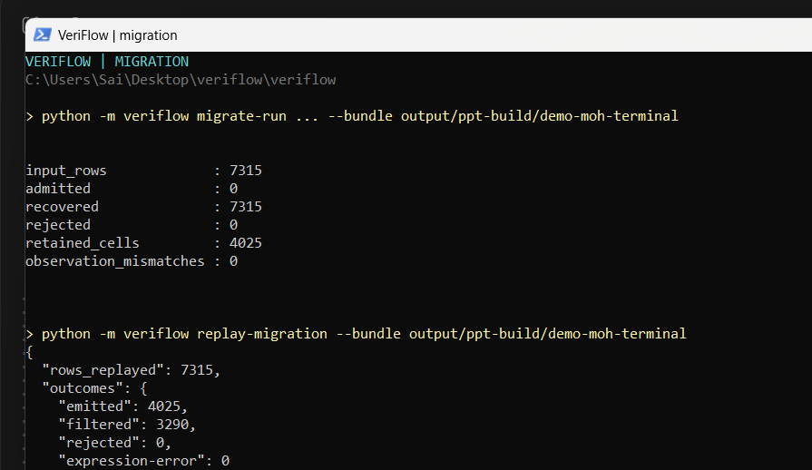
EXECUTION EVIDENCE
Persisted migration and replay produce the same typed results
7,315 paired rows
Official post-change projection matches every accepted migrated row.
4,025 emitted
Dropped field retained only when final select is reached.
3,290 filtered
No old selected cell is stored for these terminal rows.
Actual migrate-run and replay-migration output
VERIFLOW · RESEARCH & COMPILER DEMO
13

Slide 14
CONTROLLED STRESS
Injected pilot probes value-dependent guard admission
Strict-threshold case | Guard-admitted | Share | Rows requiring sparse recovery
Abalone | 2,782 / 4,177 | 66.6% | 1,395
Iris | 99 / 150 | 66.0% | 51
Red Wine | 1,214 / 1,599 | 75.9% | 385
Across all 10 injected cases
Sparse: 10,379 admitted + 7,549 recovered; 0 observed replay mismatches.
8 negative controls and 4 CSV parity checks passed. Results are finite observations over reused rows.
VERIFLOW · RESEARCH & COMPILER DEMO
14
Notes:
UCI datasets: https://archive.ics.uci.edu/dataset/1/abalone ; https://archive.ics.uci.edu/dataset/53/iris ; https://archive.ics.uci.edu/dataset/186/wine+quality . Study results: evaluation/migration-results.json.

Slide 15
ASSESSMENT
What the prototype establishes—and the next research step
Implemented now
Measured now
Guard proof, typed conversion, evolved VM bindings, migration ledger, sparse retention, terminal-aware projection, disk replay.
One genuine paired drop/rename history; 10 injected cases; 107 tests; retained cells and byte costs across three strategies.
Scope boundary
Next useful study
Well-typed old rows at migration time; row-wise operations. One real event and researcher-authored pipelines.
Add a second independent real lossy history and a directly comparable system baseline before broadening the language.
VERIFLOW · RESEARCH & COMPILER DEMO
15

Slide 16
SOURCES
References and primary data documentation
Awiti, Wrembel & Zimányi (2025), Repairing ETL Processes — reference-global.com/article/10.2478/fcds-2025-0006
Kramer, Restat & Störl (2025), Evolving Gracefully — vldb.org/2025/Workshops/VLDB-Workshops-2025/QDB/QDB25_4.pdf
Auge & Heuer (2022), Provenance-assisted schema evolution — arxiv.org/abs/2211.13810
Ortín, Hoyos & García-Molina (2026 preprint), U-Schema migration — arxiv.org/abs/2604.22415
Vassiliadis et al. (2023), schema and source histories — openproceedings.org/2023/conf/edbt/paper-160.pdf
EvoSchema (2025), text-to-SQL schema evolution — vldb.org/pvldb/vol18/p3655-zhang.pdf
Malaysia Ministry of Health, ICU history (2021) — github.com/MoH-Malaysia/covid19-public/commit/4e80229047d796f14c7aac82910a3377277b699f
UCI Machine Learning Repository: Abalone, Iris, Wine Quality — archive.ics.uci.edu
VERIFLOW · RESEARCH & COMPILER DEMO
16
Notes:
Full papers and data links are listed in the manuscript reference section. No project codebase is cited as external literature.

