Slide 1

Data Science - Statistics
Central Limit Theorem

Slide 2
Central Limit Theorem
The Central Limit theorem states that if you have a population with mean μ and standard deviation σ and take sufficiently large samples from the population, then the distribution of the sample means will be approximately normally distributed.
The Central Limit Theorem tells us that as sample sizes get larger, the sampling distribution of the mean will become normally distributed, even if the data within each sample are not normally distributed.
This will hold true regardless of whether the source population is normal or skewed, provided the sample size is sufficiently large (usually n > 30)
If the population is normal, then the theorem holds true even for samples smaller than 30.
For the random samples we take from the population, we can compute the mean of the sample means:
The standard deviation of the sample means:
So, to summarize, the Central Limit Theorem states that the sampling distribution of the sample means approaches a normal distribution as the sample size gets larger — no matter what the shape of the population distribution. This fact holds especially true for sample sizes over 30

Slide 3
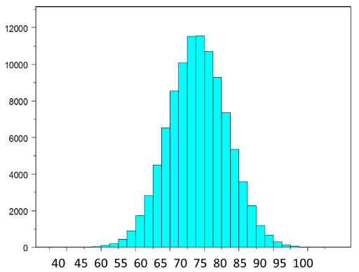
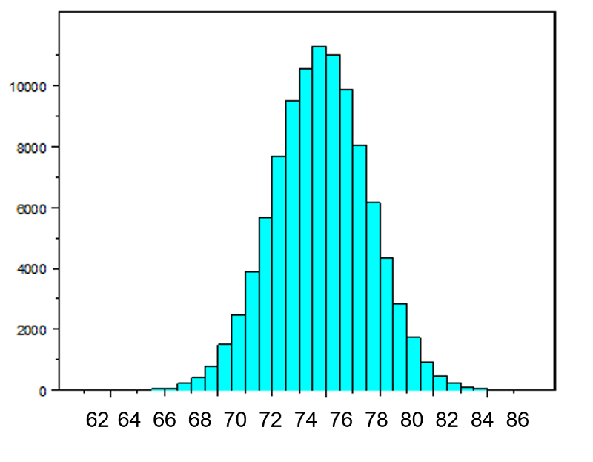
Central Limit Theorem – With Normal Population
The figure below illustrates a normally distributed characteristic, X, in a population in which the population mean is 75 with a standard deviation of 8.
If we take simple random samples (with replacement) of size n=10 from the population and compute the mean for each of the samples, the distribution of sample means should be approximately normal according to the Central Limit Theorem. Note that the sample size (n=10) is less than 30, but the source population is normally distributed, so this is not a problem. The distribution of the sample means is illustrated below. Note that the horizontal axis is different from the previous illustration, and that the range is narrower.
The mean of the sample means is 75 and the standard deviation of the sample means is 2.5 (8/sqrt(10))

Slide 4
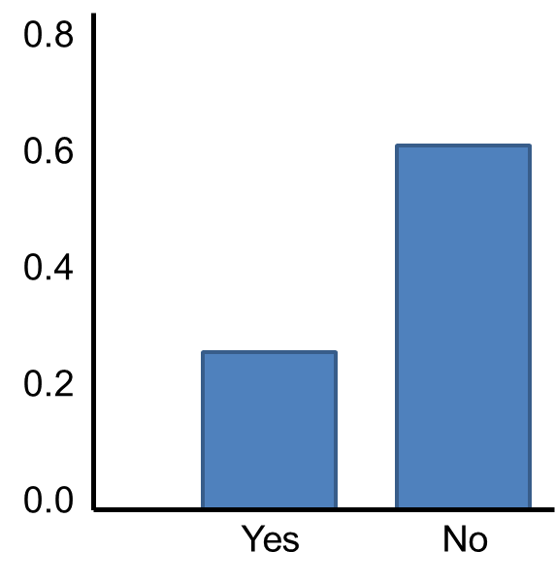


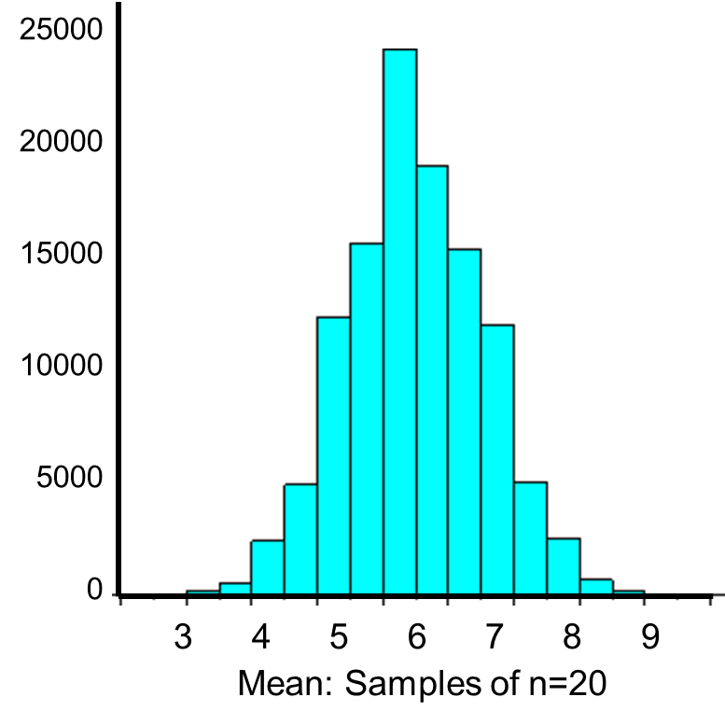
Central Limit Theorem – With Dichotomous outcome
Now suppose we measure a characteristic, X, in a population and that this characteristic is dichotomous (e.g., success of a medical procedure: yes or no) with 30% of the population classified as a success (i.e., p=0.30) as shown below.
The population mean and standard deviation for a binomial distribution are:
Mean binomial probability:
Mean of the sample is 20(0.3) = 6
Standard deviation:
The standard deviation of the sample means:
S
The distribution of sample means based on samples oif size n=20 is shown in the adjacent figure
The Central Limit Theorem applies even to binomial populations like this provided that the minimum of np and n(1-p) is at least 5, where "n" refers to the sample size, and "p" is the probability of "success" on any given trial. In this case, we will take samples of n=20 with replacement, so min(np, n(1-p)) = min(20(0.3), 20(0.7)) = min(6, 14) = 6. Therefore, the criterion is met.

Slide 5
Central Limit Theorem – Key Takeaways & Real Life Example
KEY TAKEAWAYS
The central limit theorem (CLT) states that the distribution of sample means approximates a normal distribution as the sample size gets larger, regardless of the population's distribution.
Sample sizes equal to or greater than 30 are often considered sufficient for the CLT to hold.
A key aspect of CLT is that the average of the sample means and standard deviations will equal the population mean and standard deviation.
A sufficiently large sample size can predict the characteristics of a population more accurately.
Below is a link to a very good example to understand a real-life example of CLT:
https://towardsdatascience.com/central-limit-theorem-a-real-life-application-f638657686e1
S

