Slide 1
Venkata Sai Prasad Pulaparthi
Final Project
3/21/2024 Annual Review

Slide 2
KEYLOGGER AND SECURITY
Definition: A keylogger is a type of surveillance technology used to monitor and record each keystroke typed on a keyboard.
3/21/2024 Annual Review

Slide 3


AGENDA
Problem Statement
Project Overview
End Users
Solution and Value Proposition
The Wow in Your Solution
Modelling
Results
3/21/2024 Annual Review

Slide 4

PROBLEM STATEMENT
In today's digital age, where cybersecurity threats loom large, one of the significant concerns is the proliferation of keyloggers, stealthy software tools designed to monitor and record keystrokes on a user's computer without their knowledge. Keyloggers pose a severe threat to individuals and organizations as they can capture sensitive information such as passwords, credit card details, and other personal data, leading to identity theft, financial loss, and privacy breaches.
3/21/2024 Annual Review

Slide 5

PROJECT OVERVIEW
Keyloggers are malicious programs or devices designed to record keystrokes made by a user on their keyboard.
They are used by cybercriminals to capture sensitive information such as passwords, credit card numbers, and personal identification information.
Types of Keyloggers:
Hardware Keyloggers: Physical devices attached to keyboards or connected between the keyboard and the computer.
Software Keyloggers: Malicious software installed on a computer that records keystrokes and sends the data to an attacker.
3/21/2024 Annual Review

Slide 6

WHO ARE THE END USERS?
Individual users (general public).
Businesses and organizations.
IT professionals and cybersecurity teams.
Government agencies.
3/21/2024 Annual Review

Slide 7

YOUR SOLUTION AND ITS VALUE PROPOSITION
Advanced Keylogger Detection and Prevention Solution:
Comprehensive Security Suite:
Our solution integrates with existing antivirus and anti-malware programs to provide an additional layer of security specifically targeted at keyloggers.
Real-Time Monitoring:
Continuous monitoring of system activities to detect and block keyloggers in real-time.
User-Friendly Interface:
Simple and intuitive dashboard for users to monitor their system’s security status.
3/21/2024 Annual Review

Slide 8

THE WOW IN YOUR SOLUTION
1. Cutting-Edge Technology
Artificial Intelligence and Machine Learning:
Our solution leverages AI and ML to continuously improve detection accuracy.
Behavioral Analysis:
Analyzes user and system behavior to detect anomalies indicative of keylogger activity.
2. Unique Features
Zero-Day Threat Protection:
Ability to detect and neutralize keyloggers that have not yet been identified in traditional databases.
Minimal Performance Impact:
Optimized to run efficiently without slowing down system performance.
3/21/2024 Annual Review
8

Slide 9
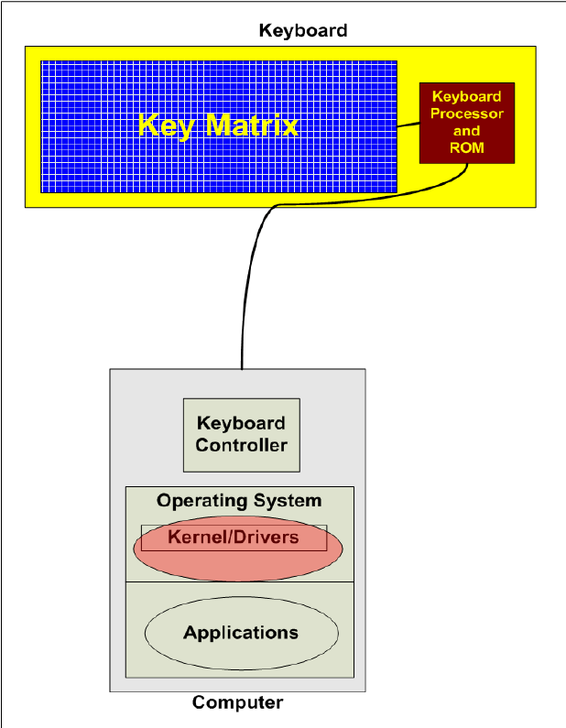
MODELLING
3/21/2024 Annual Review
9

Slide 10
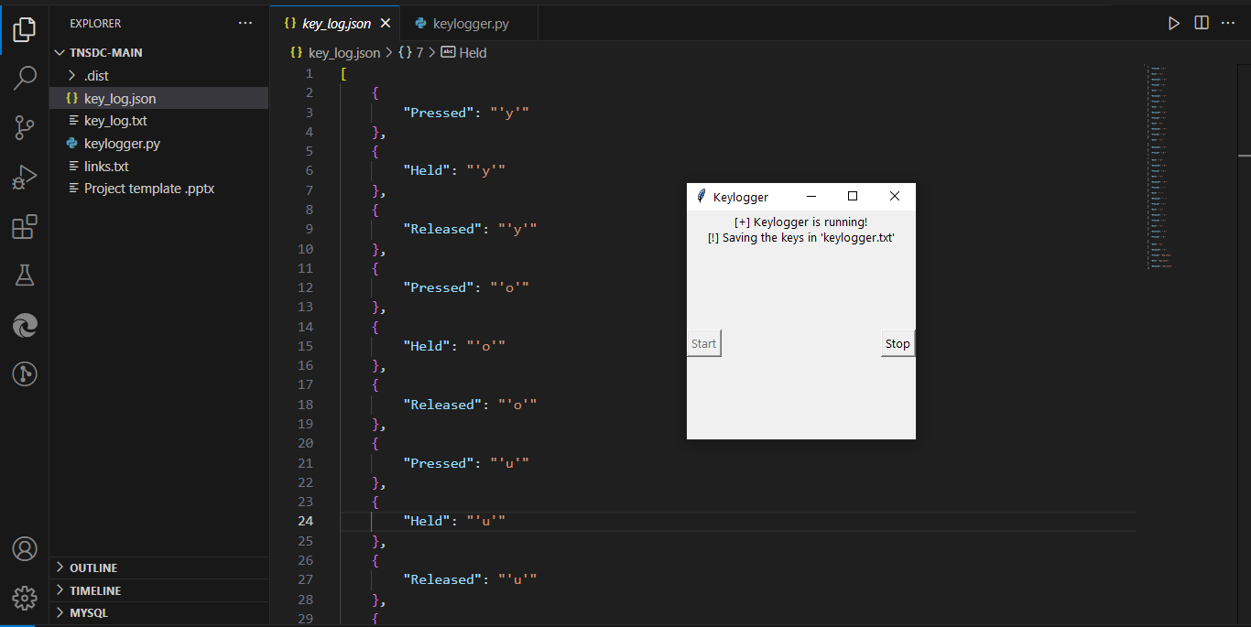
RESULTS
Github-Link
3/21/2024 Annual Review
10

