Slide 1

Steganography in Action
Venkata Sai Prasad Pulaparthi

Slide 2

PROBLEM STATEMENT
In the digital age, the need for secure communication has become critical. Traditional encryption methods are often targeted by adversaries. Steganography offers a solution by hiding information within other non-suspicious data, thus concealing the very existence of the message.

Slide 3
Project Description
Steganography is the practice of hiding data within other data. This project explores various categories of steganography, demonstrating techniques to conceal information within different media types, such as images, audio files, video files, and text. The project aims to illustrate how steganography can enhance data security and provide practical examples of its application.

Slide 4
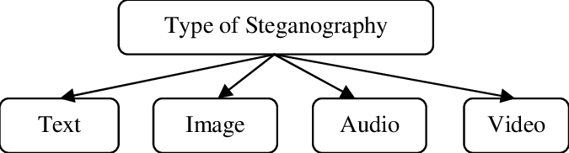
Categories of Steganography
Text Steganography
Image Steganography
Video Steganography
Audio Steganography
Network Steganography

Slide 5

WHO ARE THE END USERS?
Government Agencies: For secure communication and data protection.
Corporations: Protecting sensitive information and intellectual property.
Individuals: Enhancing personal privacy and security in digital communications.
Cybersecurity Professionals: Implementing and testing steganographic methods for data security.

Slide 6

Technology Used
Programming Languages: Python
Software Tools: Visual Studio Code
Libraries: OpenCV, OS
Platforms: Windows, Linux

Slide 7
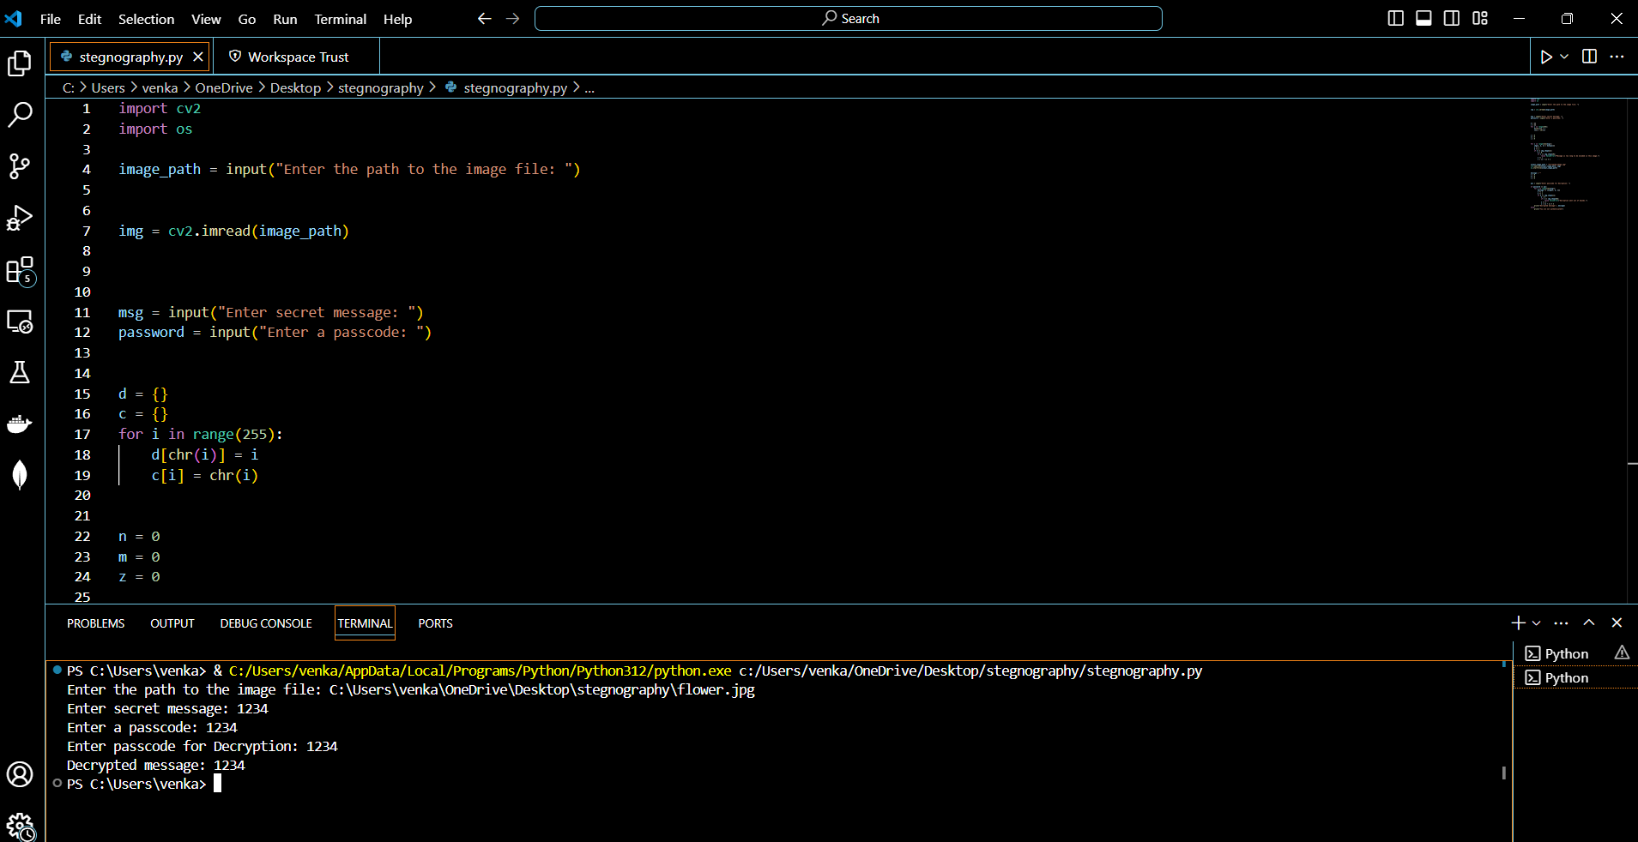
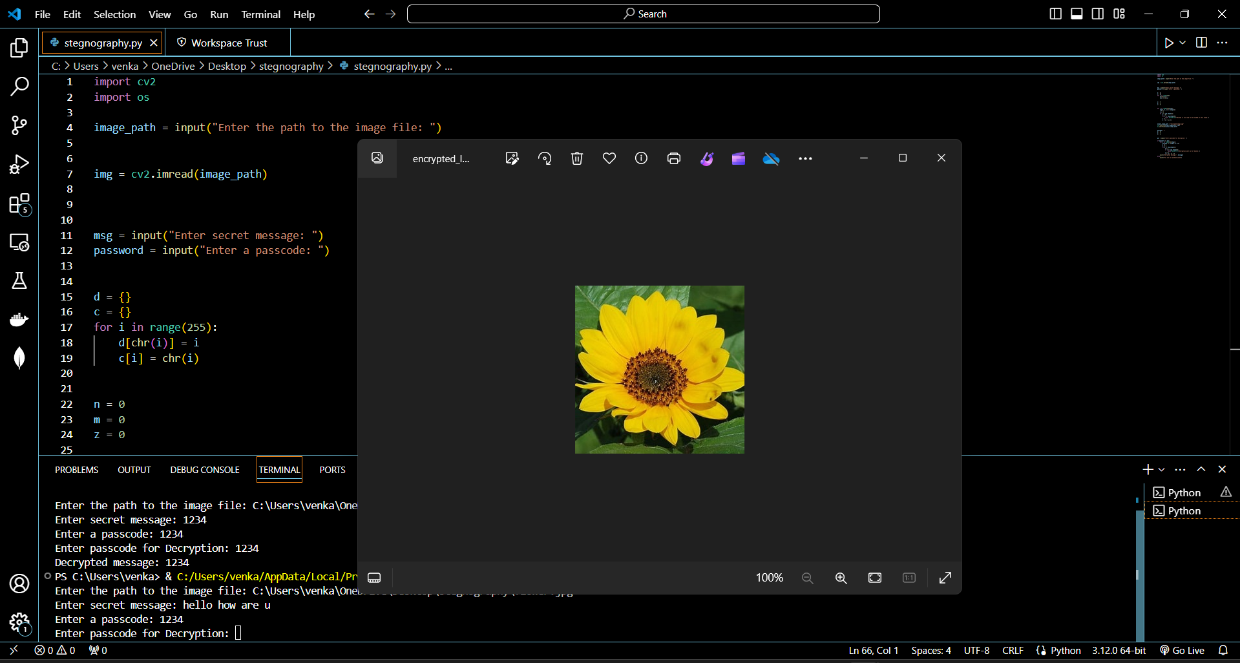
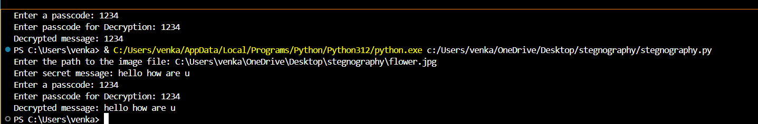
RESULTS
Screenshots
Github_Link

Slide 8
Thank you
.
.

