Slide 1
Data Types
Data Type represent the type of data present inside a variable. In Python we are not required to specify the type explicitly. Based on value provided, the type will be assigned automatically.
Hence Python is Dynamically Typed Language.

Slide 2
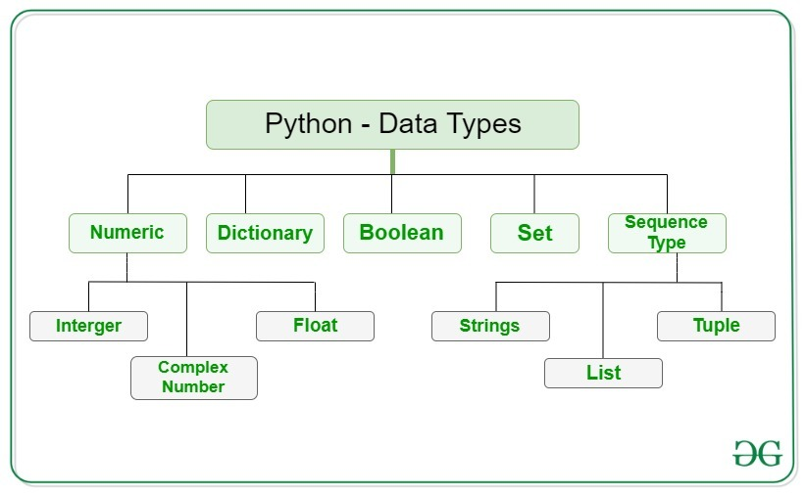

Slide 3
Python contains the following built-in data types
Text type : Str
Numeric type : int ,float, complex
Sequence type : list, tuple, range
Mapping Type : dict
Set Type : set, frozen set
Boolean Type: bool
Binary Type :bytes, byte array, memory view
None –None type

