Slide 1
Application website for ESports
Dota-2

Slide 2


Slide 3
Requirements
LOGIN MODULE
2.USER NAME (E –MAIL)
3.PASSWORD
4.WEBSITE(https://www.google.com/dota-2.com)

Slide 4
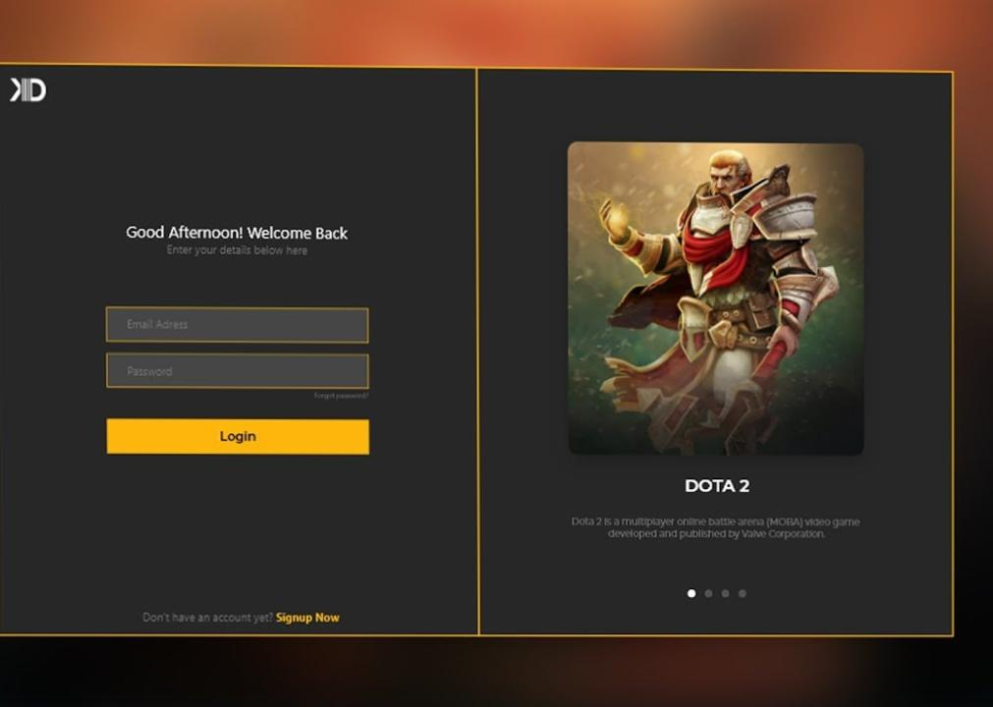
Login page

Slide 5
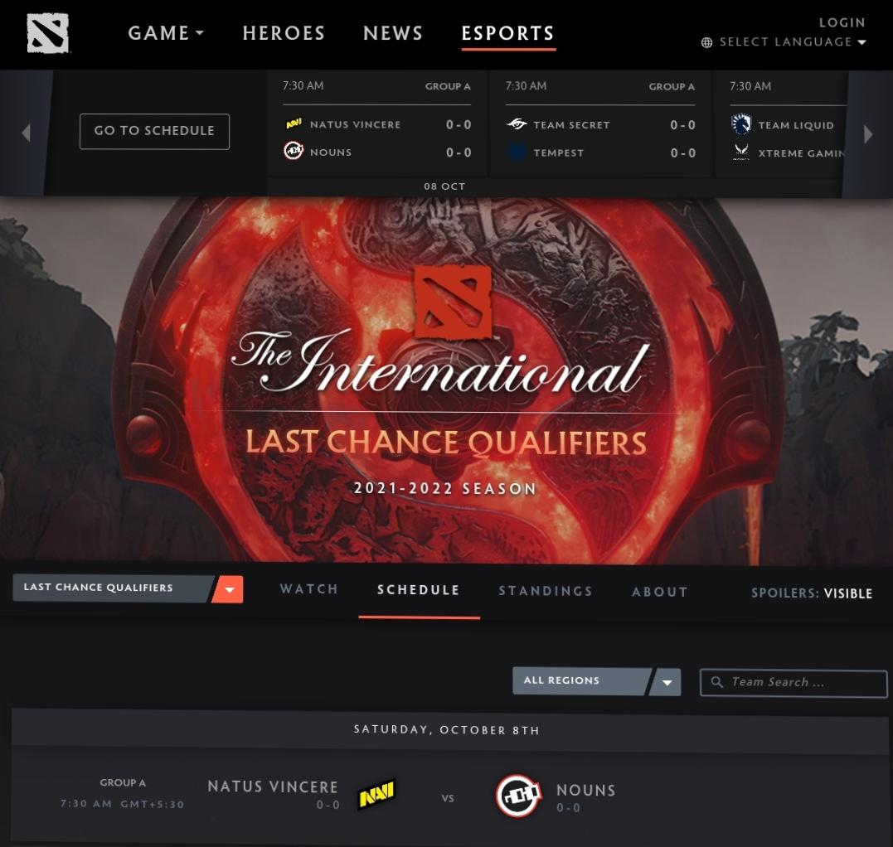
Search page

Slide 6
Positive test scenario
Enter Valid email or mobile number. Enter Valid Password. Click on “Forgot Password” Link and find out forgot password page. Click on Create new account button and verify if it takes to new account page. Select “Keep me signed in” option to retain login session Select “Help” option to get help from dota. In Forgot page –Enter the OTP(One Time Password) to recreate the amazon password. Clicking on the “subscription” .It directly takes to the montly plans. Clicking on the “Buy Now “ link Button. It directly takes to the payment page.

Slide 7
Negative test scenario
Enter invalid username and valid password. Enter valid username and invalid password. Enter invalid username and password. Keep one field blank either username or password and check login. The payment declaim was high in the dota 2 application. Need to improve the UI(USER INTERFACE) on the web site. When the network was slow the was buffer on that time.

Slide 8
TEST CASES
Test cases | Type – negative/positive
Verify if a user will be able to login with valid username and valid password. | Positive
Verify if a user cannot login with a valid username and an invalid password. | Negative
Verify the login page for both ,when the field is blank and submit button is clicked. | Negative
Verify the forget password functionality. | Positive
Verify the messages for invalid login. | Positive
Verify the not remember me functionality. | Negative
Verify if the data in password field is either visible as asterisk bullet signs. | Positive
Verify if user is able to login with a new password only after he\she has changed the password. | Positive

Slide 9
Conclusion
I have navigate these web application and find out the positive / pass and negative / fail test cases. This is to improve the application performance in better manner.

Slide 10
Thank you

