Slide 1
INTRODUCTION TO APRIORI
For instance, if item A and B are bought together more frequently then several steps can be taken to increase the profit. For example:
A and B can be placed together so that when a customer buys one of the product he doesn't have to go far away to buy the other product.
People who buy one of the products can be targeted through an advertisement campaign to buy the other.
Collective discounts can be offered on these products if the customer buys both of them.
Both A and B can be packaged together.
The process of identifying an associations between products is called associative rule mining
Different statistical algorithms have been developed to implement association rule mining, and Apriori is one such algorithm.

Slide 2
Theory of Apriori Algorithm
There are three major components of Apriori algorithm:
1.Support
2.Confidence
3. Lift
We will see these three concepts with the help of following example:
Suppose we have a record of 1 thousand customer transactions, and we want to find the Support, Confidence, and Lift for two items e.g. burgers and ketchup.
Out of one thousand transactions, 100 contain ketchup while 150 contain a burger.
Out of 150 transactions where a burger is purchased, 50 transactions contain ketchup as well. Using this data, we want to find the support, confidence, and lift.

Slide 3
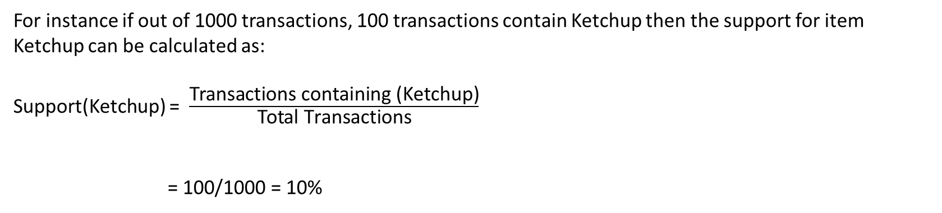
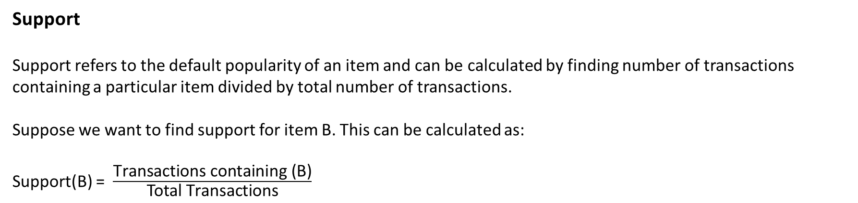
Support
Support refers to the default popularity of an item and can be calculated by finding number of transactions containing a particular item divided by total number of transactions.
Suppose we want to find support for item B. This can be calculated as:
Support(B) = $\frac{\text{Transactions} \text{containing}\text{ (}\text{B}\text{)}}{\text{Total} \text{Transactions}}$
For instance if out of 1000 transactions, 100 transactions contain Ketchup then the support for item Ketchup can be calculated as:
Support(Ketchup) = $\frac{\text{Transactions} \text{containing}\text{ (}\text{Ketchup}\text{)}}{\text{Total} \text{Transactions}}$
= 100/1000 = 10%

Slide 4
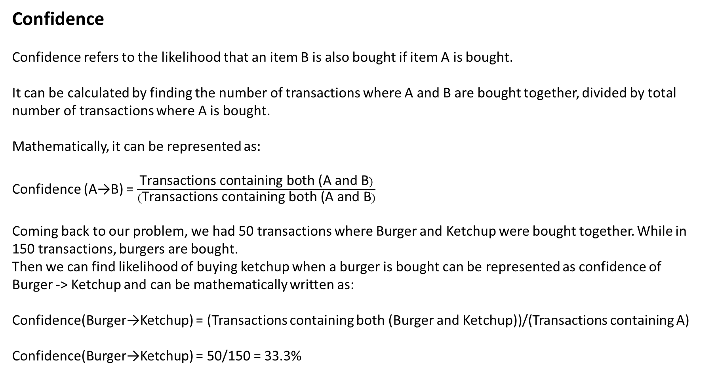
Confidence
Confidence refers to the likelihood that an item B is also bought if item A is bought.
It can be calculated by finding the number of transactions where A and B are bought together, divided by total number of transactions where A is bought.
Mathematically, it can be represented as:
Confidence (A→B) = $\frac{\text{Transactions} \text{containing} \text{both}\text{ (}\text{A} \text{and} \text{B})}{(\text{Transactions} \text{containing} \text{both}\text{ (}\text{A} \text{and} \text{B})}$
Coming back to our problem, we had 50 transactions where Burger and Ketchup were bought together. While in 150 transactions, burgers are bought.
Then we can find likelihood of buying ketchup when a burger is bought can be represented as confidence of
Burger -> Ketchup and can be mathematically written as:
Confidence(Burger→Ketchup) = (Transactions containing both (Burger and Ketchup))/(Transactions containing A)
Confidence(Burger→Ketchup) = 50/150 = 33.3%

Slide 5
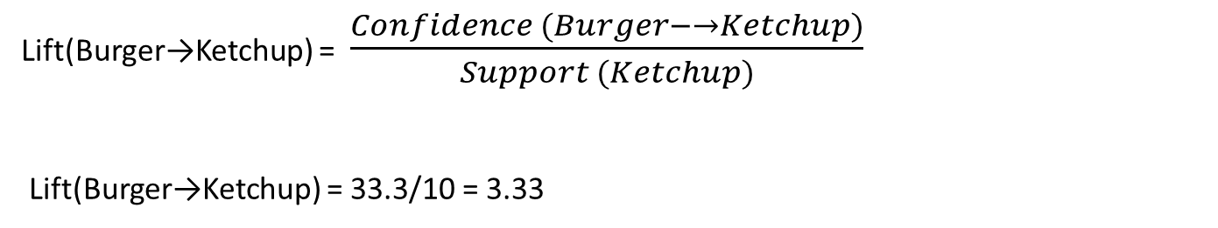
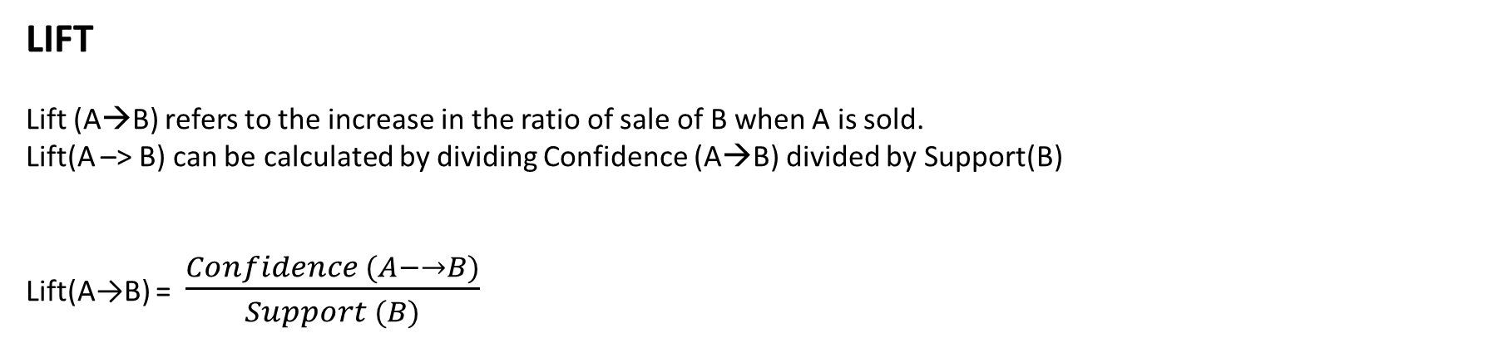
LIFT
Lift (A→B) refers to the increase in the ratio of sale of B when A is sold.
Lift(A –> B) can be calculated by dividing Confidence (A→B) divided by Support(B)
Lift(A→B) = $\frac{Confidence (A−→B)}{Support (B)}$
Lift(Burger→Ketchup) = $\frac{Confidence (Burger−→Ketchup)}{Support (Ketchup)}$
Lift(Burger→Ketchup) = 33.3/10 = 3.33
Lift basically tells us that the likelihood of buying a Burger and Ketchup together is 3.33 times more than the likelihood of just buying the ketchup.
A Lift of 1 means there is no association between products A and B.
Lift of greater than 1 means products A and B are more likely to be bought together.
Finally, Lift of less than 1 refers to the case where two products are unlikely to be bought together.

Slide 6
Steps Involved in Apriori Algorithm
For large sets of data, there can be hundreds of items in hundreds of thousands transactions.
The Apriori algorithm tries to extract rules for each possible combination of items. For instance, Lift can be calculated for item 1 and item 2, item 1 and item 3, item 1 and item 4 and then item 2 and item 3, item 2 and item 4 and then combinations of items e.g. item 1, item 2 and item 3; similarly item 1, item2, and item 4, and so on.
As you can see from the above example, this process can be extremely slow due to the number of combinations. To speed up the process, we need to perform the following steps:
Set a minimum value for support and confidence. This means that we are only interested in finding rules for the items that have certain default existence (e.g. support) and have a minimum value for co-occurrence with other items (e.g. confidence).
Extract all the subsets having higher value of support than minimum threshold.
Select all the rules from the subsets with confidence value higher than minimum threshold.
Order the rules by descending order of Lift.

Slide 7
