Slide 1

CLUSTERING
T.K.Senthil Kumar
Senior Associate Faculty, MaGE

Slide 2
Why Clustering ?
Un-Labeled Data
Un-supervised Learning
Grouping

Slide 3
What is Clustering ?
Cluster analysis groups data objects based only on information found in data that describes the objects and their relationships.
Goal of Clustering
The object within a group be similar to one another and different from the objects in other groups

Slide 4
Types of Clustering
Partitioning and Hierarchical Clustering
Partitioning Clustering
A division data objects into non-overlapping subsets (clusters) such that each data object is in exactly one subset
Hierarchical Clustering
A set of nested clusters organized as a hierarchical tree

Slide 5
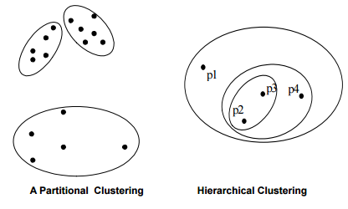
Partition Vs Hierarchical

Slide 6
K-Means - Recap
Given k, the k-means algorithm is implemented in four steps:
1. Partition objects into k nonempty subsets
2. Compute seed points as the centroids of the clusters of the current partition (the centroid is the center, i.e., mean point, of the cluster)
3. Assign each object to the cluster with the nearest seed point
4. Go back to Step 2, stop when no more new assignment

Slide 7
Hierarchical Clustering
Agglomerative (Bottom Up)
Divisive (Top Down

Slide 8
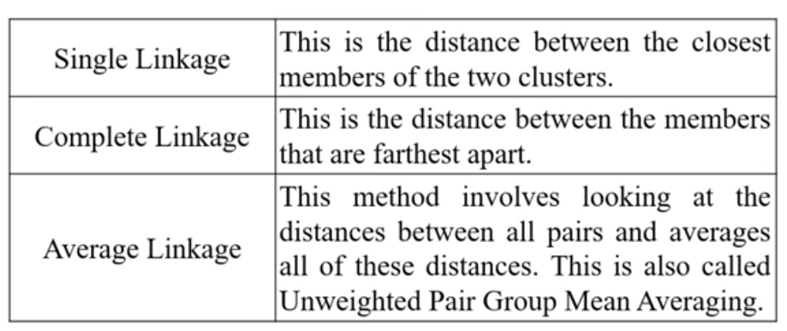
Distance Measure

Slide 9
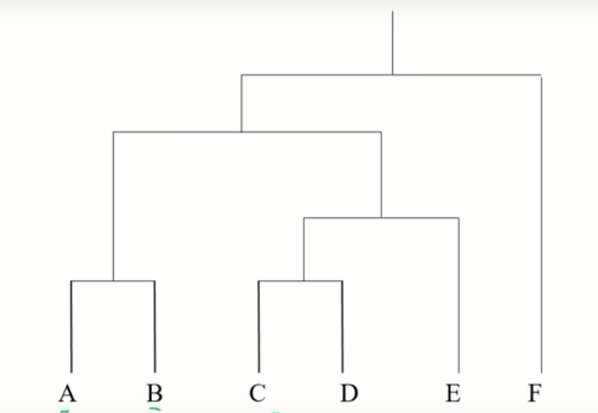
Hierarchical - Dendrogram

Slide 10
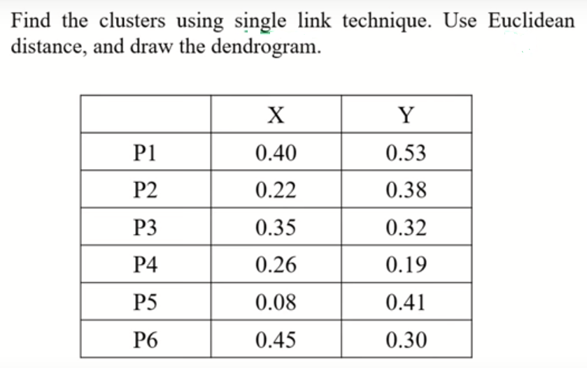
Sample Data

Slide 11
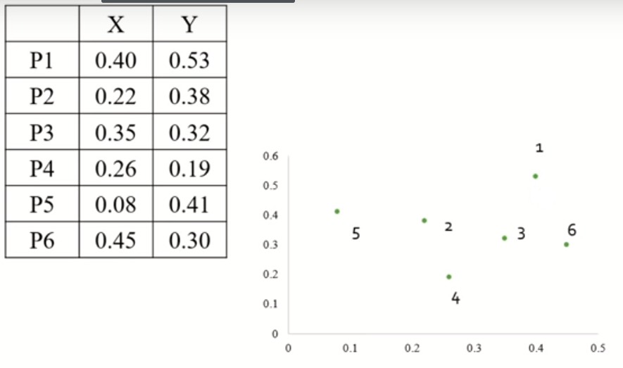
Data and Its Distribution

Slide 12
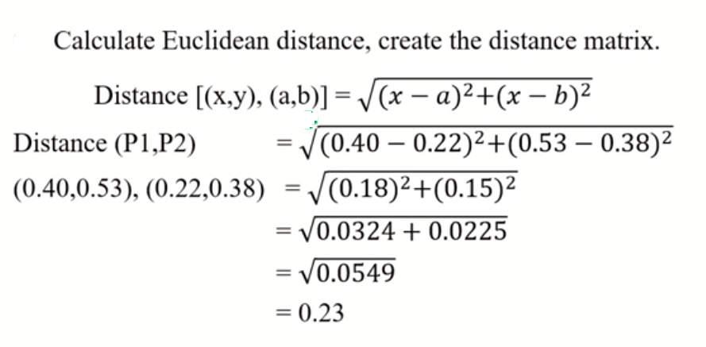
Distance Calculation

Slide 13
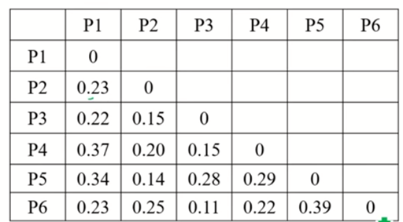
Distance Matrix

Slide 14
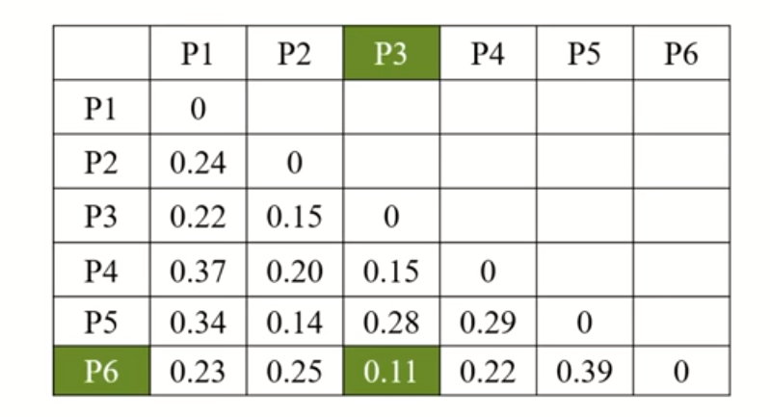
Minimum Distance Identification

Slide 15
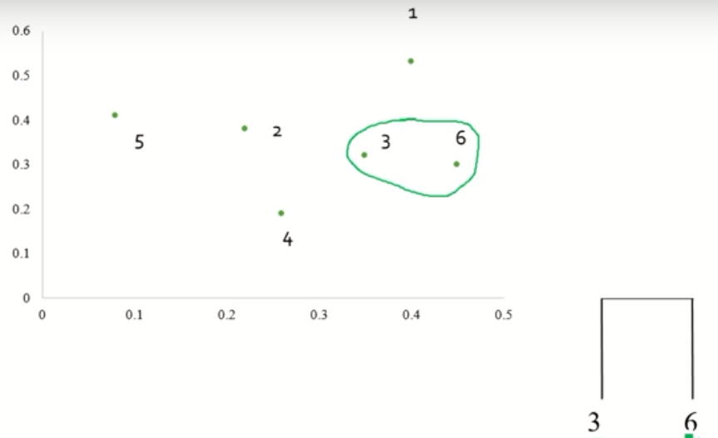
First Grouping

Slide 16
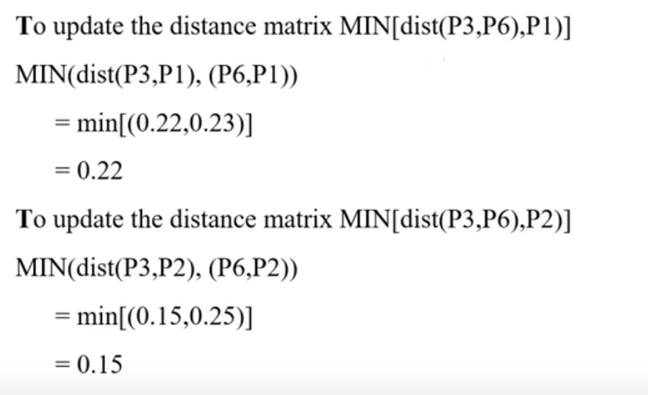
Modified Distance Computation

Slide 17
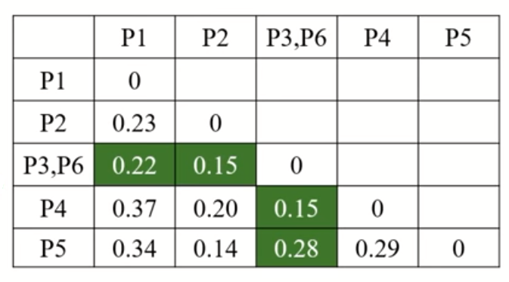

Slide 18
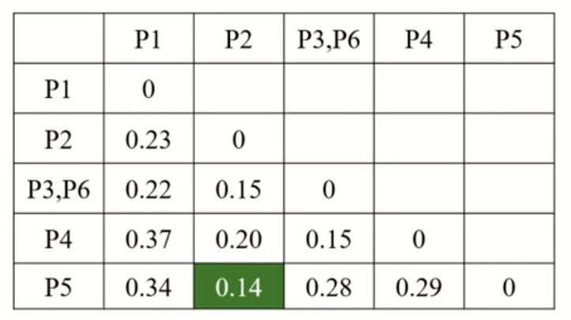

Slide 19
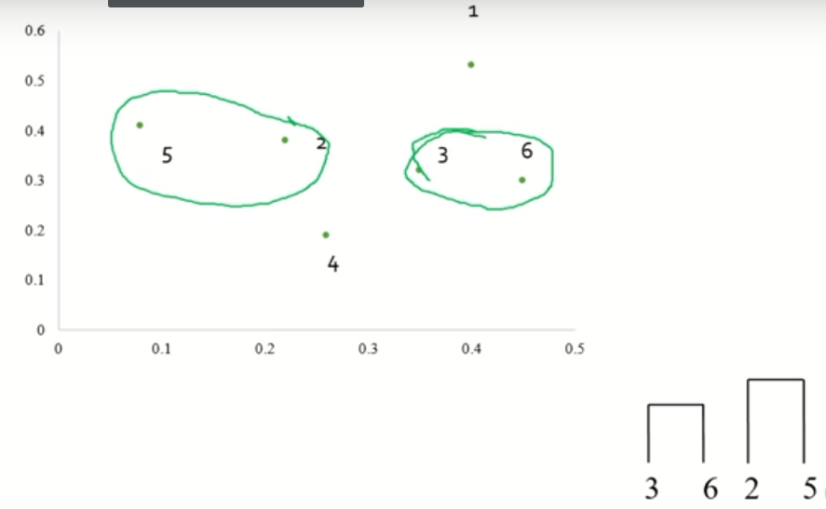

Slide 20
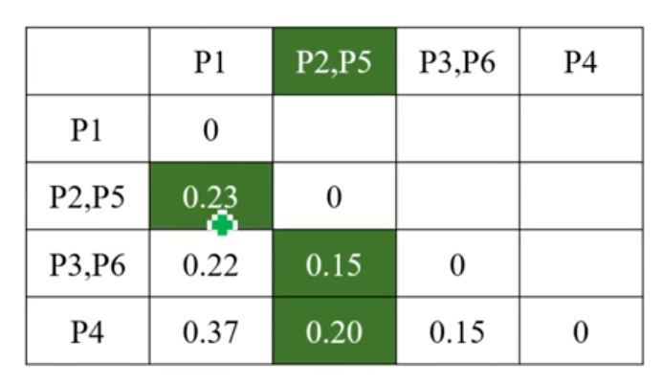

Slide 21
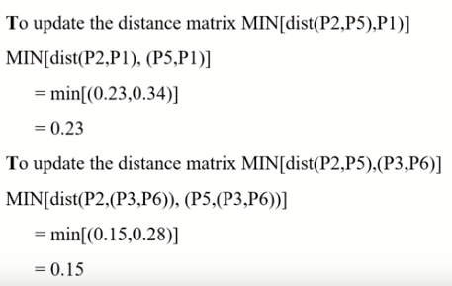

Slide 22
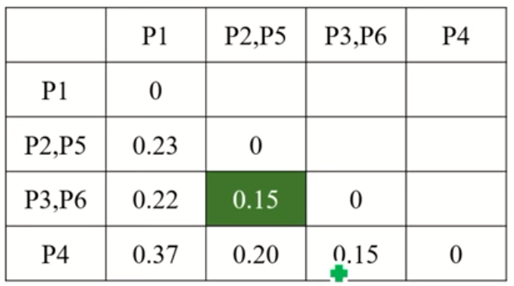

Slide 23
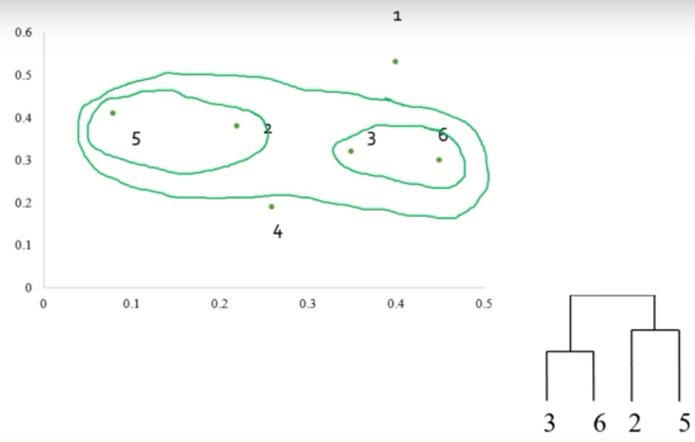

Slide 24
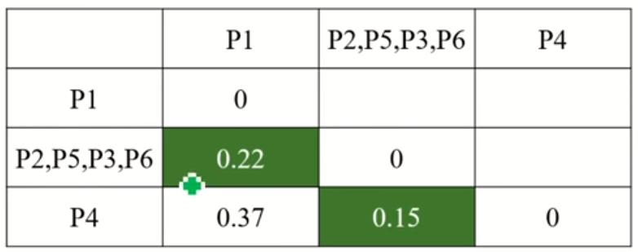

Slide 25
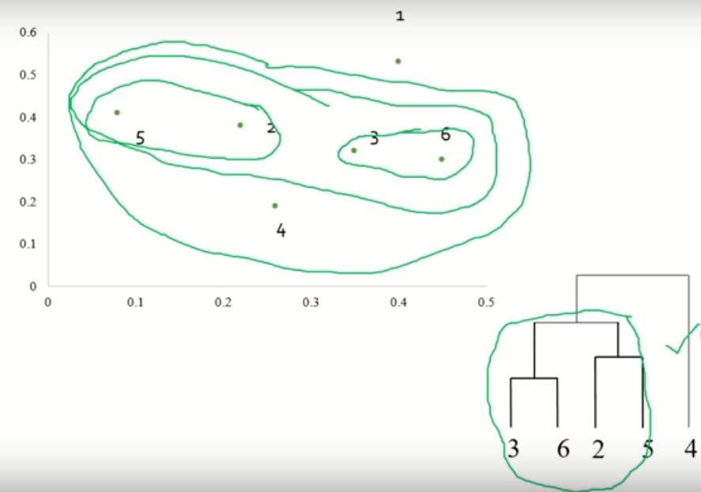

Slide 26
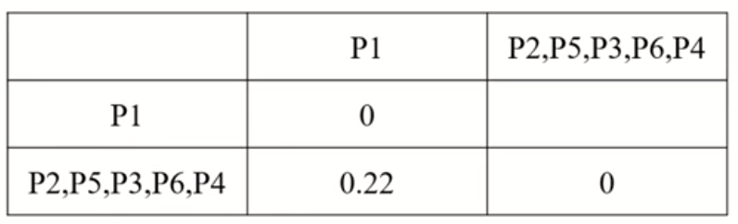

Slide 27
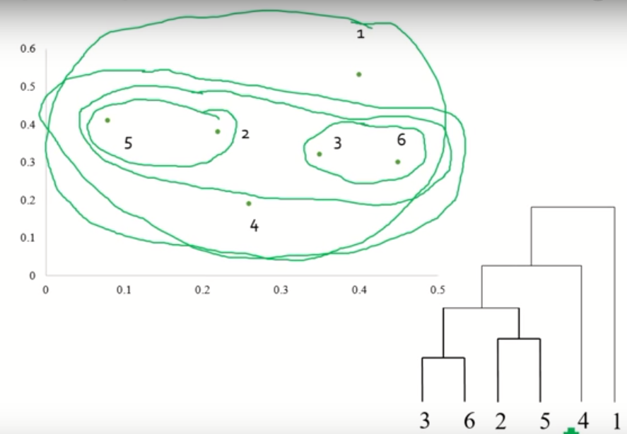
Final Grouping & Dendogram

Slide 28
Clustering Measures
Internal
External
Relative

Slide 29
THANK YOU

