Slide 1
SAI AKHILA MARISARLA
FINAL PROJECT
6/12/2024 Annual Review

Slide 2

PROJECT TITLE
KEYLOGGER AND SECURITY
6/12/2024 Annual Review

Slide 3

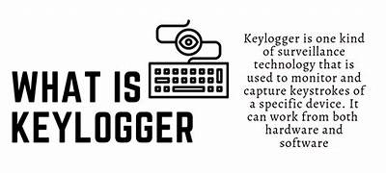

AGENDA
The main objective of this project is to make a clear understanding of spyware called Keylogger which is one of the threats that can steal records when the user enters anything on the keyboard.
In this presentation, we will learn about the keylogger, its types, causes, detection methods and protection against them.
We will also discuss how it is performed to get user information and the solution to prevent its occurrence.
3/21/2024 Annual Review

Slide 4

PROBLEM STATEMENT
This project aims to show the workings of spyware that causes harm to the user’s information called the Keylogger.
We will showcase the work and its harmful effects on the users’ system conducted by a keylogger spyware.
The working of a keylogger in a user’s system is activated when the attacker targets the source system.
The keylogger’s main aim is to get the log details of the targeted source when the user types anything through the keyboard.
The attacker can see the typed details.
The code to make a keylogger can be done in any programming language, Python.
6/12/2024 Annual Review

Slide 5

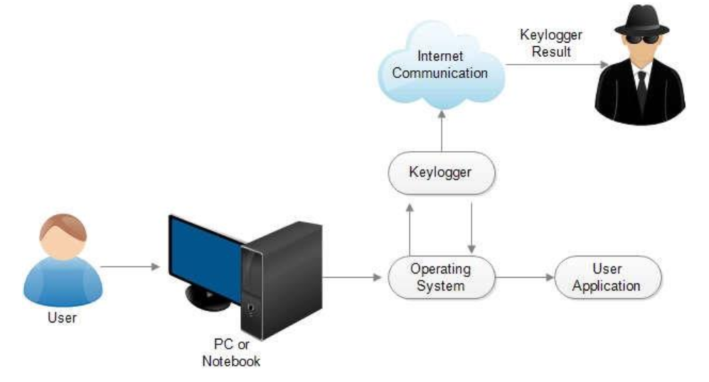
PROJECT OVERVIEW
Keylogging is the action of capturing and recording keys struck on the keyboard. A keylogger is a program that captures and monitors all keys.
Keyloggers can be either a built software program or directly downloaded onto a hardware module.
A keylogger in Python that logs keys, gathers computer information, and network information, gets the clipboard content, records the user microphone and takes screenshots of a computer screen.
6/12/2024 Annual Review

Slide 6


WHO ARE THE END USERS?
The users who try to implement a keylogging system are said to be keyloggers and the users who get affected by these attacks are said to be the victims of an attack.
Keyloggers invade PCs in the same way the other malware does. They install when the user clicks on a file attachment duped into the opening.
The attachments can come through email, text message, social networks or through a visit to an illegitimate website that exploits the vulnerability.
6/12/2024 Annual Review

Slide 7

YOUR SOLUTION AND ITS VALUE PROPOSITION
The best way to protect yourself and your system from falling victim to keyloggers is to scan your system regularly with a quality cybersecurity program.
Always update the devices and be up to date with the latest security patches.
Always be sceptical about any attachments received with unknown senders, keep the passwords long and complex and do not use the same password for different services.
Malwarebytes is a first-line defence against the relentless onslaught of cybercriminals.
6/12/2024 Annual Review

Slide 8

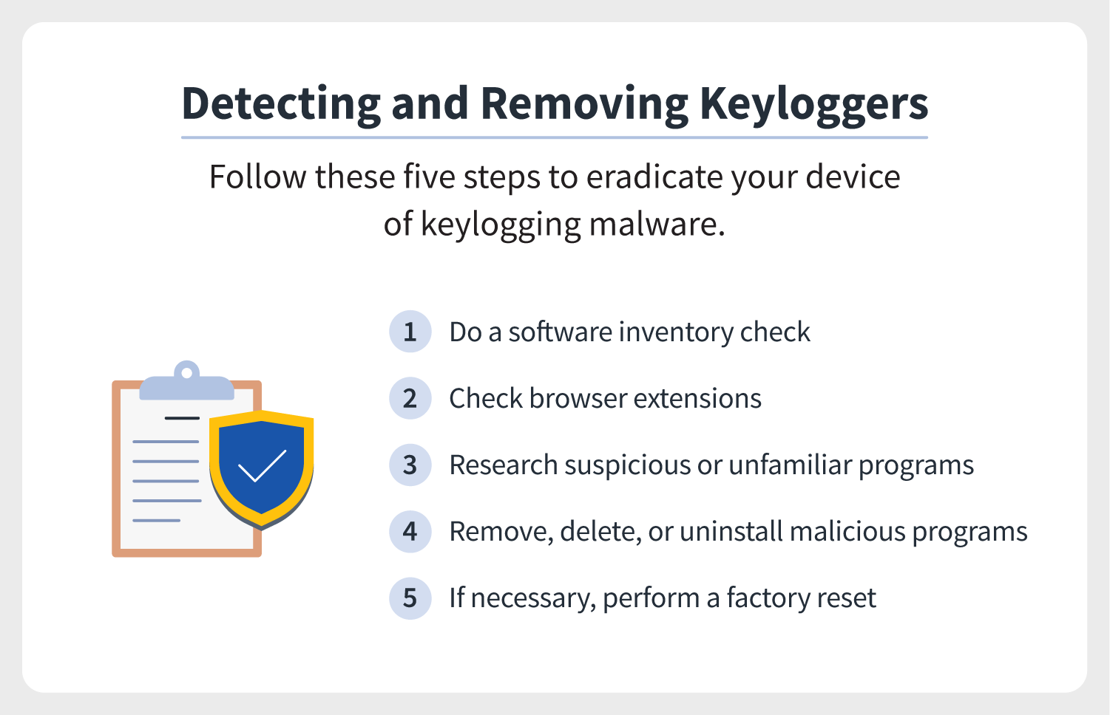
THE WOW IN YOUR SOLUTION
These are the basic methods to prevent the systems from any attacks.
If these steps are followed regularly there is a low rate of chance that the attack will occur.
Other than these steps, there are various other methods for each and every type of attack that can be performed for a better security composition of the system.
3/21/2024 Annual Review
8

Slide 9
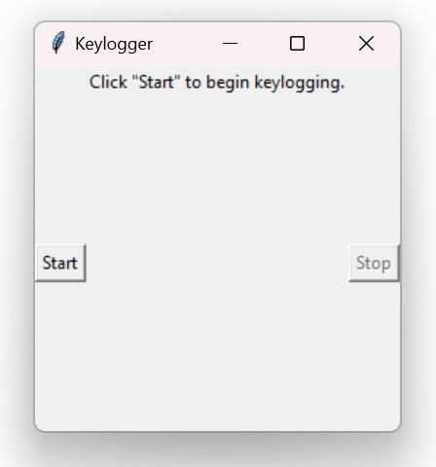
MODELLING
The model to create a keylogger is by writing a code in Python with the JSON libraries and PYNPUT installation in the system for functioning.
This library is used to control and monitor input devices like keyboard and mouse.
The keyboard and mouse listeners are activated in the code to gain access to the details entered through the input devices.
This is the interface for the generated code of a keylogger.
When the start button is clicked, the keylogger gets activated and by clicking on the stop button, the keylogger is stopped.
6/12/2024 Annual Review
9

Slide 10
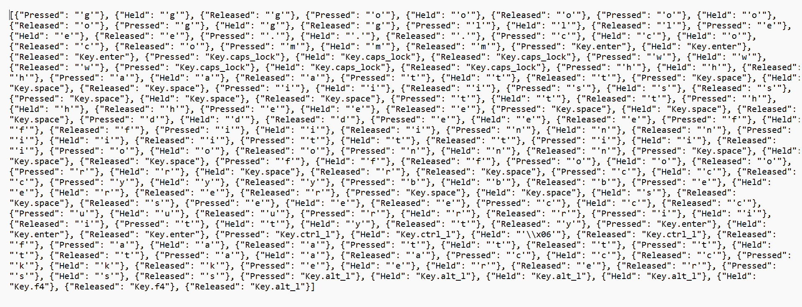
RESULTS
The result for the model generates two files where one file stores the details of pressed or relieved and the other file stores the details of the typed information gained from the user through keyboard.
6/12/2024 Annual Review
10

