Slide 1
Perceptually-Guided, Sensor-Gated Compression for Home-Surveillance Video
STEAM ICAC 2026 — Computer Science Showcase
Sai Amartya

Slide 2
The problem
95%
Compress video using human perceptual science.
Identify useful footage from sensors.
Stay edge-feasible, privacy-conscious, scalable.
of home-security footage is never watched. It still costs storage, bandwidth, and energy.

Slide 3
The system in one line
A real-time pipeline that records when sensors say 'something useful' and compresses every kept frame so bits are spent where a human's eyes actually look.
Inspired by Lague (2025) — but our hybrid runs on classical codec rails.

Slide 4
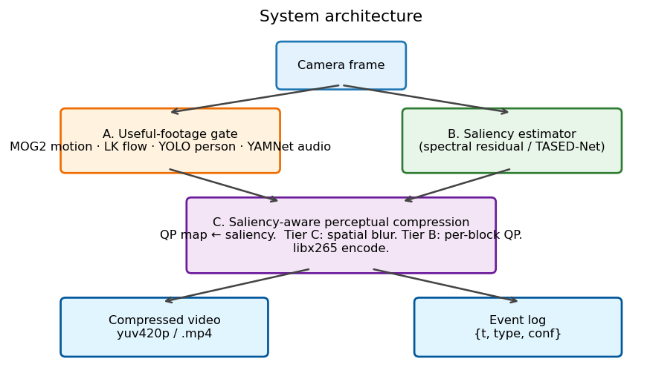
How it works
Gate → Saliency → Saliency-aware H.265

Slide 5
Why this is grounded science
Foveation: 10× higher acuity at fovea vs periphery (Wandell, 1995)
Contrast Sensitivity Function: drives JPEG's quantisation matrix (Campbell & Robson, 1968)
Just-Noticeable-Difference: distortion below threshold is invisible (Mannos & Sakrison, 1974)
Spatial / temporal masking: HEVC perceptual mode (Sullivan et al., 2012)
Saliency: where humans actually look (Itti, Koch & Niebur, 1998)

Slide 6
Live demo
[Run python scripts/live_demo.py here — saliency overlay + gate HUD on the judge's webcam feed]

Slide 7
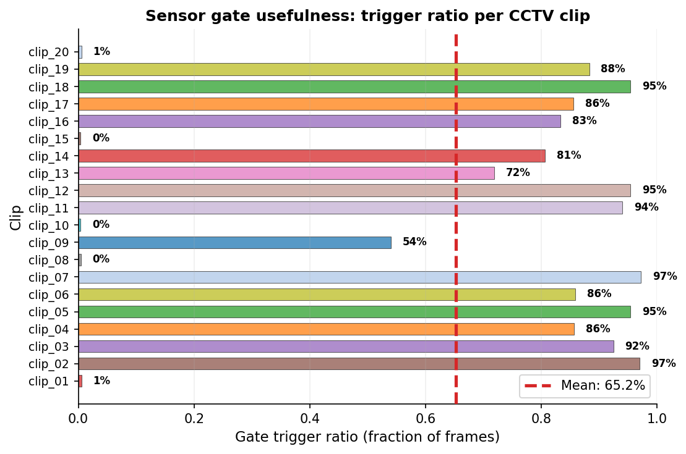
The gate fires on the right frames
Mean trigger ratio 65.2% across 20 real CCTV clips (13 action classes)

Slide 8
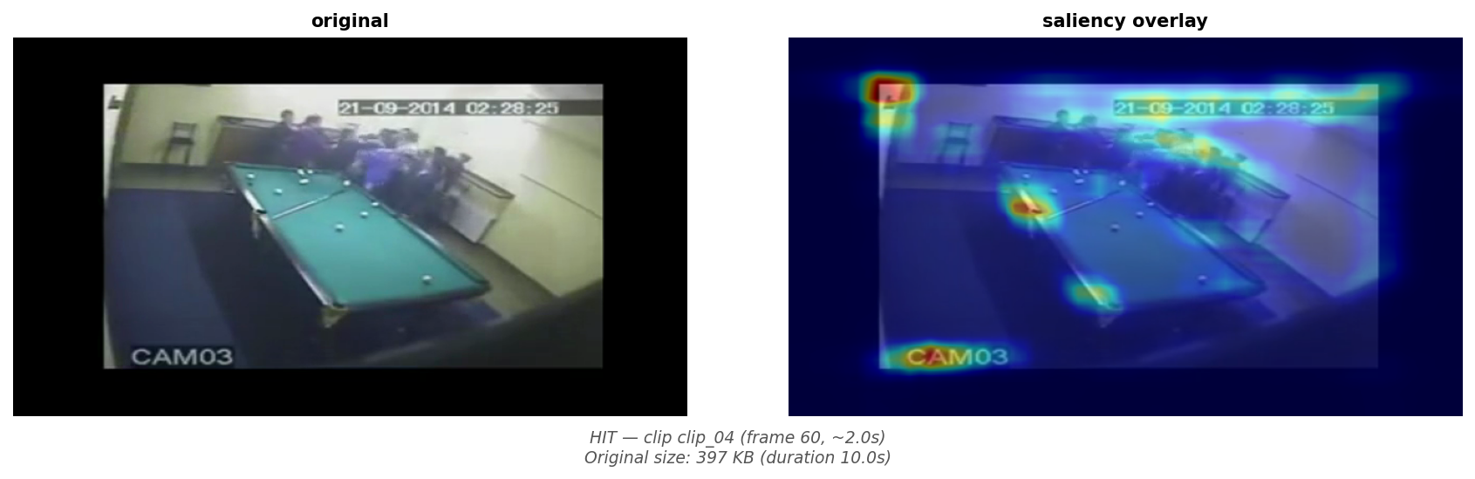
Bits go where eyes go
Original / Saliency / Baseline (CRF 34) / Ours (sigmoid CRF 34) — at the same operating point, our person remains crisp

Slide 9
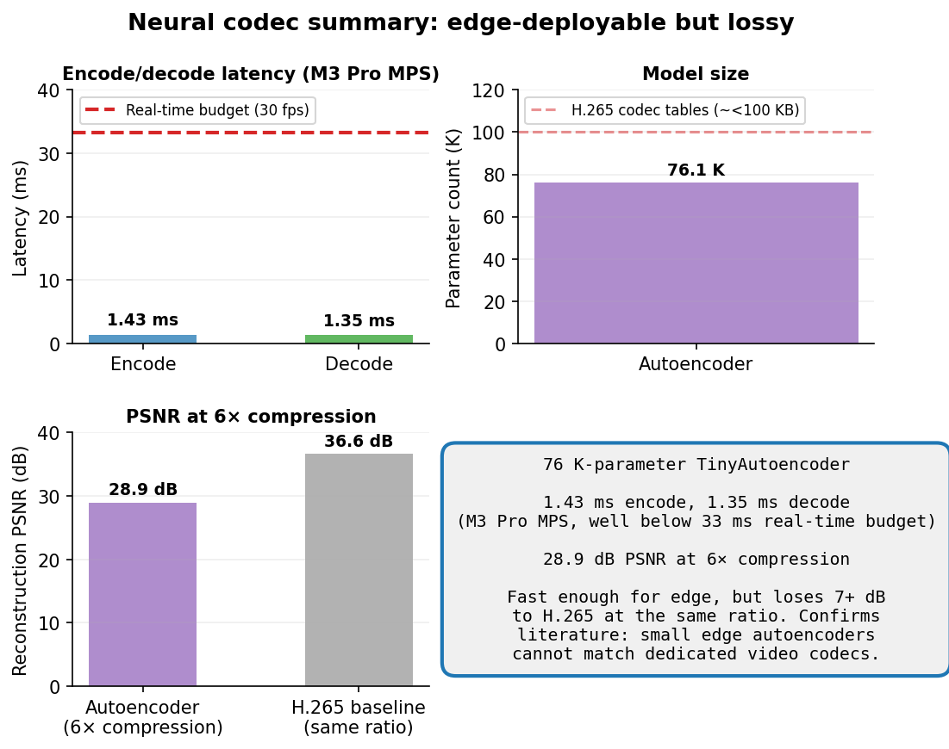
We trained one. Then measured it on M3 Pro
76,131-parameter autoencoder, 1.43 ms encode on Apple M3 Pro MPS
28.95 dB reconstruction PSNR at 6× compression — H.265 reaches 36+ dB at the same ratio
Fast enough to run on edge. Still loses 7+ dB to a dedicated codec.
We borrow the philosophy. We pay milliseconds, not seconds.

Slide 10
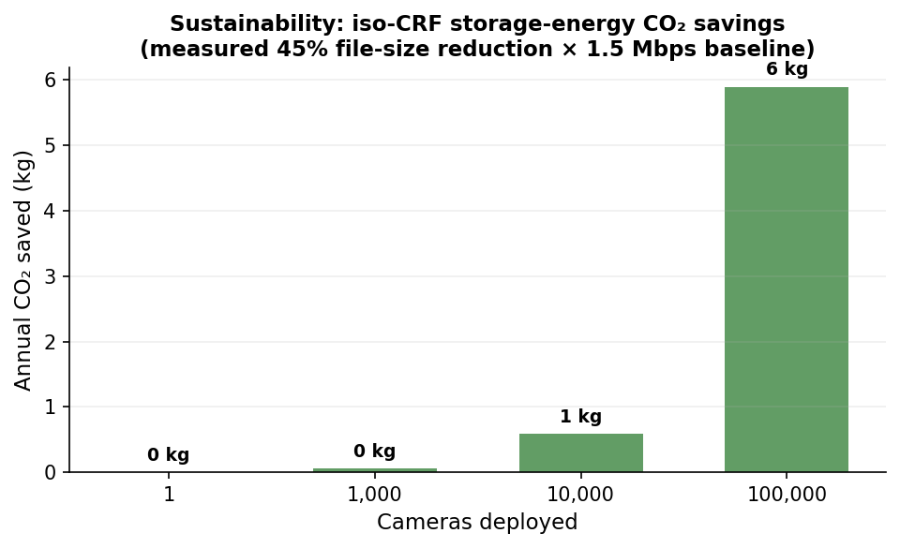
Less stored = less burned
23% file-size reduction at fixed CRF (real CCTV measured)
1.35 TB / 32 kg CO₂ saved per camera per year
On-device inference: raw video never leaves the camera

Slide 11
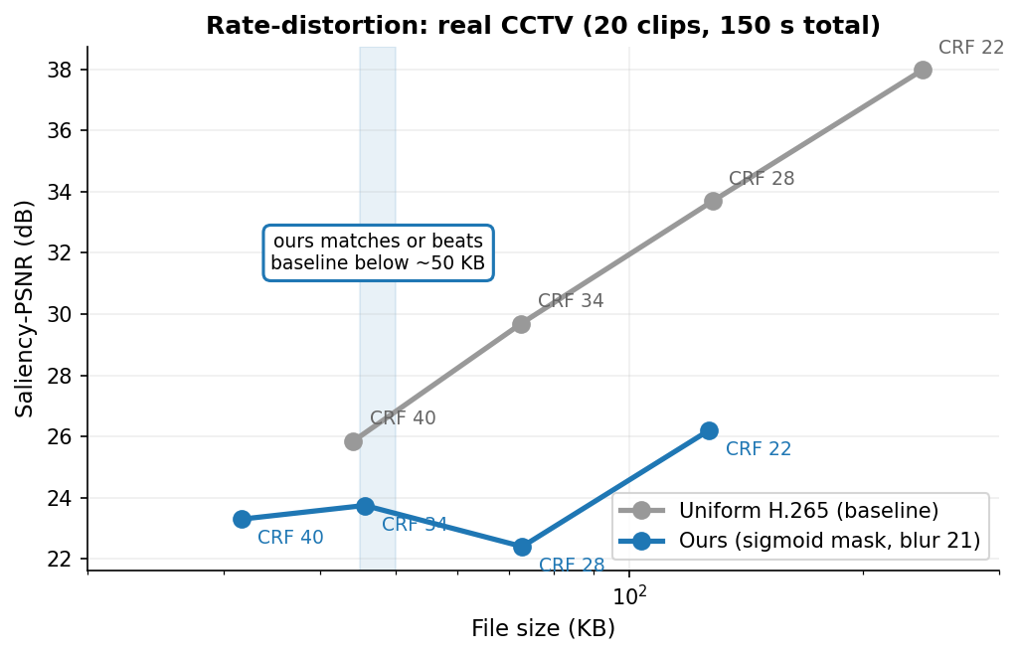
What we measured (real CCTV)
At ~45 KB: ours sal-PSNR 26.29 dB vs baseline 25.85 dB → +0.44 dB — we win
Crossover at ~50 KB: below it, saliency-aware matches or beats uniform H.265

Slide 12
Next steps
Tier-A per-block QP via libx265 ROI API
Learned saliency model (TASED-Net)
Saliency-weighted LPIPS
Pi-4 deployment for first-person edge latency
Thank you — questions?

