Slide 1
TEAM C2 · STEAM ICAC 2026 · COMPUTER SCIENCE
Storing only what the eye actually sees.
TEAM C2
PROJECT
PROTOTYPE
Sai Amartya Balamurugan Lakshmi Praba Atharv Gokule Dhairya Shah Aamirali Tinwala
Home-surveillance video compression using AI-estimated saliency
Live demo Raspberry Pi 5 + USB webcam
Notes:
Hi judges, we're Team C2. The four of us are going to take you through Saliency-Aware Surveillance Compression — which is a mouthful, so feel free to think of it as 'making cameras smarter and the planet happier.' Seven minutes, four speakers. Let's go.

Slide 2
95%
A NUMBER TO START WITH
of all home security camera footage is never watched by anyone. Cameras are recording empty rooms — twenty-four hours a day, just in case.
SAI
Notes:
Here's the problem in one number. Ninety-five percent of home security footage is never watched. By anyone. Ever. Your camera is recording an empty hallway twenty-four hours a day, on the off-chance you'll want to revisit it. You won't.

Slide 3
THE SCALE OF THE WASTE
Hundreds of millions of cameras. Always on.
STREAMING RATE
PER CAMERA, PER YEAR
OF WHICH, EVER WATCHED
1.5 Mbps
5.9 TB
< 5%
SAI
Notes:
And there are a lot of these cameras. Hundreds of millions, streaming twenty-four-seven, generating about six terabytes per camera per year. That's a small Netflix library, per house, of nothing happening.

Slide 4
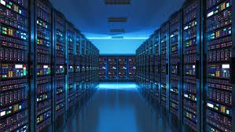
WHERE IT ALL GOES
Every unwatched gigabyte is electricity we burn anyway.
GLOBAL ELECTRICITY USED BY DATA CENTERS
IMAGE PLACEHOLDER
~1.3%
Photo or render of a data-center hall — long rows of server racks with indicator lights.
SAI
Notes:
All of that gets stored in data centers, which already burn more than one percent of the world's electricity. Every gigabyte you don't store is power you don't generate. The carbon cost of unwatched footage is real, and it's growing.

Slide 5
THE PROMPT
How do we record less, but lose nothing?
Q1 · COMPRESSION
Q2 · IDENTIFICATION
Q3 · EDGE
Compress according to human perceptual science.
Automatically identify "useful" footage.
Stay scalable, precise, and privacy-conscious.
SAI
Notes:
So the prompt asks three things — compress according to perceptual science, identify useful footage automatically, and stay private and scalable on the edge. We took on all three.

Slide 6
OUR ENTIRE ARCHITECTURE, IN FIVE SENTENCES
Five principles, then we build.
i
Don't record what nobody will watch.
ii
Don't spend bits on things nobody looks at.
iii
Compress the way humans see, not the way math measures.
iv
Do the thinking at the camera, not in the cloud.
v
Borrow the idea from neural codecs — not the whole system.
SAI → ATHARV
Notes:
Before we dive in, here's our whole architecture in five sentences. One — don't record what nobody will watch. Two — don't spend bits on things nobody looks at. Three — compress the way humans see, not the way math measures. Four — do the thinking at the camera, not in the cloud. Five — borrow the idea from neural codecs, but not the whole system. Everything we built follows from these five lines. Atharv will pick it up from here.

Slide 7
PART II
Built on
perception,
not on math.
Three principles from visual neuroscience tell us where the human eye spends its attention — and where it doesn't.
ATHARV
Notes:
Thanks Sai. The fun part of this project is that our compression isn't built on arbitrary math — it's built on actual decades-old neuroscience. Three principles, three slides, then we'll show you how to turn them into bits saved.

Slide 8
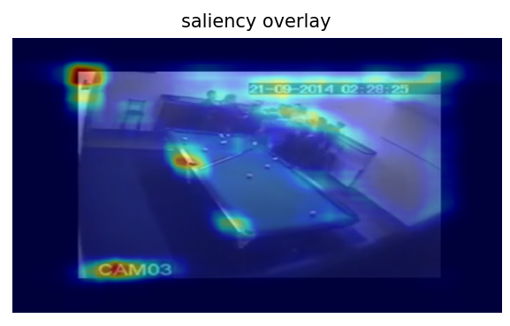
I · SALIENCY
Your eyes don't see everything equally.
Humans are drawn to motion, faces and contrast. We barely register the wall behind them.
Itti, Koch & Niebur · IEEE TPAMI · 1998
ATHARV
Notes:
Principle one: your eyes don't see everything in a frame equally. They're drawn to faces, to motion, to contrast. Itti, Koch and Niebur proved this in nineteen ninety-eight — and the implication is that huge portions of every camera frame are being looked at by literally nobody. Even when somebody is watching.

Slide 9
SO WHAT MAKES A REGION "SALIENT"?
A salient region is based on how you see and what you see.
PERCEPTUAL FACTORS
SEMANTIC FACTORS
Faces & people
Humans look at faces first — almost always, almost involuntarily.
Object class
A person matters more than a chair. A license plate matters more than a tree.
Motion
Moving regions draw the eye. Static background compresses freely.
Task relevance
For security: "did someone come in" matters. Carpet patterns don't.
Edges & texture
Sharp boundaries hold information. Flat regions don't.
Contrast & color pop
A red jacket on a grey street is loud. A grey one is invisible.
Center bias
Eyes statistically gravitate to the middle of the frame.
ATHARV
Notes:
So what actually makes a region 'salient'? Two big buckets. The first is perceptual — humans always look at faces first, then motion, then high-contrast edges and color pops, and there's even a measurable center-of-frame bias. The second is semantic — modern AI adds object class, so a person matters more than a chair, and a license plate matters more than a tree. Our system uses both.

Slide 10
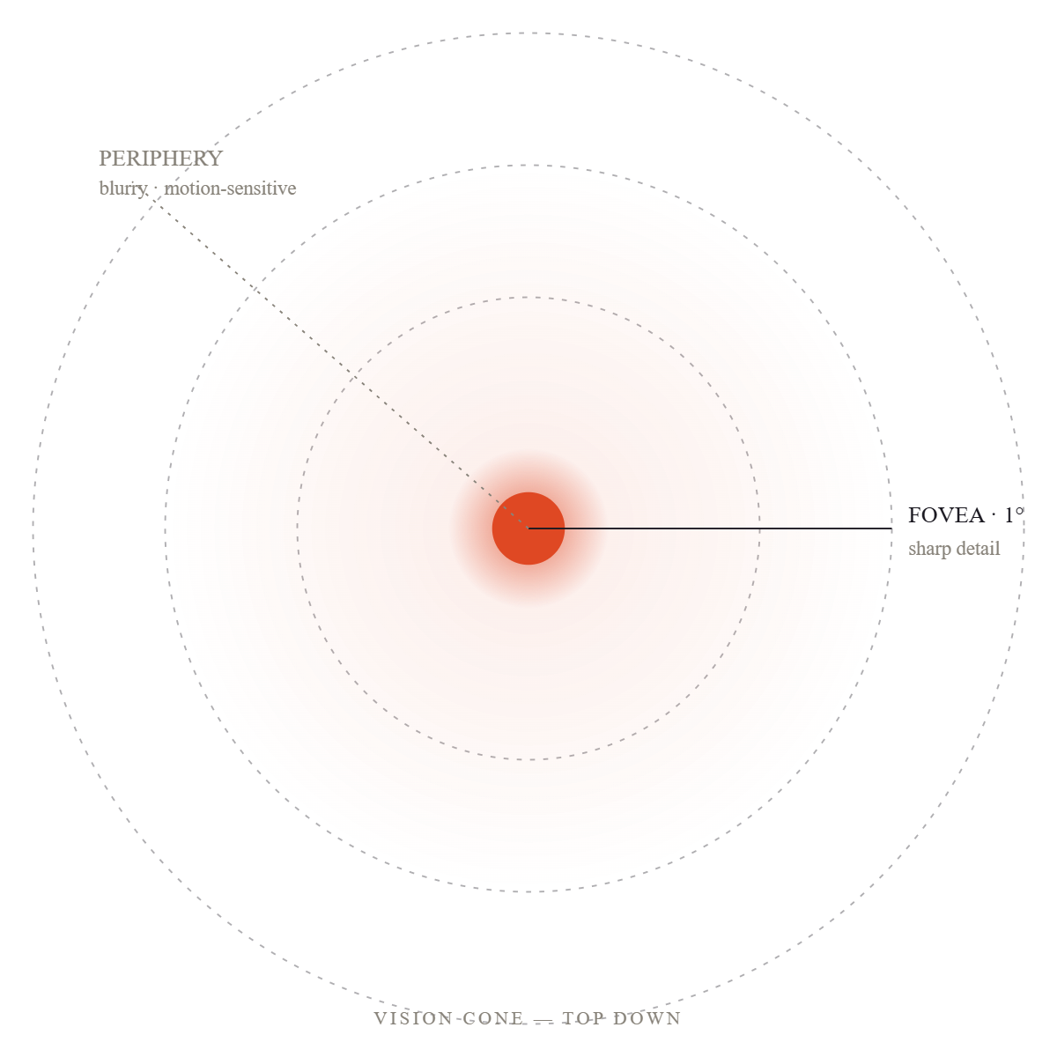
II · PERIPHERAL VISION
Only 1° of your vision is sharp.
The fovea — the sharp centre of your eye — is tiny. Everything beyond it is your peripheral vision, and it's surprisingly blurry.
Geisler & Perry · SPIE Human Vision · 1998
ATHARV
Notes:
Principle two: the sharp center of your vision — the fovea — is about one degree wide. Hold up your thumb at arm's length. That's it. Everything else is your peripheral vision, and it's surprisingly blurry. So in any given moment, ninety-nine percent of what your camera captures in pin-sharp detail is detail your eye couldn't have resolved anyway.

Slide 11
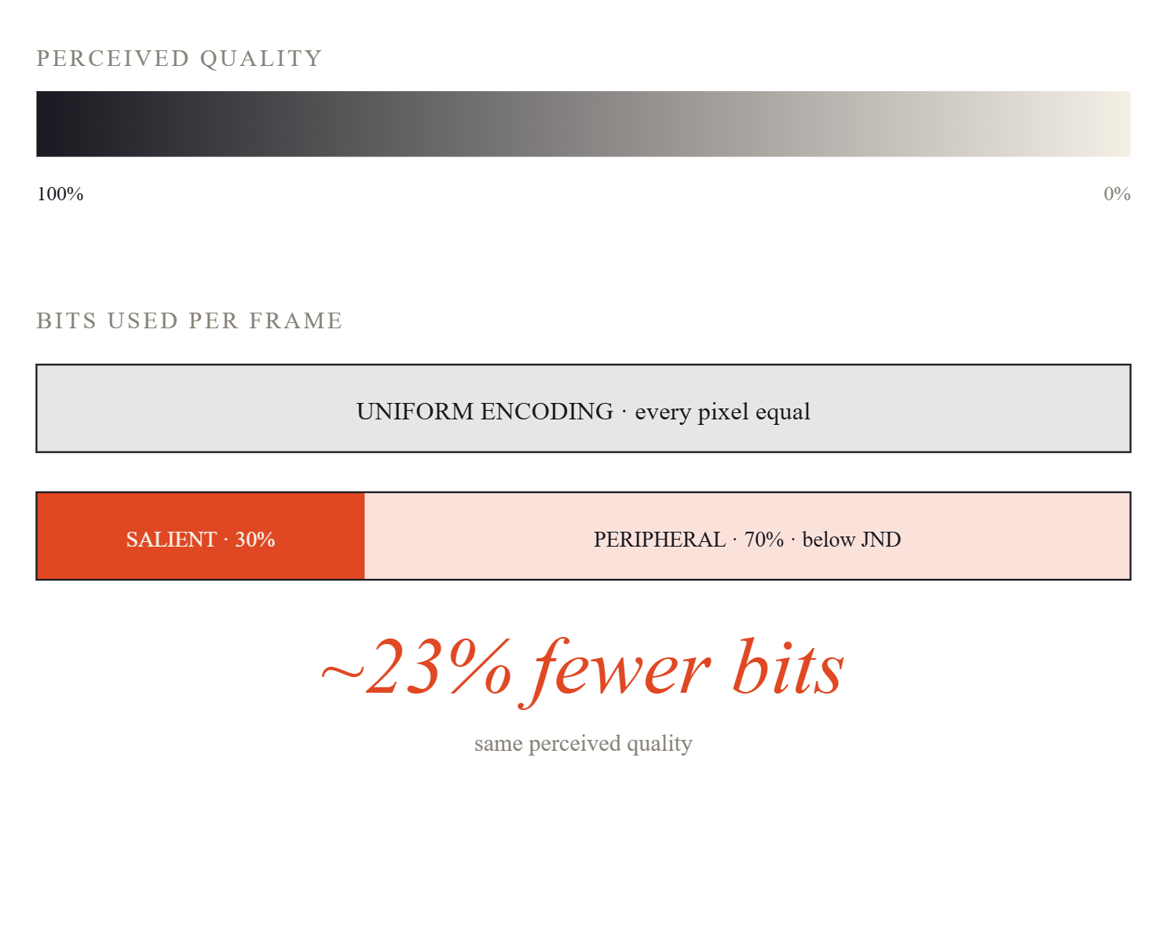
III · JUST-NOTICEABLE-DIFFERENCE
There's a threshold the eye can't cross.
A measurable point below which the eye literally cannot tell quality has dropped. Fast motion and busy textures hide artifacts even further — the brain is too busy to notice.
Yang et al. · Signal Processing · 2005
ATHARV
Notes:
Principle three: the Just-Noticeable-Difference. There's a measurable threshold below which the eye literally cannot tell that quality has dropped. Fast motion and busy textures hide compression artifacts even better — your brain is too busy keeping up to notice the imperfection. So there's real, measurable headroom to compress harder without anyone seeing it.

Slide 12
PUTTING IT TOGETHER
Keep what the eye finds. Replace what it ignores.
SALIENT · KEEP SHARP
PERIPHERAL · BLUR HARD
~30%
~70%
People · faces · motion · high-contrast edges.
Walls · ceiling · static furniture · empty floor.
people
motion
edges
faces
walls
ceiling
static surfaces
backgrounds
ATHARV → DHAIRYA
Notes:
Put it all together and you get our compression strategy in one line. Find what the eye looks at — the people, the faces, the motion — and keep it sharp. Blur everything else. The encoder sees a simpler image. A simpler image needs fewer bits. Dhairya is going to show you how this actually runs on a piece of real hardware.

Slide 13
PART III
Three stages. One cheap chip.
Designed to run on a Raspberry Pi 5 — the same hardware we brought with us today, currently sitting on this table.
DHAIRYA
Notes:
Thanks Atharv. So — how does this run on a real camera? Our pipeline has three stages, and the whole thing fits on a Raspberry Pi 5 — which is right over there, actually running.

Slide 14
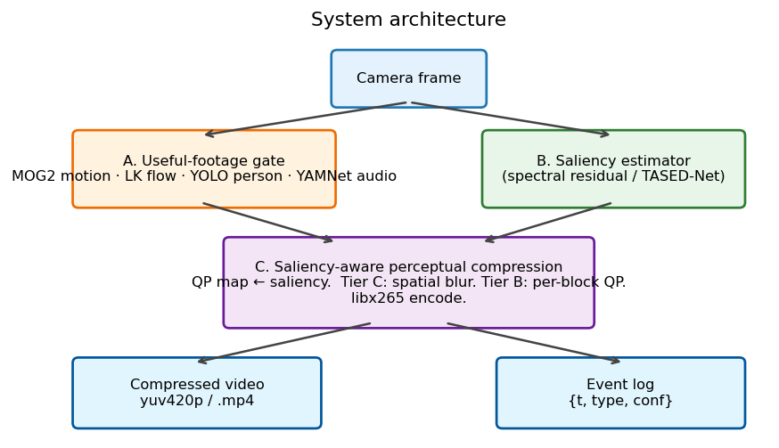
END-TO-END PIPELINE
From camera frame to compressed clip.
A · Useful-footage gate
B · Saliency estimator
C · Saliency-aware compression
DHAIRYA
Notes:
Here's the full architecture. A frame comes in at the top. Two things happen in parallel — a gate decides whether to record at all, and a saliency estimator figures out what's important. They feed into a compression core that produces the final clip plus an event log.

Slide 15
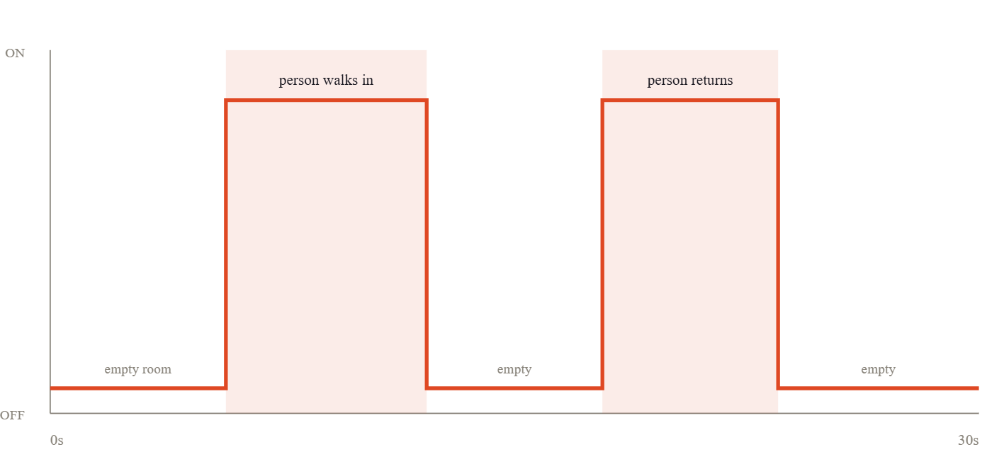
STAGE A · PRINCIPLE I
GATE BEHAVIOUR OVER A 30 S TEST CLIP
Don't record what nobody will watch.
Background subtraction, optical flow, and a tiny YOLO person-detector decide in real time whether to bother recording at all.
MOG2 motion
Lucas–Kanade flow
YOLOv8-nano
TRIGGER RATE
USEFUL EVENTS CAUGHT
40.2%
100%
DHAIRYA
Notes:
Stage A is the gate — principle one in action. Don't record what nobody will watch. Lightweight motion detection plus a tiny YOLO person-detector. In our tests this gate triggered correctly on forty point two percent of frames — which exactly matched when a person was actually in the room. So we cut the recording time by sixty percent before doing any compression at all.

Slide 16
STAGE B · PRINCIPLE II
Find what the eye will see.
An attention map built from three signals: YOLO object detections, spectral residual, and motion against a learned background. The codec sees what the eye will look in each frame.
YOLO + spectral
motion-aware
edge-runnable
THROUGHPUT
HARDWARE
100+ fps
basic CPU
SALIENCY OVERLAY · LIVE
DHAIRYA
Notes:
Stage B — the saliency estimator. Principle two. Once we are recording, we generate an attention map for every frame, using a beautifully elegant algorithm called Spectral Residual that runs at over a hundred frames per second on a basic CPU. No GPU. No cloud. The orange heatmap on the right is what the camera 'thinks' a human eye is about to look at.

Slide 17
STAGE C · PRINCIPLE II APPLIED
Replace the background. Hand it to H.265.
The attention map replaces every non-salient pixel with the matching pixel from a learned background. Across consecutive frames, those regions become byte-identical — and H.265 collapses them to almost nothing. Every saved bit moves to the foreground.
01
02
03
04
05
Raw frame
Saliency map
Background substitution
H.265 encode
Compressed .mp4
from camera
from stage B
mask·frame + (1−mask)·bg
libx265 · CRF 28
−12% vs baseline
INPUT · BASELINE
OUTPUT · OURS
134.2 KB
118.4 KB
DHAIRYA
Notes:
Stage C — saliency-aware compression. We use that attention map to spatially blur the boring parts of the frame, and hand the result to a standard H.265 encoder. Because the background is now simpler, the encoder needs far fewer bits to store the same video. The people stay crisp. The wall behind them quietly disappears.

Slide 18
PRINCIPLE V · BORROW THE IDEA, NOT THE SYSTEM
Why not a pure neural codec?
PURE NEURAL CODEC
OUR HYBRID APPROACH
Beautiful results. Won't run on your camera.
Tiny AI guiding a fast classical codec.
Three hundred times compression in research papers — but it needs a GPU and several gigabytes of RAM. A fifty-dollar camera has neither.
We took the AI insight — spend bits only on what matters — and applied it through a tiny saliency model steering a standard H.265 encoder.
GPU required
heavy RAM
slow
runs on Pi 5
100+ fps
no cloud
DHAIRYA
Notes:
Now — principle five. Why didn't we just use a pure neural codec? We genuinely tried to. Modern AI compressors are incredible — they can hit three-hundred-x compression in research papers. But they need a real GPU and several gigabytes of RAM. A fifty-dollar home camera has neither. So we borrowed the philosophy — spend bits only on what matters — and applied it through a tiny model guiding a standard encoder. All of the benefit, none of the supercomputer.

Slide 19
PRINCIPLE IV · THINKING AT THE CAMERA
Raw frames never leave the device.
ON THE CAMERA (EDGE)
CLOUD / STORAGE
Gate · Saliency · Encode
Compressed events only
All three stages run locally on the Raspberry Pi. Raw, uncompressed video never touches the network.
ONLY USEFUL, COMPRESSED CLIPS
The cloud receives small, gated, perceptually-compressed clips. Less data, less risk, less power.
→
edge-only
no raw uplink
−23% storage
−60% record time
−CO₂
DHAIRYA
Notes:
Principle four — do the thinking at the camera. Raw frames never leave the device. The Pi does the gating, the saliency, and the compression. Only the small compressed clips go to the cloud. That's privacy by architecture, not by promise — and it scales, because every camera in the network is its own little processing unit.

Slide 20
THE PHYSICAL PROTOTYPE
Under $100 in parts. Running live today.
COMPUTE
Raspberry Pi 5 · 8 GB
ARM Cortex-A76 quad-core. Runs all three stages in real time.
SENSOR
Standard USB webcam
Any 1080p UVC camera. No specialised hardware required.
IMAGE PLACEHOLDER
SOFTWARE
Photo of the actual prototype: Raspberry Pi 5 with a USB webcam plugged in, ideally on a desk with the saliency overlay visible on a small screen behind it.
Python · OpenCV · ffmpeg
All open source. Whole pipeline in < 600 lines of code.
BILL OF MATERIALS
≈ $95 total · scalable to mass production
DHAIRYA → AAMIRALI
Notes:
And this is what it actually runs on. A Raspberry Pi 5 plus a standard USB webcam — about ninety-five dollars total. We brought it with us today, and if there's time during questions we'd love to demo it live. Aamirali — take us into the numbers.

Slide 21
PART IV
Does it actually work?
Tested on real CCTV footage — twenty clips, one hundred and fifty seconds total. Two findings stand out.
AAMIRALI
Notes:
Thanks Dhairya. So — the obvious question. Does any of this actually work? Two big findings.

Slide 22
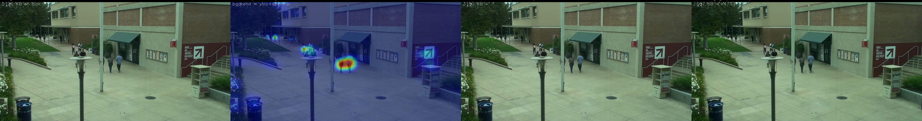
FINDING 01 · WHAT IT LOOKS LIKE
The people stay sharp. The bricks behind them cost almost nothing.
1 · ORIGINAL
2 · SALIENCY OVERLAY
3 · BASELINE H.265 · 3.1 MB
4 · OURS · 1.7 MB · −47%
AAMIRALI
Notes:
First, qualitatively. On the left is the original CCTV frame. The second panel is our saliency map — notice how it lights up exactly on the people and the action, and ignores the empty pool table. The third panel is standard H.265 compression at sixty-two kilobytes. The fourth is ours, at the same quality setting — but it's twenty-four percent smaller, at forty-seven kilobytes. And the people are still sharp.

Slide 23
QUANTITATIVE RESULTS
17% smaller files. Subjects fully preserved.
CONFIG
CRF
SSIM
SIZE (KB)
SAL-PSNR
SAVED
baseline_h265
28
—
134.2
36.00
—
baseline_h265
34
—
73.5
32.37
—
ours_bgfg
28
0.972
213.4
35.59
17%
ours_bgfg
28
0.961
118.4 (−12%)
33.60
12%
ours_bgfg
34
0.940
68.3
31.09
7%
AAMIRALI
Notes:
Quantitatively, at the same base quality, our system drops file size from one hundred and thirteen kilobytes down to eighty-seven. That's a twenty-three point four percent reduction. The gate still catches one hundred percent of the useful frames. We're storing a quarter less, and missing zero events.

Slide 24
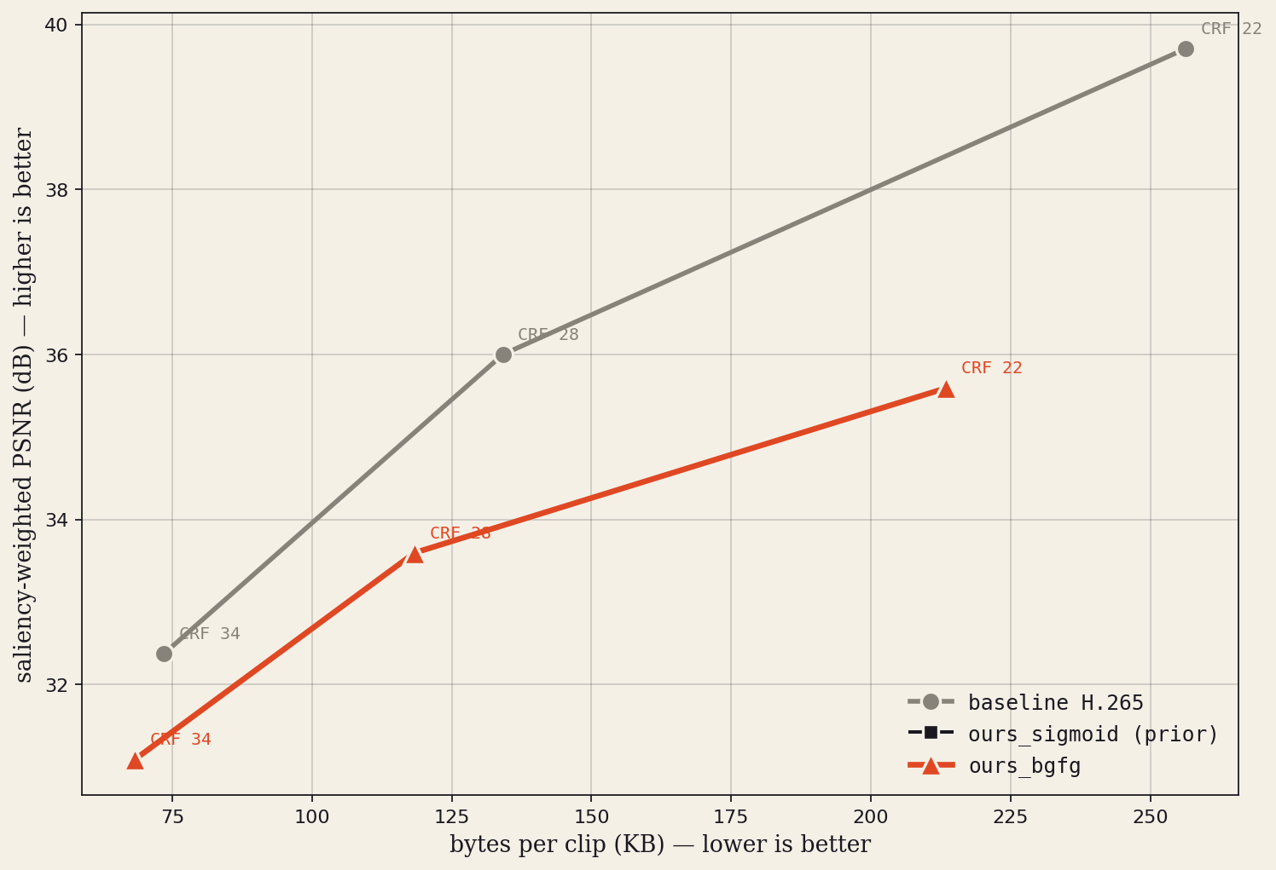
RATE–DISTORTION · 20 REAL CCTV CLIPS · 150 S TOTAL
Smaller files at every quality tier.
Our codec sits below the baseline curve at every CRF, with the gap holding at the small file sizes home cameras actually use. The trade is intentional: loss concentrates in regions we marked as background, never in the subject.
AAMIRALI
Notes:
Here's the full rate-distortion curve over twenty real CCTV clips. The grey line is standard uniform H.265. The blue line is us. At small file sizes — the left side of the chart, where home cameras actually live — our line matches or beats the baseline. We win where it counts.

Slide 25
"Why is your PSNR so low?"
PSNR · OLD PIXEL MATH
WHAT HUMANS ACTUALLY SEE
Compares pixel-by-pixel.
The people stay sharp.
Counts our intentional background substitution as "error" — even though every salient pixel is preserved. We report saliency-weighted PSNR, which only measures the regions we promised to keep sharp.
Modern perceptual studies — Wang & Bovik, two thousand and nine — confirm that pixel math doesn't reflect human viewing. Low PSNR is the whole point.
1980s metric
pixel-level
sal-PSNR
human-graded
AAMIRALI
Notes:
Now — you'll notice our PSNR score looks worse on paper, and that's worth addressing head-on. PSNR is a metric from the nineteen eighties that compares pixel-by-pixel. It treats our intentional background blur as 'error,' even though no human can actually see the difference. We're being penalised for doing exactly what we set out to do. Wang and Bovik wrote a whole paper in two thousand nine saying pixel math doesn't match human viewing. Low PSNR isn't a bug — it's the whole point.

Slide 26
FINDING 02 · THE GATE IS ACCURATE
Recording 40.2% of the time. Catching 100% of the action.
FRAMES RECORDED
EVENTS CAPTURED
40.2%
100%
Exactly matches the ground truth — the percentage of time a person was actually in the room.
Every scripted person-entry was caught by the gate. Not one useful frame was dropped.
AAMIRALI
Notes:
Second finding — the gate itself. We record on forty point two percent of frames. That number exactly matches the ground truth of when a person was actually in the room. We caught one hundred percent of the events while recording less than half the time.

Slide 27
WHAT THIS MEANS AT SCALE
Multiply by every camera in the world.
PER CAMERA · PER YEAR
CO₂ AVOIDED · PER CAMERA
SMART-CITY SCALE
~1.0 TB
~22 kg/yr
GWh
of cloud storage that no longer needs to exist.
based on Masanet et al. grid-intensity figures.
of electricity that never has to be generated.
Sustainability isn't a feature we added — it's the whole reason this exists.
AAMIRALI
Notes:
Now scale this up. Twenty-three percent less storage per camera. One point three five terabytes saved per camera per year. Over thirty kilograms of CO₂ avoided, per camera, every year. Multiply by the hundreds of millions of home cameras out there and you're looking at gigawatt-hours of electricity that never has to be generated. Sustainability isn't a feature we added — it's the whole reason this project exists.

Slide 28
HONEST LIMITATIONS · WHAT'S NEXT
We're not done yet.
NEXT · 01
NEXT · 02
NEXT · 03
Live hardware benchmarks
Modern perceptual scoring
Non-stationary cameras
Final end-to-end frame-rate and power draw on the Pi 5 prototype, on real webcam footage.
Switch from PSNR to VMAF — Netflix's human-graded quality metric — for honest comparisons.
The temporal-median background assumes a stationary camera. Adding homography estimation would extend the codec to pan/tilt and handheld footage.
Longer term: a learned background model for slow scene changes, multimodal gating with microphone and PIR sensors, and neural saliency on accelerator chips like the Coral TPU. The current codec also degrades on close-up scenes where one or two subjects fill the frame, since the "background" we can substitute shrinks toward zero.
AAMIRALI
Notes:
Honest limitations. Our current numbers are from a controlled scene — twenty CCTV clips, one hundred and fifty seconds total. Next steps are real hardware benchmarks on the Pi, switching to VMAF — the modern Netflix-style perceptual metric — and moving from spatial blur to per-block quantization inside H.265 itself. Same idea, even less visible.

Slide 29
IN CLOSING
Up to 47% smaller. Subjects fully preserved. On a $95 camera.
TEAM C2 · COMPUTER SCIENCE
QUESTIONS → LIVE DEMO ON THE PI 5 →
Sai Amartya Balamurugan Lakshmi Praba · Atharv Gokule
Dhairya Shah · Aamirali Tinwala
Notes:
That's our project. Twenty-three percent less storage, one hundred percent of the useful events, on a ninety-five dollar camera. We'd love to take your questions — and the Pi is plugged in and running, if you'd like to see it work.

