Slide 1
Project title: hardware inventory system
Name: palimeti sai amulya branch: CSE(AI)

Slide 2


Introduction
A hardware inventory system is essential for efficiently tracking and managing physical IT assets within an organization. It ensures real-time visibility of inventory, reduces losses, and improves maintenance scheduling. This presentation highlights the core objectives, features, and benefits of implementing such a system.

Slide 3


Purpose and Objectives
The primary goal is to provide a centralized platform for managing all hardware components from procurement to disposal. This system aims to increase accuracy in asset tracking, minimize manual errors, and facilitate audits. It supports compliance with organizational policies and helps optimize inventory levels to reduce costs.

Slide 4
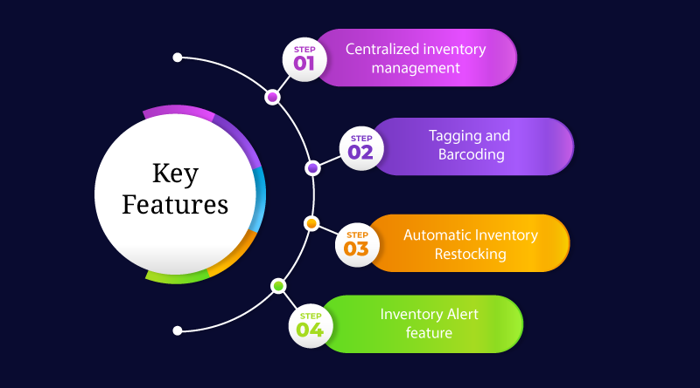
Key Features and Functionalities
Key features include barcode/RFID scanning for quick data capture, automated alerts for maintenance and warranty expiration, and detailed reporting tools.
The system also supports multi-user roles for secure access and provides integration capabilities with existing enterprise resource planning (ERP) systems for seamless data sharing.

Slide 5

Stakeholders and User Roles
The hardware inventory system serves multiple stakeholders such as IT administrators, finance teams, and procurement officers. Each user role is assigned specific access levels to ensure data security and operational efficiency. End users can track assets, generate reports, and manage hardware lifecycle, while management benefits from aggregated insights for strategic decisions.

Slide 6

System Architecture and Technologies Used
The system employs a client-server architecture with a cloud-based database for scalability and remote access. Technologies include RFID/barcode scanners, web interfaces, and secure APIs. This design enables real-time updates, high availability, and seamless integration with enterprise resource planning (ERP) and asset management platforms for enhanced functionality.

Slide 7

Deployment and Integration Strategy
Deployment involves phased rollouts starting with critical departments to minimize disruptions. The system integrates with existing IT workflows and software tools via standardized protocols. Training sessions ensure user adoption, and continuous technical support is provided to address potential challenges during and after implementation.

Slide 8

Conclusion
Implementing a hardware inventory system delivers robust asset control, streamlined workflows, and enhanced transparency. It empowers organizations to maximize hardware value while reducing management overhead. The system’s scalability and integration capabilities ensure long-term adaptability aligned with evolving business needs.

Slide 9


