Slide 1
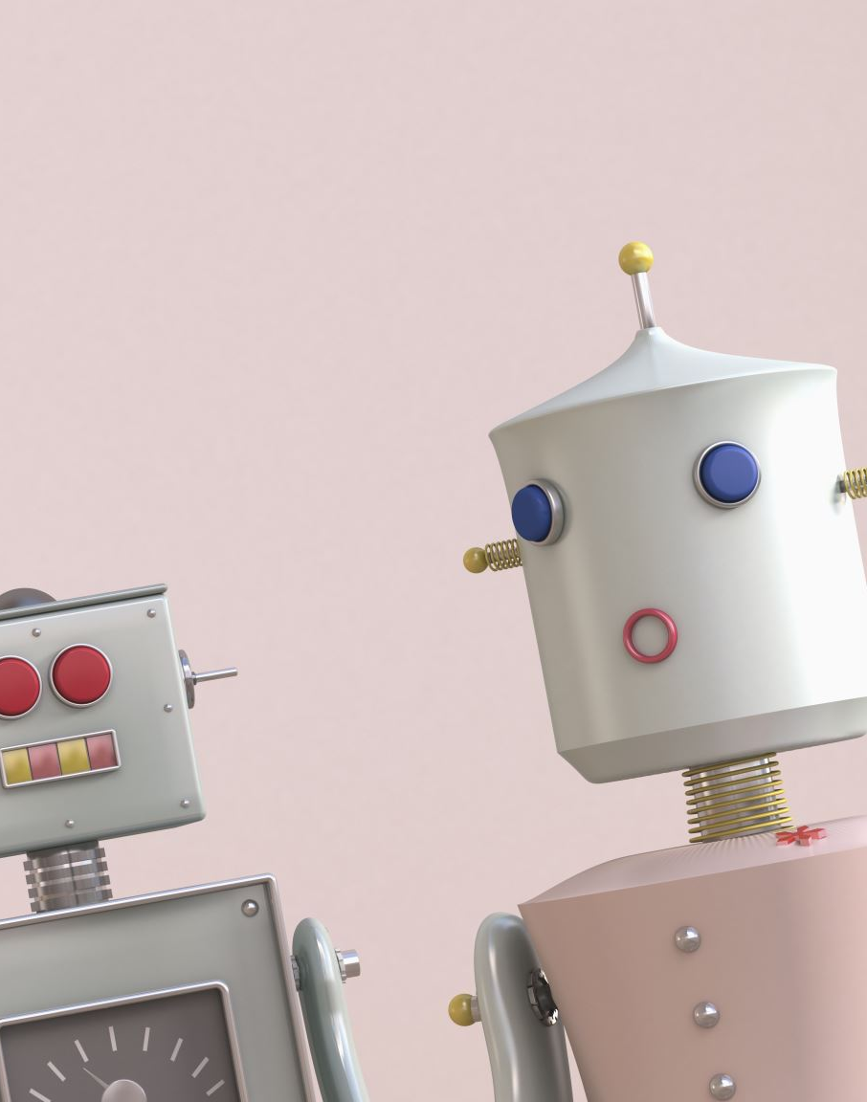
Face Verification
TEAM 7
Narasimha Reddy Nalamalapu (11920025) Srinath Veluri (11920004) Vamshi Krishna B (11920065) Satya Arun Manohar K (11920032) Somanchi Sai Anirudh (11920042)

Slide 2
Introduction
The Data consists of images belonging to 1680 persons.
First the images need to be converted to machine understandable features
Next we will run machine learning models to identify name of persons in images
Various supervised learning models will be tested to identify a model with best accuracy.

Slide 3
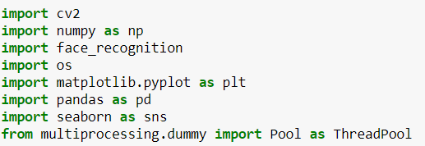
Loading of Packages
Basic packages for loading the datasets, Exploratory Data Analysis

Slide 4
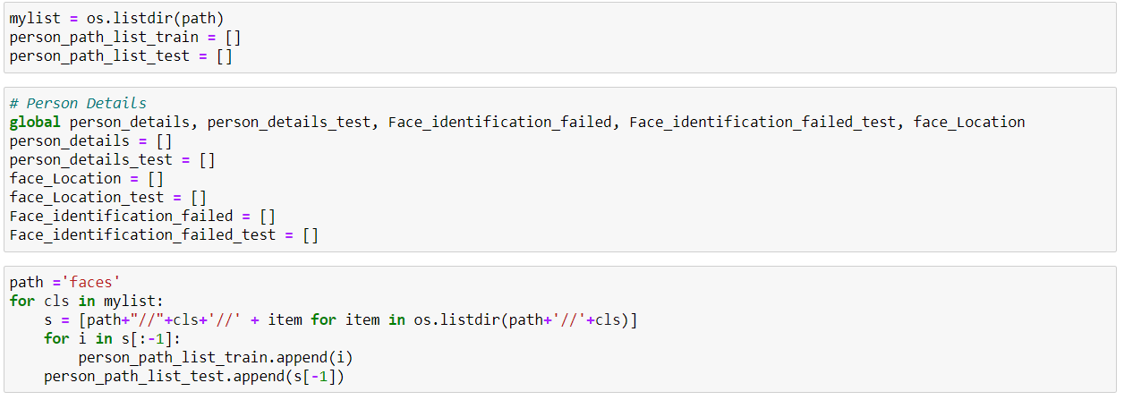
Loading the datasets into directory files
Loading the images
Segregating Image directories – Train and Test directories

Slide 5
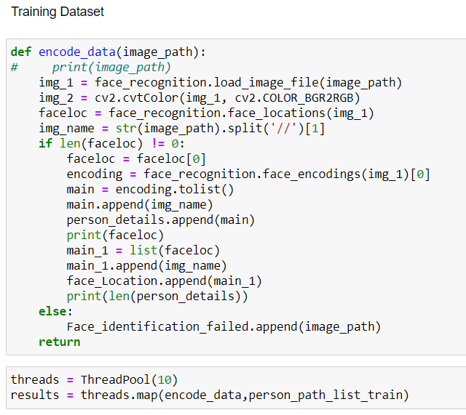
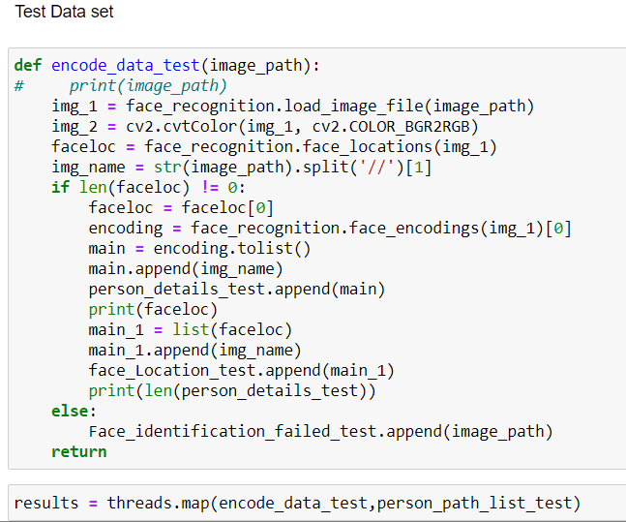
Forming data frames with features space
We have encoded 128 Features and identifying Face Location of the images

Slide 6
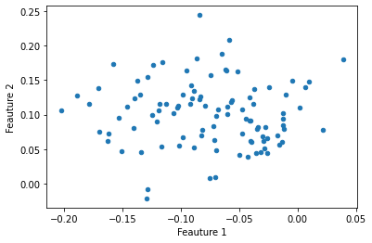
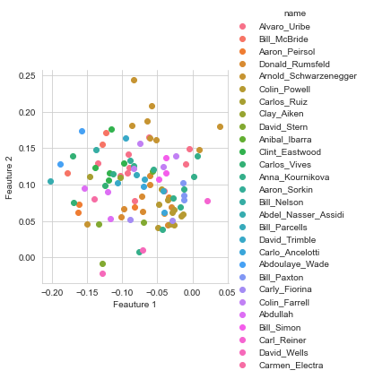
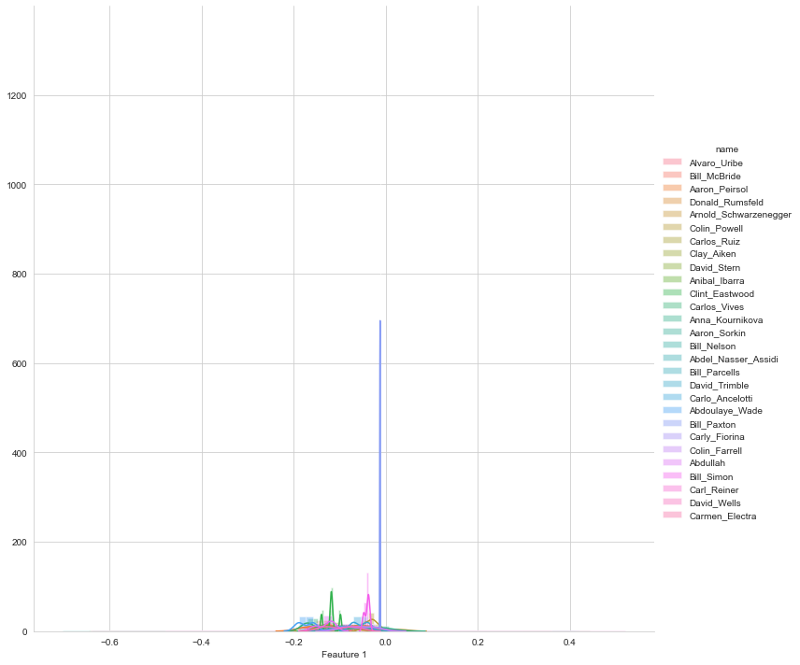
Basic Exploratory Data Analysis
We performed EDA for features 1 and 2 which really did not give any information which can be used further
Scatterplot and pair plot also resulted in no clear clusters
This is due to high number of labels

Slide 7
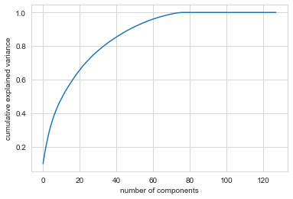
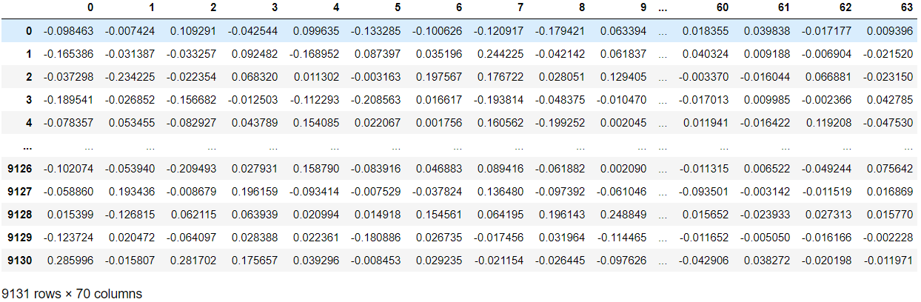
Principal Component Analysis
Using PCA – we have identified a minimum of 70 components required to explain variance
Segregated 70 principal components which explain all the variance and used for further analysis

Slide 8
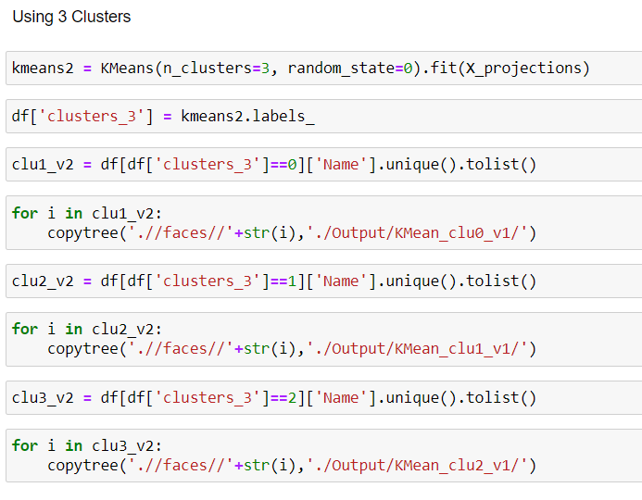
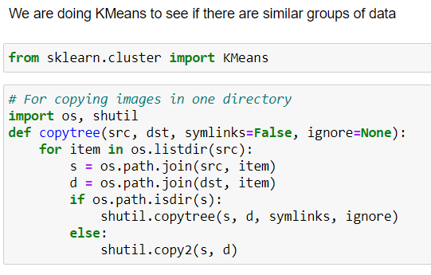
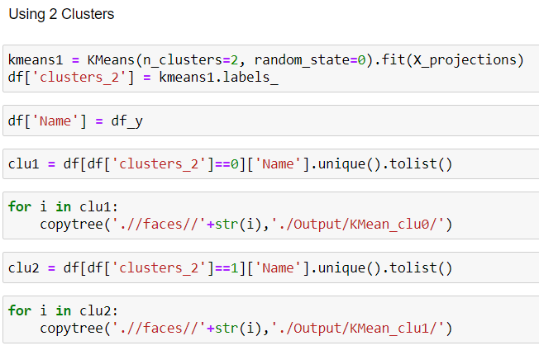
K- Means Clustering
With 2 clusters = We were able to segregate images into two folders (Majority females[1] and majority males[2])
With 3 clusters = We were successful in segregating the images into three folders (Majority females[1], majority males[2], Asian/Brown/Black [3] )

Slide 9
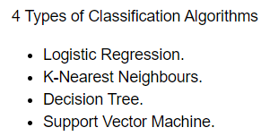
Classifiers
Classifiers Code Snippet |  | Accuracy Obtained
from sklearn.linear_model import LogisticRegression # instantiate model logreg = LogisticRegression(solver='lbfgs', max_iter=1200000,dual=False) # fit model logreg.fit(X_train, y_train) |  | 5.33%
from sklearn.tree import DecisionTreeClassifier dtree=DecisionTreeClassifier(criterion='entropy') dtree.fit(X_train,y_train) y_pred_d = dtree.predict(X_test) round(metrics.accuracy_score(y_test,y_pred_d)*100,2) |  | 10.24%
from sklearn import svm clf = svm.SVC(kernel='rbf') clf.fit(X_train,y_train) y_pred_svm = clf.predict(X_test) round(metrics.accuracy_score(y_test,y_pred_svm)*100,2) | from sklearn import svm clf = svm.SVC(kernel='linear') clf.fit(X_train,y_train) y_pred_svm_linear = clf.predict(X_test) round(metrics.accuracy_score(y_test,y_pred_svm_linear)*100,2) | RBF = 11.92% Linear = 14.55%
knn = KNeighborsClassifier(n_neighbors=1, metric='euclidean') knn.fit(X_train, y_train) y_pred_knn_e = knn.predict(X_test) round(metrics.accuracy_score(y_test,y_pred_knn_e)*100,2) |  | > 92%

Slide 10
Results from KNN classifier
We downloaded some images from Google for testing purposes
All the persons available in the training dataset were identified correctly
For some of the persons which are not present in the training dataset were shown as “Person not found”
However, some persons who were not present in the training dataset were still matched to the wrong persons
This issue can be due to facial features matching/closely related to another person
KNN-Classifier performed well on majority of new persons which were downloaded from Google

Slide 11
Thank You

