Slide 1
Wine Quality Prediction
By Leela Sai Krishna Arja

Slide 2
Problem Statement
In industries, understanding the demands of wine safety testing can be a complex task
for the laboratory with numerous analytes and residues to monitor. B a
But, our application’s prediction, provide ideal solutions for the analysis of wine, which
will make this whole process efficient and cheaper with less human interaction

Slide 3
OBJECTIVE
Our main objective is to predict the wine quality using machine learning through Python an
programming language
A large dataset is considered and wine quality is modelled to Analyse the quality of wine a
through different parameters like fixed acidity, volatile acidity etc.
All these parameters will be analyzed through Machine Leaming algorithms like random forest
classifier algorithm which will helps to rate the wine on scale | - 10 or bad - good.
Output obtained would further be checked for correctness and model will be optimized
accordingly. :
It can support the wine expert evaluations and ultimately improve the production.

Slide 4
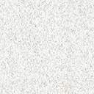
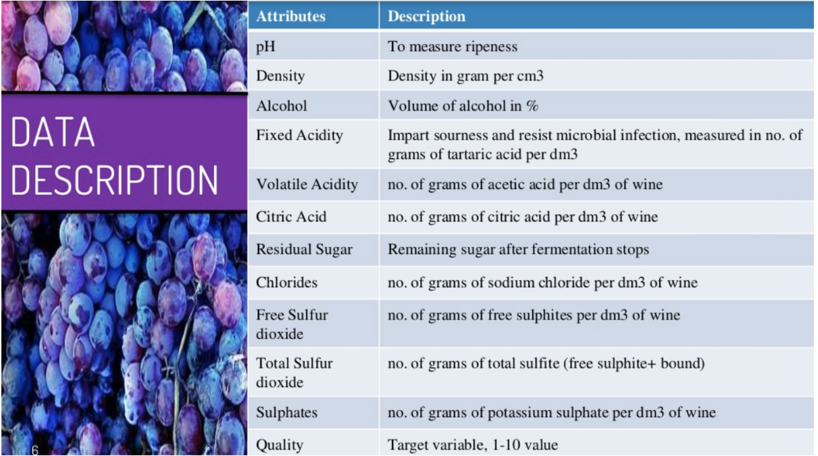

Slide 5
Steps For Analysis
1.Importing the Libraries
2.Loading the Data
3.Cleaning the data
4.Analysis of the data
5.Apply the data to Machine learning models

Slide 6
Outlier Treatment
We have Found outliers with the IQR method,
IQR = Q1-Q3
And we will treat all the data points out side Q1-1.5*IQR and Q3+1.5IQR as outliers
And we have replaced those values with Median values

Slide 7
Observations from the Plots
1.Citric acid, Chlorides, Alcohols, Sulphates, Volatile Acidity are more Co related with the Quality Feature

Slide 8
Logistic Regression
We have Applied Logistic Regression Algorithm and we got an Accuracy of 0.853125

Slide 9
DecisionTreeClassifier
We have Applied Logistic Regression Algorithm and we got an Accuracy of
8666666666666667

Slide 10
RandomForestClassifier
e have Applied Logistic Regression Algorithm and we got an Accuracy of 0.871875

Slide 11
Support Vector Machine
We got an Accuracy of 0.86875

Slide 12
Applying the Grid Search CV on SVM
Our SVM Accuracy has incresed to 0.896875

Slide 13
Applying Cross Validation Score to Random Forest
Our random Forest Accuracy got increased to 0.9046321358267717

Slide 14
Observation from ROC and AUC
From the ROC we can see that AOC of the Random forest is Greater than the AOC of SVM

Slide 15
Conclusion
The Random Forest Classifier algorithm is the best for the Prediction of wine Quality

