Slide 1

🌱 SDG Goal 13 – Climate Action
AI Carbon Footprint
Estimator
Analyze daily lifestyle habits · Estimate environmental impact · Get AI-powered sustainability insights
Name: Sai Arpit
College Name:Jaypee University of Engineering and technology
AICTE student id:-STU67f74a62b09591744259682

Slide 2

Problem Statement
❌
No Awareness
🌍
Unaware
population
People don't know how daily activities affect carbon emissions
📉
Unsustainable Habits
Lack of feedback leads to persistent environmentally harmful choices
🌡️
Climate Impact
Unchecked emissions contribute to global warming and climate change

Slide 3
AI Solution Overview
Streamlit
Python
Gemini API
HTML/CSS
📥
🧮
Input Collection
Carbon Scoring
Collects transport, electricity, food & plastic consumption data from users
Calculates an estimated carbon footprint score based on lifestyle inputs
🤖
📊
AI Analysis
Impact Display
Gemini AI generates personalized sustainability recommendations
Shows impact level and a custom eco-friendly action plan

Slide 4
SDG Alignment
SDG Goal 13
🌱 Climate Action
🌍
Take urgent action to
combat climate change
and its impacts.
✅ Carbon emission awareness at individual level
✅ Encourages sustainable daily lifestyle choices
✅ Promotes environmental responsibility globally

Slide 5
Prompt Workflow & Agent Logic
📝
⚙️
🤖
📊
💡
User
Inputs
▶
▶
▶
▶
Generate
Prompt
Gemini
AI
Carbon
Analysis
Recommendations
Output
Agent Logic Flow
Input Collection
→
Carbon Score Calculation
→
AI Analysis
→
Report Generation
→
Display Output

Slide 6
Target Users
🎓
Students
🏠
Families
Learn sustainable habits
Build eco-awareness early
Apply in daily campus life
Track household impact
Reduce electricity waste
Make sustainable choices
🌿
Eco-Conscious Users
🏫
Educational Institutions
Monitor personal emissions
Get tailored action plans
Track progress over time
Promote SDG initiatives
Integrate into curriculum
Inspire large communities

Slide 7
Responsible AI Considerations
Built with ethics and transparency at its core
🔒
No Personal Data Storage
🔍
Transparent Recommendations
User inputs are never saved or shared — full privacy by design
All AI suggestions are clearly explained and traceable
🧠
Human Decision Remains Final
🌱
Sustainability Focused Output
AI informs; users retain full autonomy over their choices
Every recommendation prioritizes environmental well-being

Slide 8
Expected Impact
🌍
⬇️
✅
Climate Awareness
Reduced Emissions
Better Decisions
Increased at individual level
Unnecessary carbon output
Daily environmental choices
If Implemented Widely: Encourage eco-friendly habits · Reduce carbon emissions · Support global climate action · Improve sustainable choices across communities

Slide 9
RAG Demo & Future Roadmap
Current Version
Future Roadmap
⚠️ No RAG implemented in prototype
📚 Connect environmental datasets & sustainability reports via RAG
What works now:
Direct Gemini AI prompting
Rule-based carbon scoring
Static sustainability tips
🌐 Integrate global emission standards and regional benchmarks
📱 Mobile app with real-time emission tracking
🤝 Community leaderboards for eco-friendly challenges
📈 Historical trend analysis and personal emission dashboards

Slide 10
Conclusion
AI Carbon Footprint Estimator combines the power of Artificial Intelligence with sustainability science to help users make environmentally responsible decisions — through simple, personalized analysis and actionable recommendations.
🌱 Raises carbon emission awareness
💡 Delivers AI-powered eco recommendations
🎯 Supports SDG Goal 13 – Climate Action
🔒 Responsible AI with user privacy
🌍 Together, small changes create a big impact.

Slide 11
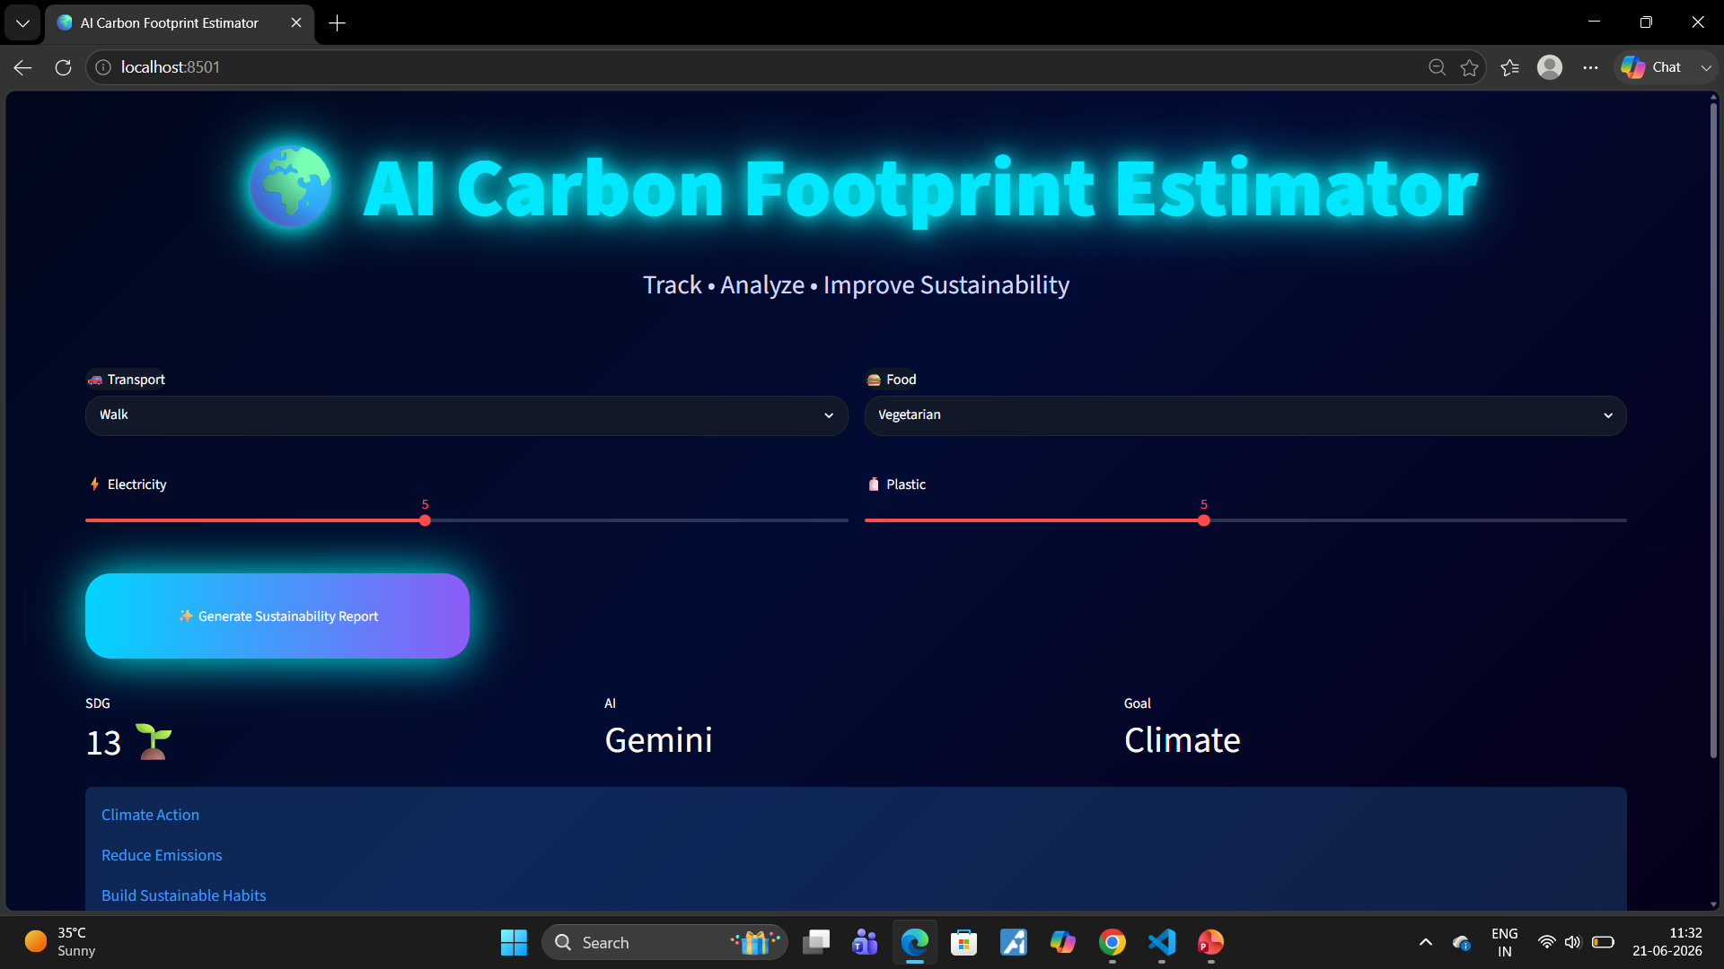
RESULT AND OUTPUT

Slide 12
GITHUB LINK OR DEPLOYMENT LINK:-
Github Link:-https://github.com/SaiArpit2006/AICTE-1M1B-PROJECT.git

