Slide 1


Slide 2

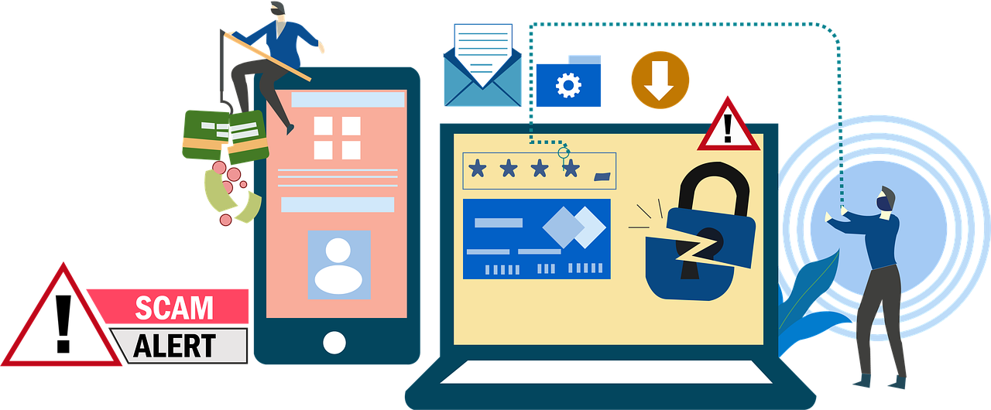
Project Name: Financial Fraud Detection Identifying and Preventing Financial Fraud Developed By: SAI ASHRITH H M

Slide 3
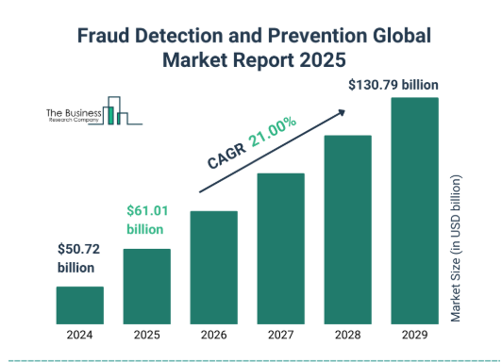
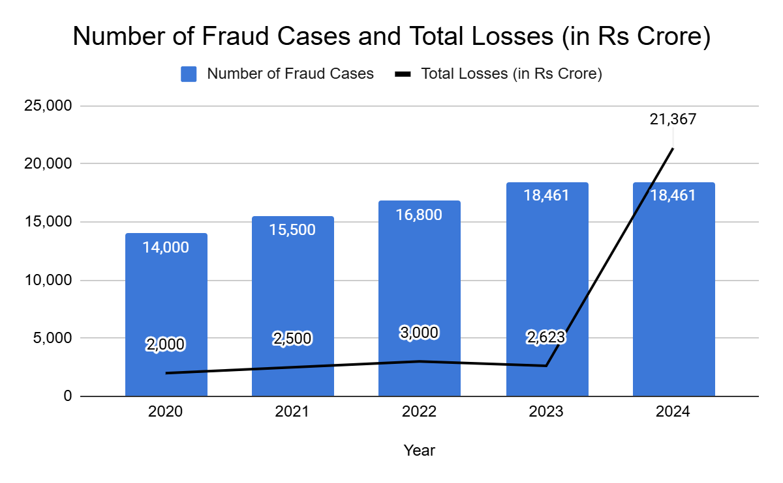
Digital Banking Fraud Trends in India
As per BioCatch Report India sees 101% growth in fraud volume in first five months of 2024
As per RBI Annual Report:
In the first half of 2024-25, India saw a significant surge in bank fraud cases, with 18,461 cases reported, resulting in losses of ₹21,367 crore, an increase of 27% in cases and an eightfold rise in the amount involved compared to the previous year.
In 2025, financial fraud cases are expected to continue evolving, with a focus on cybercrime and synthetic identity fraud, potentially costing Indian entities around Rs 20,000 crore .
80% of fraud cases take place digitally (via cards or digital banking)

Slide 4
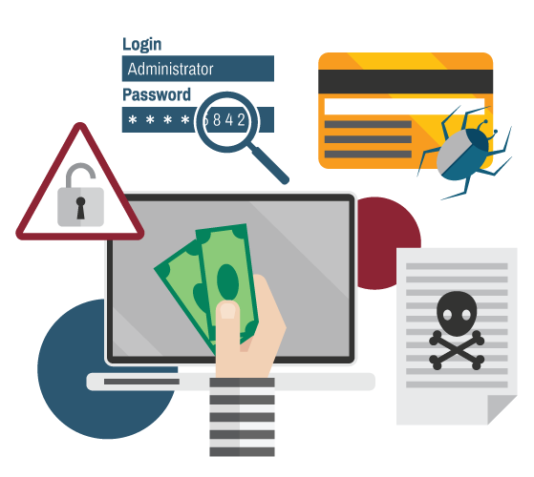

Introduction
>> Financial fraud is a major threat, causing significant losses and eroding trust. This project leverages machine learning to develop a fraud detection model, enabling financial institutions to identify and prevent fraud in real-time.
>> By accurately distinguishing between legitimate and fraudulent transactions, this model safeguards businesses and customers from financial losses and protects institutional reputation.

Slide 5
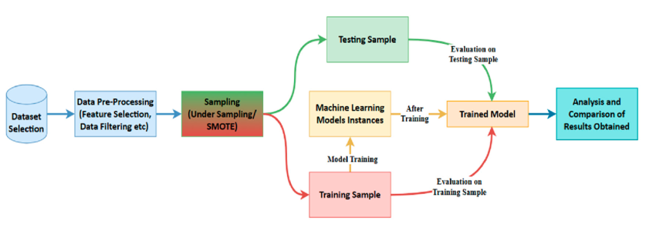

Project Objective and Solution
Leverage advanced machine learning algorithms to analyze transaction data and identify patterns indicative of fraud.
Develop a model that can accurately distinguish between legitimate and fraudulent transactions.
Enable proactive fraud prevention by flagging suspicious activities before they result in financial losses.
Workflow

Slide 6


Benefits of Fraud Detection
>> Implementing a robust fraud detection model offers numerous benefits to businesses and customers.
Reduced Financial Losses: Minimize losses due to fraudulent activities, saving businesses significant costs.
Improved Customer Trust and Security: Enhance customer confidence by providing a secure and reliable transaction environment.
Proactive Fraud Prevention: Flag suspicious activities early, preventing potential losses before they occur.
Enhanced Operational Efficiency: Automate fraud detection processes, freeing up resources for other critical tasks.
Data-Driven Insights: Gain valuable insights into fraud patterns and trends to strengthen security measures.
Workflow

Slide 7




Hardware, Software & Libraries Used
Hardware – Computer /
Software / IDE – VS Code , JupyterNotebook
Coding Languages – Python
Python Libraries Used – Pandas, NumPy, Seaborn, Matplotlib, Sklearn etc…

Slide 8
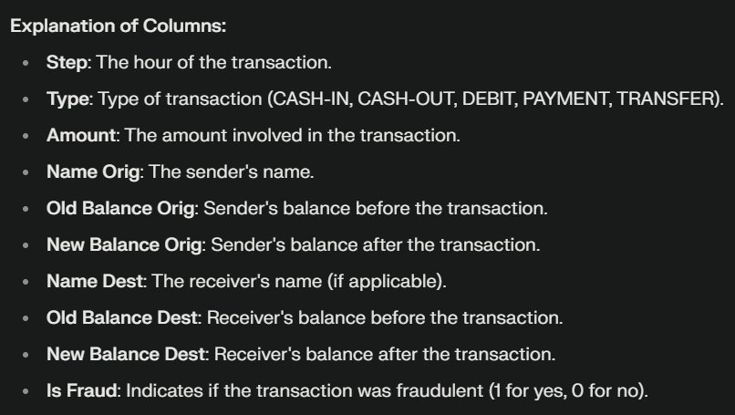
Features Description
Workflow
The "isFraud" column labels transactions as fraudulent (1) or legitimate (0) within a simulated financial system where agents steal money by first taking control of customer accounts, then transferring (TRANSFER) funds to their own accounts, and finally withdrawing the stolen money as cash (CASH_OUT).

Slide 9
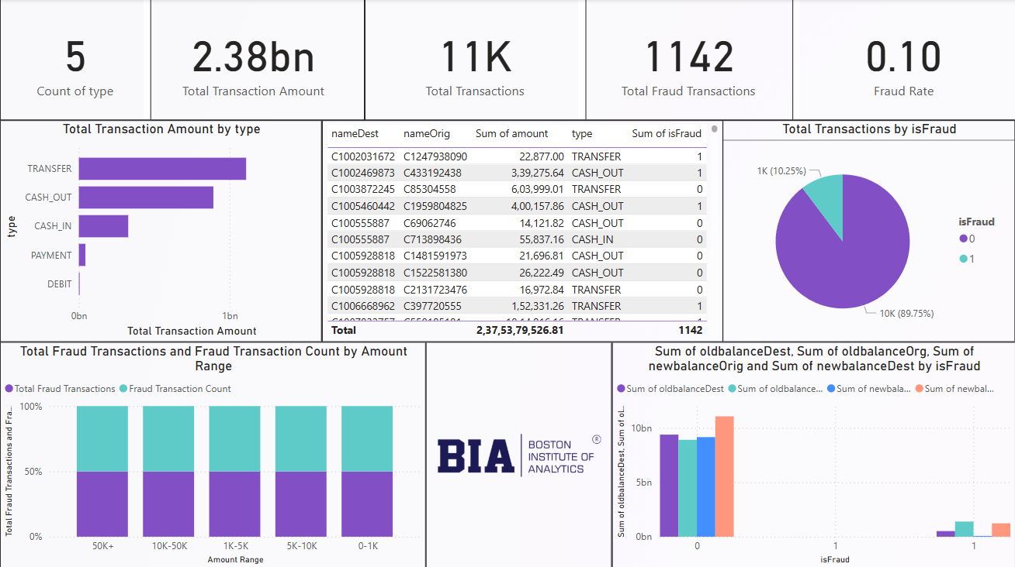
Fraud Detection Dashboard
Workflow
This slide represents a dashboard that assists Financial Institutions & Banking Companies to detect and prevent Financial Frauds effectively. It includes various components such as Fraud transactions by Type, Fraud Amount, Total Transaction Amount, Steps, etc

Slide 10
Model Architecture
Raw Data
EDA
(Identify Fraud Patterns)
Feature Engineering
Training Data
Testing Data
Model Selection
Random Forest Classifier
DT/SVM & Classifier
Logistic Regression
XGBoost Classifier
Final Model Selection
Output & Prediction

Slide 11
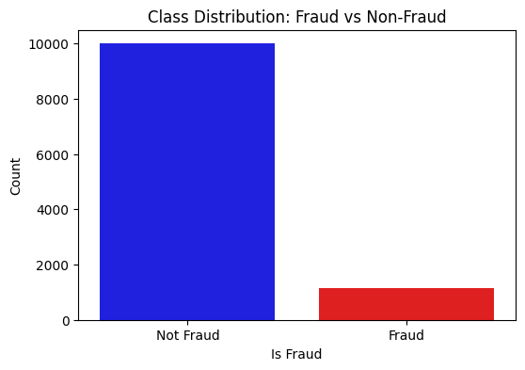
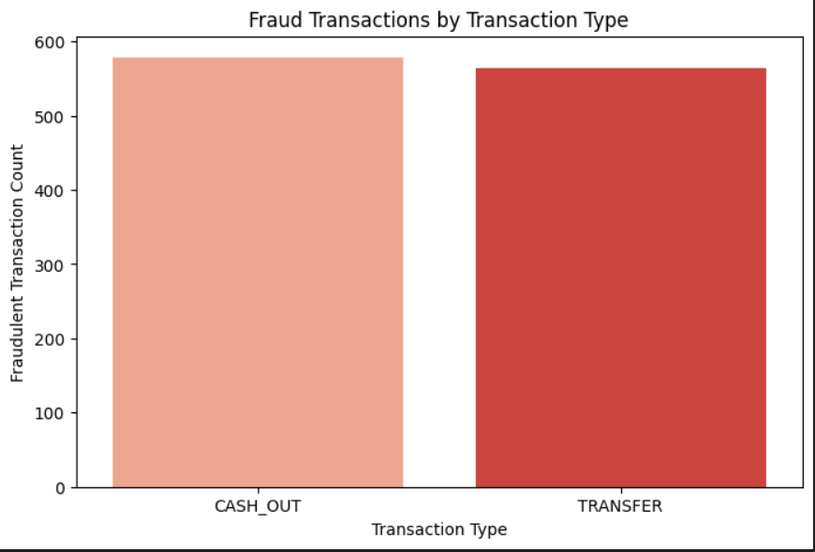
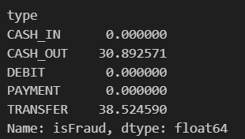
Data Exploration & EDA
(EDA) was conducted to understand transaction patterns and identify potential fraud indicators.
The dataset used for this project contained 11,142 transactions with features such as Transaction Type, Steps, Transaction Amount, Old & New Balance & Fraud Amount.
EDA revealed key insights into transaction behavior, such as:
90% transactions are non-fraudulent, while 10% are fraudulent.
In five types of transactions, only TRANSFER and CASH_OUT has fraud occurrences.
Fraudulent transactions often empty the sender’s account (newbalanceOrig = 0) and leave the recipient’s balance unchanged (oldbalanceDest = 0, newbalanceDest = 0).

Slide 12
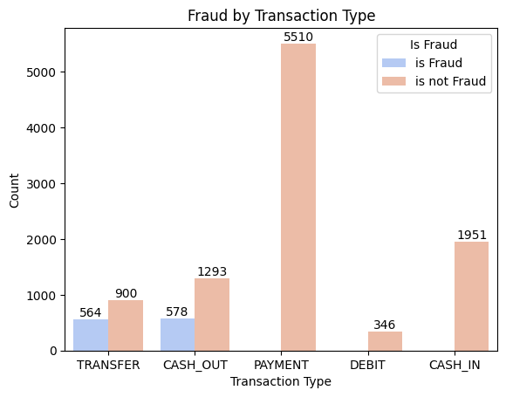
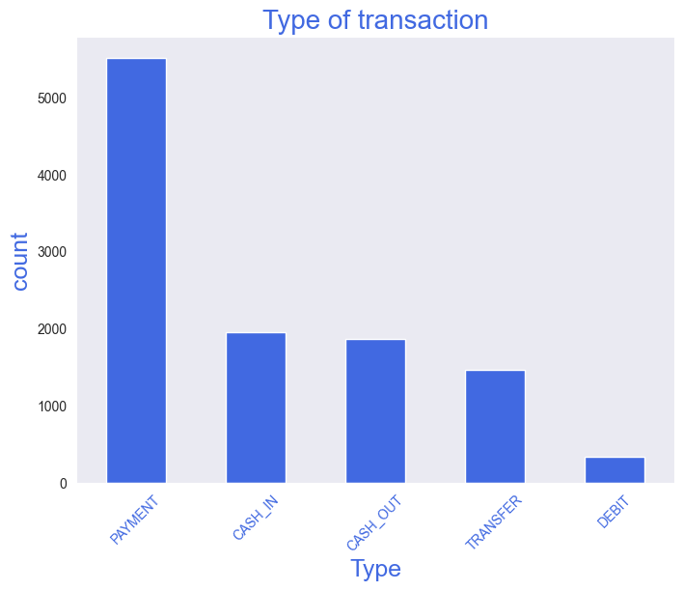
Important Graphs & Plots
Below Visualizations were used to further explore the data and identify potential fraud indicators, such as unusual transaction amounts, account balances, and transaction types.
This plot shows which transaction types are more prone to fraud. Based on the visualization, CASH_OUT and TRANSFER transactions exhibit notable fraud occurrences, while PAYMENT, DEBIT, and CASH_IN transactions show minimal to no fraud.
This bar plot shows the frequency of each transaction type in the dataset, revealing which types are most and least common. This provides insight into the overall distribution of transaction activities.

Slide 13
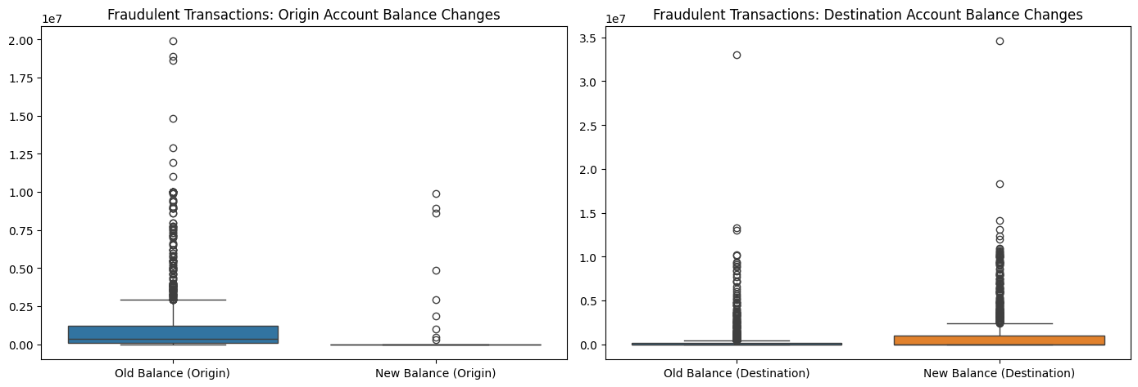
Explore balance changes before and after transactions to identify fraud patterns.
---> Fraudulent Transactions - Origin Account
Old balance (oldbalanceOrg) is high, but newbalanceOrig drops to zero.
This suggests that fraudsters completely drain the sender’s account.
----> Fraudulent Transactions - Destination Account
Both oldbalanceDest and newbalanceDest are often zero.
This indicates that fraudulent transfers are often sent to empty or fake accounts.
Fraudsters often drain the sender’s account completely, leaving the balance at zero. On the receiving side, fraudulent transactions usually go to accounts that were empty before transfer, suggesting they might be fake or newly created accounts used for fraud.

Slide 14
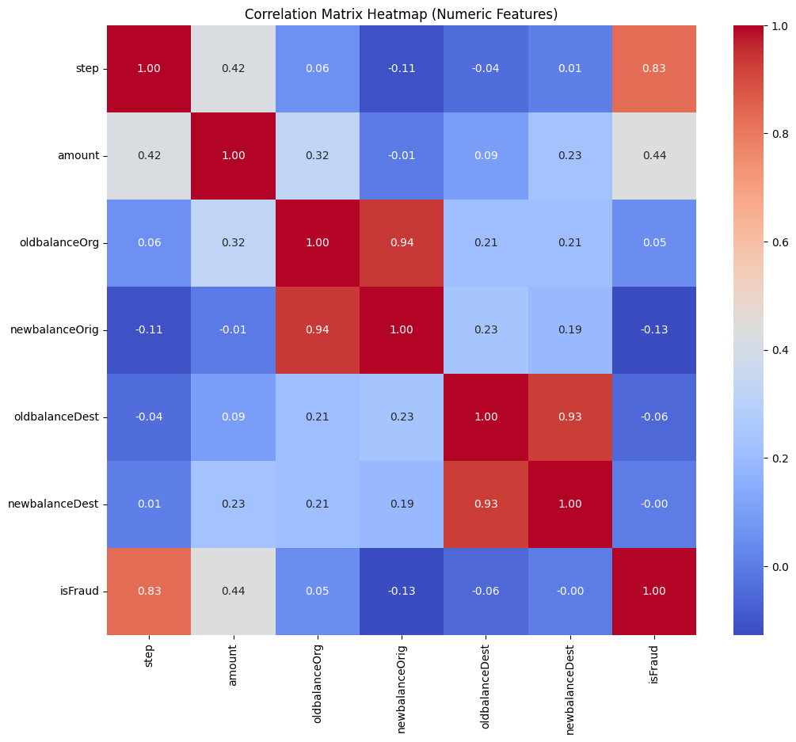
Correlation Matrix Plot
This correlation matrix visualizes the relationships between different numerical features in the dataset that are strongly associated with fraudulent transactions.
The plot shows relationships between dataset factors.
Dark Red indicates a strong positive link.
Dark Blue indicates a strong negative link.
Lighter colors indicate a weaker link.
This helps identify fraud-related factors for model building.

Slide 15
Feature Engineering
>> Feature engineering was applied to create new features and transform existing ones to improve the model's ability to detect fraud. Reduced Financial Losses: Minimize losses due to fraudulent activities, saving businesses significant costs.
New features:
Balance Differences (balance_diff_orig, balance_diff_dest) : To findbalance amount difference between OldBalance and NewBalance of Origin and Destination.
Transaction Ratio (transaction_ratio): Amount/OldBalanceorg as fraudulent transaction consume 100% of sender’s balance.
New Recipient Flag (is_new_dest) : As fraudulent transactions often to go new account.
Categorical encoding: The “Type” column was One-Hot Encoded to represent each transaction type with binary features.
Feature importance : Selected key features were chosen for Train and Test Split data to avoid biased results.
Workflow

Slide 16
Model Selection and Training
>> Various machine learning models were evaluated to select the most effective approach for fraud detection.
Several Models Were Considered:
Test Data 20%
Remaining Data for Training
Random Forest Classifier
Support Vector Machine Classifier
Logistic Regression
Decision Tree Classifier
XGBoost Classifier

Slide 17
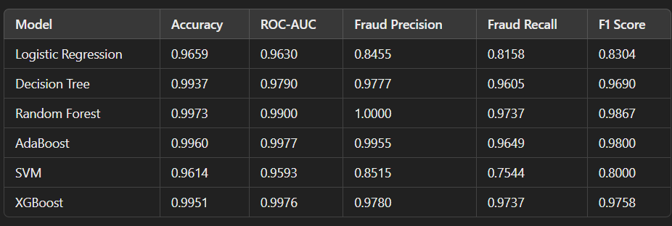
Model Performance Evaluation
>> Each model was trained using the x_train and y_train data, which represent 80% of the dataset, and evaluated using the x_test and y_test data (20% of the dataset)
>> Performance metrics such as accuracy, precision, recall, F1-score, and potentially ROC-AUC were used to compare model performance. You can include a table or chart showcasing the results of these metrics for each model

Slide 18
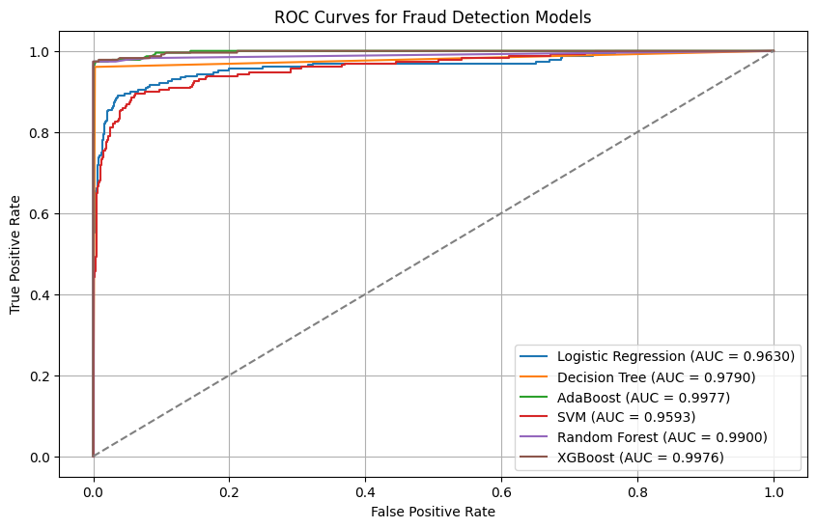
Model Performance Evaluation using ROC Curve
>> The most excellent models performing amongst the applied models are AdaBoost (AUC=0.9977), XGBoost (AUC=0.9976) and Random Forest Classifier (AUC=99.00) and least effective is SVM (AUC=0.9593)
>> The ROC curve lets you see how well your model performs when you adjust how strict it is about flagging something as Fraud.
>> AUC score tells you how good your model is differentiating real fraud and normal transactions, even when there are far fewer fraud cases.

Slide 19
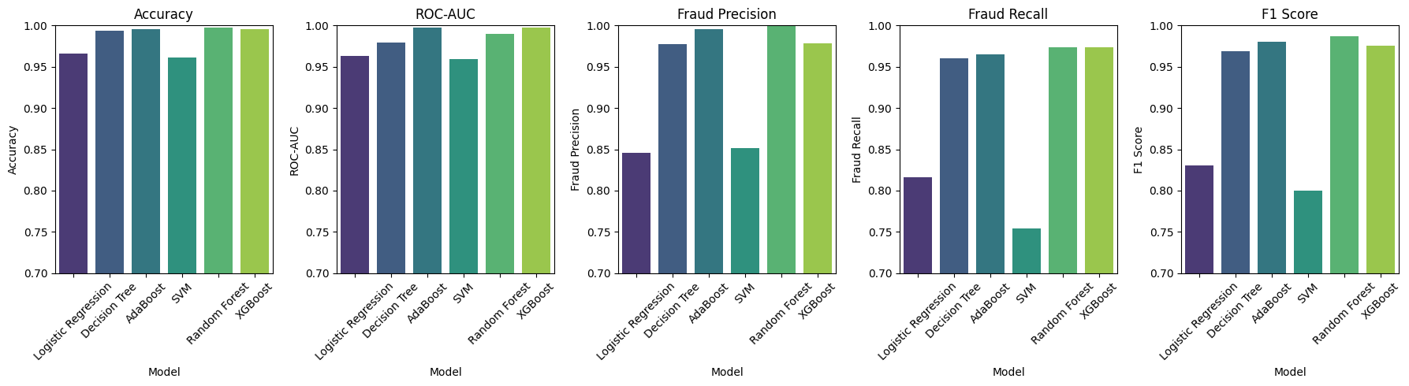
Model Selection
>> Random Forest Classifier, was chosen as the most effective model for fraud detection as Random Forests are known for their robustness to outliers and noisy data, which is some degree of noise often present in fraud detection datasets. This makes them a reliable choice for real-world applications.

Slide 20
Why Precision, Recall, and F1-Score Matter for Fraud Detection?
In fraud detection, where fraudulent transactions are rare, accuracy alone is insufficient as imbalance data is present , we cant rely on accuracy.
These metrics provide a more nuanced view of model performance.
Recall (Sensitivity): Catches Actual Fraud
Formula: Recall = True Positives (TP) / (True Positives (TP) + False Negatives (FN))
Explanation: Measures the model's ability to identify all actual fraudulent transactions. High recall minimizes the risk of missing real fraud, which is critical in financial security.
Precision: Avoids False Alarms
Formula: Precision = True Positives (TP) / (True Positives (TP) + False Positives (FP)) -
Explanation: Indicates how many of the transactions flagged as fraudulent by the model are genuinely fraudulent. High precision reduces false alarms, preventing unnecessary customer inconvenience and investigations.
F1-Score: Balances Precision and Recall
Formula: F1-Score = 2 * (Precision * Recall) / (Precision + Recall)
Explanation: Provides a harmonic mean of precision and recall, offering a single metric that balances both aspects. A higher F1-score signifies a better overall fraud detection performance, especially when both minimizing false alarms and catching real fraud are equally important.

Slide 21
Why Random Forest Classifier
Best Model for Fraud Detection: Random Forest
Top Performer: The Random Forest model is the most reliable for detecting fraudulent transactions.
Fraud Precision: It ensure the flagged fraud cases are actually fraduluent.
Fraud Recall (0.9737): Indicates that the model correctly identifies nearly all fraudulent cases.
F1-Score (0.9867): Demonstrates a strong balance between precision and recall.
ROC-AUC (0.9900): Shows excellent ability to differentiate between fraudulent and non-fraudulent transactions.
Key Advantage: Random Forest performs slightly better than other models in avoiding mistakes and detecting almost all real fraud cases.
Other Strong Models
AdaBoost:
F1-Score: 0.9800
ROC-AUC: 0.9977
Highly effective at detecting fraud but slightly less balanced than Random Forest.
XGBoost:
F1-Score: 0.9758
ROC-AUC: 0.9976
A strong contender with a high fraud detection capability.
Conclusion
While AdaBoost and XGBoost are also strong models,
Random Forest remains the best choice due to its ability to correctly identify fraud cases
with high accuracy while minimizing errors.

Slide 22
Answering Business Questions
What is the model's precision and accuracy in detecting fraudulent transactions?
>> As I have selected Random Forest Classifier, the model achieved perfect precision (1.0) and Recall (0.97) in detecting fraudulent transactions, indicating flawless identification of fraud without misclassifying legitimate transactions.
Precision: Ensures the flagged fraud cases are actually fraudulent.
Recall : How many fraudulent transactions the model correctly identifies.
How reliable is the model in classifying transactions as legitimate or fraudulent?
>> Based on the reported perfect precision, recall, and accuracy, Random Forest Classifier appears exceptionally reliable in classifying transactions. It achieved a flawless ability to distinguish between fraudulent and non-fraudulent transactions, correctly identifying all fraud without misclassifying legitimate ones.

Slide 23
Answering Business Questions
What are the potential losses due to model errors?
>> Considering Random Forest Classifier achieved perfect precision and recall on the training data, the likelihood of these errors might seem low. However, it's essential to consider the potential impact in a real-world scenario where unforeseen data patterns might arise.
False Positives: Even a small number of false positives can lead to significant customer dissatisfaction and operational inefficiencies. For example, if a high-value customer's legitimate transaction is mistakenly flagged as fraud, it could damage their relationship with the business.
False Negatives: While the model ideally aims to catch all fraudulent transactions, even a small percentage of missed fraud can have substantial financial and reputational consequences. For instance, a single undetected fraudulent transaction could result in a significant financial loss, especially in high-value transactions.

Slide 24
Answering Business Questions
Why SMOTE Analysis Was Not Used?
Initially, SMOTE (Synthetic Minority Over-sampling Technique) was applied to balance the dataset. However, it led to overfitting, as the model started recognizing synthetic patterns too perfectly, resulting in biased decision-making. This impacted the model’s generalization ability, making it less effective on real-world data. To prevent this, SMOTE was not utilized in the final model.
2. Why Were Outliers Not Treated?
The dataset contained significant outliers, primarily due to a large number of zero balance transactions. These zero values indicated instances where fraudsters drained the accounts completely. Additionally, high-value transactions were considered outliers, but removing them would have resulted in data loss and impacted fraud detection accuracy. Instead of treating these outliers through removal or transformation, new features were engineered to capture key transaction behaviors. These engineered features were strategically used in model training to reduce overfitting while preserving critical fraud patterns. 3. Why Were Correlated Features Not Dropped?
Through this project, I learned that not all highly correlated features should be removed, as they can provide valuable insights for model prediction. In my dataset, features such as oldbalanceOrg, oldbalanceDest, newbalanceOrig, and newbalanceDest exhibit strong correlations. However, these features are crucial in understanding how fraudsters manipulate transactions to steal money. Instead of removing them, I engineered new features based on their relationships and incorporated them into the model training process. This approach helped retain essential fraud patterns while improving model performance.

Slide 25
Conclusions & Key Findings
This project successfully developed a highly reliable fraud detection system using the Random Forest Classifier. Through data exploration, feature engineering, and model evaluation, we identified the Random Forest as the most effective model, achieving exceptional performance with perfect precision, recall, and accuracy on the training data. This suggests its potential to significantly reduce financial losses and enhance security by accurately identifying fraudulent transactions while minimizing false positives. While further evaluation on unseen data is recommended to ensure real-world reliability, the project provides a strong foundation for deploying a robust fraud detection solution.
>> Key Takeaways
EDA: Revealed valuable insights into transaction patterns and potential fraud indicators.
Feature Engineering: Enhanced the model's ability to capture complex patterns.
Model Selection: Identified the Random Forest Classifier as the most effective model.
Performance: Demonstrated exceptional performance with perfect precision, recall, and accuracy on the training data.
Financial Impact: Has the potential to significantly reduce financial losses due to fraud.
Visualization: Created clear and informative visualizations for communication and understanding.

Slide 26
Questions?

Slide 27
Thank You!!

