Slide 1
FACULTY MANAGEMENT SYSTEM

Slide 2
Under the Guidance of: M. Vishwashanthi
Done By:
A. Nagalaxmi (21R11A05A9)
G. Madhukiran (21R11A05C4)
A. Sai Bhagya Sree (21R11A05E3)

Slide 3
ABSRACT OF THE PROJECT
The Faculty Management System (FMS) is a streamlined digital solution designed to efficiently handle the registration and management of faculty information within an educational institution. This system allows administrators to register new faculty members by entering detailed personal and professional information into a centralized database. The FMS offers robust search functionality, enabling quick retrieval of specific faculty data based on various criteria such as name, department, or research interests. This ensures that administrative tasks and decision-making processes are supported by accurate and up-to-date information. Additionally, the FMS includes features that allow for the easy extraction and download of faculty data in Excel format. This capability facilitates reporting, data analysis, and sharing of information across departments. By providing a secure and user- friendly platform, the FMS enhances administrative efficiency, ensures data accuracy, and supports data-driven decision-making within the institution. The system also integrates role-based access control, ensuring that sensitive faculty data remains protected, with access granted only to authorized personnel. Furthermore, its scalable architecture allows it to accommodate the growing needs of institutions, making it adaptable to both small and large- scale educational-organizations.

Slide 4
INTRODUCTION
The Faculty Management System (FMS) is designed to streamline the administration of faculty data within educational institutions. In traditional setups, managing faculty information, including personal details, academic qualifications, and professional history, is often a time-consuming and error-prone task, primarily relying on paper-based systems or decentralised databases. FMS resolves these issues by providing a centralised digital platform where all faculty data can be efficiently stored, managed, and retrieved.
This system supports educational institutions in maintaining accurate and up-to-date faculty records, enabling administrators to quickly search and retrieve data based on specific criteria such as department, research interests, or years of service. By centralising data, the FMS facilitates smoother administration, better decision-making, and easier access to essential faculty information. The system incorporates features like detailed faculty profile creation, real-time data updates, and advanced search functionalities to ensure quick retrieval of relevant information. Additionally, FMS enables the extraction of faculty data in multiple formats, including Excel, to streamline reporting and data sharing across departments.

Slide 5
OBJECTIVES
Online Management: The FMS enables faculty and administrative staff to manage profiles, and academic data online, eliminating the need for manual record-keeping.
Digital Faculty Data Management: The system allows faculty members to submit all necessary personal and professional details in a digital format, streamlining record-keeping and reducing paperwork.

Slide 6
Role-Based User Authentication: The FMS incorporates a secure authentication system where different roles (e.g., faculty, HODs, admin, higher officials) can log in and access role-specific functionalities.
Real-Time Data Access: Faculty and administrators can access up-to-date information, such as attendance, academic schedules, and leave applications, in real-time.
Transparency and Accountability: The system enhances transparency by making faculty data, performance reports, and leave records accessible to authorized personnel, improving the accountability of faculty management processes.

Slide 7

EXISTING SYSTEM
Most educational institutions still rely on manual or semi-automated processes for faculty data management, often using spreadsheets or isolated databases. These methods are prone to errors, data redundancy, and inefficiencies. The lack of integration between different departments can result in delayed access to critical faculty information, impacting administrative tasks like faculty evaluations, workload distribution, and decision-making.

Slide 8
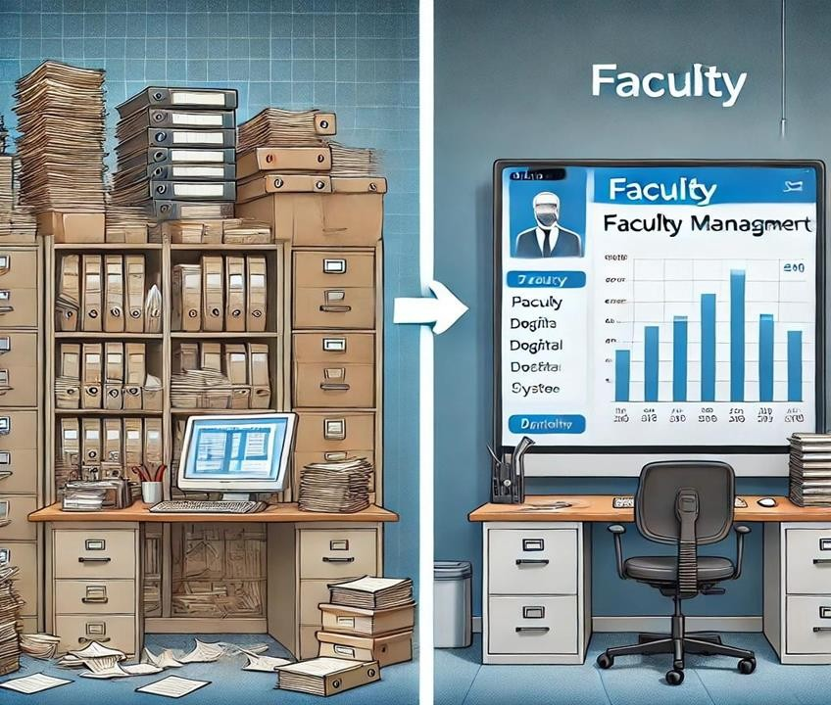
DISADVANTAGES OF EXISTING SYSTEM
Prone to Human Errors
Data Redundancy
Inefficiency
Limited Access to Information
Lack of Real-Time Data
No Integration Between Departments
Inadequate Reporting Capabilities

Slide 9
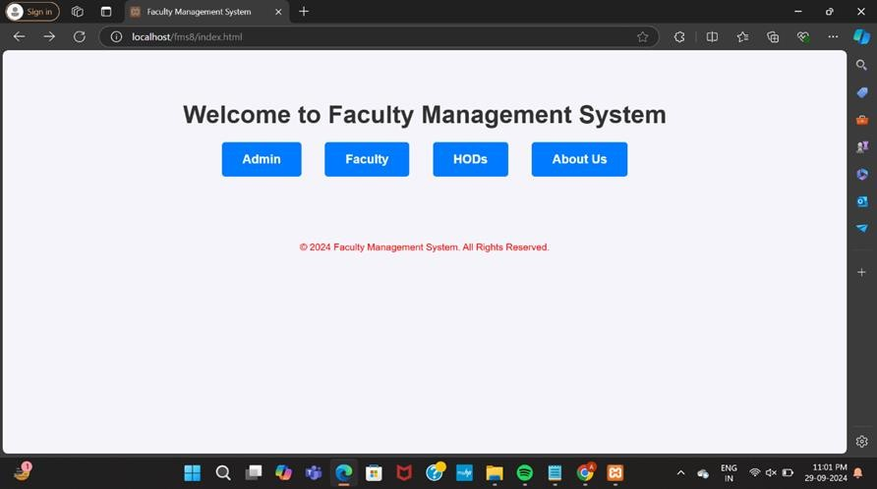
Proposed system
The Faculty Management System proposes a fully digital platform that centralizes faculty data in one secure location. With features such as role-based access control, automated data validation, and real-time updates, the FMS streamlines the administrative process, reducing the time and effort required to manage faculty information. The system includes advanced search filters that allow users to retrieve data based on specific criteria and download the information in report-ready formats like Excel.

Slide 10
ADVANTAGES
Centralized Data Management
Role-Based Access Control
Automated Data Validation
Real-Time Data Availability
Improved Efficiency
Enhanced Reporting Capabilities
Integration Across Departments
Scalable and Flexible
Scalable and Flexible
Data Security and Backup

Slide 11
TECHNOLOGY USED
XAMPP server
MySQL database
HTML, CSS
PHP

Slide 12
MODULES
ADMIN
FACULTY
HODs

Slide 13
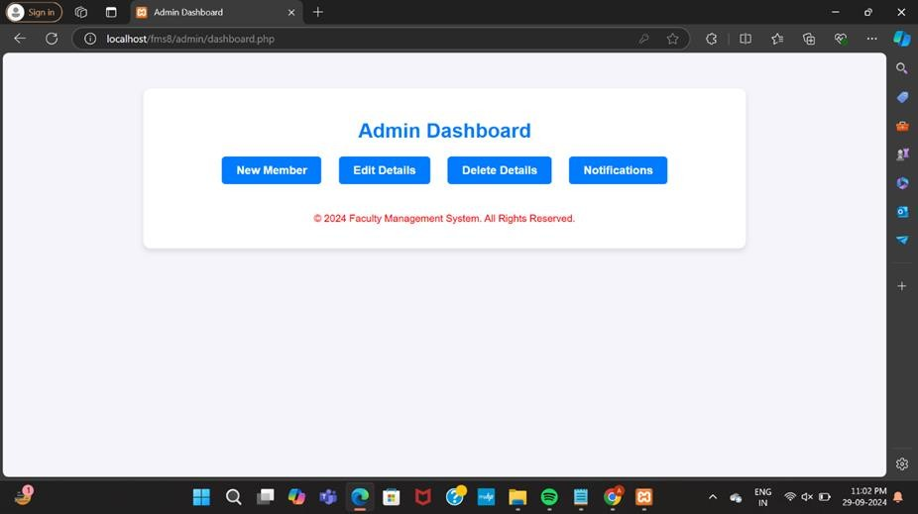
PROPOSED SYSTEM (ADMIN LOGIN)
When ADMIN logins successfully open the admin dashboard which consists of ‘New Member” for adding a new faculty member, ‘Edit Details’ for editing theirs details, ‘Delete Details’ for deleting faculty member, etc.

Slide 14
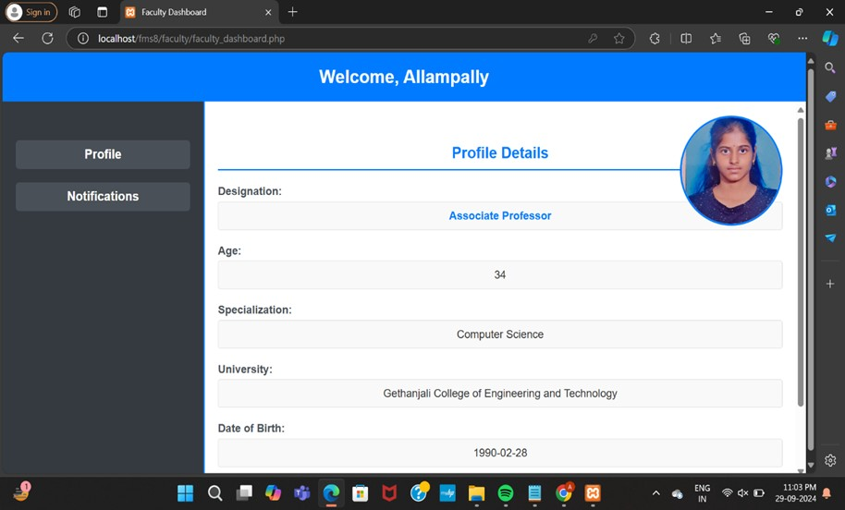
PROPOSED SYSTEM(FACULTY LOGIN)
When the Faculty login is successful, it opens the faculty dashboard page where their profile details are displayed if updated else asks for an update of profile.
The profile can be updated or modified in the profile tab for n number of times.

Slide 15
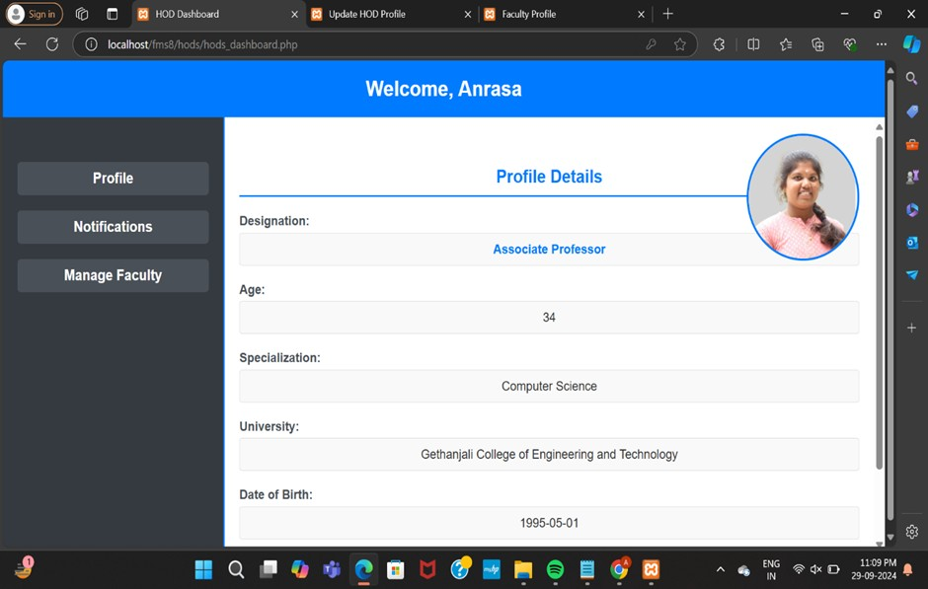
PROPOSED SYSTEM (HODs LOGIN)
When the HODs login is successful, it opens the hods dashboard page where their profile details are displayed if updated else asks for an update of profile.
Apart from profile update it also has an option like manage faculty where the faculty details can be viewed, filtered based on different parameters and converted into excel sheet too.

Slide 16
IMPLEMENTATION

Slide 17
CONCLUSION
The Faculty Management System is a transformative solution that streamlines academic and operational tasks for faculty, heads of departments, and administrators. By digitizing essential functions like profile management and communication, the system reduces administrative workloads, enhances operational efficiency, and fosters transparency. Faculty can access and update their information from anywhere, ensuring timely updates and stronger collaboration. Overall, the system bridges the gap between faculty and administration, creating a more convenient, organized, accountable, and effective educational environment.

Slide 18
Thank YOU!

