Slide 1

What is Phishing?
Phishing is a type of cyber attack where criminals attempt to trick individuals into revealing sensitive information, such as login credentials, financial details, or personal data. Phishers often use fraudulent emails, websites, or social media messages that appear to be from legitimate sources to lure unsuspecting victims.

Slide 2



Common Phishing Tactics
Fake Emails
Spoofed Websites
Impersonation Calls
Phishers often send convincing emails that appear to be from legitimate organizations like banks, government agencies, or tech companies. These emails may ask you to click a link, provide personal information, or download an attachment - all with the goal of stealing your data.
Phishers create fake websites that mimic real ones to trick you into entering your login credentials or other sensitive information. These sites may have a very similar URL or branding to the real website.
Phishers may call you pretending to be from a trusted organization and try to coerce you into providing personal details or taking an action like making a payment. They rely on social engineering tactics to build a false sense of urgency or trust.

Slide 3
Identifying Phishing Emails
1
Look for Suspicious Sender Addresses
2
Be Wary of Urgent or Threatening Tones
3
Inspect for Spelling and Grammar Errors
Phishers often use email addresses that appear to be from legitimate organizations but have subtle differences, like extra letters or numbers. Carefully inspect the sender's email address to ensure it matches the expected domain.
Phishing emails often use fear-inducing language to pressure you into clicking a link or providing sensitive information. Be skeptical of any email that creates a sense of urgency or threatens negative consequences.
Phishing emails are often hastily crafted and may contain typos, grammatical mistakes, or awkward phrasing. Carefully review the email for any signs of poor quality or lack of attention to detail.

Slide 4
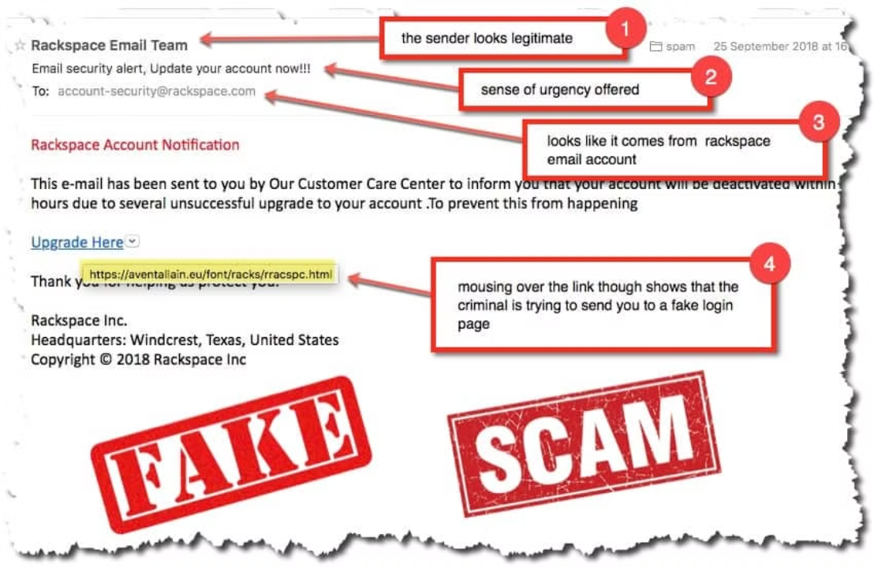

Slide 5
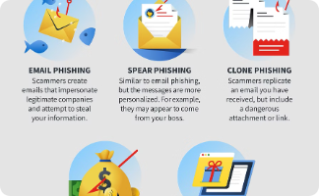
Spotting Fake Websites
Suspicious URL
Sloppy Design
Lack of Security
One of the telltale signs of a phishing website is a suspicious or unusual URL. Look out for URLs that are slightly misspelled, use numbers instead of letters, or contain extra characters like dashes or underscores. These are often attempts to mimic legitimate websites and trick you into thinking you're on a real site.
Phishing websites are often hastily thrown together and have a sloppy, unprofessional design. They may use low-quality images, have broken links, or have inconsistent formatting. Legitimate websites, on the other hand, typically have a polished, cohesive look and feel.
A tell-tale sign of a phishing website is the lack of HTTPS security. Legitimate websites will have a secure, encrypted connection indicated by the "https://" prefix in the URL and a lock icon in the browser. Phishing sites often lack this basic security feature.

Slide 6
Social Engineering Tricks
Manipulative Emails
Fake Websites
Impersonation
Tailored Attacks
Phishers create convincing replicas of real websites, such as banking portals or online stores, to lure victims into entering their login credentials or other personal data. These sites may even have the same branding and design as the legitimate website.
Phishers may pretend to be someone in a position of authority, like a supervisor or IT support, to gain the victim's trust and convince them to share sensitive information or perform actions that compromise their security.
Some phishers research their targets, gathering personal information to craft highly personalized and convincing messages. This level of customization makes it harder for victims to detect the deception.
Phishers often send emails that appear to be from legitimate businesses or authorities, using persuasive language to trick victims into revealing sensitive information or clicking on malicious links. They may create a false sense of urgency or play on people's emotions to pressure them into acting quickly.

Slide 7
Protecting Yourself from Phishing
1
Be Wary of Unsolicited Messages
Be cautious of any email, text, or social media message that comes from an unfamiliar source or asks you to take urgent action. Legitimate organizations will not request sensitive information or ask you to verify your account through a link or attachment.
2
Verify the Sender's Identity
Carefully inspect the email address, website URL, and social media profile of the sender. Look for subtle differences or misspellings that could indicate a fake or impersonated source. If you're unsure, contact the organization directly using a known, trusted method.
3
Avoid Clicking on Links or Attachments
Never click on links or download attachments from unsolicited messages, even if they appear to be from a trusted source. Phishers often use these tactics to deliver malware or direct you to a fake website that looks legitimate.

Slide 8
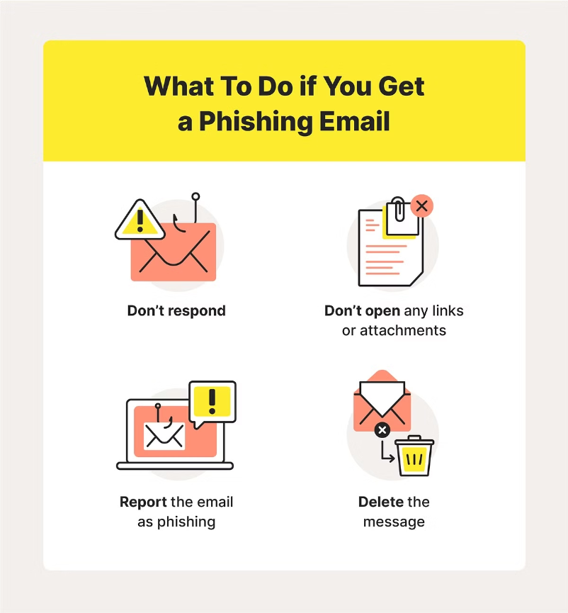

Slide 9



Reporting Phishing Attempts
Identify
1
Recognize the phishing attempt.
Document
2
Save the email or website details.
Report
3
Submit the report to the proper authorities.
If you suspect you have received a phishing email or encountered a fraudulent website, it's important to take immediate action. First, carefully examine the message or site to identify the signs of a phishing attempt. Save any relevant details like the email headers, sender information, or website URL. Then, report the incident to your organization's security team, the Anti-Phishing Working Group, or the Federal Trade Commission. By reporting phishing, you can help protect yourself and others from falling victim to these malicious scams.

Slide 10
Educating Others about Phishing
Lead by Example
Share Phishing Awareness
Create Educational Resources
Demonstrate safe browsing and email habits to your friends, family, and colleagues. Show them how to identify suspicious links and emails, and encourage them to be cautious when sharing personal information online.
Organize workshops, presentations, or informal discussions to educate people about the latest phishing tactics. Provide real-world examples and practical tips to help them recognize and avoid falling for these scams.
Develop informative materials, such as brochures, infographics, or short videos, that explain the dangers of phishing and how to stay safe. Share these resources with your community, school, or workplace to increase awareness and knowledge.

Slide 11
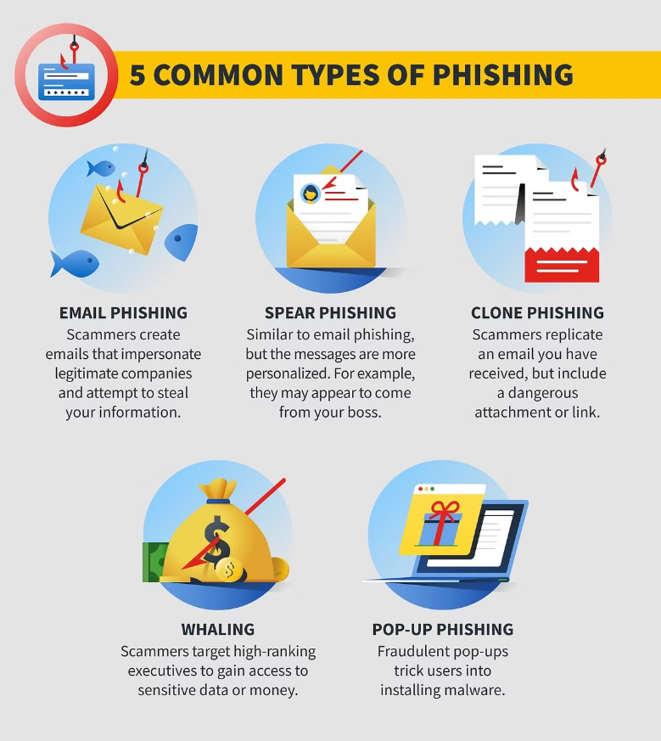

Slide 12
The Impact of Phishing Attacks
Phishing attacks can have devastating consequences, both for individual victims and organizations as a whole. The financial losses from these scams can be staggering, with the average cost of a successful phishing attack estimated to be $4.65 million for a large company. Beyond the direct monetary impact, phishing can also lead to data breaches, identity theft, and reputational damage that can haunt victims for years.
$4.65M
20%
90%
Average Cost
Increase in Attacks
Successful Attacks
The average cost of a successful phishing attack for a large company
The number of phishing attacks has risen by 20% in the past year alone
Up to 90% of all data breaches start with a successful phishing attempt

Slide 13
Best Practices for Staying Safe
Be Skeptical
Verify URLs
Adopt a healthy skepticism towards any unsolicited emails, messages, or websites that ask you to provide sensitive information or take urgent action. Verify the source before responding or clicking any links.
Carefully inspect the URL of any website you're about to visit. Phishing sites often use similar-looking domain names or subdomains to trick you. Look for spelling errors or unusual characters that don't match the legitimate website.
Use Two-Factor Authentication
Keep Software Updated
Enable two-factor authentication (2FA) on your accounts whenever possible. This adds an extra layer of security beyond just a username and password, making it much harder for attackers to gain access to your accounts.
Regularly update your devices, browsers, and security software to ensure you have the latest protections against known vulnerabilities that phishers could exploit. Enable automatic updates whenever possible.

