Slide 1
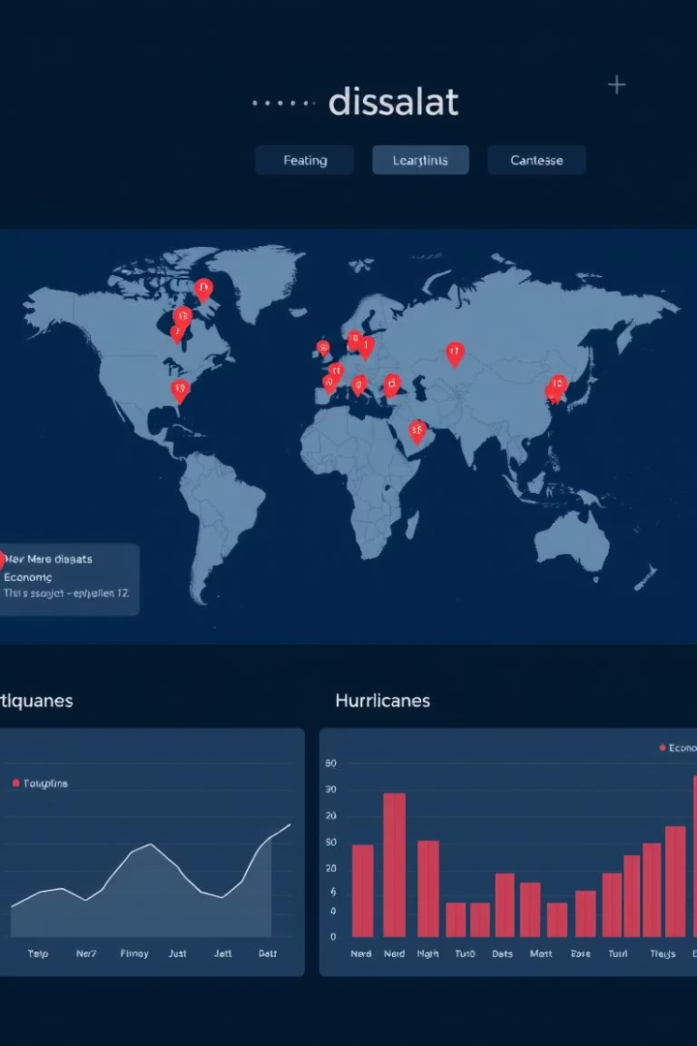
Global Natural Disasters Visualization
Name: Sai Bhaskar Kora
Student ID: 02148111
Course: Data Visualization (Online) - Spring 2025

Slide 2

Introduction + Task
An interactive dashboard showcasing global natural disasters from 1900 to 2021, emphasizing deaths, damages, and affected populations.
How (Methodology):
Data from EM-DAT Global Disaster Database.
What (Objective):
Built using D3.js for interactive web visualizations.
Analyze global disaster impacts.
Map View, Sunburst View, and Bubble Pack View created.
Enable user-driven exploration by disaster type and year.
Filters for disaster type and year included.
Why (Importance):
Assist policymakers and researchers with historical disaster insights.
Simplify complex data through clear visual storytelling.

Slide 3
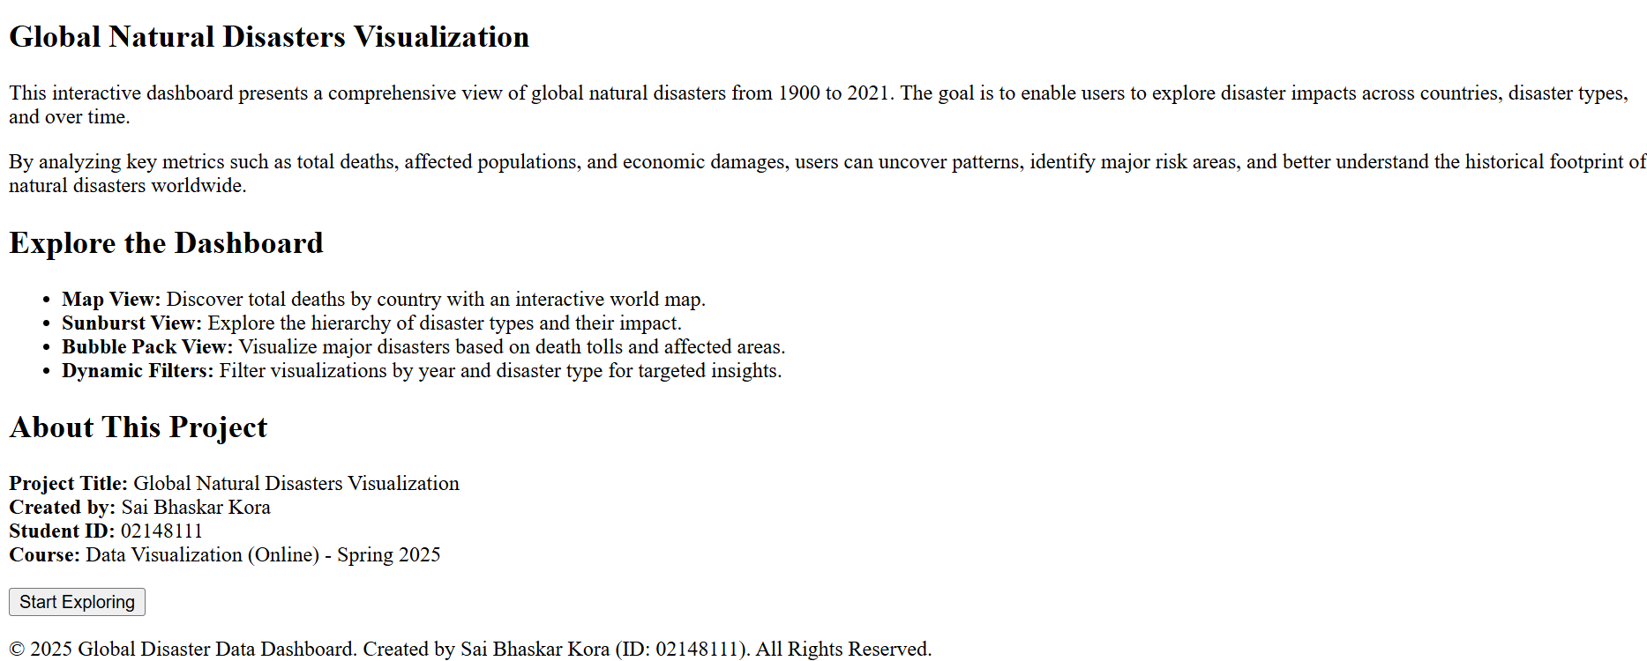
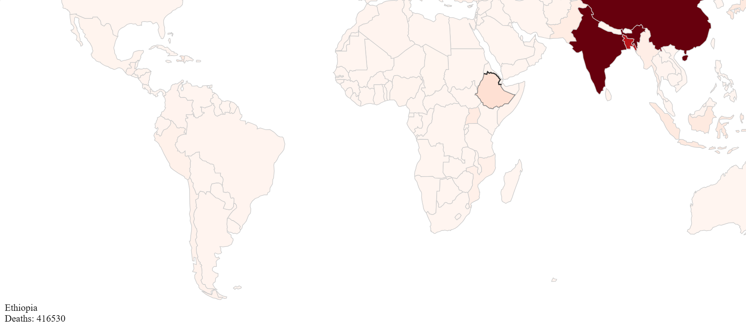
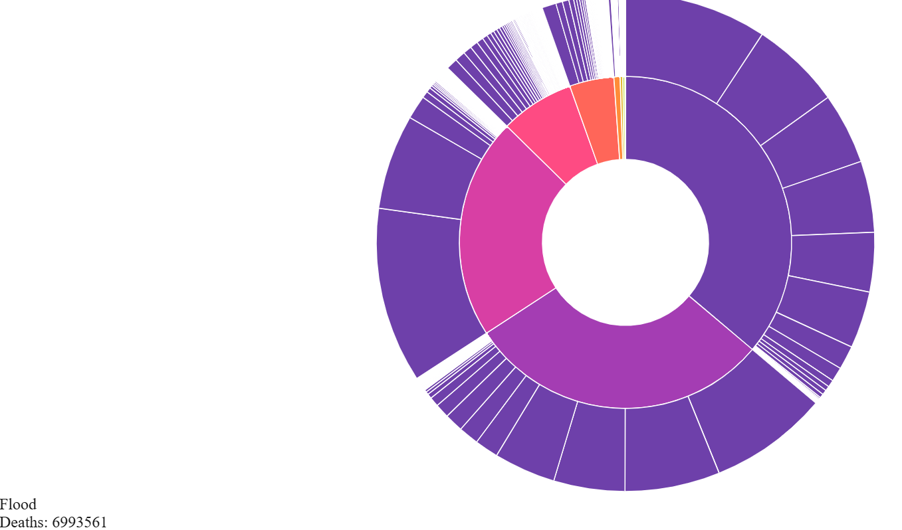
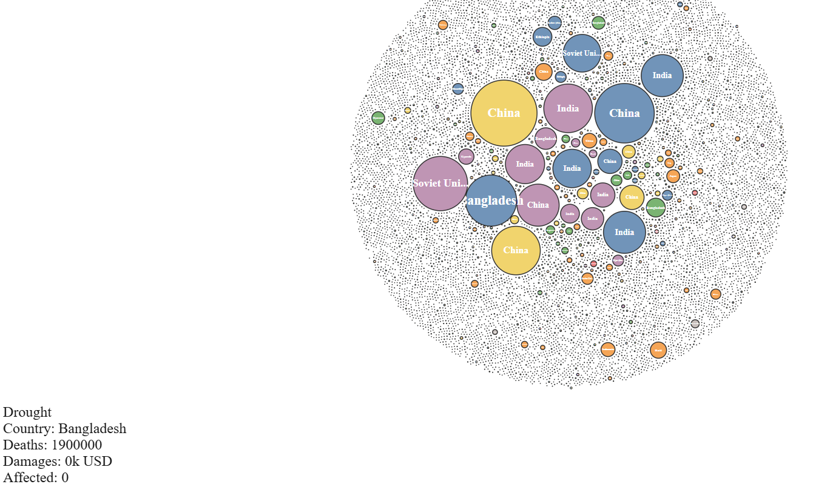
Screenshot of Visualizations
Home Page Overview
Map View (Total Deaths by Country)
Sunburst View (Disaster Types Breakdown)
Bubble Pack View (Disasters with Country Labels)

Slide 4
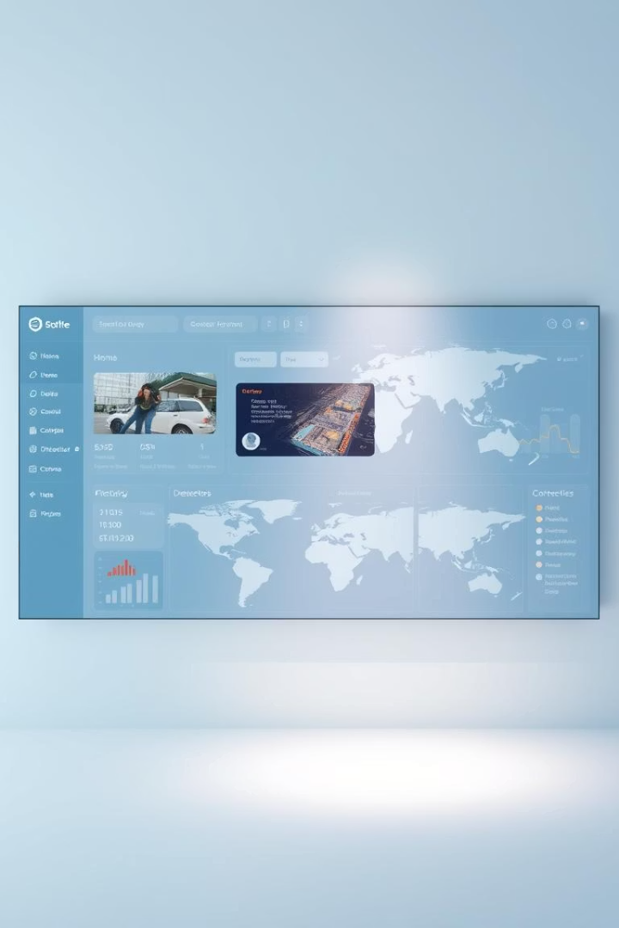


Conclusion + Possible Improvements
Conclusion
Created a professional dashboard analyzing historical disaster data.
Enabled interactive filtering and multi-dimensional analysis.
Possible Improvements
Integrate real-time disaster feeds (e.g., GDACS API).
Cross-analyze disaster data with climate/economic indicators.
Add zoom/select features on maps.
Introduce additional visualizations like timelines or heatmaps.
Further enhance animation smoothness and loading performance.

Slide 5

End of Presentation
1900-2021
3
Years of Data from
https://www.kaggle.com/datasets/brsdincer/
all-natural-disasters-19002021-eosdis
Visualization Views
Map, Sunburst, and Bubble Pack
100+
Countries
Global disaster analysis
Thank You!

