Slide 1
Third eye: object recognition and speech generation for visually impaired
By - Yarlagadda Sai Bhavadeesh (2018BCS0082),
Peddi Shwejan (2018BCS0047), Allu Harsha Vardhan (2017BCS005), Lavanya S (2017BCS0034).
Guided by - Dr. Koppala Guravaiah

Slide 2
Introduction
Project - Phase 1 and Phase 2
Phase 1 constitutes of training a model which takes images through a camera as input, it detects the objects found in the images and object’s text labels are given as output.
Used YOLOv5 for Phase 1.
Phase 2 constitutes of using the object’s text labels as input to a model which converts text to speech and the speech is given as output.
Text to speech conversion libraries:
Google Text to Speech (gTTS)
pyttsx3 (text to speech conversion library in python)

Slide 3
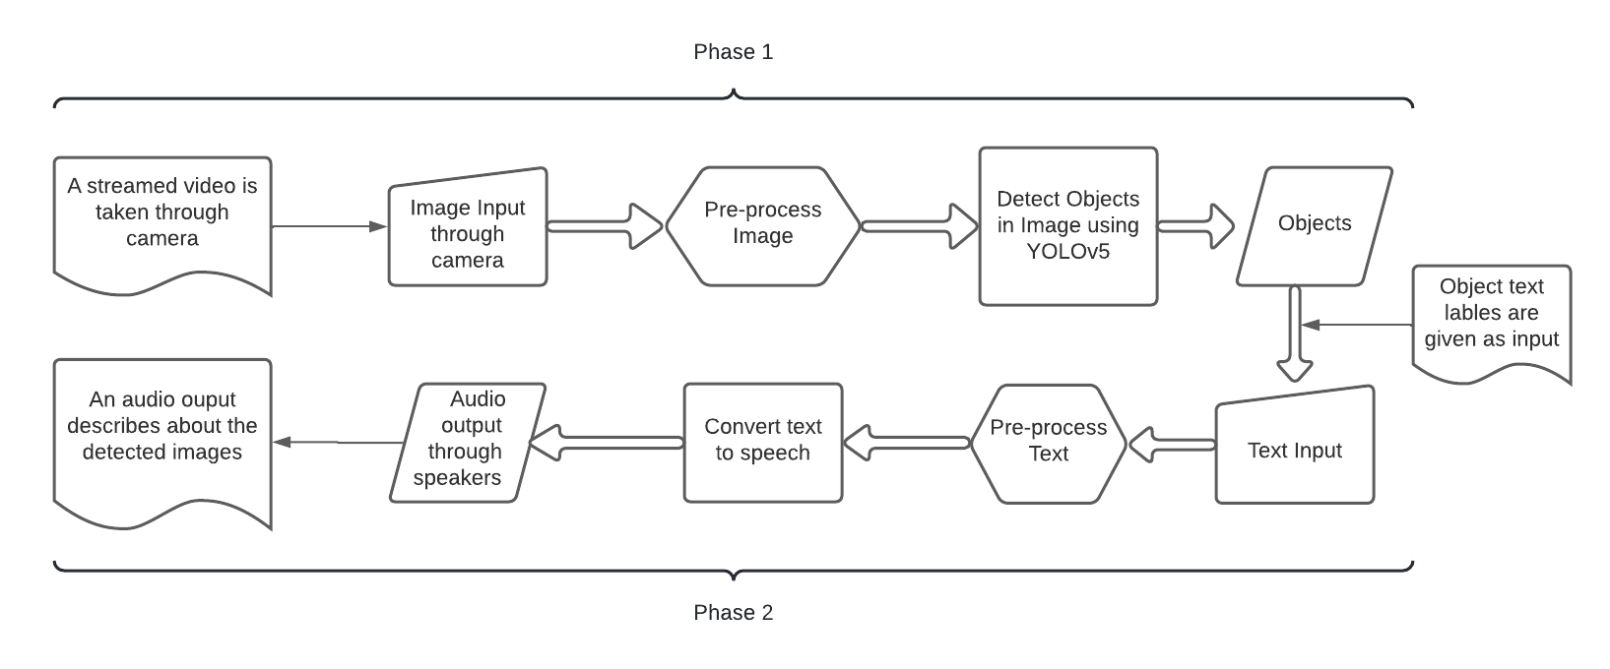
Project Overview

Slide 4
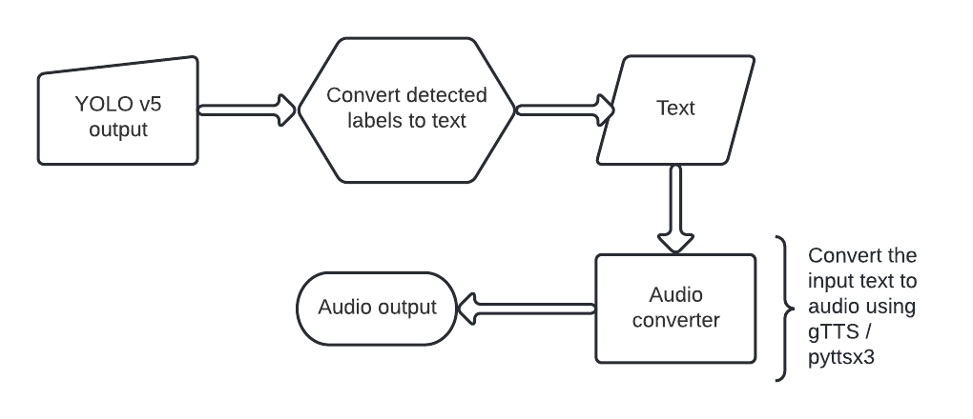
Phase - 2, Overview

Slide 5
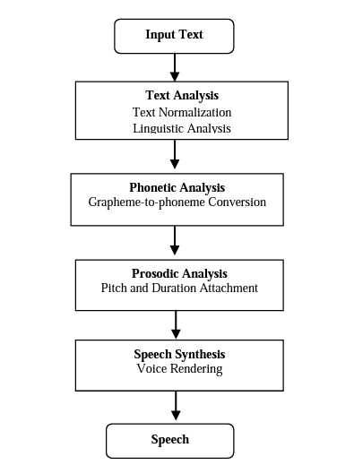
Text to Speech Synthesizer
Figure: Block diagram of text-to-speech synthesis [1]

Slide 6
Text to Speech Synthesizer contd…
Text to speech system (TTS) converts text into voice using a speech synthesizer.
A computer system used for this purpose is called a speech synthesizer.
Text processing and speech generation are two main components of a text to speech system.
The objective of the text processing component is to process the given input text and produce appropriate sequence of phonemic units.
These phonemic units are realized by the speech generation component either by synthesis from parameters or by selection of a unit from a large speech corpus.

Slide 7
Text to Speech Synthesizer contd…
Text processing
A text-to-speech system the input text is first analyzed, normalized and transcribed into a phonetic or some other linguistic representation.
Text processing components deals with low level processing issues such as sentence segmentation and word segmentation.
Three Phases :
1. Document Structure detection
2. Text Normalization
3. Linguistic Analysis

Slide 8
Text to Speech Synthesizer contd…
Speech generation
The speech generation component processes to generate the speech by using parameters as
Phonetic Analysis:
Grapheme to phoneme conversion
Homograph disambiguation
Prosodic Analysis : - The analysis of prosody is important because it gives basis for marking prosodic effect around our utterance plans.

Slide 9
pyttsx3
pyttsx3 is a text-to-speech conversion library in Python. Unlike alternative libraries, it works offline and online, and is compatible with both Python 2 and 3 versions.
We can also change the voice of the engine.
We can also change the Speed of the Speech Engine.
The Default Speed Rate of the Speech Engine is 200.
If we set the Speed below 200 the voice will speak slowly and above 200 will increase the speed rate of the engine.
It supports several languages that is unicode

Slide 10
pyttsx3
It Defaults to the best available driver for the plattform:
sapi5 - SAPI5 on windows
nsss- NSSpeechsynthesizer on Mac OS X
espeak - eSpeak on every other platform
THE DRIVER PROXY INTERFACE:
isBusy()→ Bool
Gets if the proxy is busy and cannot process the next command in the queue
setBusy(busy:bool)→ None
Sets the proxy to busy so it cannot continue to pump the command queue or idle so it can process the next command.

Slide 11
gTTS
gTTS (Google Text-to-Speech)is a Python library and CLI tool to interface with Google Translate text-to-speech API.
It is very easy to use the tool and provides many built-in functions which used to save the text file as an mp3 file.
gTTS which works perfectly in python3 but it needs internet connection to work since it relies on google to get the audio
Customizable speech-specific sentence tokenizer that allows for unlimited lengths of text to be read, all while keeping proper intonation, abbreviations, decimals and more;
Customizable text pre-processors which can, for example, provide pronunciation corrections;

Slide 12
gTTS
The processed text is passed into the digital signal processing is performed on the processed text.
The gTTS module can be used extensively on other languages such as French, German, Hindi, etc.

Slide 13
Detected objects to Text
def get_text(results, H, W, names):
texts = []
for i in results:
centerX, centerY = i[0], i[1]
W_pos, H_pos = '', ''
if centerX <= W/3:
W_pos = "left "
elif centerX <= (W/3 * 2):
W_pos = "Center "
else:
W_pos = "right "
if centerY <= H/3:
H_pos = "top "
elif centerY <= (H/3 * 2):
H_pos = "mid "
else:
H_pos = "bottom "
texts.append(H_pos + W_pos + names[int(i[5])])
return ', '.join(texts)
results - a 2-D list, contains outputs of each detected box
Each detected box is again a list of size 6.
It contains, x, y, w, h, conf, label
names - All the labels, we trained model on.

Slide 14
Converted text to Speech
# real-time audio output
# pyttsx3 library
import pyttsx3
# libraries required for using gTTS
import subprocess
from gtts import gTTS
from pydub import AudioSegment
AudioSegment.converter = r"D:/Bhavadeesh/BHAVADEESH/BTP/models/ffmpeg/ffmpeg-n4.4-latest-win64-gpl-4.4/bin/ffmpeg.exe"
# Using gTTS
tts = gTTS(text, lang = 'en')
tts.save('tts.mp3')
tts = AudioSegment.from_mp3("tts.mp3")
subprocess.call(["ffplay", "-nodisp", "-autoexit", "tts.mp3"])
# Using pyttsx3
speech.say(text)
speech.runAndWait()

Slide 15
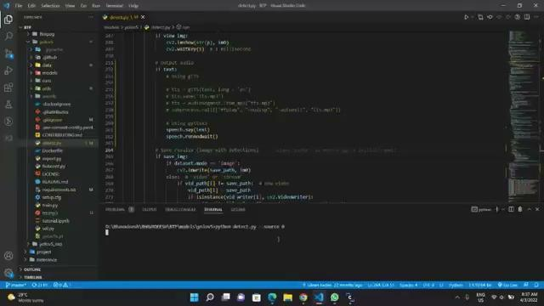
Experiment
Experimental video using pyttsx3

Slide 16
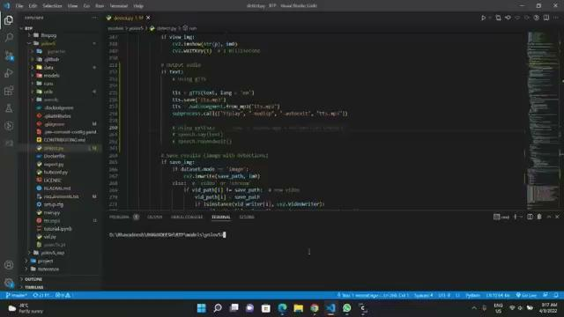
Experiment contd…
Experimental video using gTTS

Slide 17
Observations
gTTS work online unlike pyttsx3. [3]
gTTS requires an active internet connection.
pyttsx3 doesn’t require any internet connection. It works offline.
gTTS sends text to Google’s servers to generate a speech file, which is then returned.
The speech generated by pyttsx3 is spoken a little faster than gTTS speech.
Time taken to provide audio by pyttsx3 is less than the time taken by gTTS.
gTTS also needs an external package to output the audio file created, whereas pyttsx3 has inbuilt functions to play the audio created by it.[2]

Slide 18
Conclusion
We found pyttsx3 more helpful than gTTS, considering,
The time taken to produce audio, and the delay in frames.
The libraries required to provide an audio feedback.
And, the network connectivity.
Hence, we used pyttsx3 as our main library to conclude this project.

Slide 19
References
[1] Mache, Suhas R., Manasi R. Baheti, and C. Namrata Mahender. "Review on text-to-speech synthesizer." International Journal of Advanced Research in Computer and Communication Engineering 4.8 (2015): 54-59.
[2] https://towardsdatascience.com/object-detection-with-voice-feedback-yolo-v3-gtts-6ec732dca91
[3] https://medium.com/@ashwinijha006/zen-of-python-the-hard-way-is-easier-b3ab7644571a#:~:text=gTTS%20(Google%20Text%2Dto%2D,text%2Dto%2Dspeech%20API.&text=pyttsx3%20is%20a%20text%2Dto,both%20Python%202%20and%203.

Slide 20
Thank you

