Slide 1
NeighbourShare Project Analysis and Gantt chart
By
Sai Karthikeya 22R01A0597
Sai Kumar 22R01A0598
Manish Reddy 22R01A0599

Slide 2
TABLE OF CONTENTS
01
02
03
04
05
06
Introduction
Project Structure
Registration Screen
Login Screen
Gantt Chart
Next Steps

Slide 3

INTRODUCTION
NeighbourShare is a smartphone application created using React Native. It facilitates the sharing of resources among neighbors, where users pay according to the duration of their usage. This approach promotes equitable sharing practices and strengthens community bonds. Moreover, NeighbourShare offers a practical solution by allowing users to borrow items from nearby neighbors instead of purchasing new ones.
In this presentation you will the project structure, current progress and the future plan regarding the application.

Slide 4
Project Structure
Authentication Module: The Authentication Module manages user authentication within the NeighborShare app. Users can log in using their email and password or opt for a seamless experience by authenticating via Google. Firebase Authentication is integrated into the app to securely handle user authentication processes, ensuring that only authorized users can access the app's features.
Location Module: The Location Module handles location-related functionalities within the NeighborShare app. Upon user consent, the app requests access to the device's location services. Once permission is granted, the app determines the user's current location, which is then used to provide relevant information such as nearby items available for rent.
Item Management Module: The Item Management Module enables users to browse, add, and request items within the NeighborShare app. Users can browse a curated list of items available for rent based on their location. Additionally, users have the option to add their own items for rent by providing detailed information about the item, including its name, description, and rental price. Furthermore, users can submit requests for specific items that are not currently available for rent.
Database Integration: The Database Integration Module seamlessly integrates Firebase Realtime Database or Firestore into the NeighborShare app. This integration enables efficient storage and retrieval of essential data, including user authentication details, user profiles, item listings, and rental requests.

Slide 5
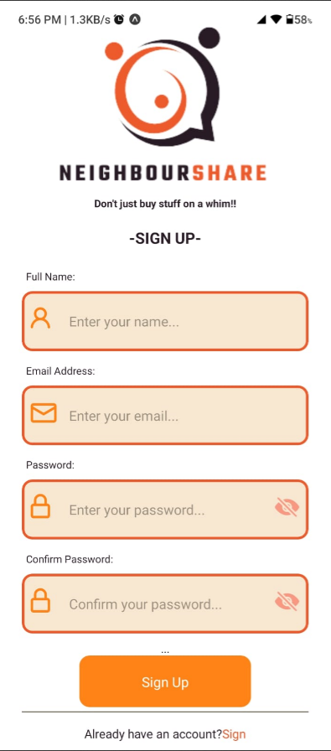
Registration Screen
The Registration Screen allows users to create a new account on the NeighbourShare app. Users are prompted to enter their full name, email address, password, and confirm the password. Firebase Authentication securely handles user registration processes, ensuring data privacy and security. Input validation and informative error messages are included to guide users through the registration process. With a user-friendly design and accessibility considerations, the Registration Screen serves as the entry point for users to join the NeighbourShare community and access its features.

Slide 6
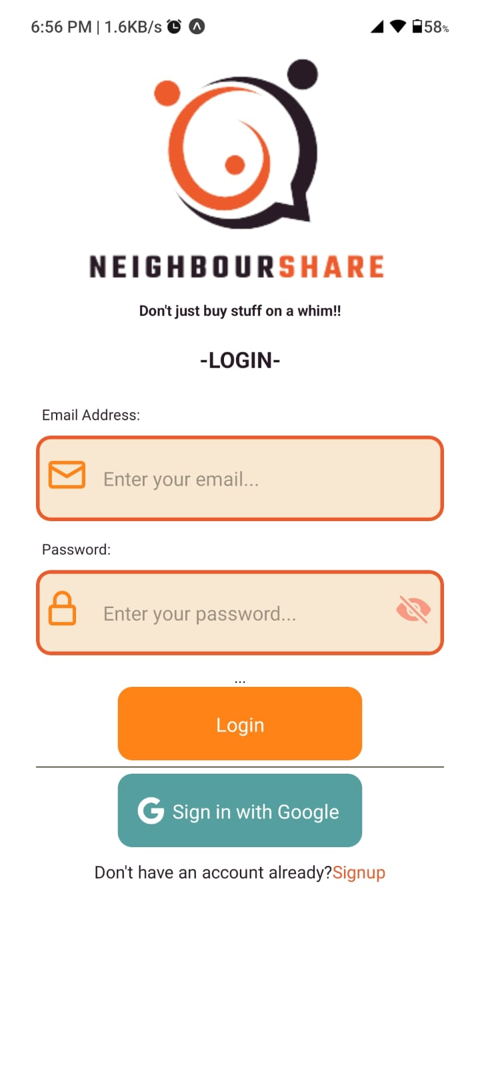
Login Screen
The Login Screen allows registered users to access their NeighbourShare accounts. Users input their registered email address and password in the designated fields. Additionally, users have the option to sign in directly using their Google account with the "Sign in with Google" button. Firebase Authentication securely manages the login process, ensuring user data protection. Error handling mechanisms provide guidance in case of incorrect inputs or login failures. With a user-friendly design and accessibility features, the Login Screen offers a seamless login experience, catering to the preferences and needs of NeighbourShare users.

Slide 7
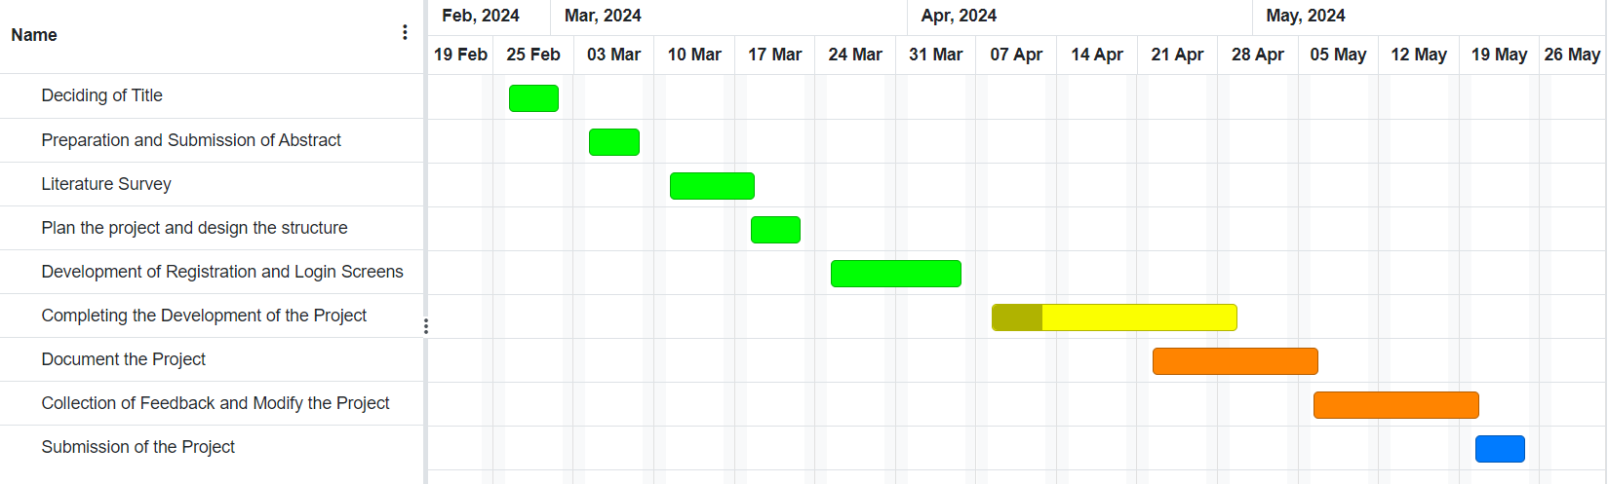
GANTT CHART

Slide 8
Next Steps
Having completed the login and registration modules, our focus now shifts to developing additional essential features for the NeighbourShare app. This includes implementing functionalities such as browsing available items for rent, enabling users to add their own items to the platform, and requesting for items.
You can look at the source code for the project in the below GitHub url:
https://github.com/SaiCarthikeya/NeighbourShare
Do checkout the GitHub page and provide your valuable feedback.

Slide 9
THANK YOU

