Slide 1


Team Details
  Team name: ONE 77
  Team leader name: Sai Charan Gobburu
  Problem Statement: Retail & Commerce: brands launch products blind. They learn what worked only after the media money is spent
Notes:
Team ONE 77. mirava.ai, an always-on world of 1,000 AI agents for rehearsing product launches.

Slide 2
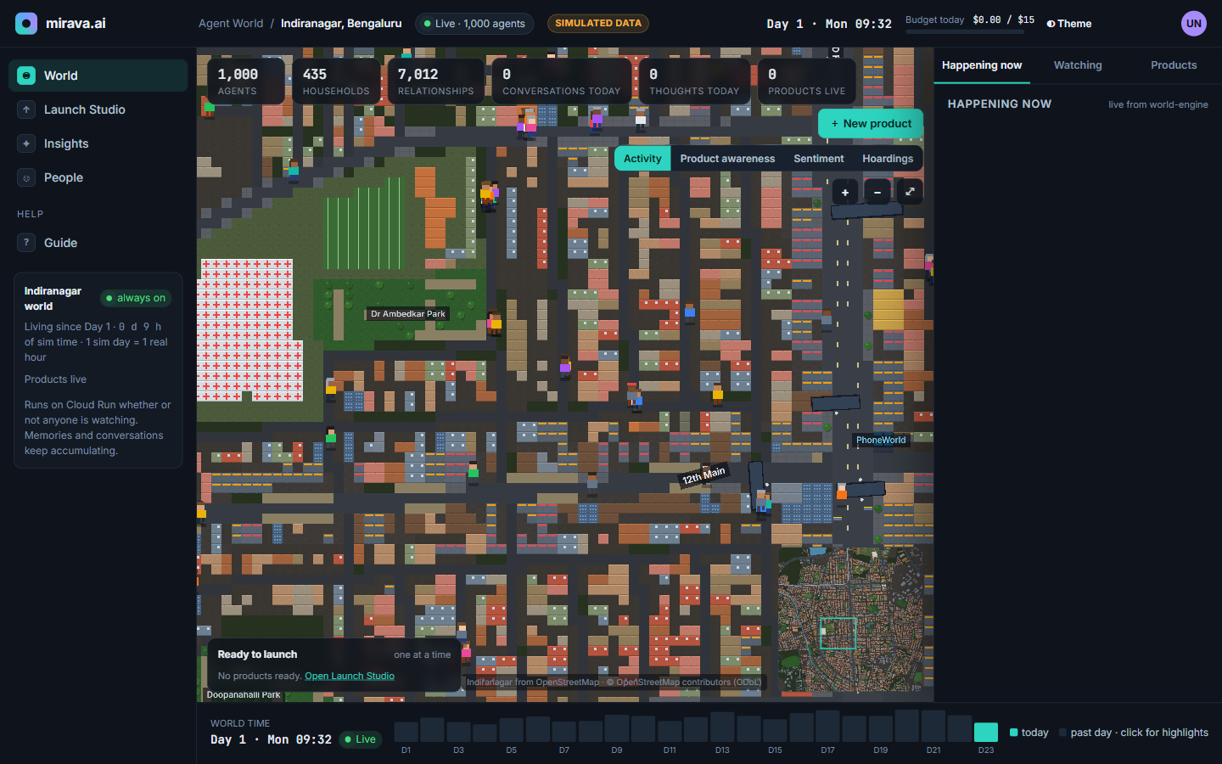
Brief about the idea
mirava.ai: a wind tunnel for product launches
Rehearse a launch in a living city of 1,000 AI agents before spending on the real one.
Always-on Indiranagar, Bengaluru from OpenStreetMap, running on Cloud Run 24/7 (1 sim day = 1 real hour)
Agents with inner lives: persona, private memory, routine, money, friends, media diet and an ageing phone
Launch Studio: Gemini reads your creatives, flags risky claims and plans hoardings automatically
Watch & ask why: who noticed, what they privately thought, what they told friends, who bought. Ask Gemini over the BigQuery log
Live world on Cloud Run: real OSM streets, 1,000 agents walking, 60 hoarding sites (simulated)
1,000
435
7,012
24/7
agents
households
relationships
always on
Notes:
Marketers find out what worked after the money is spent. mirava.ai lets them rehearse the launch first.

Slide 3
Opportunities
Surveys capture what people say. mirava.ai captures what they notice, think, share and buy
1
How is it different?
2
How does it solve the problem?
3
USP
Not a one-shot survey or persona chatbot: a persistent city where memory, gossip and word of mouth build up
Attention is simulated physically: walking path, hoarding facing and dwell time decide pass / glance / notice
Agents keep private thoughts and share only what they choose to say
Test creatives, claims and hoarding sites before buying media
See notice rates by site and facing, word of mouth, store questions and purchases, all logged exactly
Ask any question in plain English and get SQL, a chart and verbatim quotes
Out-of-home measured, not guessed: which wall, which direction, which audience
Purchases only when need, budget and intent line up (₹ money and credit per agent)
Runs for about $15/day under a budget governor that never stops the world
Notes:
Three questions from the template: difference, how it solves the problem, and our USP.

Slide 4
List of features offered by the solution
01
Globe to live city
02
1,000 agents with lives
cobe globe flies into a Phaser pixel city built from OpenStreetMap: 3,501 road nodes, 12,179 places
Persona, needs, routine, money and credit, households, 7,012 relationships, media diet, phone age
03
Private layered memory
04
Think vs speak chats
Episodic memories with 768-d embeddings, beliefs and nightly reflection, per agent only
Private prep, dialogue from share plans (≤10 messages each), private debrief. Exact transcripts
05
Launch Studio
06
Automatic hoarding plan
Products, posters, reels, posts, newspaper ads, store displays; claim risk, salience, knowledge graph
Sites and facings chosen from simulated footfall by segment, each with a written reason
07
Channels & stores
08
Insights + Ask Gemini
Hoardings, reels, newspaper, reviewers, community threads; salespeople in fictional stores
Ask, Hoardings, Segments, Funnel, Conversations, Polls and live Interviews over BigQuery
Notes:
Eight feature groups, all live in the deployed prototype.

Slide 5
Process flow diagram
From creative upload to 'why did they buy?'
STEP 1
STEP 2
STEP 3
STEP 4
STEP 5
STEP 6
Add product
Understand
Auto plan
Launch
Live world
Insights
details, personas, creatives
Gemini: claims, salience, graph
hoarding sites + facings with reasons
one at a time, firework drop
notice, think, talk, ask, buy
Ask Gemini, OOH dashboards
Inside the live world: what happens to each agent after launch
Pass
Glance
Notice
Private thought
Talk
Store inquiry
Buy
in range, not looking
in the cone, brief look
attention model, no LLM
Gemini, only on notice
prep → dialogue → debrief
think → decide → speak
need × budget × intent
Every step emits an event (exposure, thought, message, inquiry, purchase) → Pub/Sub → BigQuery. Private events are flagged private and never enter another agent's prompt. The budget governor approves every background model call; over the cap, work falls back to rules and templates.
Notes:
Top: the marketer's journey. Bottom: the agent's journey. The attention model gates every model call.

Slide 6
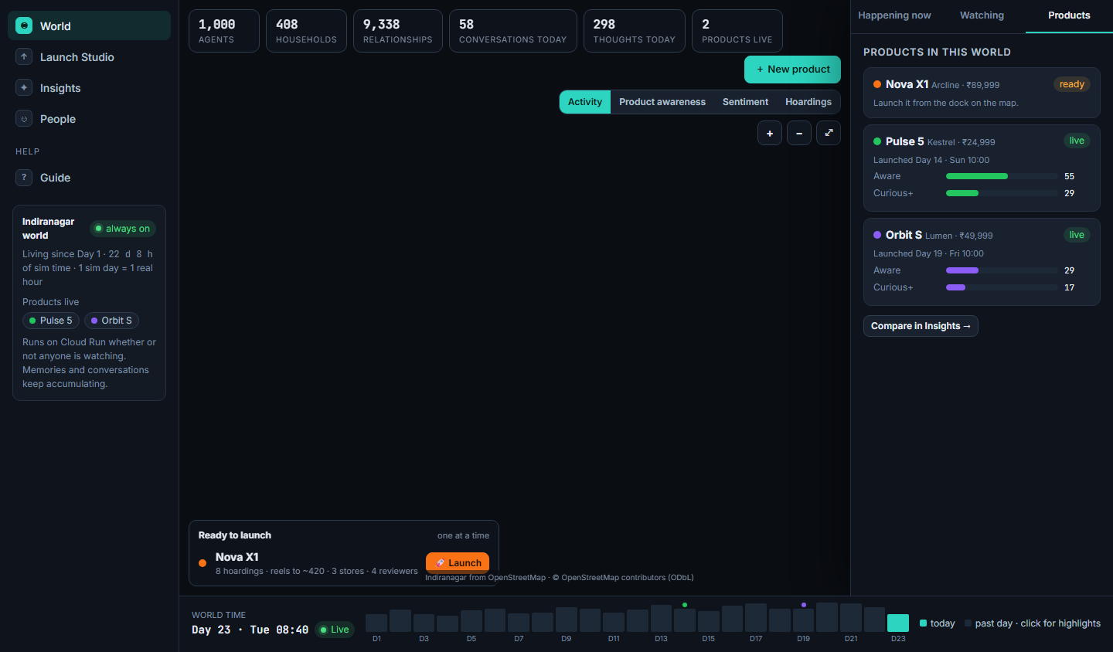
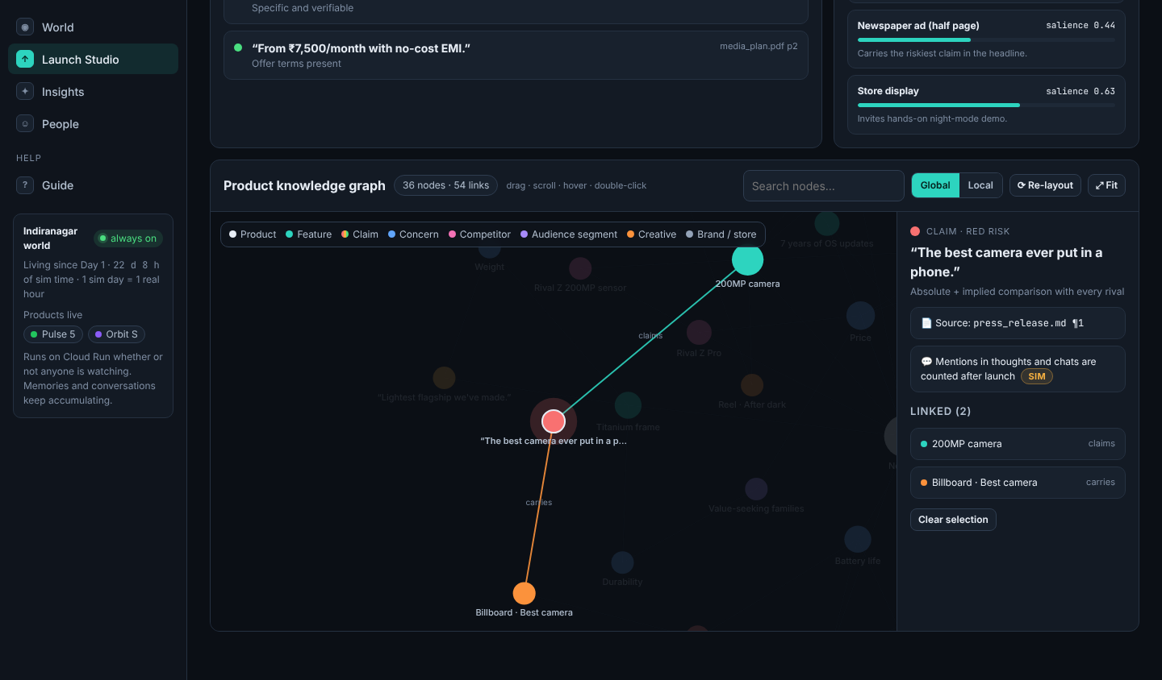
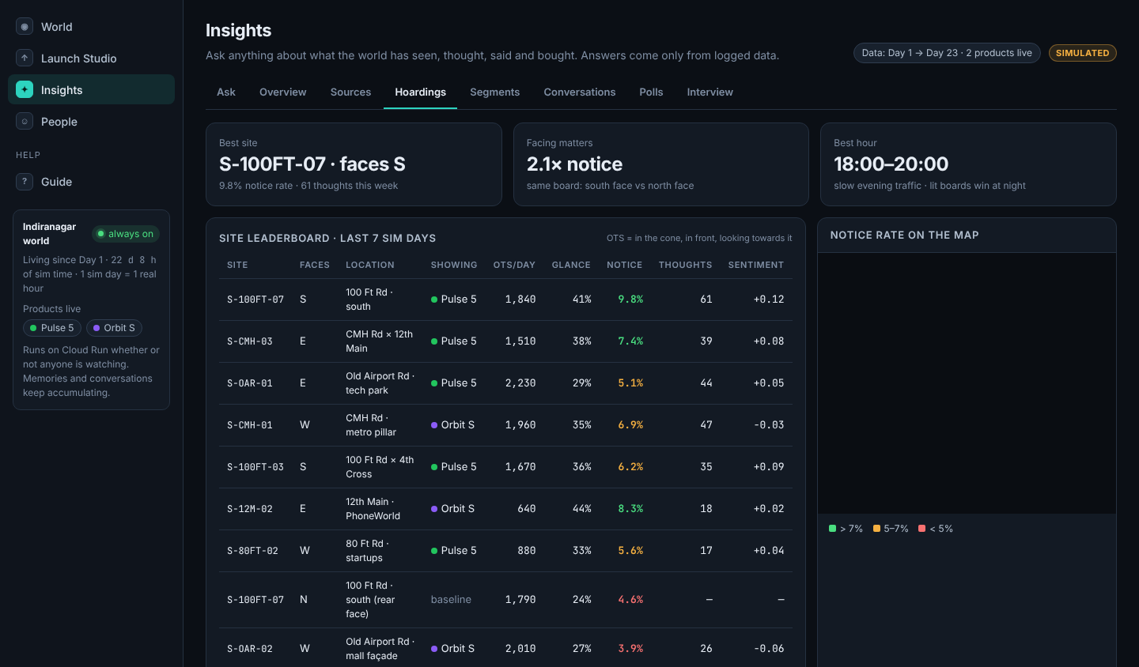
Wireframes / mock diagrams of the proposed solution
Designed first as a 34-screen interactive mockup (1440×900), then built and checked against it pixel by pixel
World: live city, stats, Ready-to-launch dock
Launch Studio: Obsidian-style knowledge graph
Insights: Hoardings by site and facing
Pages
/globe
/world
/launch
/insights
/people
/guide
intro fly-in
home: live city
Launch Studio, 5 steps
8 tabs
1,000 profiles
how it works
Notes:
Every screen was specified in the mockup before coding; 29 gated screens now pass the pixel check.

Slide 7
Architecture diagram of the proposed solution
Google Cloud · asia-south1
Firebase Hosting
Firestore
GCS
web app, /api rewrite
state · lease · memories + vector index
checkpoints · uploads
Gemini 3
Browser
Cloud Run: mirava-api
Cloud Run: world-engine
Pro: Insights, claim risk
Flash: dialogues, creatives
Flash-Lite: thoughts, chats, decisions
Embedding: 768-d memory
React · Phaser 3 city · cobe globe · ECharts
FastAPI · Launch Studio · Insights (ADK) · 0→5
always-on single writer · min=max=1 · /live WebSocket
Only world-engine writes world state (Firestore lease). The API reads, or sends POST /commands.
Model Armor
Pub/Sub
BigQuery
Google ADK agents
screens uploads + questions
world-events · world-texts
events · texts · views · vector search
Insights assistant · salesperson · interviewer · understanding
Secret Mgr · Scheduler
Build · Monitoring
key · 5-min watchdog
CI/CD · uptime · spend alerts
Notes:
Single-writer engine with a Firestore lease; events stream through Pub/Sub BigQuery subscriptions with no glue code.

Slide 8
Technologies to be used in the solution
Every Google service has one clear job
Google Cloud & Google AI
Application stack
Gemini 3 Pro / Flash / Flash-Lite
Gemini Embedding
Google ADK
FRONTEND
thinking, talking, Insights
768-d memory + text search
4 tool-using agents
React 18 · Vite · TypeScript · Phaser 3 · cobe · react-force-graph · ECharts · Tailwind
Cloud Run ×2
Firestore
BigQuery
BACKEND
always-on engine + API
state, lease, vector memories
event log, views, VECTOR_SEARCH
Python 3.12 · FastAPI · pydantic v2 · asyncio + NumPy · A* on road graph
Pub/Sub
Cloud Storage
Model Armor
DATA
OpenStreetMap → Tiled map, road graph, places, 60 hoarding sites
BigQuery subscriptions
checkpoints, creatives
prompt-injection screening
Firebase Hosting
Secret Manager · Scheduler
Cloud Build · Monitoring
QUALITY
pytest · Playwright + pixelmatch visual tests · ruff · mypy · gitleaks
web app + /api
key, health watchdog
CI/CD, alerts, dashboard
Notes:
Gemini 3 only. Model IDs live in one file; engine calls use low reasoning effort and usage accounting.

Slide 9
Estimated implementation cost
A budget governor keeps the whole city affordable. It never stops, it only gets quieter
$15
$5
$0.003
$0.52
per day cap on background
agent thinking
per day cap on interactive
Insights, polls, interviews
average cost of one
rendered conversation
to generate 950 Gemini
personas at genesis
Item | Estimate / month (simulated demo scale)
Cloud Run world-engine (2 vCPU, 4 GiB, always on) | ≈ $110
Cloud Run API, Firestore, Pub/Sub, BigQuery, GCS, Hosting | ≈ $15–25 (mostly free tier)
Gemini 3 via governor (background + interactive caps) | ≤ $600 at cap · observed ≈ $1/day
Total for an always-on 1,000-agent city | ≈ $150 typical · ≤ $750 worst case
Cost levers
Attention model first: no model call for pass or glance
Flash-Lite for most calls; 32 decisions per batch
Hourly caps by priority class (store talk > ad thoughts > chats)
Over cap → rule/template fallback; the clock can slow 1×–3×
Notes:
Estimates use Cloud Run list prices in asia-south1 and OpenRouter Gemini 3 prices on 17 Oct 2026. Observed: engine spend $0.88 on a real day with 149 thoughts.

Slide 10
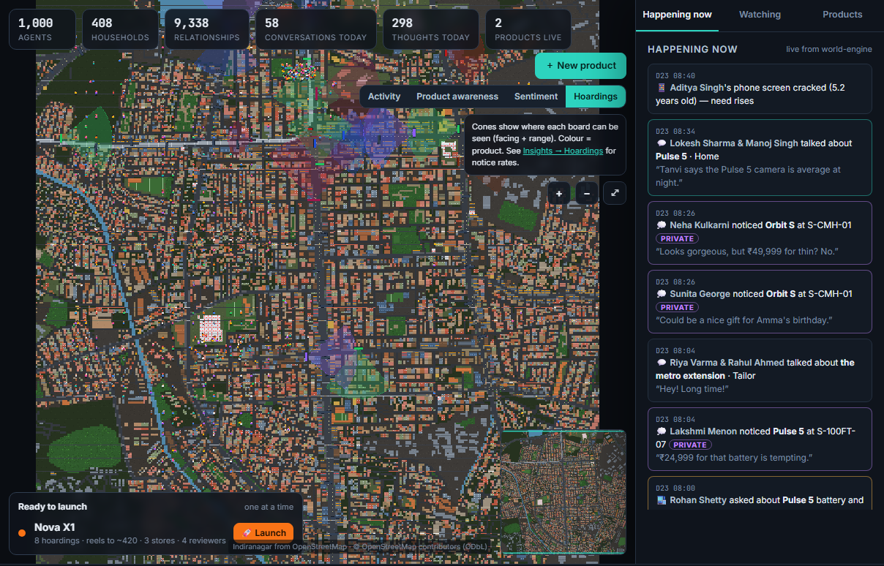
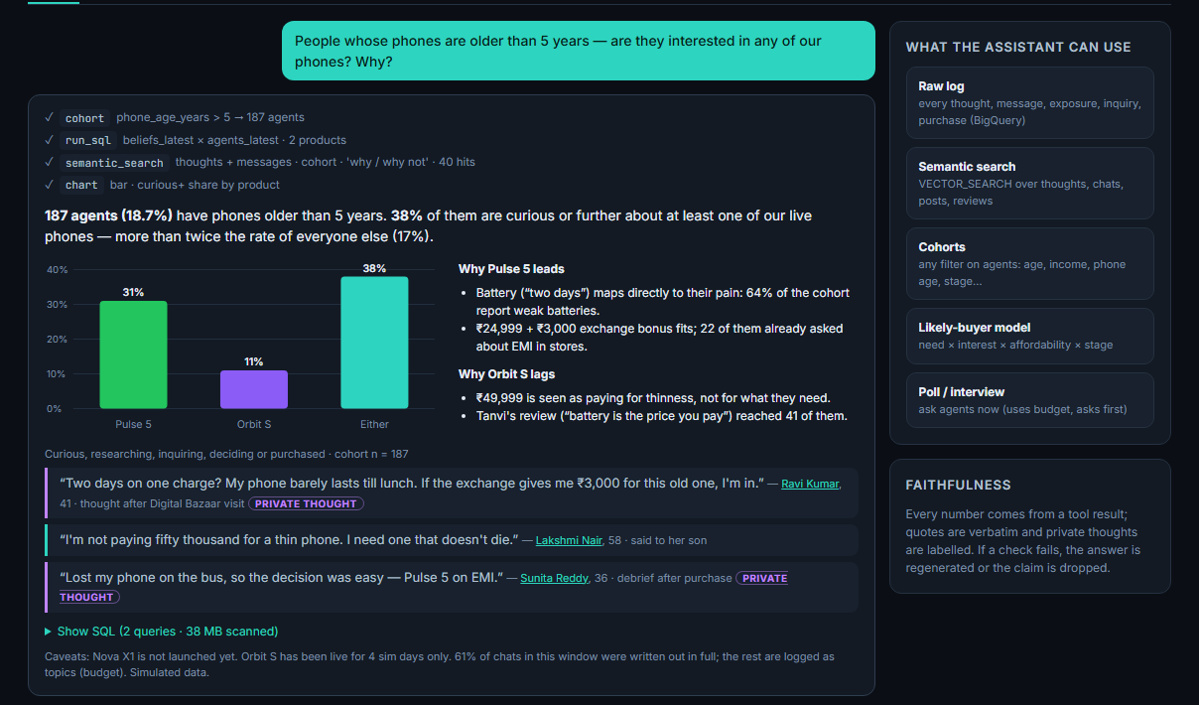
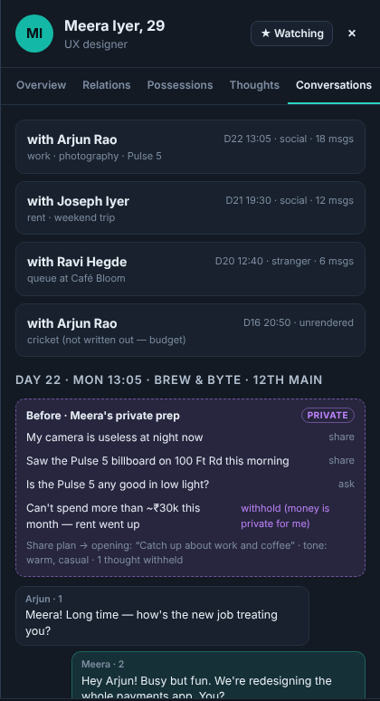
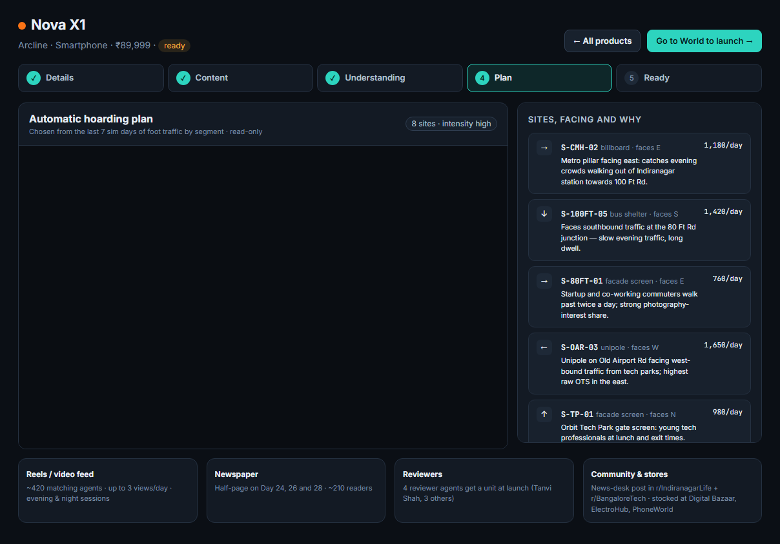
Snapshots of the prototype
Live at mirava-ai-hack.web.app (all data simulated)
Insights · Ask Gemini: SQL, chart, verbatim private quotes
World · Hoardings lens with live 'Happening now' feed
Profile → Conversations (right): Meera's private prep chose what to share and withheld her budget. The dialogue only ever sees that share plan.
Launch Studio · automatic hoarding plan with reasons
Notes:
Four real screens: world lens, Ask, auto plan, and a think-vs-speak conversation.

Slide 11
Prototype performance report / benchmarking
Evals: 200 agents · 2 sim days · deterministic seed; UI pixel checks against the mockup
100%
100%
6 / 6
29 / 29
Insights faithfulness
(target ≥ 95%)
quotes verbatim
from the log
survey-realism
checks pass
gated UI screens pass
the pixel check
Engineering & scale
152 automated tests (134 Python + 18 web); lint, types, gitleaks clean
Map: 299×305 tiles, 3,501 road nodes, all reachable; 12,179 places
Live cloud day: 149 rendered ad thoughts for $0.88 total engine spend
Privacy: marker-fact tests prove no memory leaks between agents
Determinism: same seed + same inputs ⇒ same events
Notes:
Insights benchmark 10 questions; the one routing miss has been fixed and pinned by a unit test.

Slide 12
Additional details / future development
1
2
3
4
Now · hackathon
Next · V1
Scale · 10k–100k agents
Product
1 city, 1,000 agents, smartphones
Always-on on Cloud Run
Ask Gemini + OOH dashboards
Any category via category bootstrap
What-if forks: test plan A vs B in parallel worlds
Vertex AI backend + Agent Engine Memory Bank
Area-sharded engines on GKE Autopilot
Memorystore + Bigtable hot state
More Indian and APAC cities from OSM
Self-serve brand workspaces
Calibrate against real campaign results
Media planner exports for OOH buyers
Market: India's out-of-home and launch spend is decided with little evidence. mirava.ai turns 'which wall, which direction, which audience' into a measured, rehearsable answer, before the money is spent.
Notes:
Same engine, new map and population config for every new city or category.

Slide 13
Private by construction, safe by default
Agents share only what they choose to say. The demo is built to be trusted
PRIVATE
SHARED
PRIVATE
Private prep
Dialogue
Private debrief
What do I want to share, ask or withhold?
Built only from both SharePlans + public text. ≤10 messages each
What did I learn? Memory and beliefs update for me only
MemoryStore(agent_id)
Marker-fact tests
✓
✓
reads and writes only that agent's memories; every prompt is built for one agent
plant secrets in one agent and prove they never appear in another's prompt
Model Armor
Honest by design
✓
✓
screens uploads and Insights questions; content is wrapped as data, never instructions
fictional stores and media, every number labelled simulated, no political campaigns
Notes:
Think vs speak is what makes word of mouth realistic: agents can hold back their budget or doubts.

Slide 14
Provide links to your:
1
GitHub Public Repository
https://github.com/SaiCharan-99/mirava.ai
2
Demo Video Link (3 Minutes)
<add YouTube / Drive link>
3
Final Product Link
https://mirava-ai-hack.web.app
API health: mirava-ai-hack.web.app/api/healthz · All people, numbers, stores and ads are simulated; stores and media are fictional.

Slide 15


