Slide 1

SMART INDIA HACKATHON 2026
Problem Statement ID – SIH26133
Problem Statement Title- VARADHI (Bridging Every Step of Rural HealthCare)
Theme- MedTech/BioTech/HealthTech
PS Category- Software
Team ID-
Team Name- NeuralNest

Slide 2
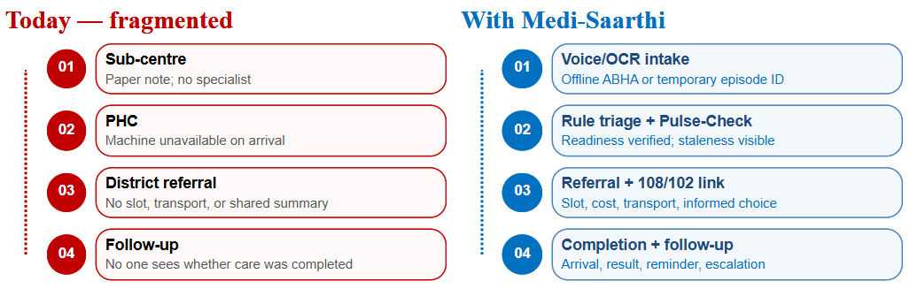
MEDI-SAARTHI
NeuralNest
Rural Care Continuity — From first contact to completed care
Understanding the Problem
Our Unique Solutions
Fragmented Care: Patients move between facilities, but information and follow-up accountability stay behind.
Data Mirage: "Availability" on paper often turns into a wasted 40km trip when a machine is down or a doctor is out.
Referral Drop-out: Patients may fail complete referrals due to travel cost, unavailable services and lack of follow-up.
Labor Tax: Frontline workers spend significant time on manual data entry.
Identity Gap: Continuity breaks for patients without ABHA IDs, smartphones, or stable connectivity.
Referral Guard: Create → Accept → Arrive → Complete → Close; refusal is recorded, not hidden.
Zero-Type Intake: Local-language Voice-to-Text and OCR keep frontline data entry under two minutes.
Pulse-Check Readiness: Staff confirm service availability in one tap; stale values are clearly flagged.
Identity Resilience: Offline-first patient episode ID with later consented synchronization.
Active Transport: Structured emergency dispatch payload
Compatible with ambulance service integration.
Coordination, not competition: e-Sanjeevani delivers teleconsultation; ABDM stores consented records;
Medi-Saarthi coordinates the next action and closure.
Scope honesty: We optimize within available capacity, we do not create specialists, beds, medicines, or roads.

Slide 3
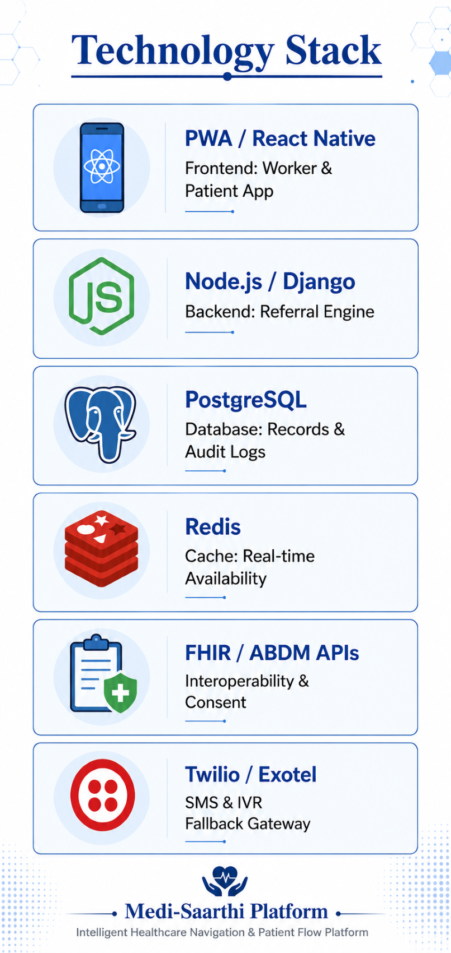
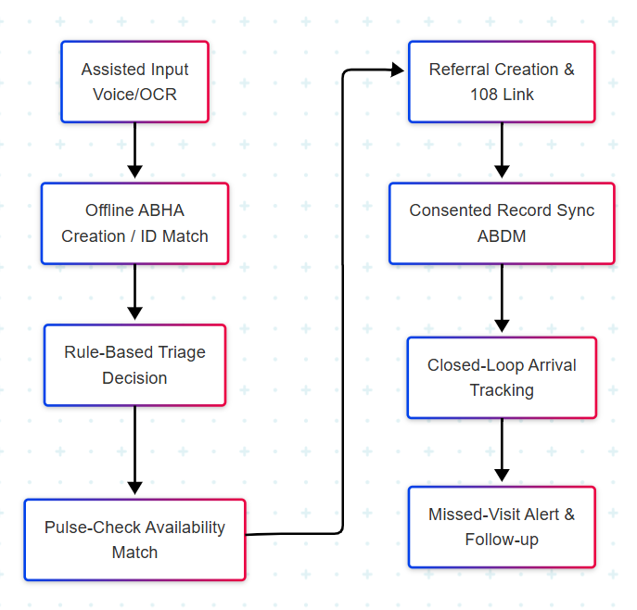
TECHNICAL APPROACH
NeuralNest
Methodology
End-to-End Patient Workflow
Assisted Capture: voice-to-text in the preferred local language; OCR reads paper prescriptions.
Rules-Based Triage: regional medical-board rules classify routine, teleconsult, urgent, or referral.
Pulse-Check: receiving staff confirm slot/stock readiness in one tap; stale values show warning.
Active Dispatch: red-flag cases send structured location/urgency packet to 108/102 adapter.
Referral Guard: created → accepted → arrived → completed → closed; refusal reason is recorded.
Continuity: consented summary syncs through ABDM; worker receives missed-visit task.
Scope boundary: VARADHI coordinates within available capacity. It does not create specialists, beds, stock, roads, or ambulances.
Human-in-loop: worker confirms the suggested path; uncertain or emergency cases escalate to clinical staff.

Slide 4
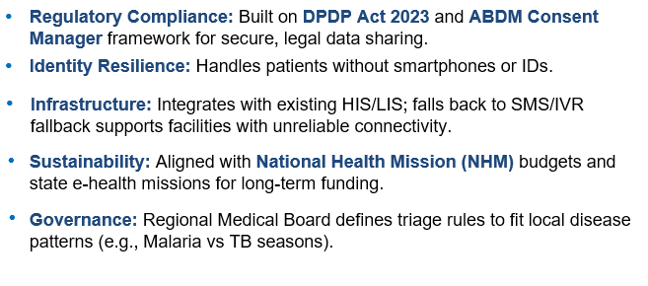
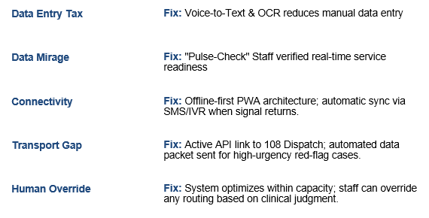
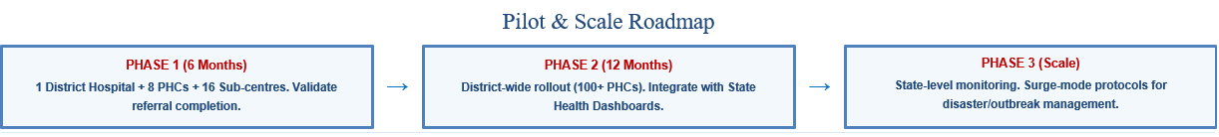
FEASIBILITY AND VIABILITY
NeuralNest
Analysis of the Feasibility of the Idea
Challenges & Mitigations

Slide 5
IMPACT AND BENEFITS
NeuralNest
Who Benefits:-
Potential Impact on Rural Patients
Strategic Outcomes
Social: Continuity of care and restored patient trust in public health.
Economic: Drastic reduction in out-of-pocket travel cost.
Governance: Auditable referral for evidence based policymaking.
Emergency: Automated escalation for high-risk maternal & child cases.
Earlier Consultation: e-Sanjeevani integration brings specialist expertise to the village level, bypassing long travel.
Reduced Travel Burden: Assisted triage directs patients to the nearest appropriate available service ,reducing unnecessary travel.
Referral Completion: Confirmed slots and shared summaries are designed to reduce referral drop-outs.
Maternal & Child Safety: High-risk follow-up tracking ensures critical care is never missed or delayed.
Inclusive Access: Multilingual, zero-type interaction builds trust and confidence in underserved communities.

Slide 6
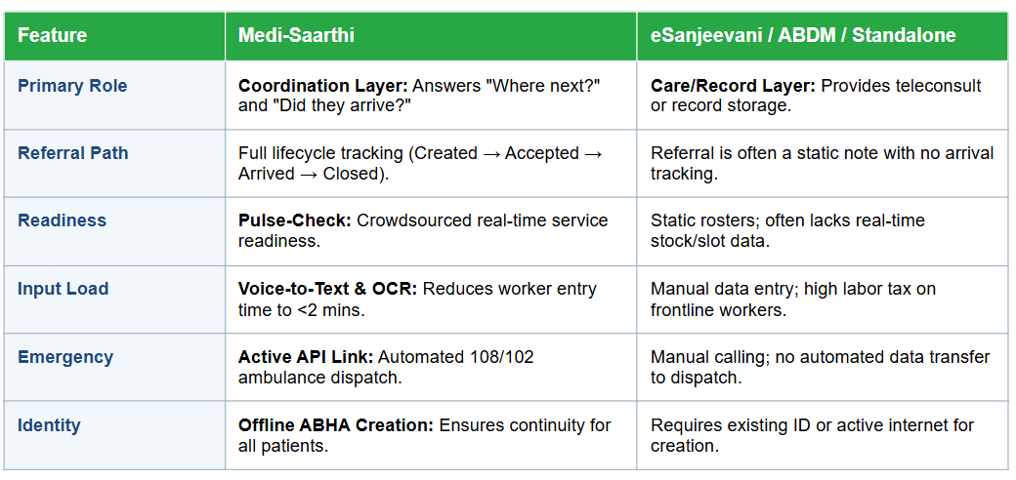
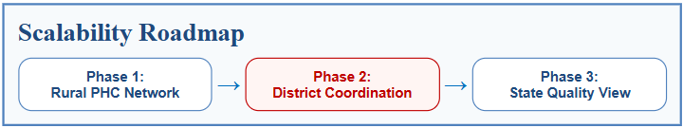
RESEARCH AND REFERENCES
NeuralNest
Proposed Solution vs Existing Platforms
Research and References
[1] National Health Authority (NHA) “— ABDM Scan and Share milestone for digita lOPD registrations.
https://abdm.gov.in/scan-share
[2] e-Sanjeevani
— National Teleconsultation Service framework for rural health access.
https://esanjeevani.mohfw.gov.in/
[3] DPDP Act 2023 — Regulatory framework for health data privacy and consent in India.
https://www.meity.gov.in/content/digital-personal-data-protection-act-2023
[4] WHO – Primary HealthCare in India
— integrated health services as coordination across primary, secondary and tertiary levels, with timely referrals and follow-up to reduce fragmentation.
[5] WHO – Online Referral System, Karnataka
— digital technology and improved referral pathway
[6] WHO – Digital Transformation Handbook for Primary Healthcare
— workflow mapping
Connect every patient, referral, diagnosis, and follow-up across the rural healthcare journey.

