Slide 1
Views

Slide 2
Views
A view is a rectangle on the screen that shows some content.
It can be an :
Image
Piece of Text
Button
Or anything that an app can display

Slide 3
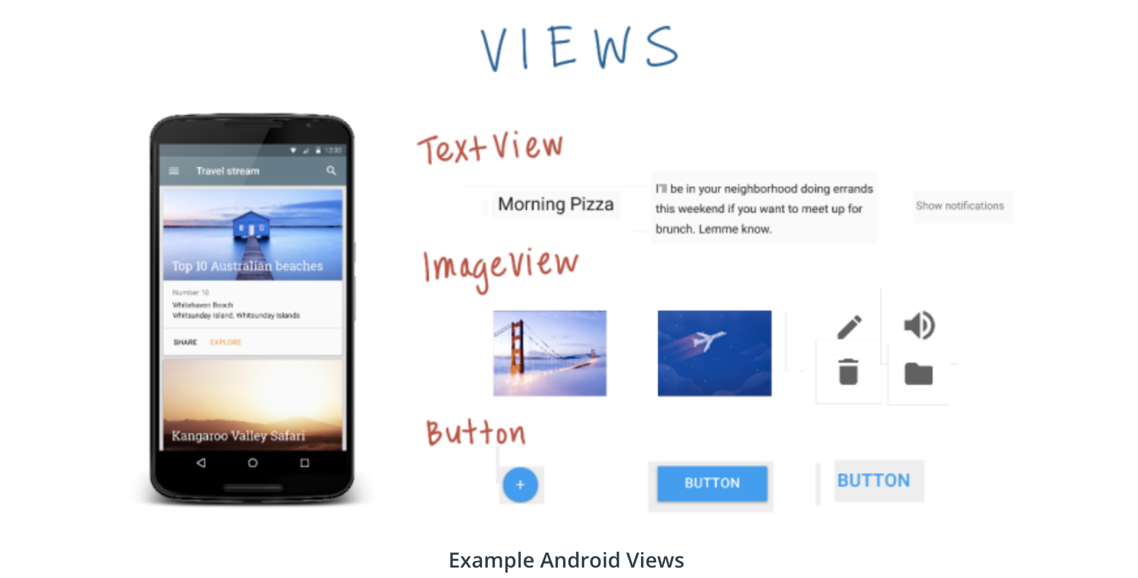

Slide 4
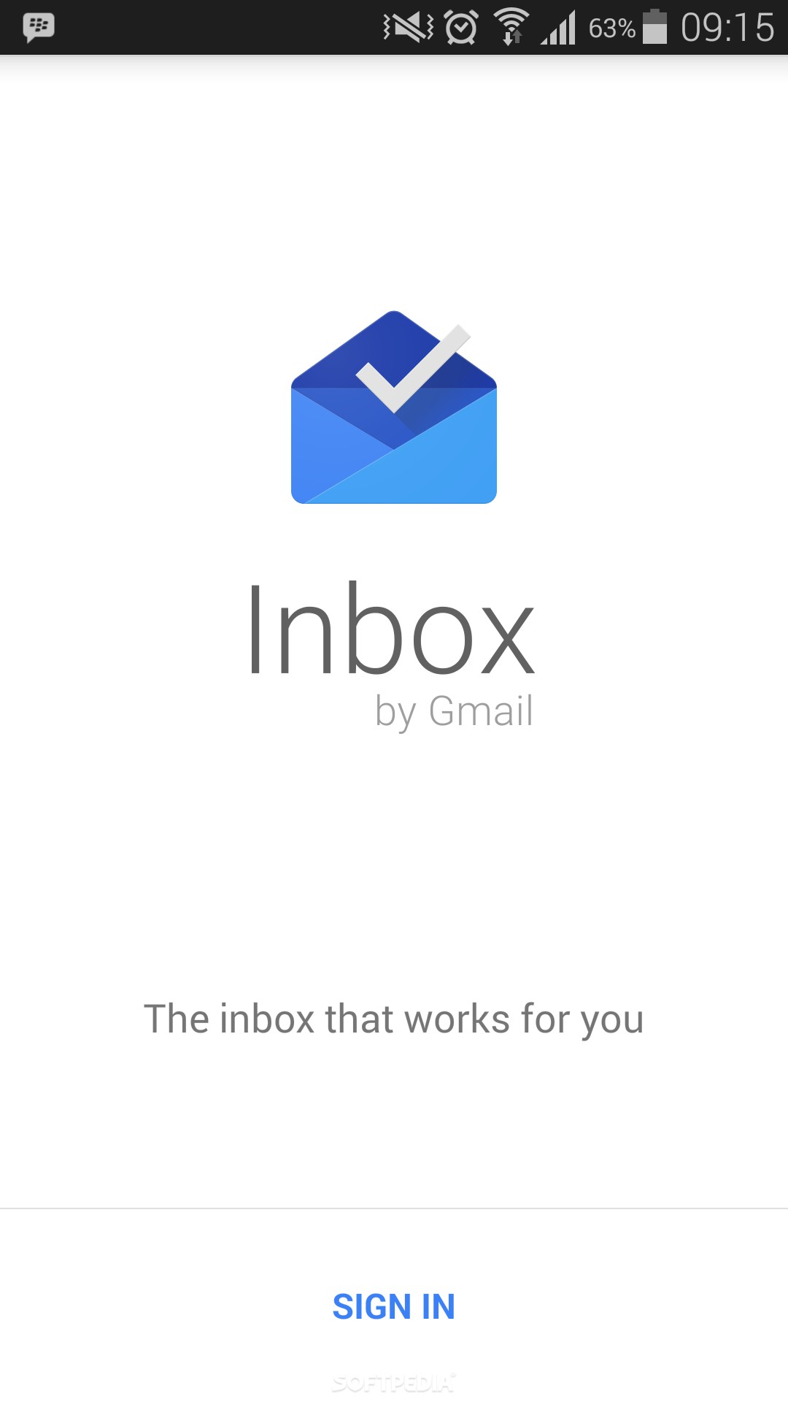
Let’s try to identify few views

Slide 5
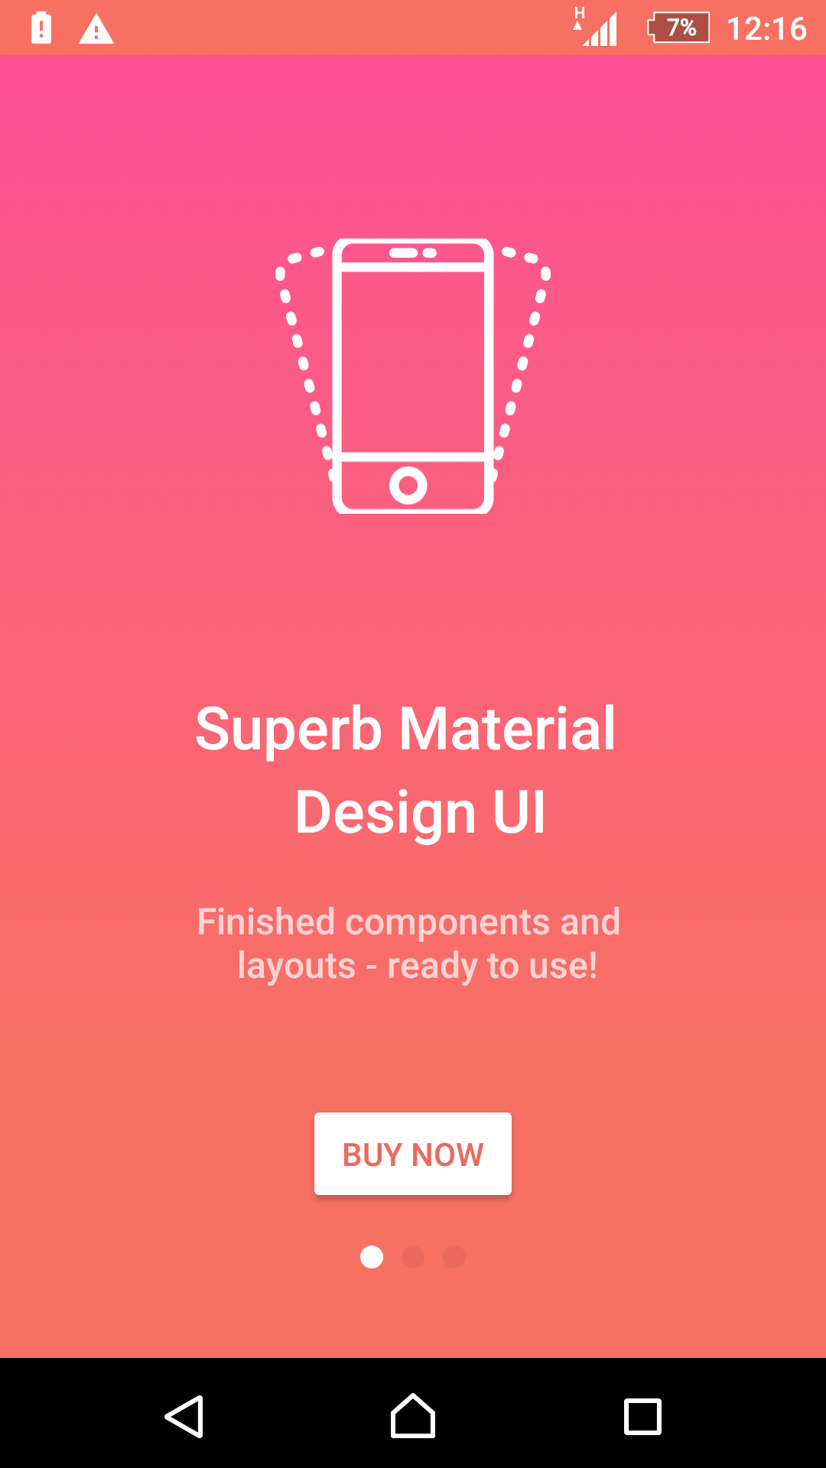

Slide 6
Text View:
<TextView android:text="Hello World!!!!" android:background="@android:color/darker_gray" android:layout_width="150dp" android:layout_height="150dp" />

Slide 7
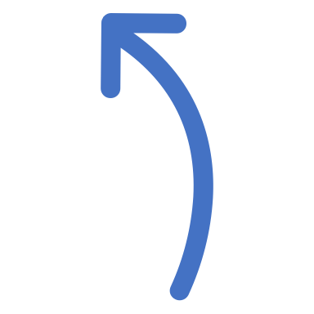
Your observations about the code
What did you think the code would do ?

Slide 8
Let’s try to change the code
Changing
Text
Changing
Width
Changing
Height

Slide 9
What does DP mean?
DP stands for density independent pixels.
Let’s have a look at the meaning in Vocab Glossary.

Slide 10
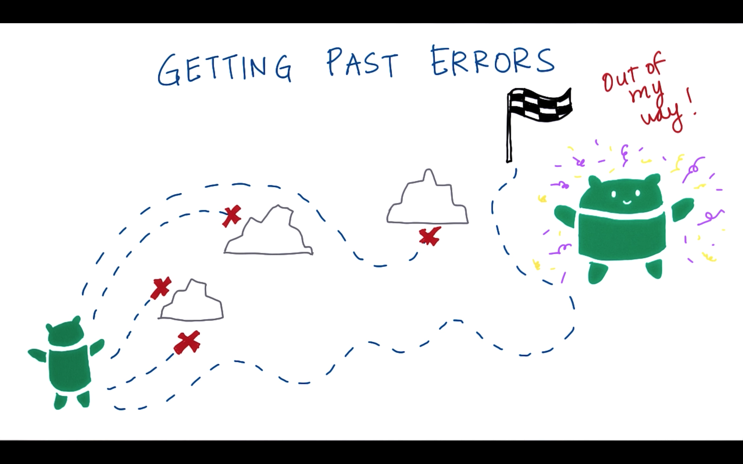

Slide 11
Let’s try to identify errors and get past them
https://labs.udacity.com/android-visualizer/#/android/xml-syntax-errors

Slide 12

Download PDF about the important views:
Some site

