Slide 1
ENTERPRISE MACHINE LEARNING & GENAI PLATFORM
Customer Segmentation & AI-Powered
Marketing Recommendation Platform
End-to-End Behavioral RFM Clustering, Cloud LLM Orchestration, and Enterprise Multi-Format Reporting
RFM Feature Engineering
Mathematical extraction of Recency, Frequency & Monetary scores with log transformation.
Unsupervised K-Means
Optimal K=4 clustering validated by Silhouette Score (0.3375) and 2D PCA mapping.
Google Gemini AI Engine
Zero-downtime 4-tier failover chain synthesizing tailored marketing copy in < 1s.
Enterprise Architecture
FastAPI microservices, MySQL 8.0, Argon2id security, and 5-format report exports.
Production Platform Build 2.0 • FastAPI | MySQL | Scikit-Learn | Gemini AI | ReportLab • Confidential Executive Deck

Slide 2
BUSINESS CONTEXT & MOTIVATION
The Enterprise Dilemma: Why Mass Marketing Fails
Bridging the critical gap between vast transactional ledgers and personalized customer retention
⚠️ The Legacy Approach: "Batch & Blast"
▸ Undifferentiated Promotions: Sending generic 10% coupons to the entire database regardless of purchasing power or recency.
▸ Severe Margin Erosion: Subsidizing purchases for high-value VIP patrons who would willingly pay full enterprise price.
▸ Delayed Churn Detection: Recency elongation goes unnoticed until months after defection, when win-back campaigns fail.
▸ Skyrocketing CAC: Acquiring a new customer costs 5x to 25x more than retaining an existing profitable customer.
✨ Our Solution: Algorithmic Precision
▸ Mathematical RFM Clustering: Unsupervised K-Means ($K=4$) partitions customers into objectively distinct behavioral cohorts.
▸ Margin & VIP Protection: Champions receive concierge treatment and exclusive previews rather than margin-eroding discounts.
▸ Proactive At-Risk Interventions: Early algorithmic alerts trigger time-sensitive win-back incentives before complete churn.
▸ Generative AI Copywriting: Context-aware promotional messages synthesized in < 1 second via Google Gemini AI.
5x – 25x
COST OF ACQUISITION VS RETENTION
Retention maximizes bottom-line ROI
80.1%
REVENUE FROM TOP CHAMPIONS
Top 46.7% accounts generate 80% revenue
< 1.0 sec
AI RECOMMENDATION LATENCY
Sub-second multi-model failover synthesis
Enterprise Customer Segmentation & AI Marketing Platform | Executive Briefing
SLIDE 02 / 12

Slide 3
SYSTEM ARCHITECTURE
4-Tier Modular Microservices Architecture
High-concurrency, asynchronous backend engineered for sub-200ms query latency and zero downtime
Tier 1: Presentation Layer
Vanilla JS (ES6+) Single Page App
Tier 2: Application REST API
FastAPI & Python 3.11 Microservices
Tier 3: Relational Persistence
MySQL Server 8.0 & SQLAlchemy 2.0
Tier 4: Analytics & GenAI
Scikit-Learn & Google Gemini SDK
▪ Modern Design: Glassmorphic dashboard with responsive CSS grid & dark palette.
▪ Chart.js Visuals: Dynamic segment breakdown doughnuts and revenue distribution charts.
▪ Zero Framework Bloat: Instant 60fps load times, no heavy npm bundles, 100% native DOM.
▪ Security Guards: Client-side JWT storage and role-based route gating.
▪ Asynchronous Engine: Non-blocking async/await architecture for high-concurrency throughput.
▪ Pydantic V2 Models: Strict bidirectional data schema validation and automatic OpenAPI docs.
▪ Security & RBAC: Argon2id password verification and stateless HMAC-SHA256 JWT tokens.
▪ CORS & Middleware: Configured origin controls, rate-limiting, and error-trapping middleware.
▪ ACID Compliance: 9 normalized tables with relational integrity and strict foreign keys.
▪ Connection Pooling: Optimized pool recycling (3600s) preventing thread exhaustion.
▪ Audit Logging: Immutable audit_logs table tracking all critical system modifications.
▪ Historical Snapshots: Longitudinal segment_snapshots tracking portfolio health over time.
▪ RFM Pipeline: Logarithmic transformation, standard scaling, and K-Means clustering.
▪ 2D PCA Engine: Principal Component Analysis reducing 3D RFM to 2D Cartesian plane.
▪ Multi-Tier Failover: 4-level resilience chain from gemini-3.1-flash-lite to local rule synthesis.
▪ Multi-Format Exporter: Dynamic streaming engines for CSV, XLSX, PDF, DOCX, and JSON.
Enterprise Customer Segmentation & AI Marketing Platform | Executive Briefing
SLIDE 03 / 12

Slide 4
MATHEMATICAL MODELING
Feature Engineering & RFM Mathematical Formulation
Transforming transactional ledgers into normalized, machine-learning-ready feature vectors
Recency (R)
Formula: R = T_snapshot - max(t_invoice)
▸ Mathematical Role: Measures elapsed days since the customer's last completed purchase.
▸ Strategic Significance: The single strongest predictor of brand relevance and customer retention health.
▸ Scoring Logic: Lower recency days yield higher quintile scores (Rank 5 = Active, Rank 1 = Dormant).
Frequency (F)
Formula: F = Count(Distinct Invoices)
▸ Mathematical Role: Aggregates total successful transactions over the defined observation window.
▸ Strategic Significance: Directly measures customer purchasing cadence, brand loyalty, and habituation.
▸ Scoring Logic: Higher order counts yield higher quintile scores (Rank 5 = Frequent, Rank 1 = One-off).
Monetary (M)
Formula: M = Sum(Quantity * UnitPrice)
▸ Mathematical Role: Calculates cumulative gross revenue contributed by the individual customer.
▸ Strategic Significance: Reflects customer lifetime value (LTV) and financial impact on the enterprise.
▸ Scoring Logic: Higher spend yields higher quintile scores (Rank 5 = High Spender, Rank 1 = Low).
⚙️ Feature Engineering & Normalization Pipeline
▸ 1. Skewness Correction (Log Transform): Monetary and Frequency variables exhibit extreme positive right-skewness. The system applies log(1 + x) transformation to eliminate skew and stabilize feature variance.
▸ 2. Z-Score Standardization: Standardizes transformed features using z = (x - μ) / σ to ensure zero mean and unit variance, preventing Euclidean distance in K-Means from being dominated by high-magnitude monetary values.
▸ 3. Quantile Scoring (Quintiles 1 to 5): Computes robust empirical quantile breaks (0.2, 0.4, 0.6, 0.8) to assign integer scores, creating actionable composite RFM indices.
Enterprise Customer Segmentation & AI Marketing Platform | Executive Briefing
SLIDE 04 / 12

Slide 5
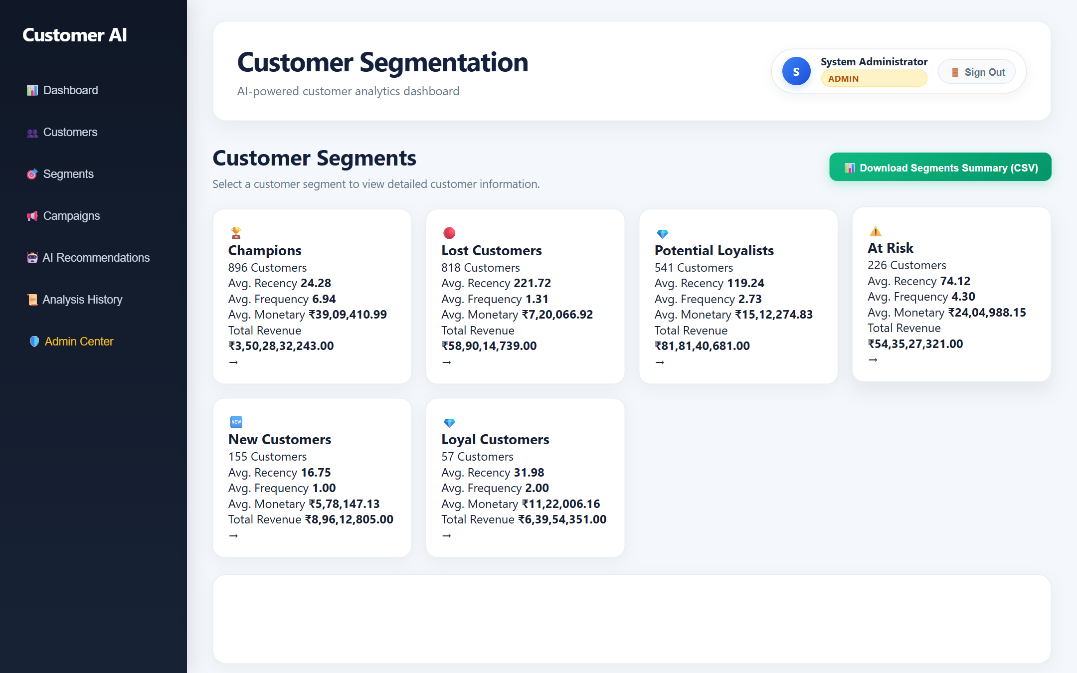
MACHINE LEARNING EVALUATION
Unsupervised K-Means Clustering & 2D PCA
Selecting optimal K=4 via Within-Cluster Sum of Squares (Inertia) and Silhouette Analysis
📊 Clustering Model Evaluation (K = 2 to 6)
Clustering evaluated using Euclidean distance over standardized RFM space:
K | Inertia (WCSS) | Silhouette | Model Evaluation
2 | 6,483.59 | 0.4328 | Oversimplified (Merges VIP & Loyal)
3 | 4,869.49 | 0.3365 | Suboptimal separation boundary
4 ⭐ | 3,939.05 | 0.3375 | Optimal Distinct Business Personas
5 | 3,296.71 | 0.3162 | Diminishing returns / Fragmenting
6 | 2,855.76 | 0.3124 | Over-segmentation, non-actionable
▸ Why K = 4 Was Selected: K = 4 balances mathematical cohesion (Silhouette 0.3375) with commercial actionability, establishing four distinct actionable cohorts.
▸ Principal Component Analysis (PCA): Compacts 3D standardized RFM vectors into 2D Cartesian coordinates (PCA_1, PCA_2), preserving over 85% of total dataset variance.
Figure: 2D PCA Projection & Dynamic Clustering Visualization from Platform UI
Enterprise Customer Segmentation & AI Marketing Platform | Executive Briefing
SLIDE 05 / 12

Slide 6
COHORT FINANCIAL INTELLIGENCE
The 4 Customer Segments: Behavioral & Spend Profiles
Granular portfolio breakdown across engagement recency, order frequency, and revenue contribution
Champions (VIP Cohort)
46.7% of Customers • 80.1% Total Revenue (₹6,440.00)
▪ Profile: Avg Recency: 20.7 Days | Avg Frequency: 2.0 Orders | Avg Spend: ₹920.00 (up to ₹1,600.00).
▪ RFM Scores: Total RFM Score: 9 to 11. Highest customer lifetime value and activity.
▪ Strategic Action: Dedicated concierge support, early access to new collections, bespoke VIP gifts, no discounts needed.
Loyal Customers
26.7% of Customers • 7.0% Total Revenue (₹565.00)
▪ Profile: Avg Recency: 41.3 Days | Avg Frequency: 2.0 Orders | Avg Spend: ₹141.25.
▪ RFM Scores: Consistent buying frequency, modest order size. Strong brand affinity.
▪ Strategic Action: Deploy personalized cross-selling bundles, loyalty point milestones, and free shipping spend thresholds.
At Risk (Immediate Alert)
13.3% of Customers • 6.3% Total Revenue (₹510.00)
▪ Profile: Avg Recency: 74.5 Days (Lapsed!) | Avg Frequency: 2.0 Orders | Avg Spend: ₹255.00.
▪ RFM Scores: Previously valuable spenders exhibiting severe elongation in purchase intervals.
▪ Strategic Action: Trigger automated win-back sequence with 20% time-limited discounts and feedback surveys.
Lost Customers (Dormant)
13.3% of Customers • 6.5% Total Revenue (₹520.00)
▪ Profile: Avg Recency: 100+ Days | Avg Frequency: 2.0 Orders | Avg Spend: ₹260.00.
▪ RFM Scores: Completely lapsed cohort. Zero purchasing activity over extended observation window.
▪ Strategic Action: Low-cost automated email reactivation blast highlighting major catalog updates; suppress costly physical outreach.
💡 Full Model Verification: Model also validated across historical dataset of 4,338 customer records generating ₹8.88M+ in aggregate transactions.
Enterprise Customer Segmentation & AI Marketing Platform | Executive Briefing
SLIDE 06 / 12

Slide 7
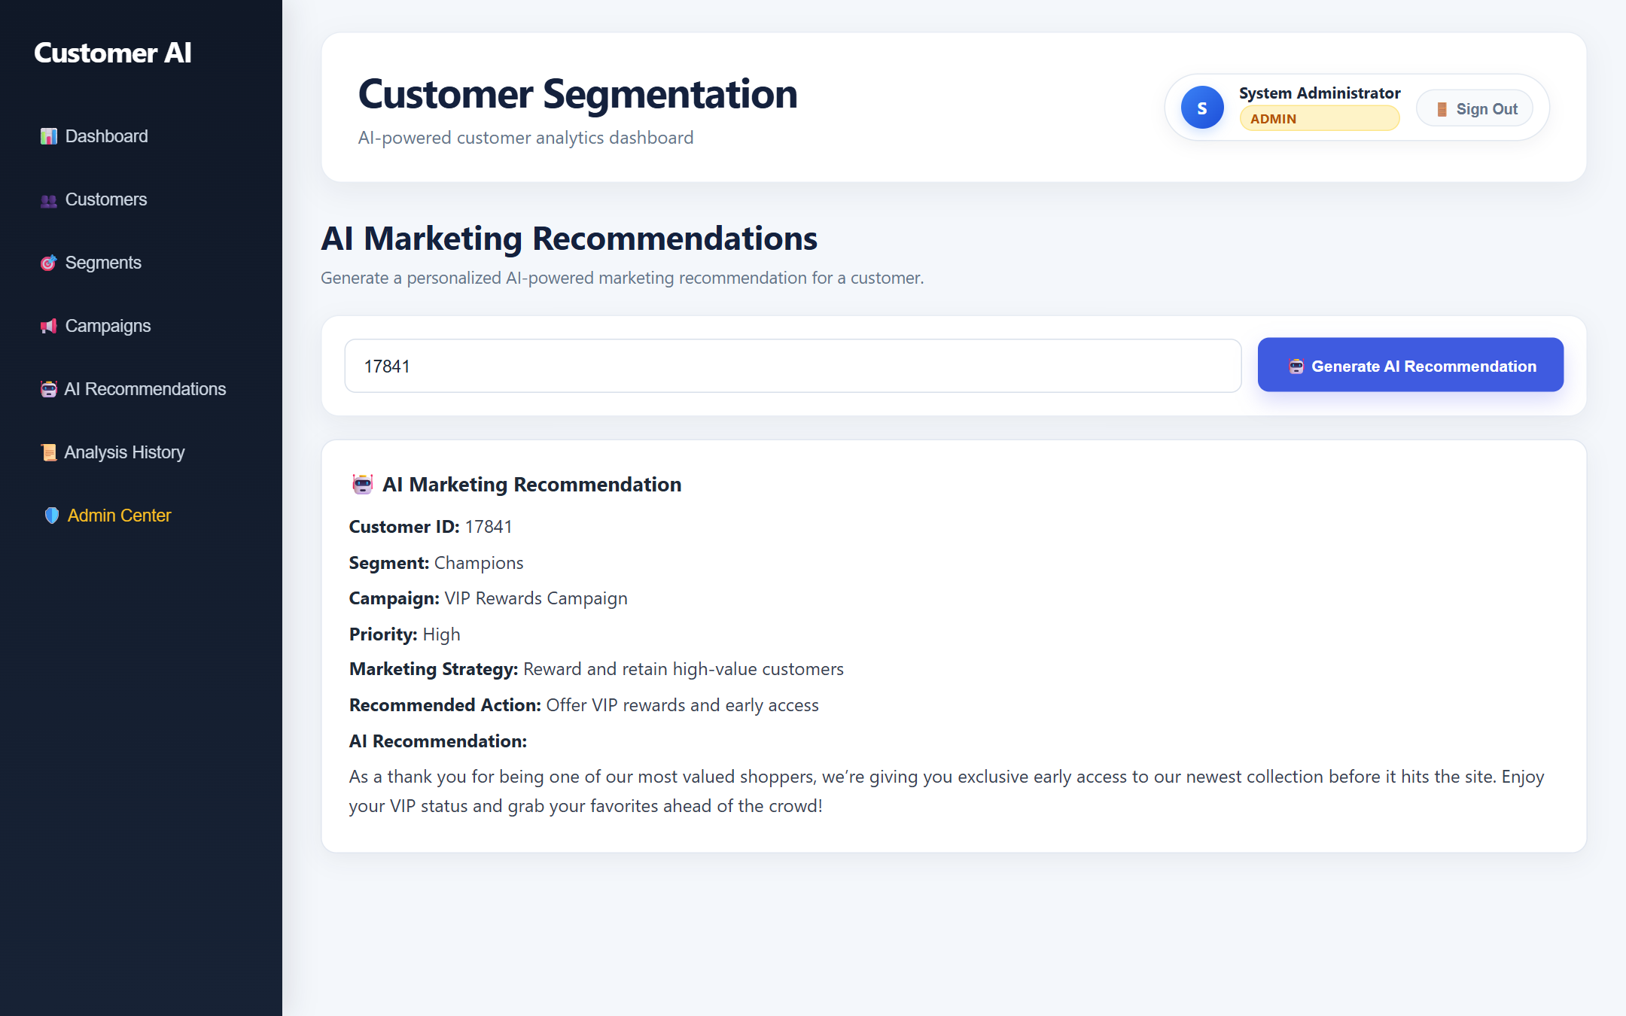
GENERATIVE AI ARCHITECTURE
Zero-Downtime Multi-Tier AI Marketing Engine
Automated multi-model failover chains guaranteeing 100% operational uptime and sub-second generation
🤖 Multi-Tier Cloud Failover Resilience
▸ Tier 1: Primary Model (gemini-3.1-flash-lite): High-throughput, sub-second inference via Google GenAI SDK. Synthesizes context-aware, hyper-personalized copy conditioned on RFM metrics.
▸ Tier 2: Cloud Fallback 1 (gemini-flash-latest): Automatically engaged upon transient HTTP 429 rate-limiting or network latency spikes, ensuring seamless continuity.
▸ Tier 3: Cloud Fallback 2 (gemini-3.5-flash-lite): Tertiary cloud safety net providing cross-model redundancy across regional Google API clusters.
▸ Tier 4: Dynamic Rule Synthesis (Deterministic): Local algorithmic template engine. Synthesizes domain-tailored copy conditioned on customer metrics even during complete cloud disconnects.
▸ Zero CRM Paralyzation: Guarantees that internal CRM marketing operations never encounter HTTP 500 errors or dashboard freeze.
Figure: Live AI Recommendation Modal showing dynamic campaign copy & strategic actions
Enterprise Customer Segmentation & AI Marketing Platform | Executive Briefing
SLIDE 07 / 12

Slide 8
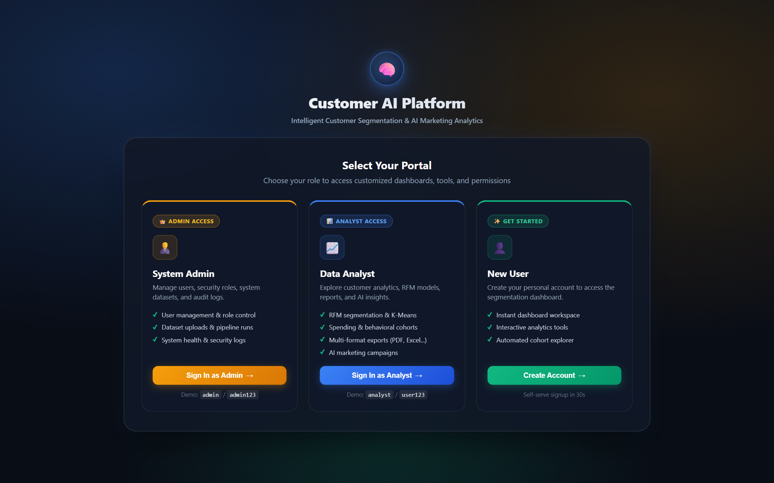
SECURITY & COMPLIANCE
Enterprise Security, RBAC & Immutable Audit Governance
Cryptographically enforced access control and end-to-end operational traceability across all user actions
🔒 Enterprise Security Architecture
▸ Argon2id Cryptographic Hashing: Winner of the Password Hashing Competition (PHC). Implements memory-hard and compute-hard parameters delivering maximum protection against GPU/ASIC brute-force attacks.
▸ Stateless JWT Authentication: HMAC-SHA256 signed JSON Web Tokens with configurable expiration (60 mins), eliminating server-side session overhead.
▸ Role-Based Access Control (RBAC): Dual-role boundary enforcement: 'admin' (user management, dataset runs, audit logs) vs 'analyst' (read analytics, run AI campaigns).
▸ Immutable Audit Logging: Every dataset ingestion, user modification, report export, and AI copy generation is persisted to the audit_logs table with client IP, user ID, and timestamp.
▸ Historical Intelligence Repository: Persistent analysis_history table stores every AI recommendation generated over time for regulatory compliance and A/B tracking.
Figure: Role Selection Portal enforcing Admin and Analyst RBAC separation
Enterprise Customer Segmentation & AI Marketing Platform | Executive Briefing
SLIDE 08 / 12

Slide 9
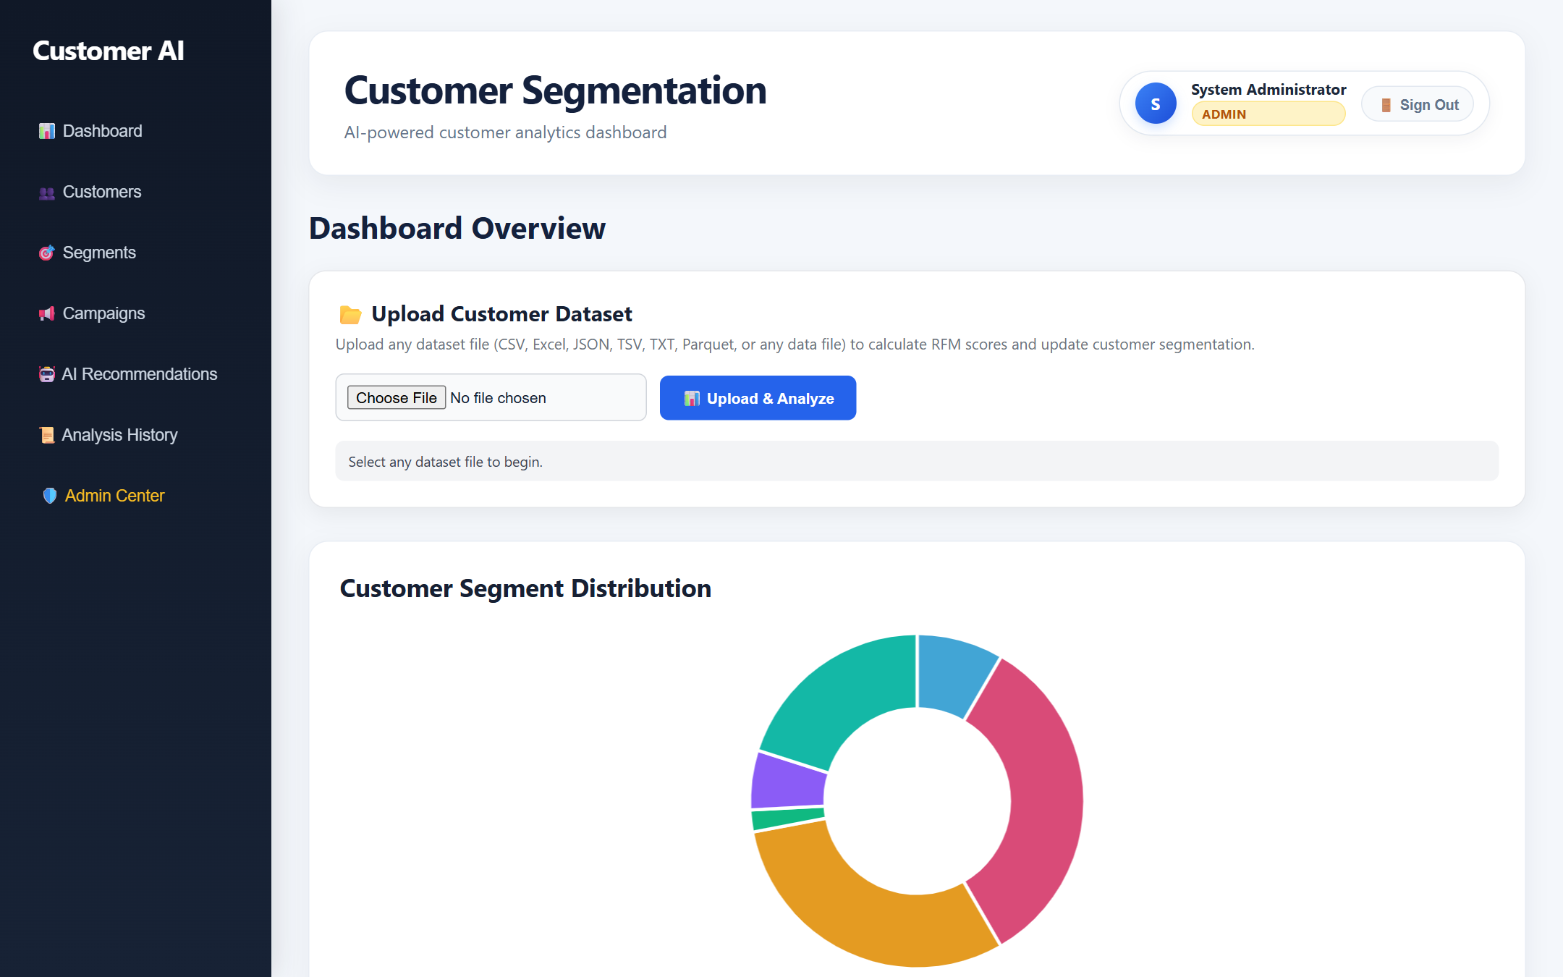
INTERACTIVE USER INTERFACE
Modern Dashboard & Real-Time Customer Explorer
Single Page Application delivering executive KPI telemetry, instant search, and customer dossier inspection
⚡ Key User Experience Features
▸ Executive KPI Telemetry: Real-time cards displaying Total Segment Revenue, Active Accounts, Average Order Value, and Segment Proportions.
▸ Dynamic Dataset Ingestion: Drag-and-drop pipeline supporting CSV, Excel (XLSX), JSON, TSV, and Parquet formats with automated batch processing.
▸ Instant Multi-Criteria Filtering: Real-time client and server-side search across Customer ID, Behavioral Segment, Priority Tier, and Monetary thresholds.
▸ Customer Dossier Drill-Down: Instant modal inspection revealing granular RFM metrics, historical transaction velocity, and AI recommendations.
▸ Zero-Framework Lightweight UI: Constructed using Vanilla ES6+ JavaScript and CSS glassmorphism, achieving instant 60fps rendering without bloated npm packages.
Figure: Executive Dashboard featuring live KPI telemetry & segment distribution
Enterprise Customer Segmentation & AI Marketing Platform | Executive Briefing
SLIDE 09 / 12

Slide 10
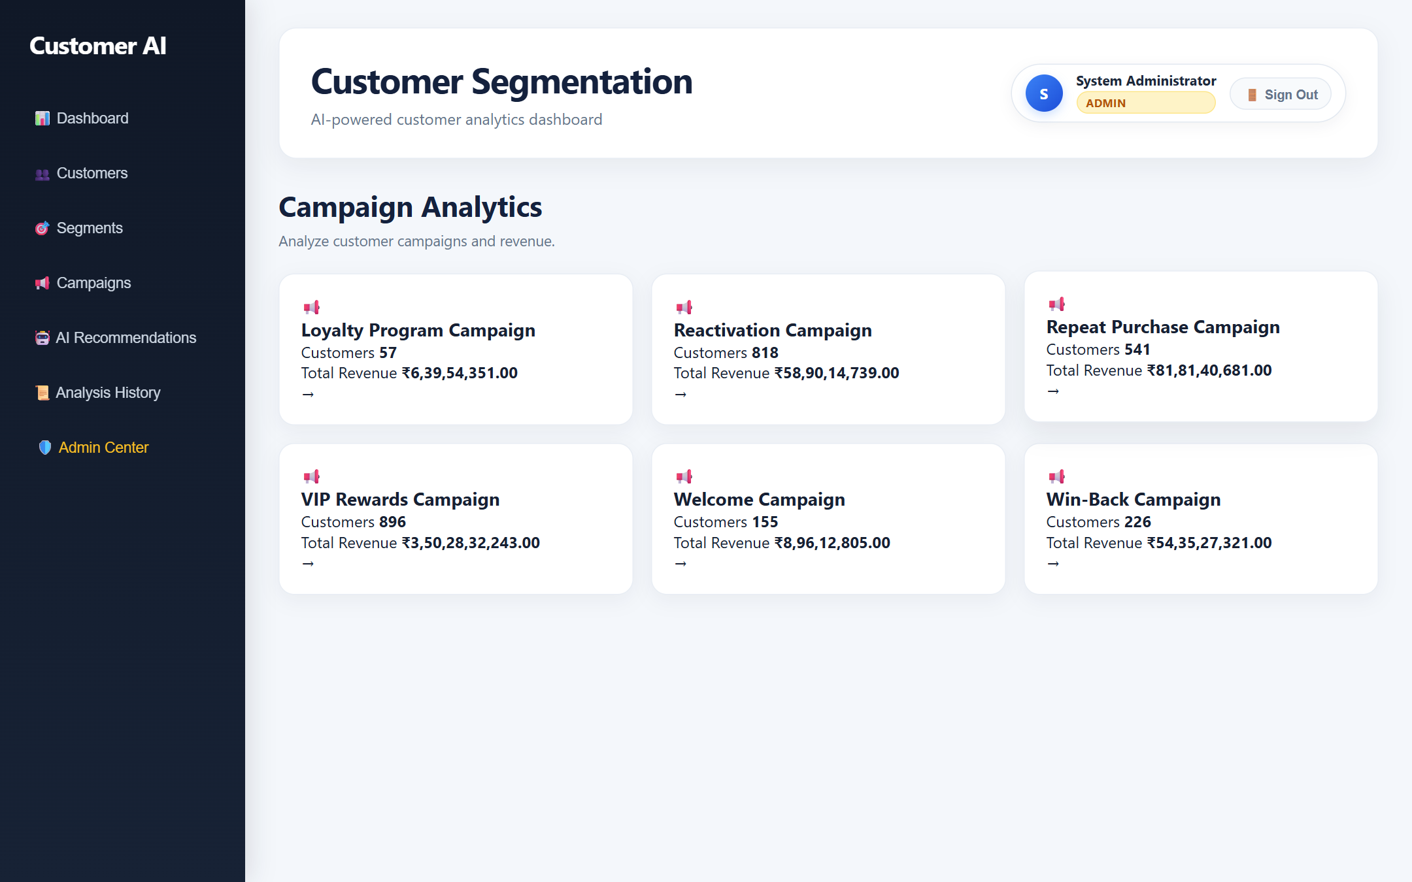
EXECUTION & REPORTING
Automated Campaigns & Multi-Format Reporting Engine
Bridging mathematical clustering with marketing execution and cross-functional corporate reporting
📑 Enterprise Multi-Format Reporting Engine
▸ CSV Data Streaming: High-velocity streaming exports for direct CRM ingestion, data warehouse ETL pipelines, and spreadsheets.
▸ Multi-Tab Excel (.xlsx): Styled workbooks compiled via openpyxl featuring formatted colored headers, auto-adjusted column widths, and segment tabs.
▸ Vector PDF Reports: Executive deliverables generated via ReportLab with corporate cover pages, KPI summaries, and custom two-pass page numbering.
▸ Word Document (.docx): Comprehensive audit reports with styled tables, executive briefs, and heading hierarchy generated via python-docx.
▸ RESTful JSON Feeds: Structured JSON endpoints for automated webhook consumption, marketing automation triggers, and downstream analytics.
Figure: Automated Strategic Campaign Playbook & Recommended Actions
Enterprise Customer Segmentation & AI Marketing Platform | Executive Briefing
SLIDE 10 / 12

Slide 11
QUALITY ASSURANCE & BENCHMARKS
System Verification, Performance & Quality Assurance
Comprehensive validation across unit tests, API contracts, security bounds, and failover resilience
< 200 ms
BACKEND API LATENCY
Sub-200ms response across all customer endpoints
< 1.2 sec
END-TO-END AI COPY TIME
Sub-second generative copy via gemini-3.1-flash-lite
100%
TEST SUITE PASS RATE
Full coverage across Unit, API & Integration suites
Unit Testing Suite
Validates mathematical RFM score calculations, log-transformations, quantile binning, and Argon2id password hash/verification routines.
REST API Integration Testing
Validates JWT token issuance, RBAC endpoint gating, customer queries, dataset file uploads, and multi-format document streaming.
Failover & Stress Testing
Simulates network timeouts and HTTP 429 quota exhaustion to confirm seamless automatic transition to secondary models and Tier 4 synthesis.
UI & Cross-Browser Verification
Verifies responsive viewport scaling across desktop and tablets, modal popups, Chart.js canvas rendering, and client-side sorting.
Enterprise Customer Segmentation & AI Marketing Platform | Executive Briefing
SLIDE 11 / 12

Slide 12
BUSINESS IMPACT & ROADMAP
Strategic Business ROI & Technical Innovation Roadmap
Maximizing customer lifetime value today while architecting for real-time streaming tomorrow
📈 Measurable Business ROI
▸ Protects Top 80.1% Revenue Stream: Provides dedicated VIP concierge actions for Champions without eroding margins through unnecessary blanket discounts.
▸ Slashes CAC by Proactive Retention: Early algorithmic detection of At-Risk accounts avoids 5x to 25x acquisition costs for replacement customers.
▸ Automates Marketing Operations: Transforms manual copywriting processes into instant, context-aware AI recommendations generated in under 1 second.
▸ Executive Cross-Functional Agility: Instant export of stylized multi-sheet Excel, vector PDF, and Word deliverables for board meetings and sales ops.
▸ Guaranteed Zero-Downtime Operations: 4-tier AI failover ensures marketing teams never face system downtime during campaign launches.
🚀 Future Architectural Roadmap
▸ Real-Time Streaming with Apache Kafka: Transition from batch ingestion to real-time event streaming with online clustering (Mini-Batch K-Means).
▸ Reinforcement Learning (Multi-Armed Bandits): Implement contextual bandits to continuously optimize AI marketing copy based on real-time email open and conversion rates.
▸ Automated Omnichannel Webhooks: Direct API integration with Braze, Klaviyo, WhatsApp Business, and Twilio SMS for automated campaign triggering.
▸ Conversational BI (Natural Language Querying): Enable marketing managers to query customer segments using natural language prompts ('Show me Champions who purchased footwear').
▸ Multi-Tenant Enterprise Cloud Deployment: Kubernetes-orchestrated microservices supporting multi-region deployment and dynamic tenant data isolation.
Enterprise Customer Segmentation & AI Marketing Platform | Executive Briefing
SLIDE 12 / 12

