Slide 1

BONAM VENKATA CHALAMAYYA INSTITUTE OF TECHNOLOGY AND SCIENCE
ENGINEERS’S DAY EVENT

Slide 2
Members Of The Project
B N S S V MAHESH
REGNO: 21H41A0506
M Saideep
REGNO:21H41A0536
M H N S S NANDAN
REGNO: 21H41A0539

Slide 3
Heart Attack Analysis & Prediction Using Machine Learning

Slide 4
Introduction
Content:
Heart disease is a leading cause of death globally.
Early prediction of heart disease can save lives.
About machine learning.
Machine learning models can help predict the risk of heart disease.

Slide 5
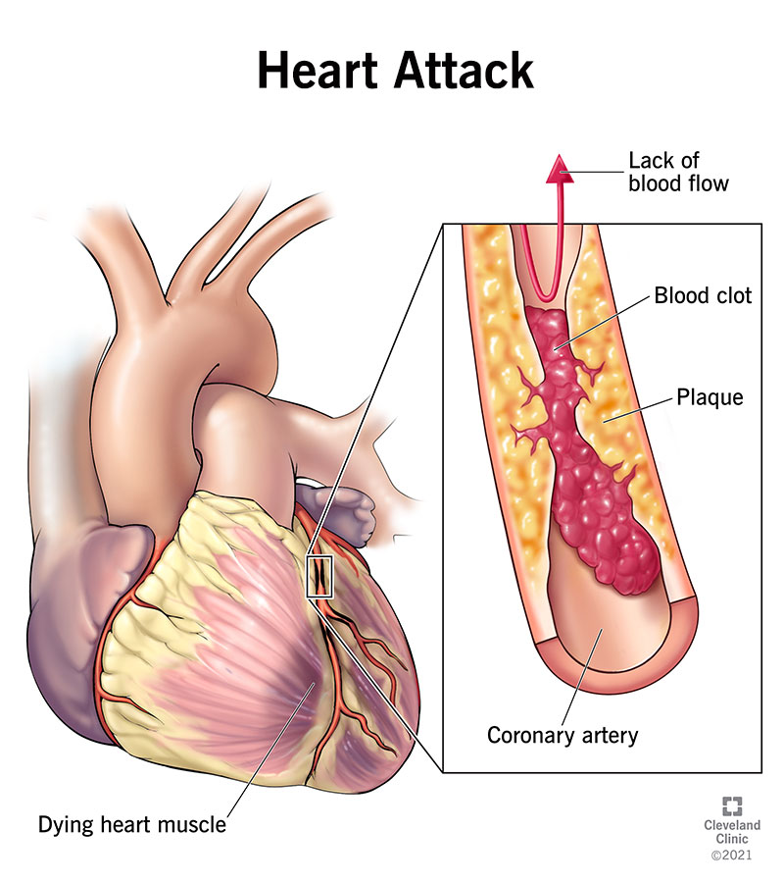

Slide 6
Heart attacks is a leading cause of death globally
Heart disease is responsible for approximately 17.9 million deaths each year, accounting for 32% of all global deaths, making it the leading cause of death worldwide.
Heart disease, particularly heart attacks, is a significant health concern in India. In 2022, India recorded 32,457 deaths due to heart attacks, marking a notable increase from previous years​
Heart disease can significantly affect a person's quality of life, limiting their ability to perform everyday activities
and reducing their overall well-being.
The cost of treating heart disease is substantial, including expenses for medical care, medications, and loss of productivity.

Slide 7
Types of Heart Disease
Coronary Artery Disease (CAD): The most common type, caused by the buildup of plaque in the heart’s arteries.
Heart Attack: Occurs when the blood flow to a part of the heart is blocked.
Heart Failure: A condition in which the heart can't pump enough blood to meet the body’s needs.
Arrhythmia: Abnormal heart rhythms that can lead to various complications.

Slide 8
Risk Factors
Lifestyle Factors:
Poor diet
lack of exercise
Smoking
excessive alcohol consumption.
Medical Conditions:
High blood pressure
high cholesterol
Diabetes
obesity.
Genetics:
Family history of heart disease increases the risk.

Slide 9
PreventionS
Healthy Diet: Eating a diet rich in fruits, vegetables, whole grains, and lean proteins.
Regular Exercise: Engaging in at least 150 minutes of moderate-intensity aerobic activity each week.
Avoiding Tobacco: Quitting smoking and avoiding secondhand smoke.
Monitoring Health: Regular check-ups to monitor blood pressure, cholesterol levels, and diabetes.

Slide 10
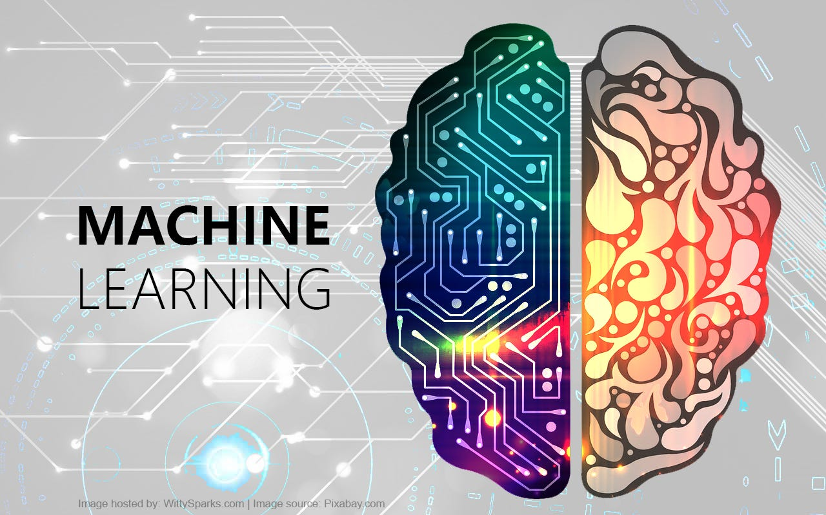

Slide 11
Machine learning
Machine learning is a study in which we train the machine by using large datasets and making predictions or decisions based on large datasets.
(OR)
Machine learning is a subset of artificial intelligence (AI) that focuses on developing algorithms and statistical models that enable computers to perform specific tasks without using explicit instructions.

Slide 12
TYPES OF MACHINE LEARNING
Supervised learning: Involves training a model on a labeled dataset, meaning that each training example is paired with an output label. Common algorithms include linear regression, logistic regression, and support vector machines.
Unsupervised learning: Deals with data that does not have labeled responses. The model tries to learn the patterns and the structure from the data. Examples include clustering algorithms like k-means and hierarchical clustering, as well as association rule learning.
Reinforcement learning: Involves training models to make a sequence of decisions by rewarding desired behaviors and/or punishing undesired ones. It's commonly used in game playing, robotics, and other applications where decisions need to be made in a sequential manner.

Slide 13
Key Algorithms
Linear regression: Used for predicting a continuous dependent variable based on one or more independent variables.(It is nothing but a relationship between dependent variable and one or more independent variabale)
Decision trees: A non-parametric supervised learning method used for classification and regression. The model predicts the value of a target variable by learning simple decision rules inferred from the data features.
Neural networks: Inspired by the human brain, these are a set of algorithms designed to recognize patterns. They interpret sensory data through a kind of machine perception, labeling, and clustering of raw input.

Slide 14
MACHINE LEARNING MODELS CAN HELP PREDICT THE RISK OF HEART DISEASE
Why machine learning?
Data Analysis and Pattern Recognition
Predictive Algorithms
Personalized Risk Assessment
Improving Clinical Decision-Making
Case Studies and Real-World Applications

Slide 15
Dataset Overview
The dataset contains 303 entries with 14 columns.
Features include age, sex, chest pain type (cp), resting blood pressure (trtbps), serum cholesterol (chol),
fasting blood sugar (fbs), resting electrocardiographic results (restecg), maximum heart rate achieved (thalachh), exercise induced angina (exng), ST depression induced by exercise relative to rest (oldpeak),
slope of the peak exercise ST segment (slp), number of major vessels colored by fluoroscopy (caa),
and thalassemia (thall).
Target variable: output (0 = less chance of heart disease, 1 = more chance of heart disease).

Slide 16
Data Preprocessing
The process of generating raw data for machine learning models. This is the first step in creating a machine learning model. This is the most-complex and time-consuming aspect.
Split the data into features (X) and target variable (y).
Split the data into training (80%) and testing (20%) sets.
Standardize the features using Standard Scaler.

Slide 17
IMPORTING CSV FILE INTO OUR CODE
import pandas as pd
# load the data from the uploaded
filedata = pd.read_csv("heart.csv")
# display the first few rows of the dataset
data.head()
data.info()

Slide 18
Data Splitting and Standardization
from sklearn.model_selection import train_test_split
from sklearn.preprocessing import standardscaler
variable x = data.drop('output', axis=1)
y = data['output’]
x_train, x_test, y_train, y_test = train_test_split(x, y, test_size=0.2, random_state=42)
scaler = standardscaler()
x_train_scaled = scaler.fit_transform(x_train)
x_test_scaled = scaler.transform(x_test)

Slide 19
Model Training and Evaluation
Train a Random Forest Classifier on the training data.
Evaluate the model on the testing data.
Achieved accuracy: 83.6%.
ENSEMBLE LEARNING
A machine learning technique that combines several individual models to produce more accurate predictions than a single model alone.
RANDOM FOREST
Combines the output of multiple decision trees to reach a single result.

Slide 20
Model Training and Evaluation
from sklearn.ensemble import randomforestclassifier
from sklearn.metrics import classification_report, accuracy_score
model = randomforestclassifier(random_state=42)
model.fit(x_train_scaled, y_train)
y_pred = model.predict(x_test_scaled)
accuracy = accuracy_score(y_test, y_pred)
report = classification_report(y_test, y_pred)

Slide 21
def get_user_input_and_predict():
print("enter the values for the following features:")
age = int(input("age: "))
sex = int(input("sex (1 = male, 0 = female): "))
cp = int(input("chest pain type (0-3): "))
trtbps = int(input("resting blood pressure (in mm hg): "))
chol = int(input("serum cholesterol (in mg/dl): "))
fbs = int(input("fasting blood sugar (> 120 mg/dl, 1 = true; 0 = false): "))
restecg = int(input("resting electrocardiographic results (0-2): "))
thalachh = int(input("maximum heart rate achieved: "))
exng = int(input("exercise induced angina (1 = yes; 0 = no): "))
oldpeak = float(input("st depression induced by exercise relative to rest: "))
slp = int(input("slope of the peak exercise st segment (0-2): "))
caa = int(input("number of major vessels colored by fluoroscopy (0-3): "))

Slide 22
thall = int(input("thalassemia (0 = normal; 1 = fixed defect; 2 = reversible defect): "))
# create a dataframe from the user input
user_data = pd.dataframe([[age, sex, cp, trtbps, chol, fbs, restecg, thalachh, exng, oldpeak, slp, caa, thall]],columns=['age', 'sex', 'cp', 'trtbps', 'chol', 'fbs', 'restecg', 'thalachh', 'exng', 'oldpeak', 'slp', 'caa', 'thall'])
user_data_scaled = scaler.transform(user_data)
# make prediction
prediction = model.predict(user_data_scaled)
prediction_proba = model.predict_proba(user_data_scaled)
print(f"\nprediction: {'more chance of heart disease' if prediction[0] == 1 else 'less chance of heart disease'}")
print(f"probability: {prediction_proba[0][prediction[0]] * 100:.2f}%")
get_user_input_and_predict()

Slide 23
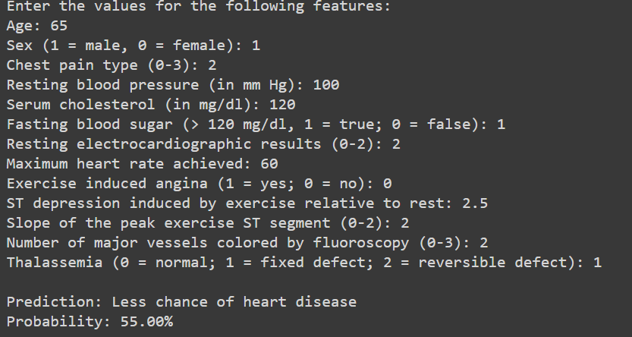
OUTPUT

Slide 24
THANK YOU

