Slide 1
Language Translator in python using Google translate API
Team:
21H41A0536 - Medicharla Saideep
21H41A0515 - Ganireddi Mahesh
216m1A0501 - Akula leela kumar

Slide 2
Introduction
Overview:
language translator project offers a convenient and efficient solution for
users who need to translate text between English and different
languages.
Importance:
these tools are essential for global business, travel, and access to
information in different languages.

Slide 3
Problem Statement
The Need for Language Translation
Many individuals and businesses face challenges in effectively communicating across language barriers
language translator project aims to facilitate effective communication and bridge language barriers for individuals and organizations worldwide.

Slide 4
Objective
To create a user-friendly and efficient language translation tool that can be easily used by individuals and businesses.
To address the limitations of existing translation tools by offering additional features and functionalities.
To facilitate effective communication and bridge language barriers for individuals and organizations worldwide.
To provide accurate and reliable translations between a wide range of languages.

Slide 5
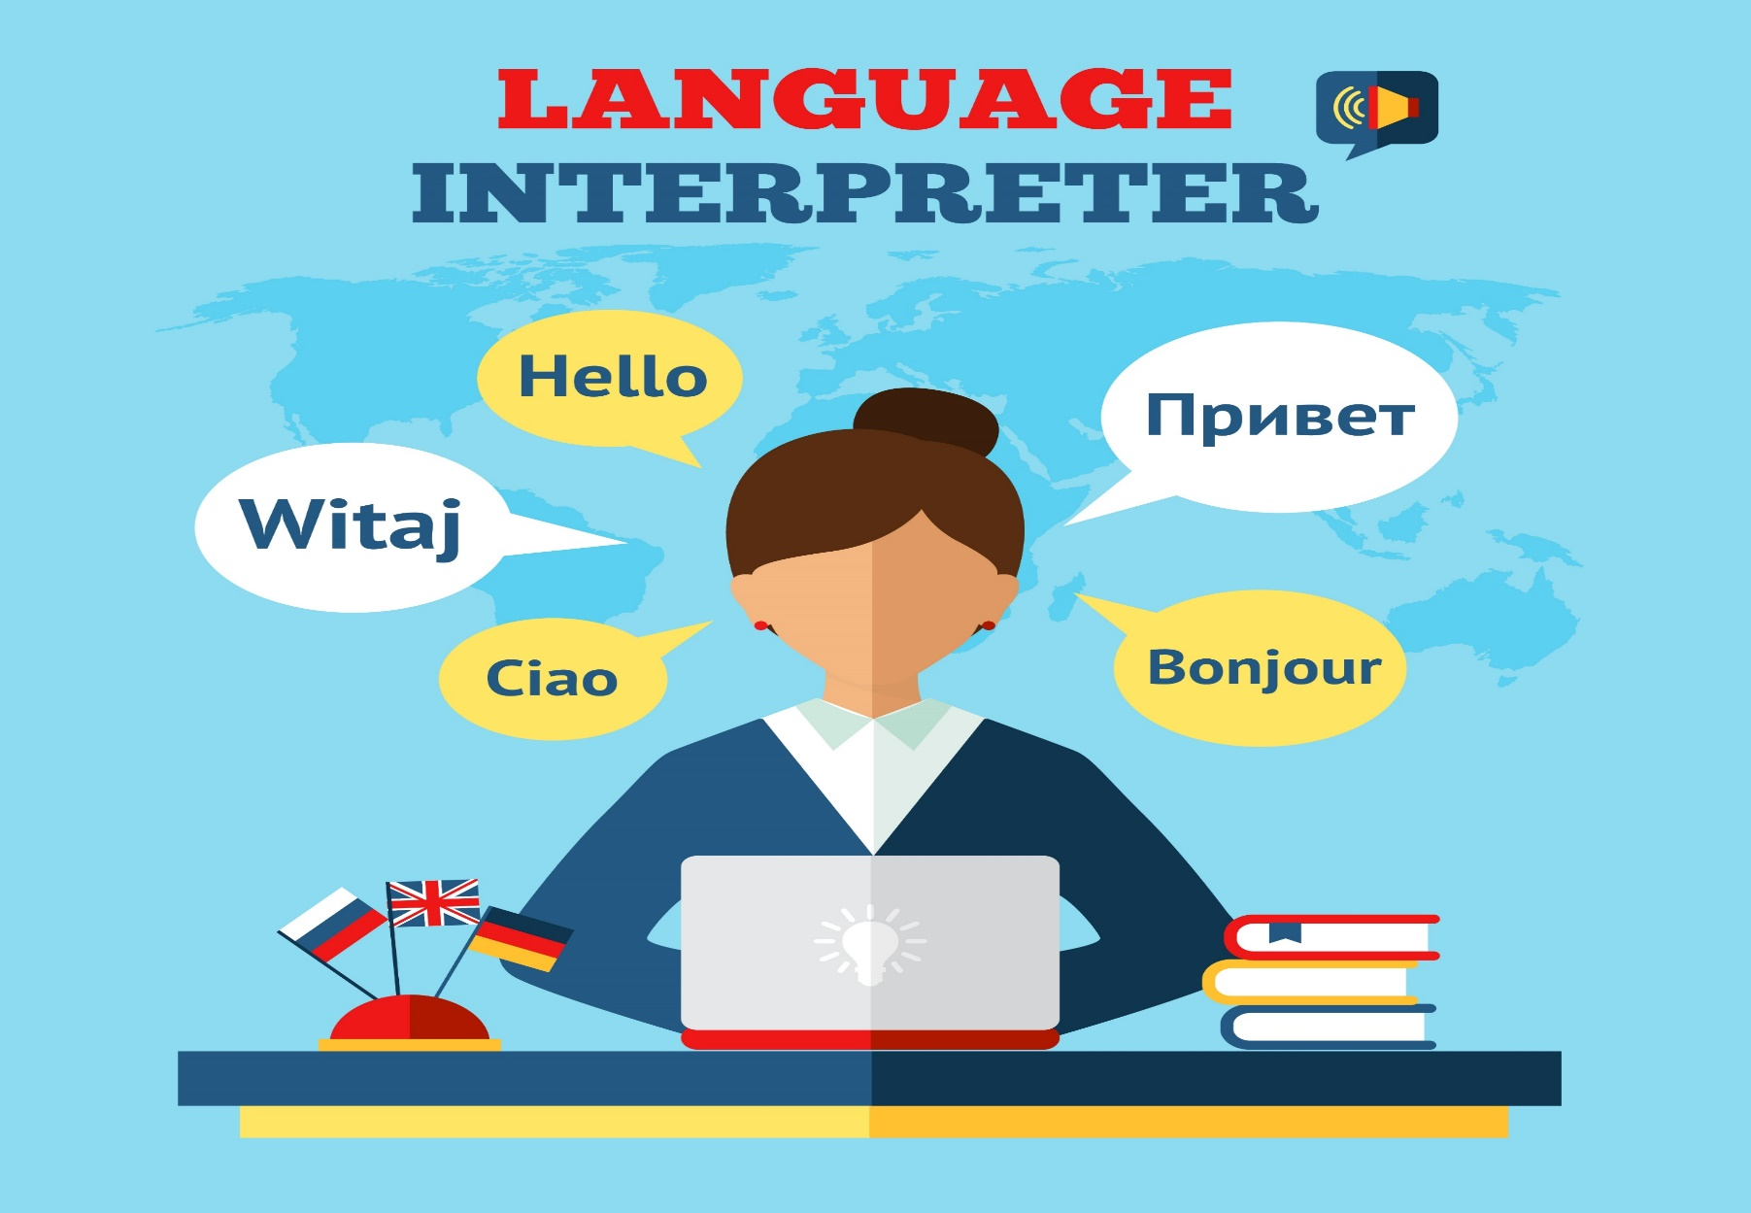
understanding

Slide 6
Tools and Technologies
Translation Library:
Googletrans: The project utilizes the googletrans library, which provides an easy-to-use interface for interacting with the Google Translate API
Programming Language:
Python: The project is written in Python which is a popular and
having extensible libraries
GUI Library:
Tkinter: Tkinter is a Python library built-in to most Python
installations.
Translation Library:
Googletrans: The project utilizes the googletrans library,
which provides an easy-to-use interface for initeracting with
the Google Translate API

Slide 7

Methodology
Steps Involved in the Project
Import necessary libraries
Set up the translator
Process input and output
Display available languages
Translate text based on user input

Slide 8
Flow chart
User enters text and select language
Click on translate button
Translator class called translation function
start
Input box is empty
translated text displayed in output Box
translate() perform translation
Clear the output box
Shows an error
End

Slide 9
Demonstration
Translation functionality:
Example: Translating "Hello" from English to Spanish.
Original text : Hello
Translated text : Hola

Slide 10
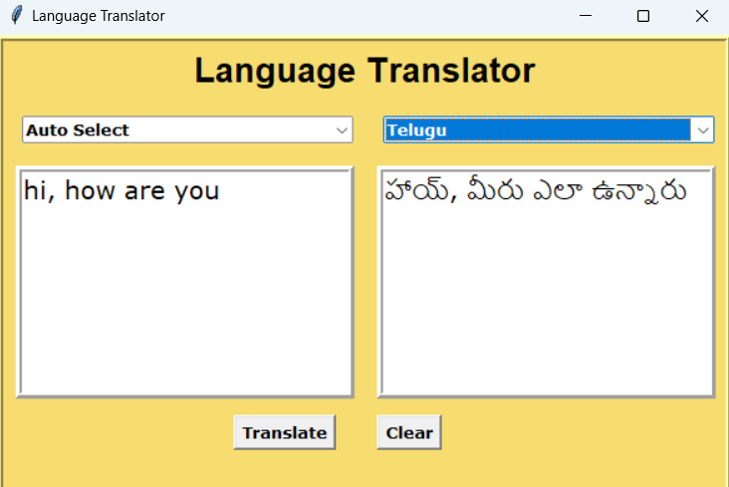
Sample Output

Slide 11
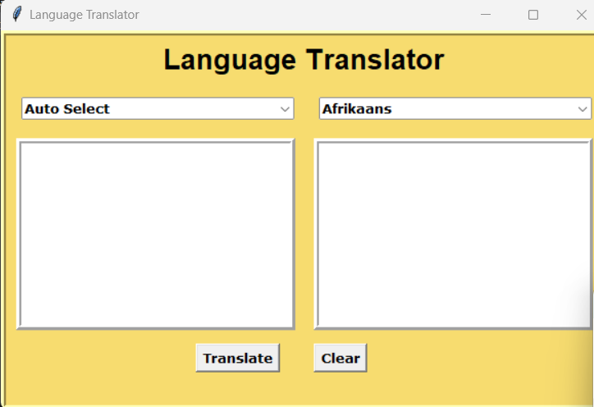
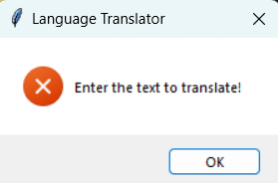
Error message

Slide 12
Advantages of Language Translator
Breaks Language Barriers:
Makes communication possible between people who speak different
languages
Cost-Effective:
Reduces the need for expensive human translators.
Real-Time Translation:
Provides instant translations during conversations and meetings.
Scalable:
Easily adds more languages and dialects as needed.
Veratile:Can be integrated into other applications.

Slide 13
Conclusion
This project demonstrates the use of python in developing a language translator.
Effective language translation is vital for global communication and understanding.
The translator achieves accurate and efficient translations, meeting the project's objectives.

Slide 14
Thank You!!!

