Slide 1

AGRIBOT: AN INTELLIGENT AUTONOMOUS SYSTEM FOR SMART AGRICULTURE
By
2111CS050110 R.SAI DEEPAK GOUD
2111CS050096 S.SRINATH
2111CS050076 V.GANGAMANIKANTA REDDY
Under the Guidance of
Mrs. D Arpitha Rani
(Assistant Professor)
Department of Internet of Things
School of Engineering
Malla Reddy University
Hyderabad, Telangana, INDIA

Slide 2
ABSTRACT
In the evolving landscape of Smart Agriculture, robotics has emerged as a key enabler for addressing critical challenges such as labour shortages, climatic uncertainties, and the need for increased agricultural productivity. The transition from manual labour to automation is driven by the demand for time-efficient, energy-saving, and scalable solutions to meet the needs of modern farming. Robotic systems not only enhance efficiency but also minimize repetitive labour-intensive tasks, ensuring consistent and precise agricultural operations. These advancements contribute significantly to improving crop yield, aligning with the goals of sustainable farming and food security.
A fundamental aspect of successful crop production is the automation of essential farming processes, which directly impacts yield, efficiency, and sustainability. Precision in seed placement, irrigation, pesticide spraying, ploughing, digging is crucial for optimizing plant growth, conserving resources, and improving productivity. In this project, a multi-purpose agricultural robot has been developed to automate these tasks, reducing human labour while enhancing farming precision.
This robotic system is powered by an Arduino microcontroller and operates via Bluetooth, RF, or IoT-based communication, ensuring wireless and remote-control capabilities. The integration of sensors (soil moisture, temperature, humidity, and pH) enables the system to adapt to varying climatic conditions and soil types, making it suitable for diverse agricultural environments. The robot efficiently performs seed sowing, smart irrigation, pesticide spraying, ploughing, ensuring uniformity, precision, and optimal field coverage.

Slide 3
1. Introduction
1.1 Problem Definition & Description
In modern agriculture, the demand for increased productivity, resource optimization, and sustainability has led to the need for automation in farming practices. Traditional manual labor in farming is not only labor-intensive but also inefficient in addressing challenges like labor shortages, varying climatic conditions, and the need for precise and scalable farming techniques. Ensuring uniformity in critical tasks such as seed sowing, irrigation, pesticide spraying, and ploughing is essential for maximizing crop yield, conserving resources, and achieving sustainability. The lack of precision, excessive use of resources, and human errors in manual farming practices often result in suboptimal agricultural output and environmental harm. Thus, there is a pressing need for an intelligent, automated, and precise farming solution that can tackle these challenges effectively.
The automation of essential farming tasks, such as seed sowing, irrigation, pesticide spraying, and ploughing, plays a crucial role in enhancing agricultural productivity. However, existing solutions are often limited by the lack of adaptability to diverse farming environments, inefficiencies in resource utilization, and the inability to integrate seamlessly with modern communication technologies. Current systems often struggle to provide real-time feedback or fail to adjust to changing climatic conditions and soil types.
The robot integrates key sensors to enable real-time monitoring and precise adjustments to its operations. The robot's key tasks—seed sowing, irrigation, pesticide spraying, and ploughing—are automated to ensure accuracy, efficiency, and uniformity in farming operations. The system's ability to adapt to varying soil conditions and environmental factors ensures optimized resource use, improved crop yield, and a reduction in human labor. This project aims to contribute to sustainable farming practices, ultimately enhancing food security and environmental conservation.

Slide 4
1.2 Objectives of the Project
The objective of this project is to develop a multi-purpose agricultural robot that automates essential farming tasks such as seed sowing, irrigation, pesticide spraying, and ploughing, aimed at improving farming efficiency and productivity. By automating these tasks, the project seeks to reduce human labor, minimize errors, and ensure consistent operations, ultimately increasing crop yield and resource efficiency. The integration of sensors for soil moisture, temperature, humidity, and pH allows the robot to adapt to diverse soil types and climatic conditions, providing a more precise approach to farming and addressing the challenges posed by varying environmental factors.
The robot is designed to operate through wireless communication technologies like Bluetooth, RF, or IoT-based systems, enabling farmers to remotely control and monitor the robot's operations. Ultimately, the project aims to contribute to the evolution of smart agriculture by providing an efficient, scalable, and cost-effective solution for modern farming. Through automation, precision, and adaptability, the robot will reduce operational costs, improve agricultural productivity, and promote sustainable farming practices. This project supports the vision of addressing global food security challenges while minimizing environmental impact, making it a valuable tool for farmers in diverse agricultural environments.

Slide 5
1.3 Aim of the Project
The aim of this project is to design and develop an automated multi-purpose agricultural robot that enhances farming efficiency, precision, and sustainability by performing essential tasks such as seed sowing, smart irrigation, pesticide spraying, and ploughing. The robot aims to reduce human labor, optimize resource usage, and ensure uniformity in agricultural operations, ultimately improving crop yield and contributing to sustainable farming practices. By integrating advanced sensors and wireless communication technologies, the project seeks to provide a versatile, adaptable, and cost-effective solution to address the challenges faced by modern agriculture.

Slide 6
2. Methodology
The methodology of the project follows a structured approach to design, develop, and implement a multi-purpose agricultural robot for automating key farming tasks. The methodology can be broken down into the following phases:
1. System Design and Component Selection:
In this phase, the appropriate components, including sensors, actuators, motors, and communication modules, are selected based on their suitability for agricultural environments. A system architecture is designed to integrate these components into a cohesive robotic system.
2. Robot Development and Integration:
The physical structure of the robot is constructed, and components like sensors and actuators are integrated with the Arduino microcontroller for task automation. This phase ensures that all hardware works together to perform essential farming tasks like seed sowing and irrigation.
3. Software Development and Communication Setup:
Software is developed to program the robot’s operations, enabling precise control over tasks like irrigation and pesticide spraying. Communication protocols, such as Bluetooth or IoT, are implemented for remote control and real-time monitoring.

Slide 7
4. Testing and Calibration:
The robot undergoes rigorous testing to ensure that all tasks are executed accurately. Sensors are calibrated for correct data collection, and task performance is evaluated under different environmental conditions.
5. Field Deployment and Data Collection:
After successful testing, the robot is deployed in real farming conditions. Data from the field is collected to monitor performance, evaluate efficiency, and assess adaptability to varying soil types and environmental factors.
6. Optimization and Final Adjustments:
Based on field data and feedback, adjustments are made to the robot’s systems to improve performance. The robot is optimized for better resource efficiency, precision in task execution, and seamless operation.

Slide 8
System Design & Component Selection
Robot Development & Integration
Software Development & Communication Setup
Testing & Calibration
Field Deployment & Data Collection
Optimization & Final Adjustments] flow chart diagram

Slide 9
Requirements
3.1 Hardware Requirements
ARDUINO (MICRO CONTROLLER)
WHEELS (X4)
CHASSIS (USING MDF BOARD)
L CLAMP (FOR MOTOR AND WHEEL SUPPORT)
12V DC MOTOR (X 2)
L293D MOTOR DRIVER MODULE
WATER MOTOR PUMP
WATER CONTAINER
SEED DISPENSOR UNIT
SERVO MOTOR (X3)
JUMPER WIRES
BLUETOOTH MODULE HC-05
BATTERY/POWER SUPPLY
IC 7805
1K Ohm RESISTANCE
CAPACITORS 1000UF, 100UF
DIODE 1N4007N
BERG STICKs (plough)
SWITCHES

Slide 10
Requirements
Real-time URL Scanning: To provide immediate analysis of submitted URLs to identify potential threats.
3.2 Software Requirements
ARDUINO IDE
EMBEDDED C : Language used in Arduino IDE
ANDROID APP[Optional]

Slide 11
4. System Analysis
4.1 Literature Survey
There are many articles and books that say about multi purpose agriculture robots. Here are some articles we referred were and the books that gives information about these smart agricul :
1Researchers at Carnegie Mellon University developed an autonomous harvesting machine known as Demeter system (Pilarski et al., 2002). The robotic machine harvested more than 40 hectares of crop without human intervention.
2. Researchers at the Technical University of Denmark (Madsen and Jakobsen, 2001) developed an autonomous robot prototype specifically for weed mapping.
3This robot was developed to mitigate the adverse effects of weed species like water hemp that are developing glyphosate resistance (Grift et al., 2006).

Slide 12
4. System Analysis
4.2 Existing System
1. Autonomous Tractors
Autonomous tractors, such as those developed by companies like John Deere, automate the process of ploughing, planting, and sometimes even spraying pesticides. These systems often rely on GPS and sensor-based technology to navigate fields and execute tasks with precision.
2.Precision Irrigation Systems
These systems focus on automating irrigation based on real-time environmental data, including soil moisture levels, weather forecasts, and plant needs. Examples include solutions from companies like Netafim and CropX.
3.Robotic Harvesters
Harvesting robots, like those developed by Octinion's Rubion, focus on automating the picking and gathering of crops like fruits. These robots use machine learning and computer vision to detect ripe produce and gently harvest it without damaging the crop.
4.Drones for Monitoring and Spraying
Drones have been widely used in agriculture for monitoring crop health, aerial imaging, and even spraying pesticides or fertilizers. Companies like DJI and Parrot offer drones equipped with advanced imaging sensors and sprayers.

Slide 13
Limitations of existing system
While these tractors are highly effective for large-scale farming, they are limited in scope, typically focusing on just one or two tasks. Additionally, they can be costly and are more suited to large farms, making them less accessible for smaller-scale operations.
While these systems are efficient in water conservation and improving crop yield, they often lack integration with other farming processes, such as planting or pesticide spraying, making them less versatile than the multi-functional robot described in your project.
Harvesting robots are often designed for specific crops and are not easily adaptable to other stages of the farming process, such as planting, irrigation, or pest control.
Drones are highly specialized in aerial monitoring and spraying but cannot perform ground-based tasks like ploughing, sowing, or irrigation. Additionally, they require skilled operators and are usually limited to small-scale or precision farming applications.

Slide 14
4.3 Proposed System
The proposed system is a multi-purpose agricultural robot designed to automate essential farming tasks, improving efficiency, precision, and sustainability. It integrates multiple functions—seed sowing, smart irrigation, pesticide spraying, and ploughing—into a single robotic platform. Powered by an Arduino microcontroller, the robot operates via Bluetooth, RF, or IoT-based communication, allowing for wireless and remote control.
Key features include:
Integrated Sensors: Soil moisture, temperature, humidity, and pH sensors allow the robot to adjust its operations to different soil types and climatic conditions.
Automation of Critical Tasks: The robot efficiently handles seed sowing, irrigation, pesticide spraying, and ploughing, ensuring precision and consistency across fields.
Wireless Control: Users can control the robot remotely using Bluetooth, RF, or IoT, providing flexibility and ease of operation.
Sustainability: By automating processes and reducing the need for manual labor, the system helps conserve resources like water and energy, while also contributing to more sustainable farming practices.
This system is adaptable to a wide range of agricultural environments, addressing challenges like labor shortages, climate variability, and the need for scalable farming solutions. It offers a comprehensive, time-saving solution that improves crop yields and supports food security goals.

Slide 15
Advantages of proposed system
1. Increased Efficiency
Time-Saving: Automation of tasks like seed sowing, irrigation, pesticide spraying, and ploughing reduces the time spent on manual labor, allowing farmers to focus on other important aspects of farm management.
Precision: The robot performs tasks with high accuracy, ensuring optimal field coverage and uniformity, which can improve crop yield and reduce resource wastage.
2. Reduction in Labor Costs
Labor Shortages: The robot minimizes the need for manual labor, addressing labor shortages in agriculture, especially in regions where finding farm workers is challenging.
Cost Reduction: By automating repetitive and labor-intensive tasks, farmers can reduce the number of workers required and lower operational costs.
3. Sustainability and Resource Conservation
Efficient Use of Water: With smart irrigation features powered by sensors, the robot can ensure that crops receive the right amount of water, preventing over-irrigation and conserving water.
Reduced Chemical Usage: For pesticide spraying, the robot can apply chemicals precisely where needed, reducing waste and minimizing environmental impact.
4. Adaptability to Diverse Agricultural Environments
Sensor Integration: With sensors that monitor soil moisture, temperature, humidity, and pH, the robot can adapt to different soil types and weather conditions, making it suitable for a variety of crops and climates.

Slide 16
5. Remote and Wireless Control
Convenience: The robot can be controlled remotely through Bluetooth, RF, or IoT-based communication, allowing farmers to operate it from a distance, even in large or hard-to-reach areas.
Real-Time Monitoring: With IoT integration, farmers can monitor the robot’s performance and receive real-time updates on soil conditions, irrigation, and task completion.
6. Improved Crop Yield and Quality
Consistent Operations: By automating essential tasks, the robot ensures consistency in agricultural processes, leading to better plant growth and healthier crops.
Optimized Fertilization and Pesticide Use: The precise application of fertilizers and pesticides improves crop health while minimizing waste and potential harm to the environment.
7. Scalability and Flexibility
Applicable to Various Farm Sizes: The robot can be used on both small-scale and large-scale farms, making it adaptable to different farming needs and budgets.
Future-Proof: With its modular design, the robot can be upgraded or customized with additional features or sensors to meet future farming challenges.

Slide 17
4.4 Feasibility Study
Technical Feasibility:
The technical feasibility of the proposed multi-purpose agricultural robot is strong due to the integration of widely available and reliable technologies. The Arduino microcontroller serves as the central control unit, handling inputs from various sensors (soil moisture, temperature, humidity, pH) and controlling actuators for tasks like seed sowing, irrigation, and pesticide spraying. Arduino's flexibility and ease of programming make it an ideal choice for automating agricultural tasks, as it can easily interface with a range of sensors and modules. Additionally, the system's wireless communication, using Bluetooth, RF, or IoT-based technologies, ensures that the robot can be controlled remotely, offering convenience and flexibility for farmers operating in large fields or remote areas.
Robustness & Reliability:
The robustness and reliability of the proposed agricultural robot are essential for ensuring consistent performance in various farming conditions. The use of durable components, such as high-quality sensors and actuators, ensures the robot can withstand the harsh and often unpredictable agricultural environment. For example, soil moisture, temperature, and pH sensors are designed to function reliably in outdoor settings, providing accurate readings even under varying weather conditions. Additionally, the actuators that control seed sowing, irrigation, and pesticide spraying are built to handle repetitive tasks over extended periods, ensuring long-term reliability and minimal maintenance.

Slide 18
5. Architectural Design
5.1 Modules Design:
The module design of the multi-purpose agricultural robot is structured to ensure efficient automation of key farming tasks. At its core, the system is powered by an Arduino microcontroller, which integrates various modules such as sensors (soil moisture, temperature, humidity, and pH) for real-time data collection, a power supply for sustainable operation, and a control system that communicates via Bluetooth, RF, or IoT. The robot's mobility is facilitated by motors and wheels/tracks, ensuring movement across the field. Task-specific modules such as seed sowing, smart irrigation, pesticide spraying, and ploughing are designed to handle essential farming activities with precision, minimizing labor-intensive efforts while maximizing crop yield.
Each of these modules is optimized for specific functions—ensuring that tasks like irrigation and pesticide spraying are done based on real-time soil and environmental conditions. The navigation system, which includes GPS and ultrasonic sensors, ensures accurate movement across the field and helps in obstacle avoidance. Communication between the robot and the user is achieved via a mobile app or web interface, offering remote control and monitoring capabilities. The integration of cloud technology enables long-distance data access and analysis, allowing farmers to optimize their operations and make informed decisions based on collected sensor data. This modular design not only enhances productivity but also promotes sustainability by reducing waste and energy consumption.

Slide 19
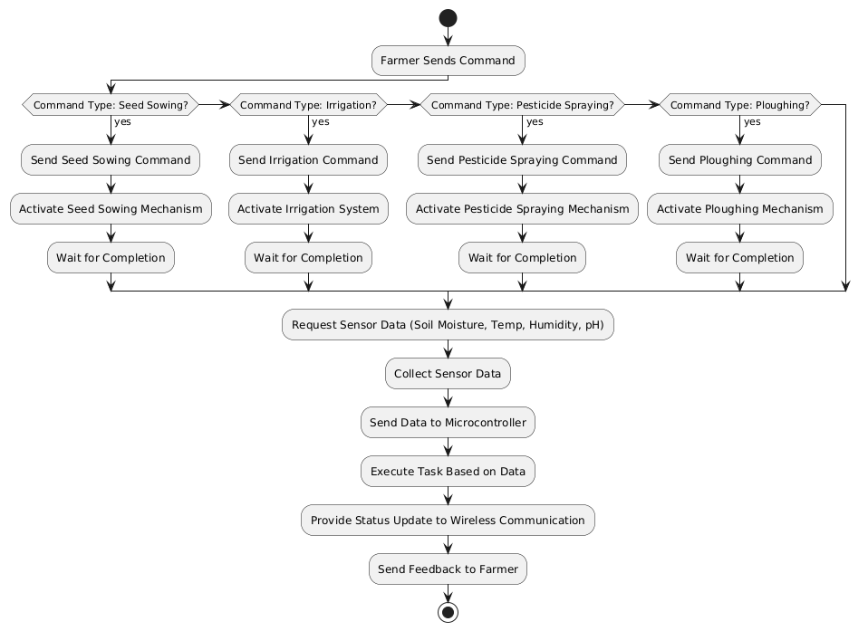
5. Architectural Design
5.2 Project Architecture
5.2.1 Activity Diagram

Slide 20
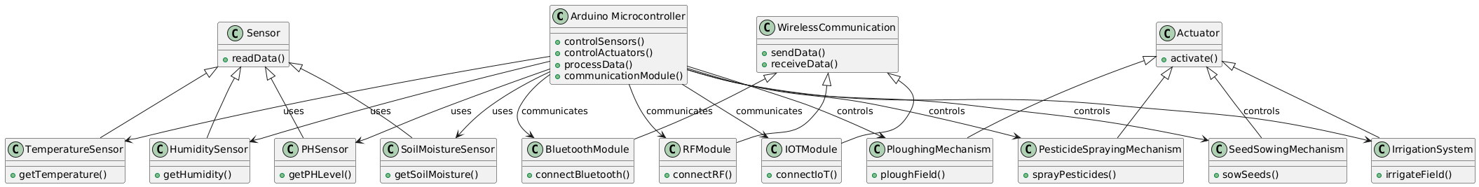
5.2.3 Class Diagram

Slide 21
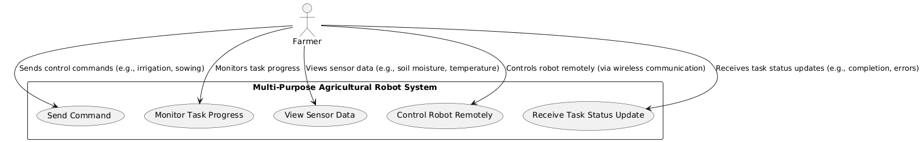
5.2.4 UseCase Diagram

Slide 22
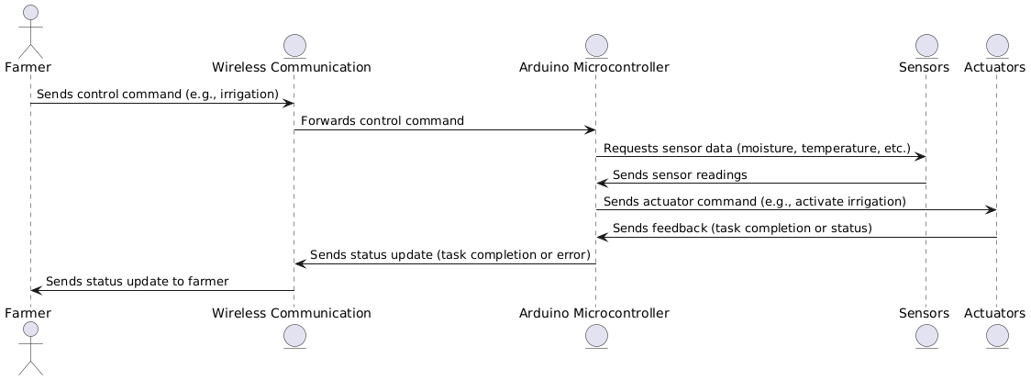
5.2.5 Sequence Diagram

Slide 23
Thank you

