Slide 1

PREDICTION OF DIABETES USING MACHINE LEARNING
CSE3506
ESSENTIALS OF DATA ANALYTICS
J-Component
KARANAM VENKATA SAI ESWAR - 20BEC1266
ACHANTA SAMPATH MIHIR- 20BEC1351

Slide 2
Abstract
Machine Learning is used across many ranges around the world. The healthcare industry is no exclusion. Machine Learning can play an essential role in predicting presence/absence of locomotors disorders, heart diseases and more. Such information, if predicted well in advance, can provide important intuitions to doctors who can then adapt their diagnosis and dealing per patient basis. We work on predicting diabetes h diseases in people using Machine Learning algorithms. In this project we perform the comparative analysis of different machine algorithms such as Logistic Regression, Adaboost, Decision tree, Gradient Boosting, XGB, SVC and Random Forest and we have taken different health parameters into consideration such as Age, Gender, Polyuria, Polydipsia, Sudden Weight loss, weakness, polyphagia and many more.

Slide 3
Objectives/Motivation
Motivation behind doing this project, Prediction of diabetes disease using machine learning algorithms is to improve the accuracy and efficiency of diagnosing and treating this chronic disease. Diabetes is a widespread and costly disease that affects millions of people worldwide. Early diagnosis and intervention are critical to managing the disease and preventing complications such as heart disease, kidney disease, and blindness.
Machine learning algorithms can be used to analyze large amounts of data, including medical records, lifestyle factors, and genetic information, to identify patterns and predict the risk of diabetes. By using these algorithms, healthcare providers can better predict the likelihood of a patient developing diabetes and take proactive steps to prevent or manage the disease.
Furthermore, machine learning algorithms can help to identify subgroups of patients with different diabetes risk profiles, allowing for personalized treatment plans that are tailored to the individual's specific needs. This approach has the potential to significantly improve the management of diabetes, reduce healthcare costs, and ultimately improve patient outcomes.

Slide 4
Literature Survey/Related Work
After conducting a literature review on healthcare datasets, researchers have employed different techniques and methods to perform analysis and predictions. Several prediction models have been developed using a combination of data mining techniques and machine learning algorithms. For example, Dr. Saravana Kumar N M, Eswari, Sampath P, and Lavanya S (2015) utilized Hadoop and MapReduce to analyze diabetic data, predicting the type of diabetes and associated risks. The system they developed is cost-effective for healthcare organizations that want to implement a Hadoop-based solution.[1] Aiswarya Iyer (2015) employed classification techniques to identify hidden patterns in a diabetes dataset. The study compared the performance of Naïve Bayes and Decision Trees algorithms and showed the effectiveness of both approaches.[2] K. Rajesh and V. Sangeetha (2012) used classification technique. They used C4.5 decision tree algorithm to find hidden patterns from the dataset for classifying efficiently.[3] B.M. Patil, R.C. Joshi and Durga Toshniwal (2010) proposed Hybrid Prediction Model which includes Simple K-means clustering algorithm, followed by application of classification algorithm to the result obtained from clustering algorithm. In order to build classifiers C4.5 decision tree algorithm is used.[4]

Slide 5
Dataset Description
1. Age: Defines patient’s age.
2. Gender: Describes whether patient is male or female.
3. Polyuria: Monitors the amount of glucose present in patient’s blood.
4. Polydipsia: Monitors patient’s thirst and dehydration level.
5. Sudden Weight Loss: Checks whether patient have lost sudden weight.
6. Weakness: Determine whether patient is physically weak or strong,
7. Polyphagia: Monitors patient’s insulin levels and hunger levels.
8. Genital thrush: Checks whether there is any fungal infection occurred.

Slide 6
9.Visual Blurring: Checks whether patient is suffering from difficulty in his/her vision.
10.Itching: Checks whether patient is suffering from any itching issues.
11.Irritability: Check whether patient is suffering from any irritation.
12.Delayed Healing: Monitors the healing time of a patient.
13. Partial paresis: Monitors patient’s bone movement.
14. Muscle stiffness: Monitors patient’s muscle movement whether it is impaired or weekend.
15. Alopecia: Monitors patient’s hair loss and checks whether it is type 1 or type 2 diabetes.
16. Obesity: Describes whether patient is obese or not.

Slide 7
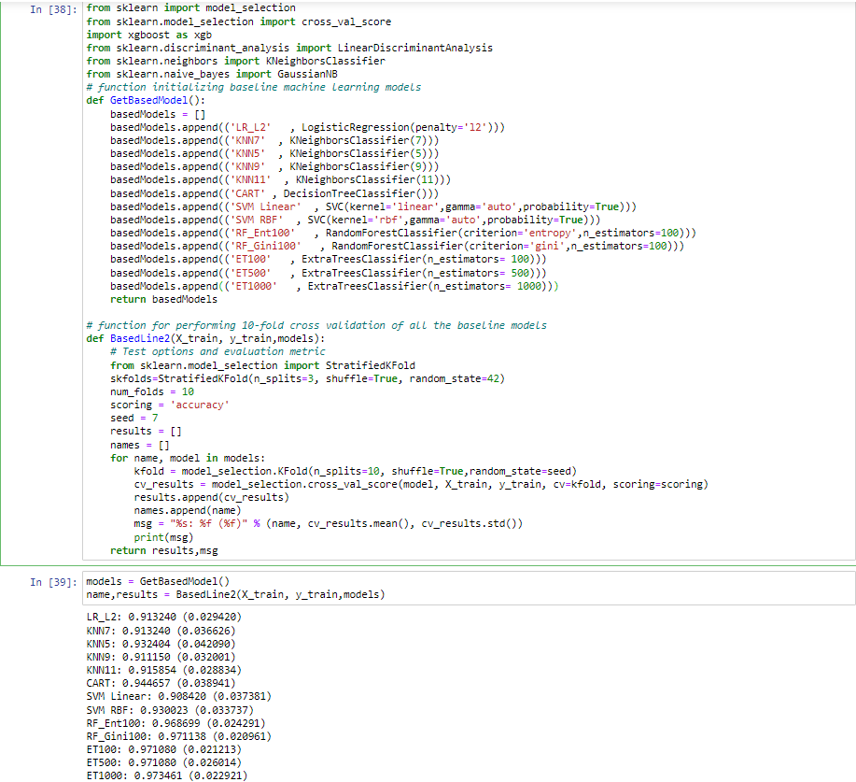
Results
Cross Validation Scores of different algorithms

Slide 8
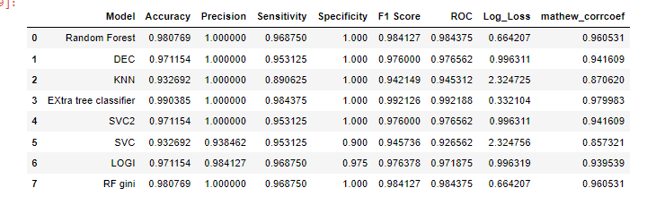
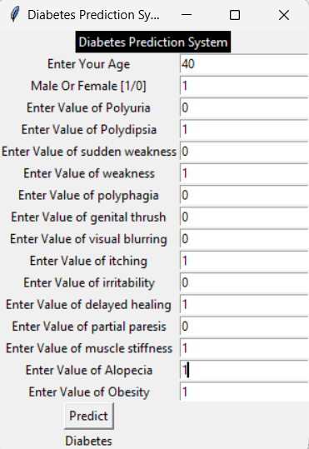
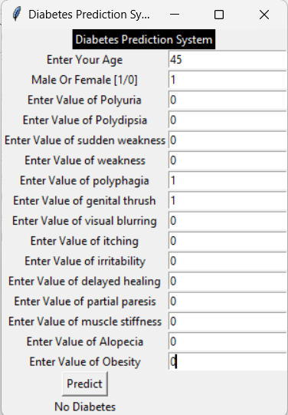
Accuracies and performance metrics of different machine learning algorithms
Prediciton Using Tkinter GUI

Slide 9
References
[1] N.M. Saravana kumar, T. Eswari, P. Sampath, S. Lavanya,(2015). Predictive Methodology for Diabetic Data Analysis in Big Data. Procedia Computer Science, 50, 203-208. https://doi.org/10.1016/j.procs.2015.04.069
[2] Iyer, Aiswarya & Jeyalatha, s & Sumbaly, Ronak. (2015). Diagnosis of Diabetes Using Classification Mining Techniques. International Journal of Data Mining & Knowledge Management Process. 5. 1-14. 10.5121/ijdkp.2015.5101.
[3] K. Rajesh and V. Sangeetha, “Application of Data Mining Methods and Techniques for Diabetes Diagnosis”, International Journal of Engineering and Innovative Technology (IJEIT) Volume 2, Issue 3, September 2012
[4] B. M. Patil, R. C. Joshi and D. Toshniwal, "Association Rule for Classification of Type-2 Diabetic Patients," 2010 Second International Conference on Machine Learning and Computing, Bangalore, India, 2010, pp. 330-334, doi: 10.1109/ICMLC.2010.67.
[5]https://archive.ics.uci.edu/ml/datasets/Early+stage+diabetes+risk+prediction+dataset.#

