Slide 1

The Mysteries of the Human Mind and Consciousness
Grp members:
Sai Ganesh Eswaraprasad
Eshwar Deshmukh Chavan
Rohit Kumar
Anirudh
Valaboju Pranav

Slide 2

What is consciousness?

Slide 3

What is consciousness
• Consciousness is the awareness of one's thoughts, feelings, sensations, and surroundings.
• It is considered a complex and mysterious phenomenon.
• It is often considered the defining characteristic of humans and other animals.
• There are many theories about consciousness, but none have been definitively proven.
• Some theories suggest consciousness arises from brain activity or information processing.
• The exact nature of consciousness and how it arises from brain activity is still unknown and a subject of ongoing research.

Slide 4

Several theories have been proposed to explain consciousness:

Slide 5

Here are some key points for several theories about the workings of consciousness:
1. Neural activity theory:
• Consciousness arises from the activity of neurons in the brain.
• Specific regions of the cortex are thought to play a role in creating conscious experience.
2. Information processing theory:
• Consciousness arises from the way information is processed and represented in the brain.
• The focus is on the relationship between information processing and conscious experience.
3. Global workspace theory:
• Consciousness arises from the distribution and integration of information across different regions of the brain.
• Conscious experience is thought to be created by the way information is shared and integrated in the brain.
4. Integrated information theory:
• Consciousness arises from the integration and combination of information in the brain.
• Conscious experience is thought to be created by the way information is combined to form a unified experience.

Slide 6
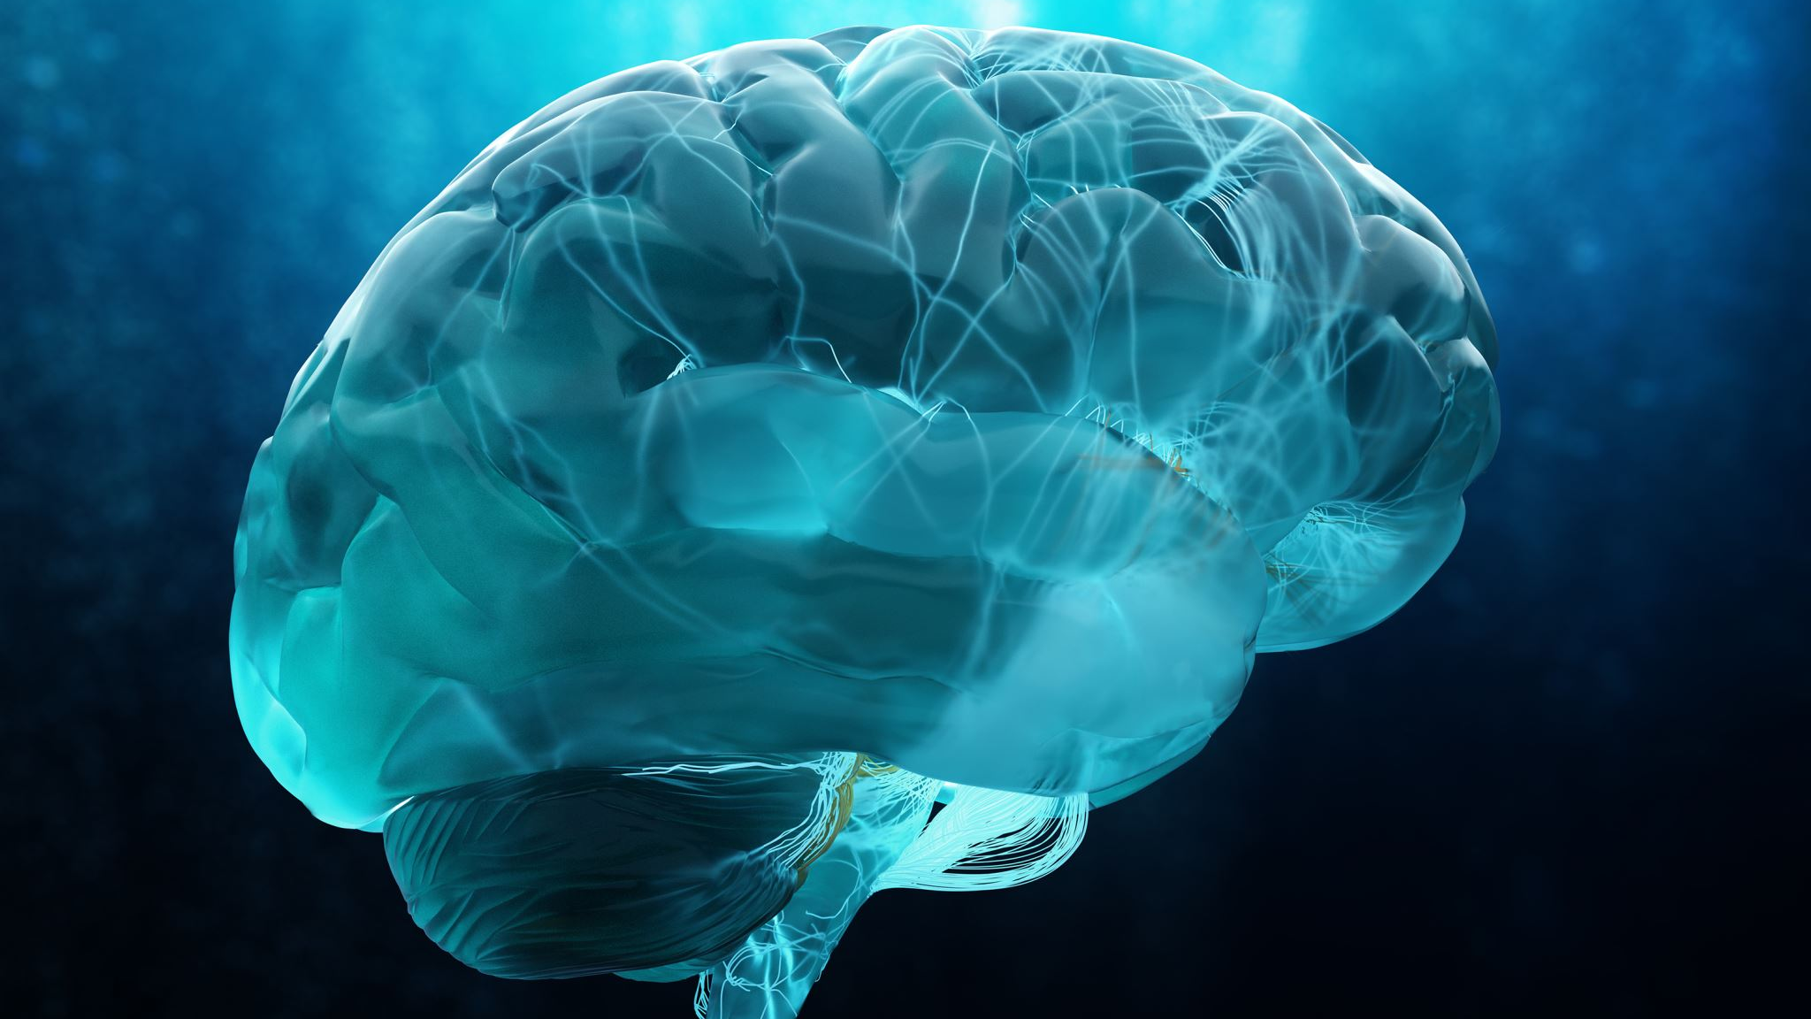
These are just a few of the many theories about the workings of consciousness, and each has its own strengths and weaknesses. Despite ongoing research, the exact nature of consciousness and how it arises from brain activity remains one of the biggest mysteries in science and philosophy.

Slide 7

The mysteries of the human mind

Slide 8
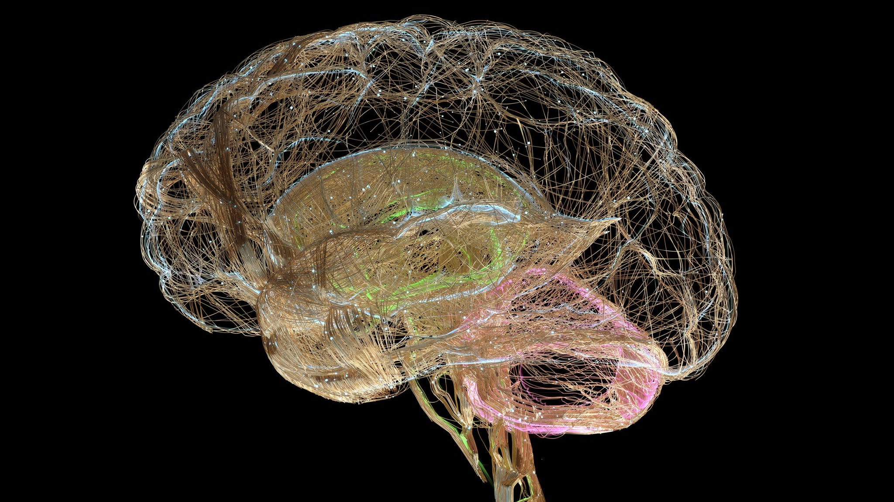
The human mind is a complex and still largely mysterious entity that encompasses the brain, thoughts, emotions, consciousness, and behavior. Despite advances in neuroscience and psychology, much is still unknown about the workings of the human mind.

Slide 9

Some of the mysteries of the human mind include:
1. Consciousness: How does the brain create subjective conscious experience?
2. Memory: How is information stored and retrieved in the brain?
3. Emotions: How do emotions arise from brain activity and how do they influence behavior?
4. Perception: How does the brain process sensory information to create our perception of the world?
5. Free will: To what extent are our actions determined by our biology and environment, and to what extent do we have control over our choices?
6. Imagination: How does the brain generate mental images and simulations of experiences that have not actually occurred?

Slide 10

These are just a few of the many mysteries of the human mind that are the subject of ongoing research and investigation by scientists and philosophers. Despite many advances, much is still unknown about the human mind, and it remains one of the greatest mysteries in science.

Slide 11

Advantages and disadvantages of understanding the mysteries of the human mind and consciousness:

Slide 12

Advantages
Improved mental health treatments: A better understanding of consciousness could lead to more effective treatments for mental health disorders, such as depression and anxiety.
Advancements in artificial intelligence: A deeper understanding of consciousness could lead to the development of more advanced artificial intelligence systems.
Enhanced quality of life: A better understanding of consciousness could lead to improvements in various aspects of life, such as sleep, creativity, and overall well-being.
This Photo by Unknown author is licensed under CC BY.

Slide 13

Disadvantages
1. Ethical concerns: As our understanding of consciousness improves, ethical concerns may arise, such as the potential misuse of this knowledge for malicious purposes.
2. Reductionist view: A focus on understanding consciousness in terms of brain activity and neural processes may lead to a reductionist view that neglects the subjective, personal experience of consciousness.
3. Lack of consensus: Despite ongoing research, there is still a lack of consensus among scientists and philosophers on the nature of consciousness and how it arises from brain activity. This lack of consensus may hinder progress in this field.

Slide 14

Overall, the study of the mysteries of the human mind and consciousness has the potential to bring about many benefits, but also raises important ethical and philosophical questions that need to be considered.

