Slide 1
Lights On, Oil Off
QISKIT FALL FEST 2026 · MEMORIAL UNIVERSITY
Does Newfoundland need a new oil-burning turbine to retire Holyrood?
Unsupervised Engineers
Sai Ganesh · Gideon Clottey
Theme: Quantum for a Sustainable Newfoundland and Labrador

Slide 2
Replace Holyrood's oil, keep the lights on
THE PROBLEM
Holyrood burns heavy fuel oil; it retires around 2030
Lifeline: the Labrador-Island Link, one 700 MW line
Hydro's plan: Unit 8 (hydro) + a diesel turbine, 150 MW each
The alternative people raise: wind and heat pumps
Winter risk: DarkNL (Jan 2014), 190,000 customers lost power
Jan 2026: frazil ice (slush in the intakes) shut Bay d'Espoir
~600 kt
CO2 a year from Holyrood's oil (2022 to 2024)
CAD 1.0 billion
for the proposed 150 MW diesel turbine
INTENDED BENEFIT
2.8 hours
Retire the oil without building new diesel: less CO2, and a clear test for a CAD 1 billion decision
NL Hydro's limit on expected blackout a year
Sources: NL GHG facility data 2016-22 and ECCC large-facility data (2026); NL Hydro, Avalon Combustion Turbine application, Rev. 1 (PUB, Apr 2026); NL Hydro, 2024 Resource Adequacy Plan, Rev. 2 (PUB, Aug 2024); NL Hydro DarkNL briefing to the PUB (Jan 2014) and January 2026 power warning notices.

Slide 3





One question, one rule
THE GOAL
Can wind and heat pumps do the new turbine's job and keep expected blackouts under 2.8 hours a year?
INPUT
OUTPUT
USE
BASELINE
METRIC
Hourly island demand, 2022-26
46 winters of weather
Plant outage odds (NL Hydro)
Blackout hours, cost and CO2 for 4,096 plans (12 yes/no options)
The link outage rate where the turbine is needed
Evidence for the 2030 build decision before the regulator (PUB)
Monte Carlo (random simulation)
Tuned importance sampling
Exact counting as the answer key
Blackout hours vs the 2.8 h rule
Runs needed for a confident pass or fail
Scope: the island grid in winter 2030, supply versus demand only; small enough to check against exact answers.
Rule: NL Hydro, 2024 Resource Adequacy Plan, Rev. 2 (PUB, Aug 2024), expected loss of load at most 2.8 hours a year. Fields follow Step 2 of the Qiskit Fall Fest 2026 rule book.

Slide 4
From weather to a yes-or-no answer
THE PIPELINE
1
2
3
4
5
Public data
AI model
Grid model
Risk per plan
Decision
Hourly island demand
46 winters of weather
Plant outage odds
Weather in, demand out
Gradient-boosted trees
Extra rule for record cold
Plants, link, wind, heat pumps
Every hour of 46 winters
Checked vs NL Hydro
Chance an hour is short of power
Qiskit amplitude estimation
Baseline: Monte Carlo
4,096 plans scored
Pass: 2.8 h or less
When is the turbine needed?
Simulator: Qiskit Aer, noise-free and with an IBM noise model
Hardware: real IBM chip (ibm_quebec, 156 qubits): 22 circuits, 64 s
Proof of concept: notebook with saved outputs, plus an interactive demo
Classical
AI
Quantum (Qiskit)
Data: Statistics Canada / CCEI High-Frequency Electricity Data (NL island demand); ERA5 reanalysis (Hersbach et al. 2020) via Open-Meteo; NL Hydro filings to the PUB (2024-26). Code: Qiskit 2.6, Qiskit Aer 0.18, scikit-learn 1.9.

Slide 5
Learning island demand from the weather
THE AI
Predicts island demand (MW) for every hour from the weather
Gradient-boosted trees, trained on 23,362 hours (Sep 2022 to Aug 2025)
Inputs: temperature now and earlier, wind, sun, snow in 3 cities; hour, weekday, holidays
Record cold: trees go flat past the coldest hour they saw (−16.8 °C), so below it we add 29 MW per degree colder
Tested on the unseen 2025-26 winter (7,502 hours)
Miss: average gap from real hourly demand; lower is better
Record cold: hid all 757 hours below −8 °C, then predicted them
Degree-hour: the utility standard, a straight line in temperature
OUR FORECAST VS NL HYDRO'S, WINTER 2026-27
1.63 h ours 1.8 h NL Hydro
Expected blackout hours this winter; within about 10%
Statistics Canada / CCEI HFED (NL island demand, Sep 2022 to Nov 2026); ERA5 via Open-Meteo; scikit-learn (Pedregosa et al. 2011); NL Hydro, 2025 Near-Term Reliability Report (PUB, Nov 2025) for the 1.8 h figure.

Slide 6
12 yes-or-no choices, 4,096 plans
WHAT IS A PLAN
 | Hydro's plan | Cheapest, no turbine | Strongest, no turbine | Strongest + turbine
SUPPLY
Diesel turbine at Holyrood, 150 MW | ● |  |  | ●
Bay d'Espoir Unit 8 (hydro), 150 MW | ● | ● | ● | ●
Wind, Avalon, 100 MW |  | ● | ● | ●
Wind, Burin, 100 MW |  | ● | ● | ●
Wind, west coast, 100 MW |  |  | ● | ●
Battery, 25 MW for 4 hours |  |  | ● | ●
Battery, 50 MW for 4 hours |  |  | ● | ●
DEMAND
Heat pumps, 15,000 electric-heated homes |  | ● | ● | ●
Heat pumps, 35,000 electric-heated homes |  | ● | ● | ●
Heat pumps, 10,000 oil-heated homes |  | ●
Heat pumps, 30,000 oil-heated homes |  | ●
Smart thermostats, 40 MW off the peak |  | ● | ● | ●
Blackout hours a year, link down 1.1% | 1.91 | 1.75 | 0.92 | 0.20
EACH PLAN IS SCORED ON
Blackout hours: replay 46 winters, hour by hour, at 2030 demand
Yearly cost: build and run, minus savings on power bills and oil
CO2: oil burned or avoided
All 4,096 plans scored on a classical computer
HEAT PUMPS CUT TWO WAYS
Electric-heated homes: lower winter peak. Oil-heated homes: less CO2, but more load on the grid.
Options: gridrisk/portfolio.py. Turbine CAD 995.9M and Unit 8 CAD 1.08B: NL Hydro filings to the PUB (2026). Battery cost and capacity value: NL Hydro battery and ELCC studies. Other costs are our stated assumptions.

Slide 7
Turbine needed only if the link gets worse
THE ANSWER
CLASSICAL MODEL · ALL 4,096 PLANS
How to read: each line is a plan. Further right, the link is down more often. Higher, more blackout hours. Below the dashed line, the plan passes.
Today: no turbine
The link was down 1.1% of the past 12 months. The cheapest plan without the turbine passes: 1.75 h a year
Cost: about a tie
Yearly cost after bill savings, cheapest passing plan: CAD 66.6M without the turbine, 64.4M with it. Without it: 10 kt less CO2
Break-even ~3%
Down more than 3.3% of the time, even our strongest no-turbine plan fails. NL Hydro plans for 5%
Our grid model, all 4,096 plans. Link outage rate 1.1%: NL Hydro, Q3 2026 Rolling 12-Month Asset Performance (PUB, Nov 2026); 5% planning value: 2025 Near-Term Reliability Report. Costs: Avalon CT application Rev. 1 (Apr 2026), Unit 8 update (Oct 2026), our assumptions for the rest.

Slide 8
Quantum only where classical has to simulate
WHY QUANTUM, AND WHERE NOT
TASK | CAN A NORMAL COMPUTER DO IT EXACTLY? | OUR CHOICE
Risk in one winter hour | Yes: a fast exact formula | Classical. It is our answer key
Risk through a multi-day cold snap | Not at scale: the work doubles with every unit (256 states at 6 units, about 9 billion at 31), so planners simulate with Monte Carlo | Quantum: amplitude estimation replaces that simulation
Finding the best of 4,096 plans | Yes: score every plan | Classical. A quantum search was slower in 41 of 45 tests
WHY THE COLD SNAP SUITS AMPLITUDE ESTIMATION
1 in 1,000
Hard line
4× vs 2×
a plan's risk: about 1 winter hour in 1,000
close calls near 2.8 h need that tiny number within a few percent
runs to halve the error: Monte Carlo vs amplitude estimation
Honest limit: a 6-unit, 7-day snap needs 64 qubits and 16,690 two‑qubit gates; today's chips manage about 30. This is for future, error-corrected machines.
Exact state counts: experiments/e6_cold_snap.py (best exact method: 4 × 2^units states). Quantum search test: Layden et al. (2023) method, notebook section 13. NL Hydro January 2026 power warning notices (Bay d'Espoir frazil ice).

Slide 9
Make the rare event common, then measure it
THE QUANTUM METHOD
SIMULATOR · QISKIT AER, NOISE-FREE
MONTE CARLO (CLASSICAL)
Simulate random winter hours, count the ones short of power
13,300 runs: only about 8 are short
Counting 8 events: error about 35%
AMPLITUDE ESTIMATION (QUANTUM)
One circuit holds every hour at once; a flag qubit is 1 with chance p
Each boost (a Grover step) raises that chance along a known curve
Measure after 0 to 32 boosts, fit the curve: that gives p
Same 13,300 runs: error 4.4%
The rule: chance after m boosts = sin²((2m + 1)θ), with p = sin²θ. A tiny angle, added up many times, becomes big and easy to measure.
To halve the error: Monte Carlo needs 4× the runs, amplitude estimation only 2×
Example: experiments/e3_quantum_core.py, today's grid, one winter hour, 24-qubit circuit on Qiskit Aer (noise-free), 300 tries. A run is one use of the grid model; one measurement after m boosts counts as 2m + 1 runs. Brassard et al. (2002); Suzuki et al. (2020).

Slide 10
One circuit holds every outage at once
THE QUANTUM PART
QISKIT
Demand (5 qubits)
Load the odds
(AI demand,
outage rates)
Boost
× m
24 qubits
Labrador link
Add lost MW,
compare with demand
today's grid, one winter hour: matches exact counting
Bay d'Espoir U7
22 qubits
Other units
a 3-day cold snap: about 3,500 two‑qubit gates
Frazil shutdown
Colder, more frazil
3 qubits
Short of power?
measure
a small exact version of a real case, run on the IBM chip
1
Load the odds: every mix of demand level and outages, each at its real chance
2
Colder, more frazil: the shutdown gets likelier on cold hours
Qubit: n of them hold 2^{n} cases at once.
Two-qubit gate: a step that links two qubits; the main source of errors on real chips, so the count measures circuit size.
3
Add lost MW: the flag qubit turns to 1 if supply falls short
4
Boost, measure, fit: gives p; p × 2,904 winter hours = blackout hours a year
Built with Qiskit 2.6 and Qiskit Aer 0.18. Maximum-likelihood amplitude estimation: Suzuki et al. (2020). Circuit layout after Woerner and Egger (2019). Exact enumeration of the same model is the ground truth.

Slide 11
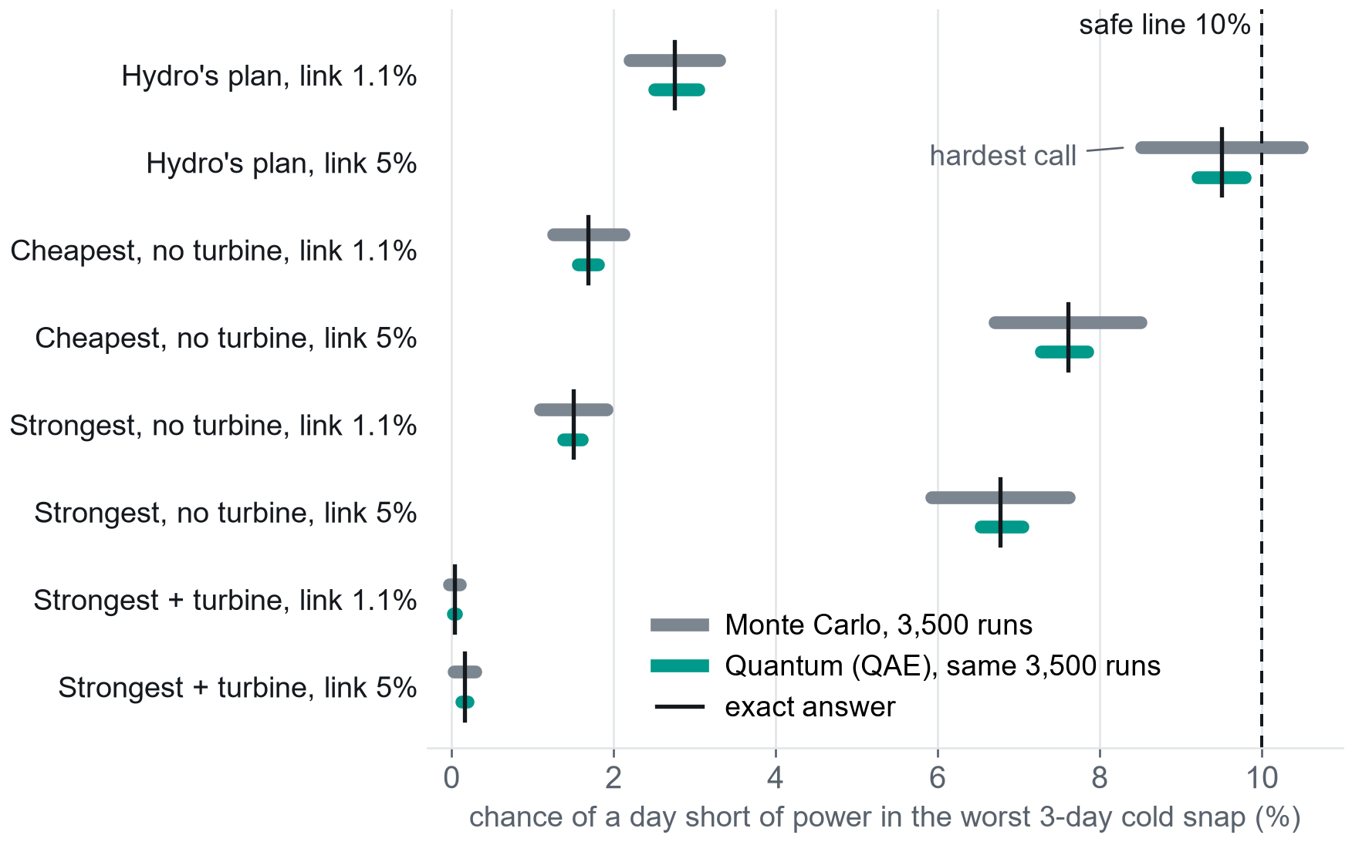
Same runs, a sharper answer
RESULTS · SIMULATOR
SIMULATOR · QISKIT AER, NOISE-FREE
THE TEST
4 plans × 2 link rates through the worst 3-day cold snap. Safe = under a 10% chance of a day short of power.
8 of 8
quantum estimates land on the exact answer
2 to 3.5× smaller error
than Monte Carlo, with the same 3,500 runs
184 vs 34 of 200
confident right calls, hardest plan (9.51%)
One hour near the 2.8 h line: 24k runs (quantum), 82k (tuned importance sampling), 2.1M (Monte Carlo). Far from the line, importance sampling is cheaper.
How to read: tick = exact answer. Bars = where 95% of 200 tries land. Shorter is better.
experiments/coldsnap_plans.py: real 22-qubit circuits on Qiskit Aer (noise-free), 200 tries of 3,500 runs per check, against exact enumeration. Single-hour counts: experiments/turbine_decision.py, importance sampling tuned over 30 settings.

Slide 12
On a real IBM chip: it works, and it ties
RESULTS · REAL HARDWARE
HARDWARE · IBM_QUEBEC
WHAT WE RAN ON IBM QUANTUM HARDWARE
ibm_quebec
64 s
156-qubit IBM Heron chip
of chip time, in 2 jobs
22 circuits
3 qubits
220,000 shots in total
a real 2030 case, p = 2.13%
Works
Calibrated, the chip follows the perfect curve: 90% after 4 boosts vs 94% ideal
Tie
Error in p with 4,000 runs: chip 9.1%, Monte Carlo 10.7%. Within the noise
Loses
Past about 30 two‑qubit gates (2+ boosts), or counting the twin runs, Monte Carlo wins
How to read: each boost should raise the flag's chance along a known curve (black); fitting that curve gives p. Grey: the raw chip. Teal: after calibrating with two "twin" circuits whose answers we know.
Simulator, IBM noise model: a noise-aware fit beats Monte Carlo from 9,000 runs (2.8% vs 5.5% error at 16,000)
IBM Quantum ibm_quebec (156-qubit Heron), Qiskit IBM Runtime SamplerV2 with gate twirling and dynamical decoupling; jobs dbnk3tgqtr0c73ad7a9g and dbnkiblt7fqc73ajposg. Noise-aware fit: Tanaka et al. (2021). Noise model: Qiskit FakeFez.

Slide 13



What this does not show yet
LIMITS AND NEXT STEPS
LIMITS
WHAT DIDN'T WORK
NEXT STEPS
Supply vs demand only: no power‑line limits, reservoir levels or imports from Nova Scotia
Four winters of demand data, scaled to Hydro's peak forecasts
Wind from weather data, no icing losses: optimistic
Quantum savings assume a perfect, error-free quantum computer
A quantum search for the best of the 4,096 plans: slower than a simple search in 41 of 45 tests
Today's chip: noise wins after about 30 two‑qubit gates
No model predicts the Feb 2023 flash-freeze demand record
Add power‑line limits and Maritime Link imports
Bigger cold snaps (more units, more days), where only simulation works
Short chip runs (1 to 2 boosts) with better error handling
Take the ~3% break-even to the utility board (PUB)
Resources: a laptop CPU (45 min to rerun everything), Qiskit Aer, 64 s on ibm_quebec. Claims hold only for the tested model and sizes.
Layden et al. (2023), quantum-enhanced Markov chain Monte Carlo, Nature 619. Assumptions and costs are listed in the notebook (sections 13 and 14) and gridrisk/portfolio.py.

Slide 14
Lights on, oil off, if the link holds
IN SHORT
1.1%
The link was down 1.1% of the past year. At that rate, Unit 8, wind and heat pumps replace Holyrood's oil with no new diesel turbine
~3%
If the link is down more than about 3% of the time, the turbine is worth building. That is the number to debate
184 vs 34
Hardest cold-snap call, same runs: quantum right 184 times in 200, Monte Carlo 34 (simulator). On today's chip: a tie
Repository
github.com/SaiGaneshPS/qiskit-fall-2026-unsupervised-engineers
notebook with saved outputs, source, and an interactive demo
Questions?

Slide 15
References and acknowledgements
BACKUP
NL Hydro, 2024 Resource Adequacy Plan, Rev. 2. Filed with the NL Board of Commissioners of Public Utilities (PUB), Aug 2024.
NL Hydro, 2025 Near-Term Reliability Report. PUB, Nov 2025.
NL Hydro, Q3 2026 Rolling 12-Month Asset Performance report. PUB, Nov 2026.
NL Hydro, 2026-27 Winter Readiness Report, October update. PUB, Oct 2026.
NL Hydro, 2025 Island Interconnected System Load Forecast. PUB, Nov 2025.
NL Hydro, Avalon Combustion Turbine application, Rev. 1 and evidentiary update. PUB, Apr 2026.
NL Hydro, Bay d'Espoir Unit 8 early execution update. PUB, Oct 2026.
NL Hydro, Effective Load Carrying Capability study. PUB, Dec 2025.
NL Hydro, DarkNL briefing to the PUB, Jan 2014; January 2026 power warning notices.
Statistics Canada / CCEI, High-Frequency Electricity Data, NL island demand.
Hersbach et al. (2020), The ERA5 global reanalysis, QJRMS 146; accessed via Open-Meteo.
NL industrial facilities GHG data 2016-22 (gov.nl.ca); ECCC large-facility emissions data (2026).
Statistics Canada table 38-10-0286-01; NRCan heat pump guide; NEEP cold-climate heat pump specification v3.1.
Brassard, Høyer, Mosca and Tapp (2002), Quantum amplitude amplification and estimation, Contemp. Math. 305.
Suzuki et al. (2020), Amplitude estimation without phase estimation, Quantum Inf. Process. 19, 75.
Tanaka et al. (2021), Amplitude estimation via maximum likelihood on noisy quantum computer, Quantum Inf. Process. 20, 293.
Woerner and Egger (2019), Quantum risk analysis, npj Quantum Information 5, 15.
Egger et al. (2021), Credit risk analysis using quantum computers, IEEE Trans. Computers 70(12).
Layden et al. (2023), Quantum-enhanced Markov chain Monte Carlo, Nature 619, 282-287.
Qiskit 2.6, Qiskit Aer 0.18, Qiskit IBM Runtime; IBM Quantum ibm_quebec. scikit-learn (Pedregosa et al. 2011), NumPy, SciPy, pandas, Matplotlib.
Our work: the demand model, grid model, plan scoring, quantum circuits and every experiment. We reused the open-source libraries above and public data only. AI coding assistants helped with parts of the code and text; the team reviewed all of it and can explain every part.

